Slide 1
Bi-Monthly Updates in Human Research Protections
Office of Research Protections, Policy, & Education (ORPP&E) VHA Office of Research and Development (ORD)
August 31, 2023

Slide 2

Please use the Q&A feature to submit questions.
  Please do not use Chat to send in questions.
  Be sure to send questions to “All panelists”.
We would be ever so grateful if you would complete the post-webinar evaluation survey that pops up once you exit the webinar.
Experiencing sound issues – you can call in using the number included on the handouts and on your registration confirmation email that you received.
Webinar
Housekeeping
A recording of this session and the associated handouts will be available on ORPP&E’s Education and Training website approximately one-week post-webinar
An archive of all ORPP&E webinars can be found here:
https://www.research.va.gov/programs/orppe/education/webinars/archives.cfm
For questions, please use Q&A box and address to “All Panelists.”
All Webinars will be recorded and posted within one week.

Slide 3
Discussion Items
The purpose of this bi-monthly webinar is to update the VA research community on the following topics:
  Updates on the CDC TPOXX Expanded Access Program (EAP) for Mpox, including
    Approval of continuing review approval for the protocol by the CDC IRB;
  Humanitarian Use Devices, including review requirements and VAIRRS tips;
  Technical amendment to VHA Directive 1200.05(3): Paperwork Reduction Act Exclusion for VHA Research; and
  Commercial IRB issues, including:
    Update on ORD’s data call on remediation of informed consent documents approved by the Advarra IRB.

Slide 4
Discussion Items (cont.)
  Revised FDA Guidance (August, 2023) on Informed Consent: Informed Consent Guidance for IRBs, Clinical Investigators, and Sponsors
  Public Responsibility in Medicine & Research (PRIM&R) 2023 Annual Conference on December 3-6 in Washington, DC: VA Presentations and Office Hours
  ORD questions and answers from VA Facilities on human subjects protections issues and ORD policies.

Slide 5
VA Facility Implementation of the CDC Expanded Access Program (EAP) for Use of Tecovirimat (TPOXX®) for Mpox
Eighty-one (81) VA Facilities were approved to participate in the CDC EAP for Tecovirimat using CDC’s Investigational New Drug Application (IND) for the Program.
  Currently Active: 68
  Closed: 13
The CDC revised the protocol and informed consent document (ICD).
  Current CDC IRB-approved protocol is Version 6.3 (May 5, 2023)
  Current CDC IRB-approved ICD is Version 6.3 (May 5, 2023).

Slide 6
CDC Expanded Access Program for Use of Tecovirimat (TPOXX®) for Mpox: Revised Protocol and Informed Consent Document
CDC published the revised protocol and ICD on June 7th on the CDC TPOXX EAP website at Information for Healthcare Providers: Tecovirimat (TPOXX) for Treatment of Mpox | Mpox | Poxvirus | CDC.
CDC IRB continuing review and approval of the EAP IND protocol occurred at a convened IRB meeting on June 22, 2023. The CDC IRB continuing review and approval letter is located at 6402-CDC-IRB-Approval-Continuation.pdf.
ORD has been assisting CDC Regulatory Affairs with a data call related to the status of VA Facilities and current names of participating clinicians/staff.
  A follow-up email will be sent to individual sites who have not yet responded in the following week.

Slide 7
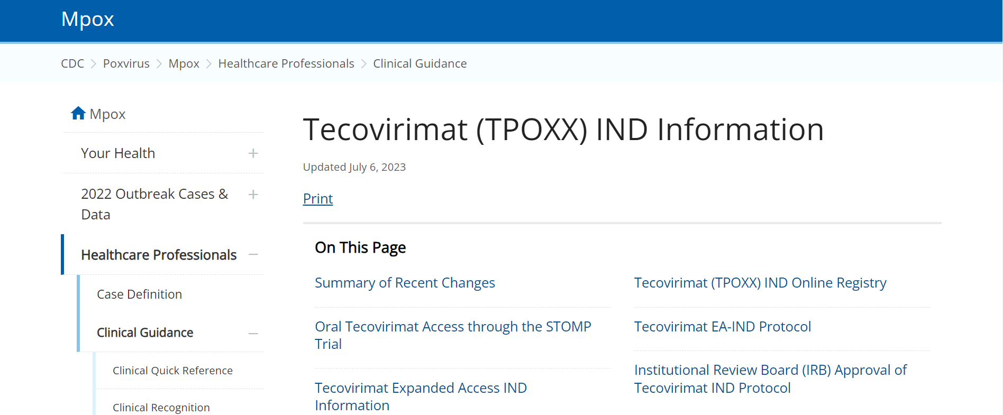
CDC Webpage for CDC EA-IND Tecovirimat Program for Mpox
CDC has its own webpage with CDC IRB documents, including the CDC approved program protocol and informed consent document located at Tecovirimat (TPOXX) IND Information (cdc.gov)

Slide 8
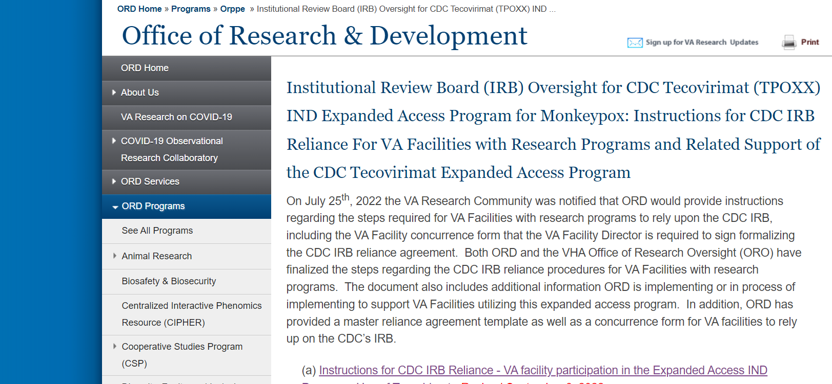
CDC EA-IND Tecovirimat Program for Mpox (cont.)
ORD has an ORD webpage describing the steps and current forms supporting implementation of this Program by VA Facilities:
https://www.research.va.gov/programs/orppe/CDC-IRB-TPOXX-EAIND-Program.cfm

Slide 9
CDC Reminder of Responsibilities to IRB Contacts and Principal Investigators (PI) for the CDC EA-IND Tecovirimat Program for Mpox
On August 28, 2023, a written communication was sent by the CDC PI of the CDC EA-IND Program, CDC Human Research Protections Office, and CDC Regulatory Affairs Office to IRB Contacts and PIs for the EAP Program.
The CDC correspondence is a reminder to Registered Institutions providing Tecovirimat under the EA-IND Program relying upon the CDC IRB of their responsibilities:
  1. Comply with CDC IRB Decisions and Requirements
  2. Review and Oversight
  3. Local Context Considerations
  4. Informed Consent
  5. Notification to CDC IRB of Reportable events
  6. Assisting CDC IRB with its required reporting to FDA or other agencies if requested
  7. Recordkeeping

Slide 10

Bottom Line for all VA Facilities Participating in the CDC EA-IND Tecovirimat Program for Mpox

Slide 11

Humanitarian Use Device (HUD)
PK Papyrus®

Slide 12
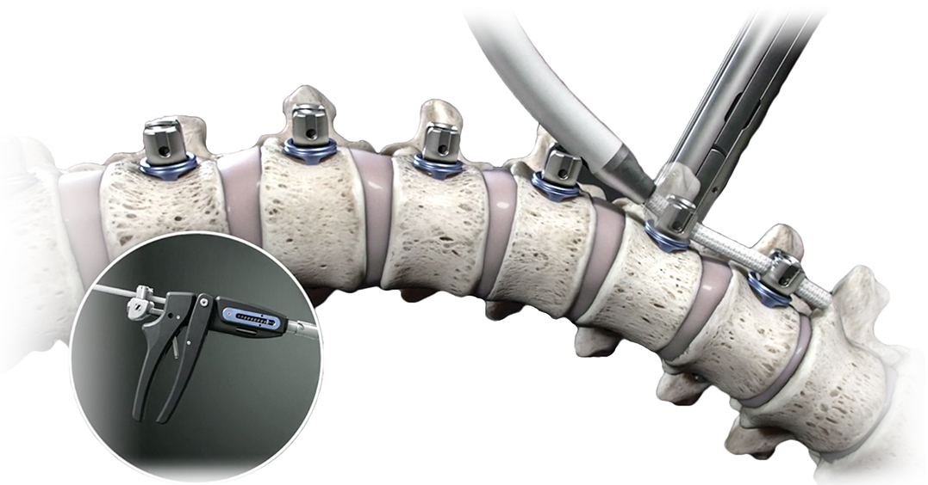
Humanitarian Use Devices (HUDs)
A HUD is defined as a medical device intended to benefit patients in the treatment or diagnosis of a disease or condition that affects or is manifested in not more than 8,000 individuals in the United States per year.
Reference: 21 CFR 814.3(n)

Slide 13
Why Humanitarian Use Devices?
• In 1990, Congress established the HUD designation and Humanitarian
Device Exemption (HDE) marketing pathway program
– encourage development of devices intended for rare diseases
• General Requirement for a new device to enter the market:
– reasonable assurance that the device is safe and effective
• Under the HUD/HDE pathway:
– device is safe and provides a probable benefit

Slide 14

Humanitarian Device Exemption (HDE)
An HDE is a marketing application for a HUD (Section 520(m)) of the Federal Food, Drug, and Cosmetic Act (FD&C Act)). An HDE is exempt from the effectiveness requirements of Sections 514 and 515 of the FD&C Act. HUDs must only be found to be safe and provide probable benefits.
Reference: Humanitarian Device Exemption | FDA

Slide 15
HUD Designation by Office of Orphan Products Development (OOPD)
Sponsor submits a HUD Designation Request (Application) to FDA’s Office of Orphan Products Development (OOPD) – Two copies
FDA sends the Sponsor an acknowledgement letter with an assigned HUD number for each application.
There is a 45-day review period by FDA.
Reference: Humanitarian Device Exemption | FDA

Slide 16
HUD Determinations by FDA
Approval: Designate the device for the disease or condition
  – Population estimate must be not more than 8,000/year in the
  U.S.
  – Disease or condition may not always be identical to what was
  requested by the applicant
Disapproval
Request Additional Information
Reference: Getting a Humanitarian Use Device to Market | FDA

Slide 17


HUDs & IRBs
        FDA approval of a Humanitarian Device Exemption (HDE) allows the HUD to be marketed.
        BUT
  Once the HDE is approved, the HDE holder is
  responsible for ensuring that the approved HUD
  is only administered at institutions that have an
  IRB constituted and acting pursuant to 21 CFR 56,
  including conducting continuing review of the HUD use.
Reference: Humanitarian Device Exemption (HDE) Postmarket Activities | FDA

Slide 18

Important Considerations for IRB Review of HUDs
Prospective approval by a convened IRB is required before a HUD under an approved HDE can be used at a VA facility for clinical care, with the exception of emergency use.
Continuing review and approval by the IRB must occur, although expedited review procedures can be utilized.
Use of a HUD for clinical care is not research, but requires IRB prospective approval (unless emergency use).
An HUD used in a clinical investigation (i.e., to collect safety and probable effectiveness data) is considered to be used for "investigational use", whether or not the device is used for the HDE-approved indication. Such investigational use is subject to the same requirements that apply to all FDA-regulated clinical studies.

Slide 19

VAIRRS: HUD IRB Submission for Clinical Care
Two VAIRRS Wizards must be completed:
VA Project Cover Sheet
IRB Information Sheet
The following, provided by the HDE-holder, must be uploaded into the VAIRRS submission package:
HDE Approval Documentation from FDA
If available, product information and product labeling
Materials (as applicable) that will be shared with
patients receiving the HUD

Slide 20

VAIRRS: HUD Submission for Clinical Care (cont.)
The following documents are NOT submitted:
OGE FORM 450 Alternative-VA Research Financial Conflict of Interest Statement
VA Form 10-250 VHA Research Protocol Privacy Review Checklist
Enterprise Research Data Security Plan (ERDSP)
VA Form 10-0493, Authorization for Use & Release of Individually Identifiable Health Information for VHA Research or a Request for a Waiver of HIPAA Authorization for Research
No R&D Committee submission.

Slide 21
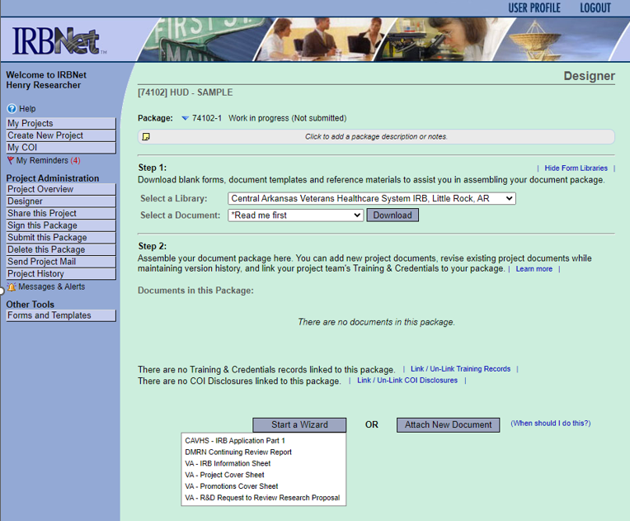
VAIRRS
VAIRRS: VA Project Cover Sheet
Create New Project
Start a Wizard
Select VA – Project Cover Sheet
VAIRRS submission wizards present questions specific to research…sometimes there does not seem to be a “right” answer for HUD for clinical use applications.

Slide 22
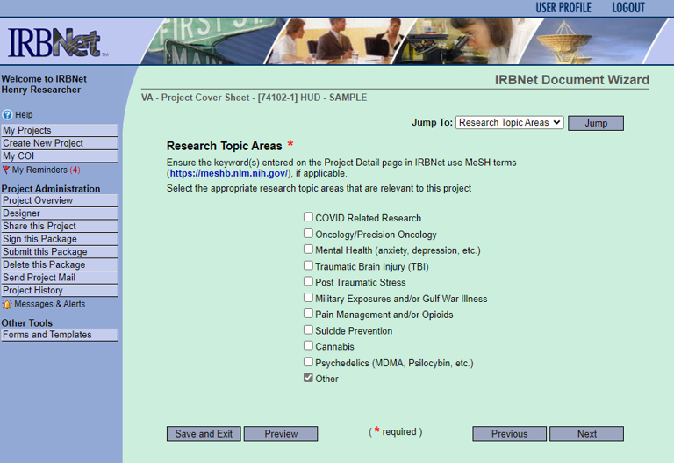
VAIRRS
VAIRRS: VA Project Cover Sheet (cont.)
Create a new wizard from scratch, and advance to “Research Topic Areas,” and select “Other.”
Continue through “Project Summary” and “Significance” screen, providing responses for both based upon the planned clinical use and the importance to Veterans to having access to this HUD.

Slide 23
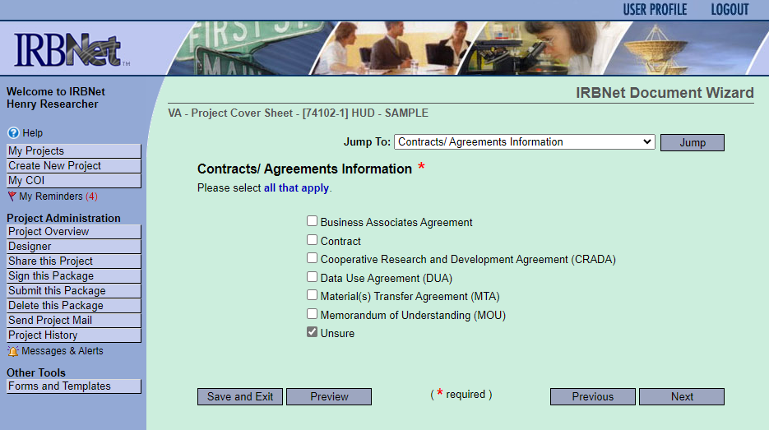
VAIRRS
VAIRRS: VA Project Cover Sheet (cont.)
Select “No” in response to “Is this study funded?”
Select “Yes” in response to “Will any contracts or agreements be required to be executed specific to this project?”
Select “Unsure” as to the type of agreement – none of the options listed are typically used for HUDs.

Slide 24
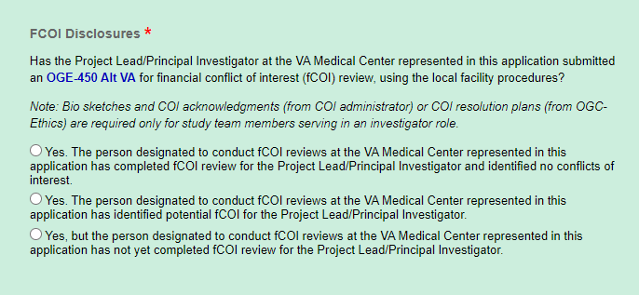
VAIRRS
VAIRRS: VA Project Cover Sheet (cont.)
Enter information about the VA PI and additional personnel.
FCOI disclosures are not required for this non-research activity. Select “Yes. The person designated to conduct fCOI reviews at the VA Medical Center represented in this application has completed fCOI review for the Project Lead/Principal Investigator and identified no conflicts of interest.”

Slide 25
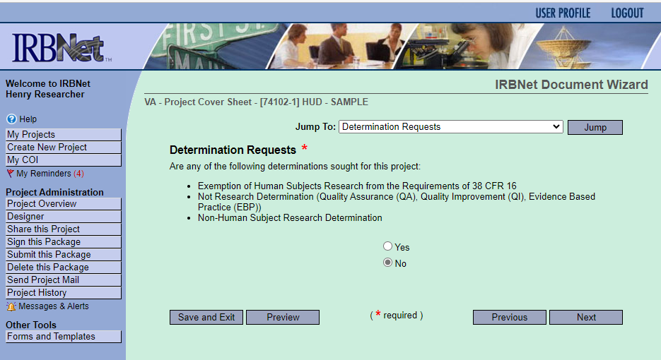
VAIRRS
VAIRRS: VA Project Cover Sheet (cont.)
Select “Other” in response to “Project Characteristics,” and describe clinical use of HUD.
Select “No” in response to “Are any of the following determinations sought for this project”.
Form Complete!

Slide 26
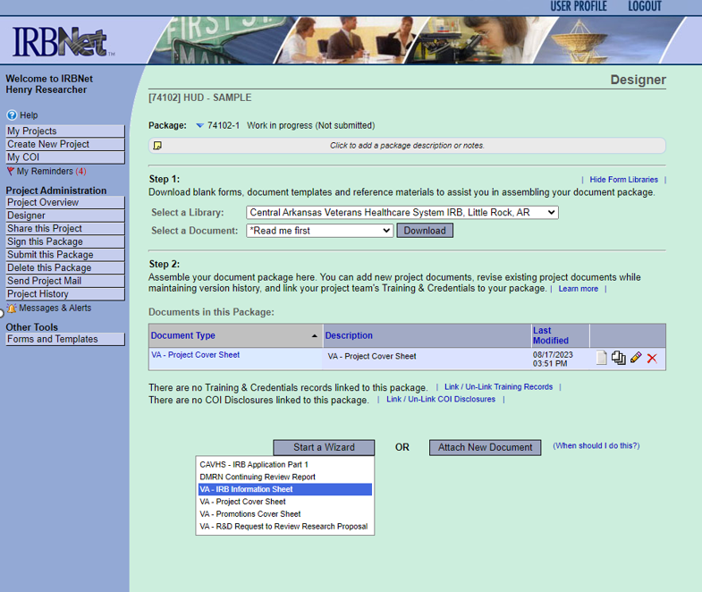
VAIRRS
VAIRRS: VA IRB Information Sheet
Return to the Designer
Start a Wizard
Select VA – IRB Information Sheet

Slide 27
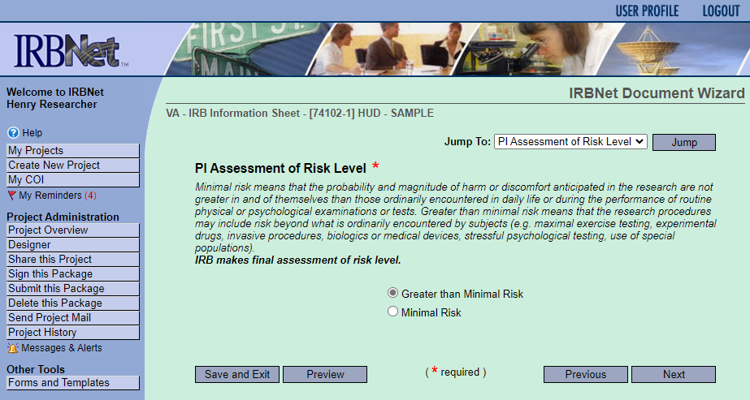
VAIRRS
VAIRRS: VA IRB Information Sheet (cont.)
Create a new wizard from scratch, and advance to “Non-VA IRB,” and select “No.”
Continue to “Multi-site” and select “No.”
At “PI Assessment of Risk Level” select “Greater than Minimal Risk.”

Slide 28
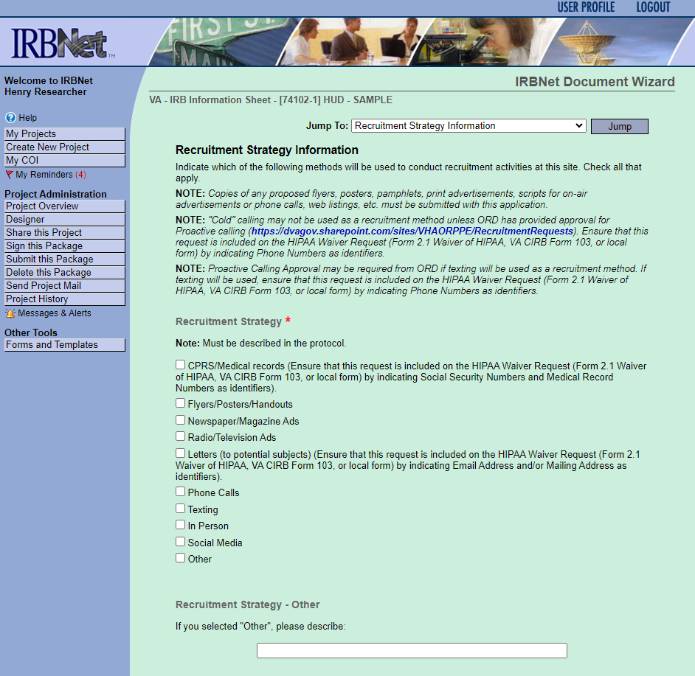
VAIRRS
VAIRRS: VA IRB Information Sheet (cont.)
Under “Greater than Minimal Risk Review Type Requested,” select “IRB Review.”
Under “Clinical Trial,” select “No.”
Select “No” for all responses under “International Research Information.”
Under “Recruitment Strategy Information” select “Other,” and describe as “HUD – Clinical Care Provision.”

Slide 29
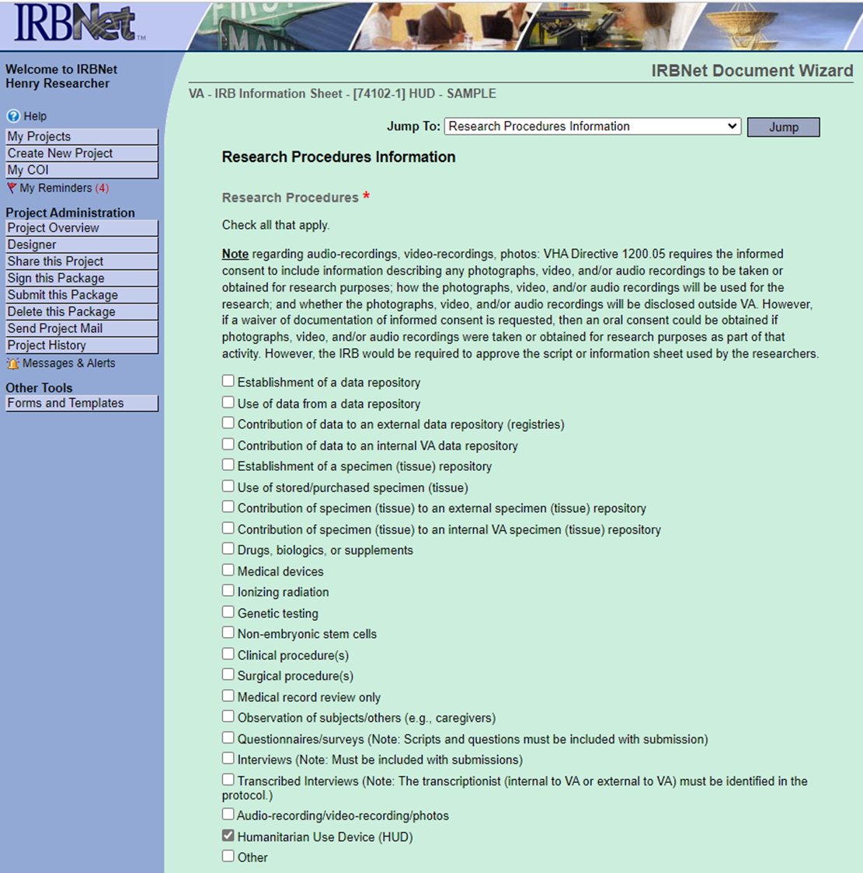
VAIRRS
VAIRRS: VA IRB Information Sheet (cont.)
Under “Subject Population Information,” select “None.”
Under “Intended Participants,” select “No.”
Under “Subject Group Interaction,” select “No.”
Under “Participant Compensation,” select “No.”
Under “Research Procedures Information,” select “Humanitarian Use Device (HUD)” only.

Slide 30
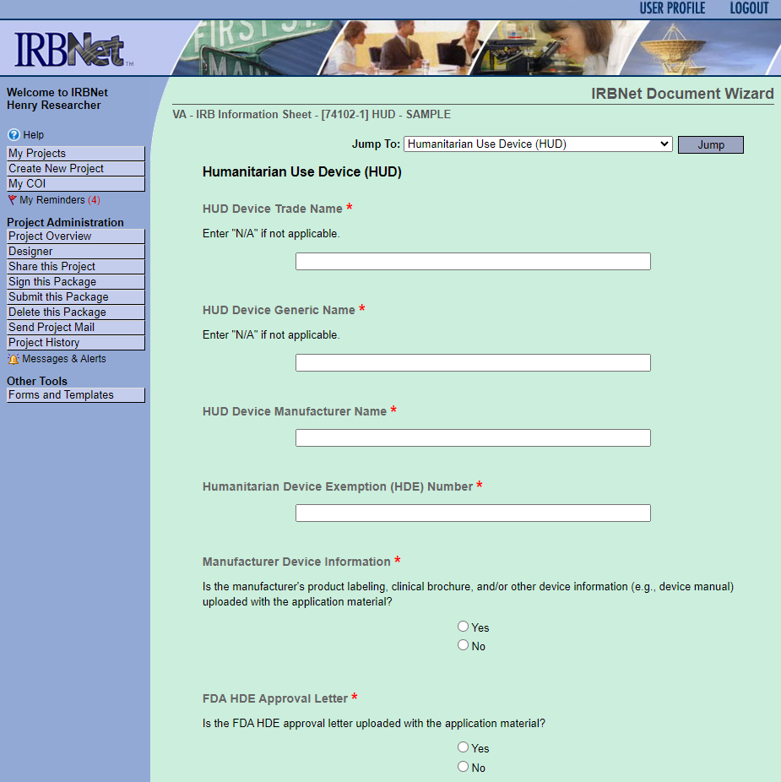
VAIRRS
VAIRRS: VA IRB Information Sheet (cont.)
Under “Usual Care/Standard of Care in a Clinical Space,” select “No.”
Under “Certificate of Confidentiality,” select “No.”
Provide responses for all requested information under “Humanitarian Use Device (HUD)” section.
Form Complete!

Slide 31
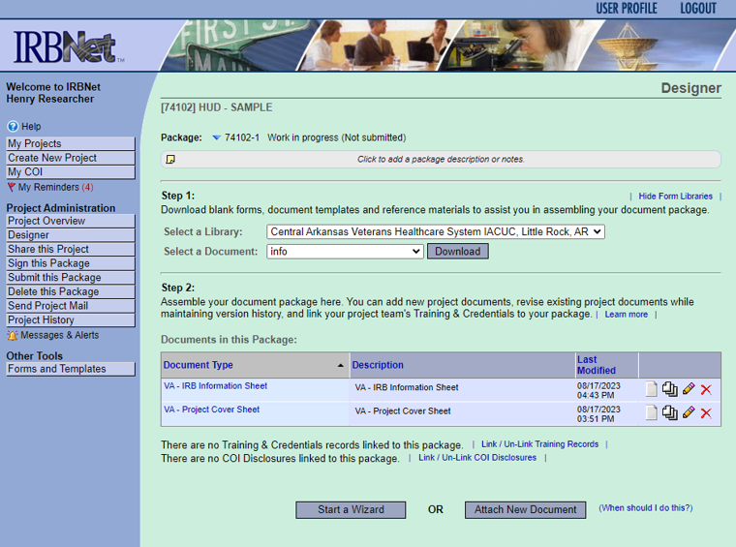
VAIRRS
VAIRRS: Documents to Upload
Return to the Designer
Attach New Documents
HDE Approval documentation from FDA
If available, product information and product labeling
Materials (as applicable) that will be shared with patients receiving the HUD

Slide 32

HUDs & IRB Review
Initial IRB review must be by convened board. FDA recommends
review of:
A copy of the HDE approval order;
A description of the device;
The product labeling;
The patient information packet that may accompany the HUD;
A sample consent form for the use of the HUD. Neither the FD&C Act nor FDA regulations require informed consent from patients who are treated or diagnosed with an HDE-approved HUD in the course of their clinical care. However, the IRB can require an IRB-approved informed consent be obtained for use of the HUD for clinical care at a facility or utilize a clinical care consent for treatment with additional content; and
A summary of how the physician proposes to use the device, including a description of any screening procedures, the HUD procedure, and any patient follow-up visits, tests or procedures.
Ref: Humanitarian Device Exemption (HDE) Program | FDA

Slide 33
HUDs & IRB Review
VAIRRS forms and wizards may not capture information the IRB needs. Making sure to provide answers to the following 9 questions can facilitate IRB review:
Describe the device, the proposed mechanism of action, and any post-manufacturing modifications.
Provide the indication for use of the device (this must be consistent with the information provided to FDA to request Humanitarian Device Exemption (HDE)).
Describe any provider training and/or credentialing required prior to use of this device.
Summarize how the provider(s) will use the device, including a description of screening procedures, the HUD procedure, and any patient follow-up visits, tests, or procedures.
Ref: Humanitarian Device Exemption (HDE) Program | FDA

Slide 34
HUDs & IRB Review
VAIRRS forms may not capture information the IRB needs. Making sure to provide answers to the following 9 questions can facilitate IRB review:
Explain any alternative clinical/standard care available.
List the contraindications, warnings, and precautions for the use of the device.
Describe any foreseeable adverse effects of the device.
Describe where the device will be stored and how access to the device will be controlled.
If specific labs or diagnostic tests are required to utilize or conduct safety monitoring, evaluate whether the VA Medical Facility has the ability to conduct those tests and/or appropriate personnel.
Ref: Humanitarian Device Exemption (HDE) Program | FDA

Slide 35


HUDs & IRB Review
IRB can approve the use of the HUD:
In general – by any qualified provider for any use, including off-label use
For groups of HUD patients that meet certain criteria
Under a HUD treatment protocol
Or on an individual patient (case-by-case) basis
Ref: Humanitarian Device Exemption (HDE) Program | FDA

Slide 36

VAIRRS
HUDs & Clinician Responsibilities
All adverse events, whether expected or not, must be reported and evaluated per Medical Device Reporting requirements in 21 CFR part 803 and to the IRB.
eCFR :: 21 CFR Part 803 -- Medical Device Reporting; MedWatch Forms for FDA Safety Reporting | FDA; https://www.fda.gov/safety/medical-product-safety-information/medwatch-forms-fda-safety-reporting#64e62c5749e27

Slide 37

Technical Amendment #3 to VHA Directive 1200.05(3):
Exclusion of the Paperwork Reduction Act (PRA) for VHA Research

Slide 38
Origin of Technical Amendment to VHA Directive 1200.05(3)
The Cleland-Dole Act was signed into law on December 29, 2022, under Division U of the Consolidated Appropriations Act of 2023 (P.L. 117-328).
Section 181 of the Cleland-Dole Act specifies that the PRA “...shall not apply to the voluntary collection of information during the conduct of research by the Veterans Health Administration, including the Office of Research and Development, or individuals or entities affiliated with the Veterans Health Administration.’’
The Agency could not implement until implementing policy was issued.
VHA Directive 1200.05(3) issued on July 13, 2023 created the implementing policy with associated published guidance.

Slide 39
Policy Language for the Technical Amendment to VHA Directive 1200.05(3)
g. Each VA investigator is responsible for:
(21) Ensuring that collection instruments for a research activity involving obtaining information directly from research subjects, such as surveys, questionnaires, and interview guides, have been reviewed by the IRB or VA Facility Research and Development Committee (as applicable) prior to research approval. NOTE: The Paperwork Reduction Act does not apply to VHA human subjects research activities involving these collections. See 38 U.S.C. § 7330D (the codification of Cleland-Dole § 181). Please refer to the ORD Guidance Document: Applicability of the Exclusion of VHA Research from the Paperwork Reduction Act.
Reference: VHA Directive 1200.05(3), Paragraph 5.g.(21)

Slide 40
Key Points Applicable to the Technical Amendment #3 to VHA Directive 1200.05(3)
The PRA exclusion applicable to VHA research does not apply to non-research activities.
The PRA exclusion for VHA research does not apply to other federal agencies who do not have a similar exclusion, such as the National Institutes of Health (NIH).
    If VA is conducting a study funded by DoD, DoD is still subject to the PRA even if VA is conducting the study.
ORD has published a guidance document (July 19, 2023) titled, “ORD Guidance Document: Applicability of the Exclusion of VHA Research From the Paperwork Reduction Act” located at Applicability-of-the-Exclusion-of-VHA-Research-from-the-PRA.pdf (va.gov) and in Find Pro.

Slide 41



Commercial (Independent) IRB Issues

Slide 42
Update on Recent Request by ORD to VA Study Teams with Active Studies Approved by Advarra IRB
On May 24th, ORPP&E sent an update to the VA research community that VA Investigators of currently active studies approved by ORD would receive a letter from ORD asking for those study teams to conduct a self-assessment by June 23, 2023 of their current approved ICDs if the study was enrolling study subjects or actively following subjects.
Follow-up queries were sent to sites that had not responded as of June 23, 2023.
Out of 218 queries to individual studies, only 11 studies did not respond as of the date of this presentation.

Slide 43
Procedures for New Commercial IRBs to Apply to Become ORD-Approved Commercial IRBs
Several commercial (independent) IRBs have contacted ORD to begin the process of becoming an ORD-approved commercial IRB.
Any commercial IRB wishing to become an ORD-approved commercial IRB must enter into a negotiated Master Service Agreement (MSA) with ORD.
  ORD vets any commercial IRB wishing to become an ORD-approved commercial IRB.
  Individual VA Facilities must enter into separate IRB reliance agreements with the applicable ORD-approved commercial IRB after the MSA is executed.
  Individual VA Facilities modify their standard operating procedures supplied to the sites specific to the ORD-approved commercial IRB.

Slide 44
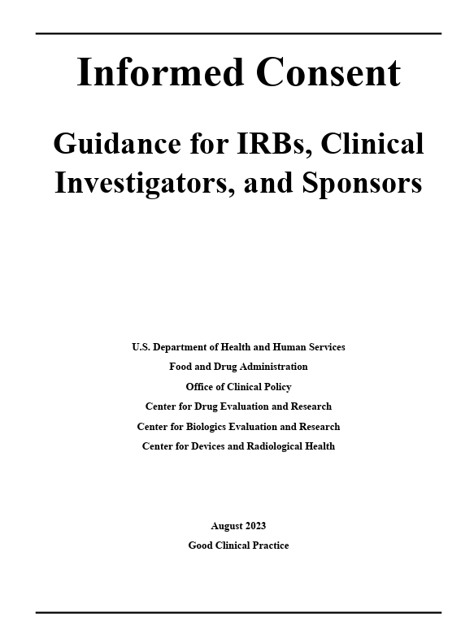
VAIRRS
FDA: Informed Consent Guidance for IRBs, Clinical Investigators, and Sponsors. August 15, 2023
Finalization of prior draft guidance.
Presents general guidance on FDA’s regulatory requirements for informed consent;
Discusses of the roles of IRBs, clinical investigators, sponsors, and FDA related to informed consent; and
Provides a series of frequently asked questions.
It is not equivalent to policy.
Ref: Informed Consent | FDA

Slide 45

ORD and ORO will be sponsoring a session:
A Dialogue With the Department of Veteran Affairs (VA)
December 6 at 1:45-2:45 PM EST
ORD and ORO will be participating in Federal Office Hours on (all times EST)
December 3: 4:30-5:30 PM and
December 5: 5:00-6:00 PM
Public Responsibility in Medicine & Research (PRIM&R) 2023
PRIMR23/SBER23 (eventscribe.net)

Slide 46
Availability of Recording
A recording of this session and the associated handouts will be available on ORPP&E’s Education and Training website approximately one-week post-webinar.
An archive of all ORPP&E webinars can be found here: https://www.research.va.gov/programs/orppe/education/webinars/archives.cfm.

Slide 47
Contact Information
ORD Regulatory Box: VHACOORDREGULATORY@VA.GOV

Slide 48
References
CDC webpage: Information for Healthcare Providers on Obtaining and Using TPOXX (Tecovirimat) for Treatment of Monkeypox | Monkeypox | Poxvirus | CDC
FIND Pro (va.gov)
Getting a Humanitarian Use Device to Market | FDA
H.R.2617 - 117th Congress (2021-2022): Consolidated Appropriations Act, 2023 | Congress.gov | Library of Congress
Humanitarian Device Exemption | FDA
Humanitarian Device Exemption (HDE) Postmarket Activities | FDA
Informed Consent | FDA: Guidance for IRBs, Clinical Investigators, and Sponsors (August, 2023)

Slide 49
References
ORD Guidance Document: Applicability of the Exclusion of VHA Research From the Paperwork Reduction Act”(July 19, 2023)
ORPP&E webpage: IRB Relationships in the VA: Single IRB Exceptions, Independent (Commercial) IRBs, and changing IRB reliance by the VA Facility
Tecovirimat (TPOXX) IND Registry for Providers/Facilities (cdc.gov)
VHA Directive 1200.05(3): Research and Development Committee at VHA Publications
21 Part CFR 814.3 located at eCFR :: 21 CFR Part 814 -- Premarket Approval of Medical Devices

