Slide 1
Bi-Monthly Updates in Human Research Protections
C. Karen Jeans, PhD, CCRN, CIP, Director of Regulatory Affairs, Office of Research Protections, Policy, & Education VHA Office of Research and Development (ORD)
September 14, 2022

Slide 2

Please use the Q&A feature to submit questions.
  Please do not use Chat to send in questions.
  Be sure to send questions to “All panelists”.
We would be ever so grateful if you would complete the post-webinar evaluation survey that pops up once you exit the webinar.
Experiencing sound issues – you can call in using the number included on the handouts and on your registration confirmation email that you received.
Webinar
Housekeeping
A recording of this session and the associated handouts will be available on ORPP&E’s Education and Training website approximately one-week post-webinar
An archive of all ORPP&E webinars can be found here:
https://www.research.va.gov/programs/orppe/education/webinars/archives.cfm
For questions, please use Q&A box and address to “All Panelists.”
All Webinars will be recorded and posted within one week.

Slide 3
Purpose
The purpose of this bi-monthly webinar is to update the VA research community on the following September topics:
  VA Facility Implementation of the Centers for Disease Control and Prevention (CDC) Expanded Access Program (EAP) for use of Tecovirimat (TPOXX®) for Monkeypox
    New VA DocuSign Procedures
    Common Questions and Answers
  National Cancer Institution (NCI) Institutional Review Board (IRB): Feedback from the NCI CIRB Helpdesk
  Commercial IRB Issues and Resolutions
  ORD and ORO activities for the PRIM&R Annual Conference: December 12-15, 2022

Slide 4
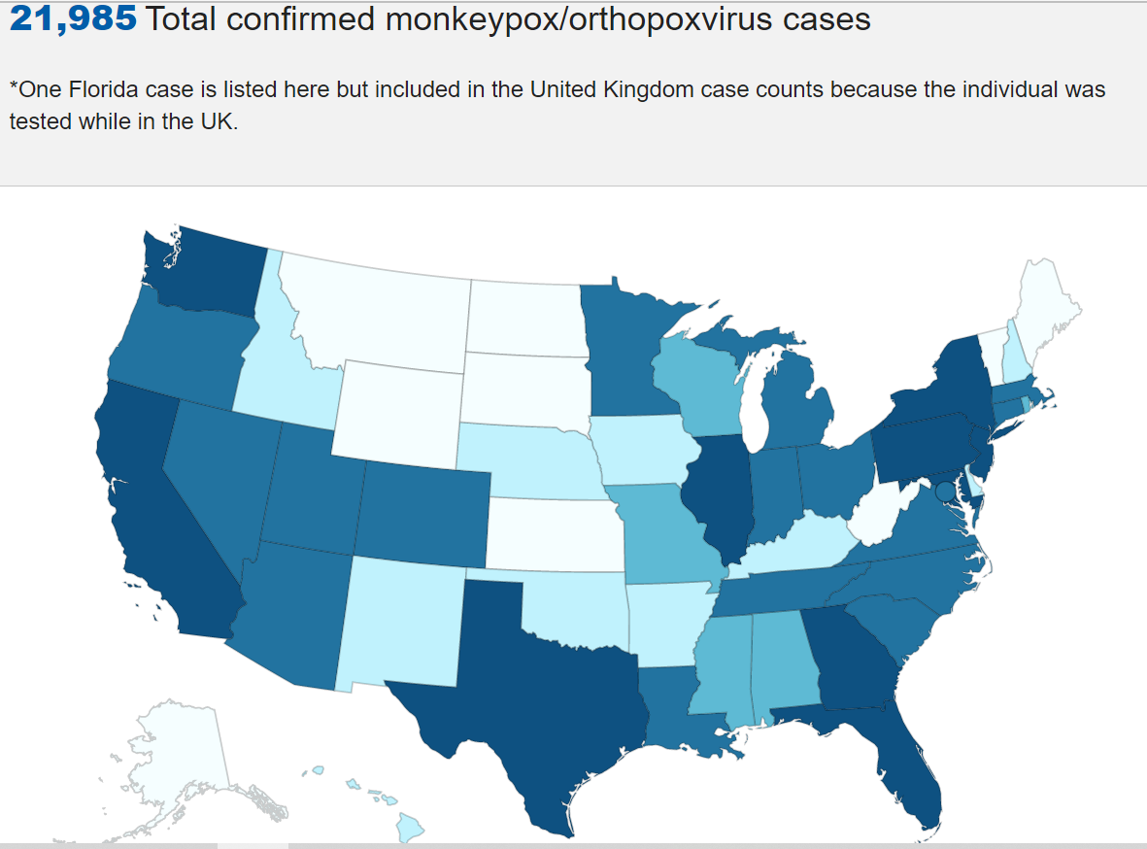
Monkeypox/Orthopoxvirus Cases: September 12, 2022
Reference: https://www.cdc.gov/poxvirus/monkeypox/response/2022/us-map.html#print

Slide 5
VA Facility Implementation of the CDC Expanded Access Program for use of Tecovirimat (TPOXX®) for Monkeypox
Eighty-one (81) VA Facilities are currently approved to participate in the CDC EAP for Tecovirimat using CDC’s Investigational New Drug Application (IND) for the Program
  Seventy-nine (79) VA Facilities are relying upon the CDC IRB
  Two (2) VA Facilities are relying upon their own internal IRBs
This EA-IND protocol allows access to and use of TPOXX for treatment of orthopoxvirus infections, including monkeypox.
The name of the CDC Protocol: Expanded Access IND Protocol: Use of Tecovirimat (TPOXX®) for Treatment of Human Non-Variola Orthopoxvirus Infections in Adults and Children.

Slide 6
CDC EA-IND Tecovirimat Program for MonkeyPox
ORD and the Office of Research Oversight (ORO) have established mechanisms for VHA Facilities to rely upon the CDC Institutional Review Board (IRB) to participate in the expanded access program and are coordinating many of the supporting regulatory needs to the Program.
The CDC’s EA-IND Tecovirimat Program for Monkeypox does not meet the definition of research under the Common Rule. However, the Program:
  Requires IRB approval, and
  Requires VA Research and Development (R&D) Committee approval.
Neither ORD nor ORO are involved in the procurement or processes to procure Tecovirimat.

Slide 7
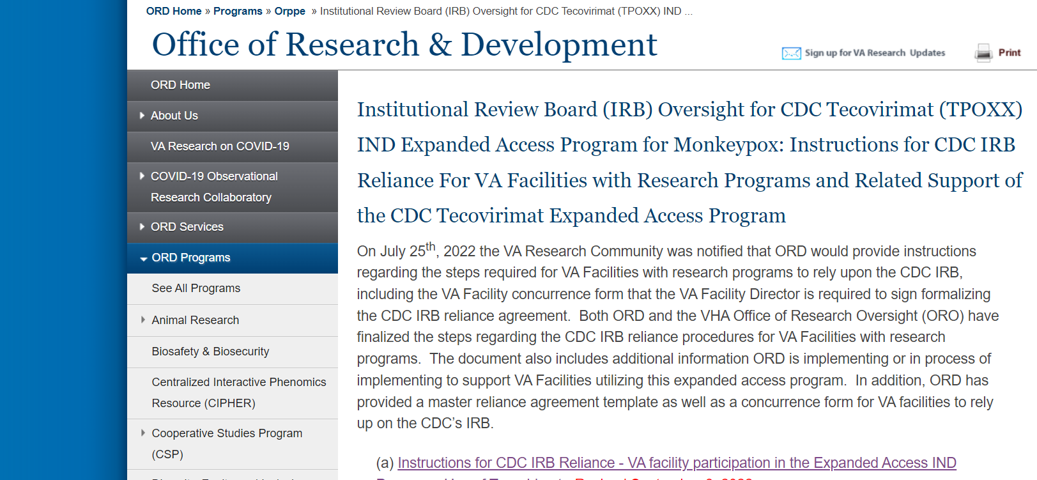
CDC EA-IND Tecovirimat Program for MonkeyPox (cont.)
ORD has established a webpage that is frequently updated describing the steps and current forms supporting implementation of this Program:
https://www.research.va.gov/programs/orppe/CDC-IRB-TPOXX-EAIND-Program.cfm

Slide 8



CDC EA-IND Tecovirimat Program for Monkeypox:
Common Questions
PHARMACY-RELATED INFORMED CONSENT ISSUES MISCELLANEOUS

Slide 9
CDC EA-IND Tecovirimat Program for Monkeypox:
Common Questions
PHARMACY-RELATED

Slide 10
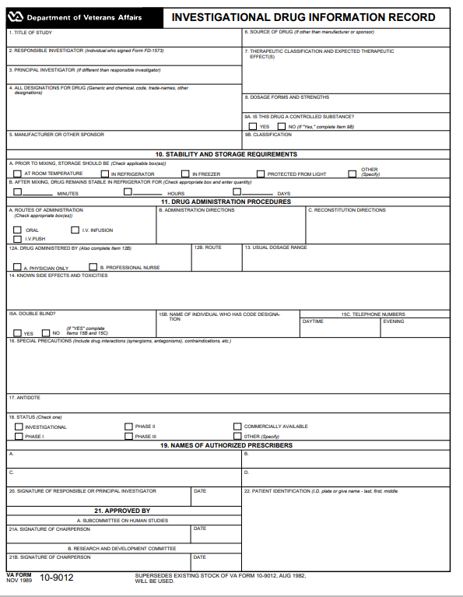
CDC EA-IND Tecovirimat Program for Monkeypox:
Pharmacy Question #1: VA Form 10-9012
Question #1:
Is completion of a VA Form 10-9012 (Investigational Drug Information Form) required for the use of Tecovirimat in the CDC EAP Program?

Slide 11
CDC EA-IND Tecovirimat Program for Monkeypox:
Pharmacy Question #1: VA Form 10-9012
Question #1: Is completion of a VA Form 10-9012 (Investigational Drug Information Form) required for the use of Tecovirimat in the CDC EAP Program?
ANSWER: NO.
A VA Form 10-9012 is not required to be completed because a drug manufacturer’s package insert is available. As per VHA Handbook 1108.04, Paragraph 11.b.(1):
(1) VA Form 10-9012 informs the authorized prescribers and other clinical personnel of the side effects and any known antidote of the investigational agent, as well as who the designated contact person is for questions. VA Form 10-9012 is required on all investigational agents where a drug manufacture’s package insert in not available.

Slide 12
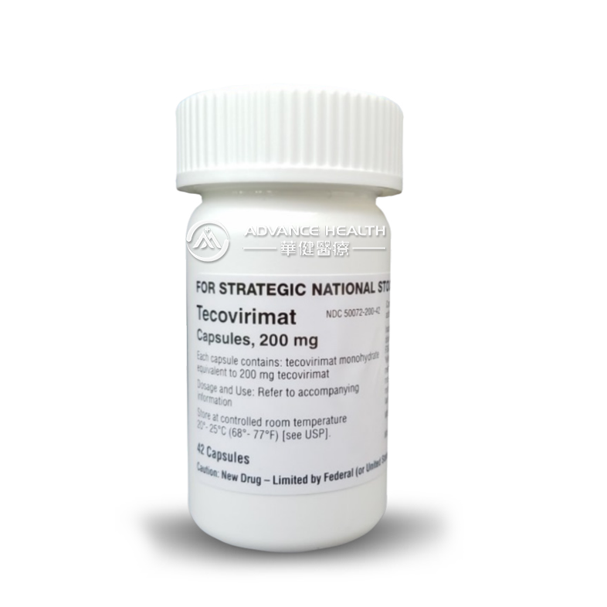
CDC EA-IND Tecovirimat Program for Monkeypox:
Pharmacy Question #2: Investigational Status of Tecovirimat
Question #2: Is Tecovirimat considered an investigational drug?

Slide 13
CDC EA-IND Tecovirimat Program for Monkeypox:
Pharmacy Question #2: Investigational Status of Tecovirimat
Question #2: Is Tecovirimat an investigational drug?
Answer: Yes and no; it depends upon how it is used.
Tecovirimat is an antiviral drug that is FDA-approved for treating smallpox.
Use of Tecovirimat for treatment of monkeypox in the United States is permitted only through an FDA-regulated Expanded Access Investigational New Drug (EA-IND) mechanism.
Under FDA’s IND regulations, Tecovirimat is an investigational drug when it is used for treating monkeypox.

Slide 14


CDC EA-IND Tecovirimat Program for Monkeypox:
Pharmacy Question #3: EUA vs. EA-IND
Question #3: Is an emergency use authorization (EUA) the same as an expanded access-IND?

Slide 15
CDC EA-IND Tecovirimat Program for Monkeypox:
Pharmacy Question #3: EUA vs. EA-IND
Question #3: Is an emergency use authorization (EUA) the same as an expanded access-IND?
Answer: No, an EUA is not the same as expanded access-IND. The EUA authority is used during a public health emergency and it is separate and distinct from use of a medical product under an investigational application (i.e., Investigational New Drug Application (IND) or Investigational Device Exemption (IDE)).
An EUA can only be granted when no adequate, approved, available alternatives exist, and when the known and potential benefits outweigh the potential risks.

Slide 16
CDC EA-IND Tecovirimat Program for Monkeypox:
EUA vs. EA-IND
The use of Tecovirimat for monkeypox is not under an EUA.
IRB approval is not required when using a medical product under an EUA.
The use of Tecovirimat for monkeypox is under an FDA-approved non-emergency IND.
IRB prospective approval is required for any non-emergency IND.
Treating clinicians and investigators do not make the determination whether an FDA-issued IND is a non-emergency IND or an emergency IND. This is a FDA determination as part of FDA’s IND approval process.

Slide 17
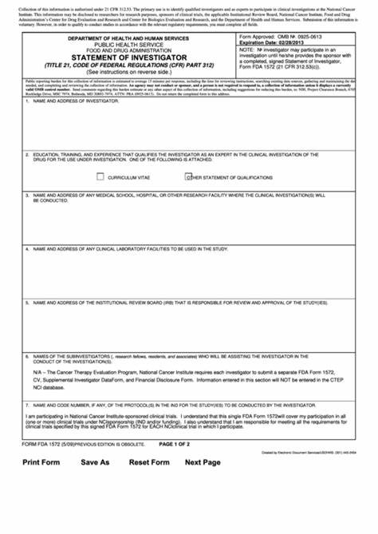
CDC EA-IND Tecovirimat Program for Monkeypox:
Pharmacy Question #4: Pharmacists on Form FDA 1572
Question #4:
Are prescribing pharmacists required to be listed as Principal Investigators on the FDA Form 1572 for the CDC EA-IND Tecovirimat Program?

Slide 18
CDC EA-IND Tecovirimat Program for Monkeypox:
Pharmacy Question #4: Pharmacists on Form FDA 1572
Question #4:
Are prescribing pharmacists required to be listed as Principal Investigators on the FDA Form 1572 for the CDC Tecovirimat EAP?]
Answer: No. Prescribing pharmacists are not to be listed on the FDA Form 1572.
In addition, prescribing pharmacists are not required to complete the ORD training slides to meet ORD's training requirement in ethical principles in lieu of CITI modules for personnel who are conducting this CDC Program: Training for VA Personnel Conducting FDA-Regulated Expanded Access Activities for the Treatment of Monkeypox.

Slide 19

CDC EA-IND Tecovirimat Program for Monkeypox:
Pharmacy Question #5: Submission of Form FDA 1572
Question #5: Does your VA Facility’s treating clinicians need to submit a copy of the Form FDA 1572 to the Office of Research and Development or upload the document into VAIRRS?

Slide 20

CDC EA-IND Tecovirimat Program for Monkeypox:
Pharmacy Question #5: Submission of Form FDA 1572
Question #5: Does your VA Facility’s treating clinicians need to submit a copy of the Form FDA 1572 to the CDC?
Answer: As per Paragraph 7.0 of the CDC protocol 6.1 (August 10, 2022), complete Form FDA 1572 and return to CDC prior to initiation of Tecovirimat to the extent feasible but no later than within 7 calendar days of Tecovirimat initiation. Only one form is required per VA Facility.

Slide 21
CDC EA-IND Tecovirimat Program for Monkeypox:
Common Questions
INFORMED CONSENT ISSUES

Slide 22

CDC EA-IND Tecovirimat Program for Monkeypox:
Common Questions: Informed Consent
What is the most frequently asked question ORD has received about the CDC EA-IND Tecovirimat Program related to Informed Consent?

Slide 23
CDC EA-IND Tecovirimat Program for Monkeypox:
#1 Most Common Question: Informed Consent
Question:
Can “verbal consent” (waiver of documentation of informed consent) be used to obtain informed consent for the CDC EA-IND Tecovirimat Program?

Slide 24

CDC EA-IND Tecovirimat Program for Monkeypox:
#1 Most Common Question: Informed Consent
Question:
Can verbal consent (waiver of documentation of informed consent) be used to obtain informed consent for the CDC EA-IND Tecovirimat Program?

Slide 25



Waiver of Documentation of Informed Consent Does Not Exist and Is Not An Option for the CDC EA-IND Tecovirimat Program

Slide 26
CDC EA-IND Tecovirimat Program for Monkeypox:
Informed Consent Challenges
Patients may not be at the VA Facility when informed they have been diagnosed with monkeypox.
CDC recommends that people with monkeypox remain isolated at home or at another location for the duration of illness as described in CDC recommendations (do not apply in healthcare settings) located at Isolation and Prevention Practices for People with Monkeypox | Monkeypox | Poxvirus | CDC.
Sharing items, such as paper that cannot be disinfected, is problematic.

Slide 27
CDC EA-IND Tecovirimat Program for Monkeypox:
Informed Consent Options
The CDC IRB requires patients (or their legally authorized representatives - LARs) to sign and date the CDC-IRB approved informed consent form unless an exception from informed consent applies.
The likelihood of a patient with monkeypox meeting the criteria for an exception from informed consent is unlikely.
A copy of the signed and dated patient’s CDC IRB-approved informed consent form is not required to be returned to CDC. It would only be required as per the CDC IRB-approved protocol if the signed informed consent forms cannot be maintained at the treating facility/institution, which is not applicable for VA Facilities.
A copy of the patient’s executed consent form (not just the signature page) must be kept by the VA Facility.

Slide 28
CDC EA-IND Tecovirimat Program for Monkeypox:
Exception from Informed Consent Requirements
The patient is unable to respond and make wishes known about tecovirimat treatment.
No next-of-kin or LAR is available, and the patient’s illness is life-threatening, obtaining informed consent may be deemed not feasible.
The patient’s treating clinician and a clinician who is not otherwise participating in this expanded access IND program will document the clinical determination on the last page of the informed consent form.
The information in the consent form should be provided to the patient or LAR at the first available opportunity.
Notify CDC via email (regaffairs@cdc.gov) within 3 working days of tecovirimat initiation when the treatment determination was made based on the mentioned certification by the treating and an independent clinician.

Slide 29
CDC EA-IND Tecovirimat Program for Monkeypox:
Informed Consent Mechanisms: iMED
ORD is working with the VA iMED team to place the CDC IRB-approved template into iMED and deploy nationally.
ORD does not have a timeline for deployment as of today’s date.

Slide 30
CDC EA-IND Tecovirimat Program for Monkeypox:
Informed Consent Mechanisms: VA DocuSign
The CDC IRB approved the use of VA DocuSign on August 25, 2022.
ORD coordinated with the VA DocuSign team within the Office of Information and Technology (OIT), Development, Security, and Operations (DevSecOps) to develop streamlined procedures for using VA DocuSign for this Program.
  Modified submission instructions.
  Faster implementation as both the CDC IRB-approved informed consent form and VA Form 10-5345 have already been made into DocuSign templates.
ORD has developed a guidance document (September 6, 2022) titled, “ORD Guidance: Instructions for Use of VA DocuSign for VA Facilities Conducting the CDC Expanded Access Program: “Use of Tecovirimat (TPOXX®) for Treatment of Human Non-Variola Orthopoxvirus Infections in Adults and Children” (IND 116039/CDC #6402).

Slide 31
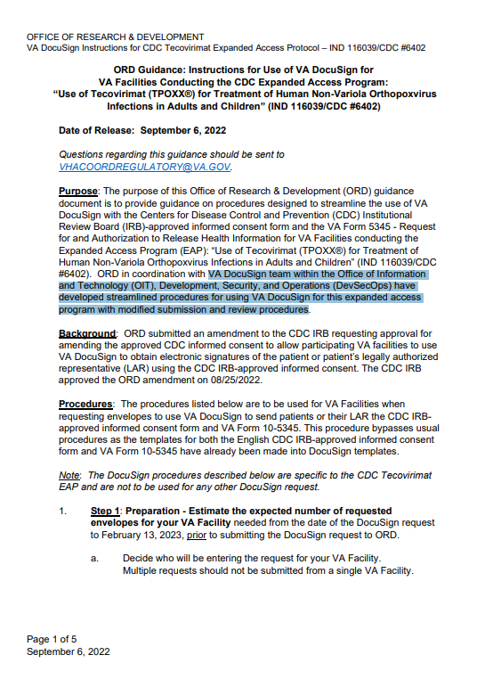
ORD Guidance on Use of VA DocuSign for the CDC EA-IND Tecovirimat Program
ORD Guidance:
Instructions for Use of VA DocuSign for VA Facilities Conducting the CDC Expanded Access Program: “Use of Tecovirimat (TPOXX®) for Treatment of Human Non-Variola Orthopoxvirus Infections in Adults and Children” (IND 116039/CDC #6402)

Slide 32
CDC EA-IND Tecovirimat Program for Monkeypox:
Common Question: Status of the VA Informed Consent Addendum
The VA Addendum is not yet approved. Until the CDC IRB has approved the informed consent addendum, please convey the following information to the patient verbally:
  #1: The patient and/or his or her insurance will not be charged for any treatments or procedures that are part of this Expanded Access IND. If the patient has co-payments for VA care and medications, these co-payment requirements will continue to apply to medical care and services provided by VA that are not part of this treatment program.
  #2. The VA will provide necessary medical treatment should the patient be injured by being in this program. The patient will be treated for the injury at no cost. This care may be provided by the local VAMC, or arrangements may be made for contracted care at another facility. The patient has not released the VA Facility from liability for negligence. In case of injury resulting from being in this program, the patient should contact their treating clinician.

Slide 33
CDC EA-IND Tecovirimat Program for Monkeypox:
Why does ORD Require the Language to be Provided to VA Patients?
Excerpts from CDC IRB-approved informed consent form (Version 6.1, dated August 10, 2022):
“WHAT ARE MY COSTS? CDC is providing tecovirimat for free. Other costs of the hospital and medical care will not be paid by CDC. Other costs will need to be paid by your insurer, Medicare, Medicaid, or you.”
“WHAT HAPPENS IF YOU ARE HARMED? In the event of an injury resulting from getting tecovirimat in this treatment program, you should seek appropriate medical care, if needed. Tell the treating doctor you have monkeypox and are taking tecovirimat. Take precautions to prevent spread of monkeypox (refer to the following website for more information: https://www.cdc.gov/poxvirus/monkeypox/clinicians/isolation-procedures.html). In the event of an emergency, you should go to an emergency room or call 911. CDC will not give this care. CDC does not normally pay for treatment needed if a patient is harmed because of being in a program like this. Thus, you or your insurer (such as Medicare or Medicaid) will have to pay for any care that is needed. But, you are not giving up any of your rights by signing this consent form and agreeing to be treated with tecovirimat in this program.”

Slide 34
CDC EA-IND Tecovirimat Program for Monkeypox:
Common Questions
MISCELLANEOUS

Slide 35
CDC EA-IND Tecovirimat Program for Monkeypox:
Other/Miscellaneous
REQUIRED FORMS
Informed Consent Form
Form FDA 1572
Patient Intake Form
Serious or life-threatening AEs and/or medication errors associated with the Tecovirimat administration
OPTIONAL FORMS
Clinical outcome form
Lesion photos
Patient diary forms
These are required and optional forms as per the CDC IRB approved protocol Version 6.1 (dated August 10, 2022).

Slide 36
CDC EA-IND Tecovirimat Program for Monkeypox:
Other/Miscellaneous
There is no local IRB regulatory review role if the CDC IRB is the IRB of Record for your VA Facility.
Treating clinicians are not required to fill out the OGE FORM 450 Alternative-VA (Research Financial Conflict of Interest Form).
ORD and ORO have developed a Tecovirimat SOP for VA Sites using the CDC IRB; points of contact for each VA Facility are emailed the revised SOP automatically whenever it is updated.

Slide 37

VA Issues Received from the National Cancer Institute Central IRB (NCI CIRB)

Slide 38
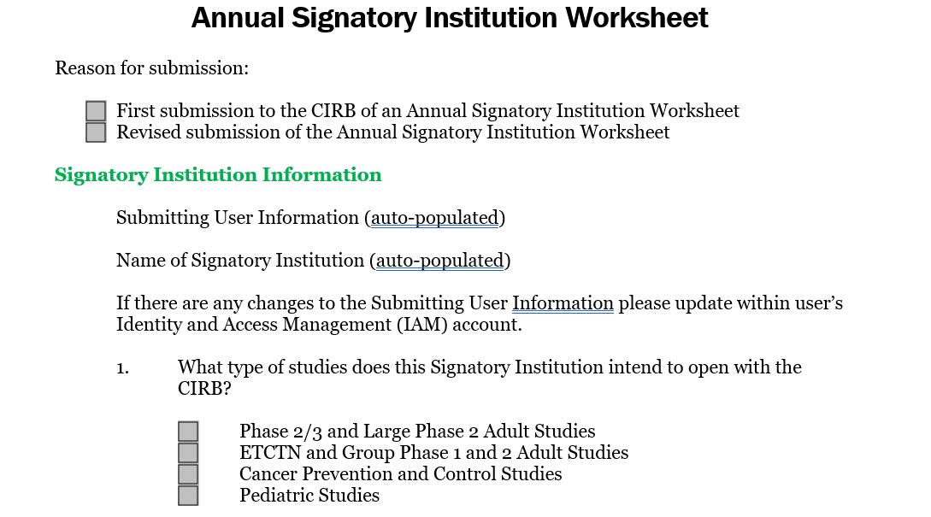
Issues with Completion of the Annual Signatory Institution Worksheets

Slide 39
Comments: Issues with Completion of the Annual Signatory Institution Worksheets (cont.)
Issues remain with VA worksheets are being rejected by the NCI CIRB for either content and/or technical reasons, requiring resubmission.
The timeline for turnaround of worksheet reviews vary. It may take 2 to 4 weeks due to volume. The time is extended when there are issues related to completion of the worksheet and/or boilerplate language.
The VA sites that have not yet had their worksheet approved will need to continue using their previous boilerplate and the VA Addendum until their worksheet is approved.

Slide 40
Example of Issue with Completion of the Annual Signatory Institution Worksheets (cont.)
Example Issue: The following question is on the Annual Signatory Institution Worksheet:
“5. What are the other state or local laws that govern the conduct of research at your institution?”
The VA Facility responded with the following:
“Not applicable – VA is a federal agency; state and local laws will never apply.”
Issue: The VA Facility’s response was incorrect as applicable state laws may apply depending upon whether those laws apply additional protections.

Slide 41
Example of Issue with Completion of the Annual Signatory Institution Worksheets (cont.)
While VA is a federal agency, VA looks to federal law to determine whether there is a basis to apply state law. VA adopted the Common Rule. Within the Common Rule, 38 C.F.R. § 16.101(f) states that:
“This policy does not affect any state or local laws or regulations (including tribal law passed by the official governing body of an American Indian or Alaska Native tribe) that may otherwise be applicable and that provide additional protections for human subjects. This policy does not affect any state or local laws or regulations (including tribal law passed by the official governing body of an American Indian or Alaska Native tribe) that may otherwise be applicable and that provide additional protections for human subjects.”
This citation within the Common Rule provides a basis for VA to follow state laws that are otherwise applicable and provide additional protections for human subjects.

Slide 42
Comments: Issues with Completion of the Annual Signatory Institution Worksheets (cont.)
The NCI CIRB Helpdesk also has provided feedback on confusion by some VA Facilities relying upon the NCI CIRB on what they can add to boilerplate language outside of the VA required language and what the CIRB does not permit.
NCI CIRB document “GUIDELINES FOR PERMITTED BOILERPLATE LANGUAGE ADDITIONS”(updated January 25, 2022) has been uploaded to the ORD-ORO NCI CIRB SharePoint Site: Home - NCI Central IRB (sharepoint.com).
The ORD-ORO NCI CIRB SharePoint Site can also be accessed on ORD’s NCI CIRB webpage at https://www.research.va.gov/programs/orppe/nci_irb.cfm.

Slide 43



Commercial (Independent) IRBs Questions Received by ORD and ORD-Approved Commercial IRBs

Slide 44
Issue: Sponsor Information Provided on Use of VA Informed Consent Template
An ORD-approved commercial IRB contacted ORD because five (5) VA Facilities were using a VA informed consent template – VA Form 10-1086 for IRB submission.
ORD queried the five VA Facilities, and both VA Facility commercial IRB liaisons informed ORD that the Sponsor informed them that they could use the VA informed consent template.
Question: Can the VA Facilities in this example use a VA informed consent template VA Form 10-1086 since the Sponsor is allowing it?

Slide 45
Issue: Sponsor Information Provided on Use of VA Informed Consent Template
Question: Can the VA Facilities use a VA informed consent template VA Form 10-1086 since the Sponsor is allowing it?
Answer: No, but the VA Facilities were following the instructions provided by the sponsor. ORD informed the commercial IRB, and the commercial IRB discussed the commercial IRB’s requirements directly with the sponsor.

Slide 46
Issue: Commercial IRB Receives VA Facility Request for Review of Study with No Prior Sponsor Submission
An ORD-approved commercial IRB notified ORD that it received an endorsement letter and VA Facility IRB submission for a multi-site study sponsored by industry.
The commercial IRB had no other submissions from any other institution (VA or non-VA); the commercial IRB had not been previously contacted by the sponsor as being the single IRB for this multi-site study.
Question: What actions were taken to address the issue?

Slide 47
Issue: Commercial IRB Receives VA Facility Request for Review of Study with No Prior Sponsor Submission
Question: What actions were taken to address the issue?
Answer:
ORD informed the commercial IRB to hold on processing the IRB submission until clarification was received from the VA Facility.
There was a misunderstanding of which commercial IRB was overseeing the study. The commercial IRB utilized by this specific sponsor was not an ORD-approved commercial IRB.
The IRB review is being done by the VA Facility’s primary IRB of Record.

Slide 48
Issue: Principal Investigator Takes Leave of Absence
The VA Principal Investigator (PI) for a clinical trial overseen by an ORD-approved commercial IRB takes a leave of absence.
The VA PI left before another VA PI could be approved by the commercial IRB.
Question: Is this a reportable event to the IRB?

Slide 49
Issue: Principal Investigator Takes Leave of Absence
Question: Is this a reportable event to the IRB?
Answer: Yes.
The absence of a PI to oversee the study is a reportable event.
For many sponsored studies, the sponsor is also required to approve any change in PI prior to the change in PI being submitted for IRB approval.

Slide 50
ORD and ORO Activities for the PRIM&R Annual Conference: December 12-15, 2022
The Public Responsibility in Medicine and Research (PRIM&R) Annual Conference will be a virtual event from December 12-15, 2022.
Session: ORD and ORO will be taping an on-demand session listed as:
  A11: A Dialogue With the Department of Veterans Affairs (VA): A Federal Agency’s Challenges and Solutions in Working with External IRBs to Facilitate Implementation of the Cooperative Research
  The session will be listed on the PRIM&R agenda for December 12, 2022 from 11:45 a.m. EST to 12:45 p.m. EST and will be available for viewing by registered attendees starting on December 12, 2022.
Federal Agency Office Hours: ORD and ORO will also be participating in the Federal Agency Office Hours on December 13, 2022 (Tuesday) from 2:30 p.m. EST to 4:00 p.m. EST.

Slide 51
September Summary
ORD continues to work on guidance and tools to support VA Facilities, including additional support for the CDC EAP-IND Tecovirimat Program.
ORD continues to communicate with the commercial IRBs and NCI IRB to address issues and develop solutions and disseminate the information to the VA research community.

Slide 52
Availability of Recording
A recording of this session and the associated handouts will be available on ORPP&E’s Education and Training website approximately one-week post-webinar.
An archive of all ORPP&E webinars can be found here: https://www.research.va.gov/programs/orppe/education/webinars/archives.cfm.

Slide 53
Contact Information
C. Karen Jeans, PhD, CCRN, CIP
Director of Regulatory Affairs, ORPP&E
VHA Office of Research and Development
c.karen.jeans@va.gov
ORD Regulatory Box: VHACOORDREGULATORY@VA.GOV

Slide 54
References
ORD webpage: Institutional Review Board (IRB) Oversight for CDC Tecovirimat (TPOXX) IND Expanded Access Program for Monkeypox: Instructions for CDC IRB Reliance For VA Facilities with Research Programs and Related Support of the CDC Tecovirimat Expanded Access Program
CDC webpage: Information for Healthcare Providers on Obtaining and Using TPOXX (Tecovirimat) for Treatment of Monkeypox | Monkeypox | Poxvirus | CDC
ORD’s NCI CIRB webpage: https://www.research.va.gov/programs/orppe/nci_irb.cfm
VA’s NCI CIRB SharePoint site: https://dvagov.sharepoint.com/sites/vacovhacomm/admin/projects/ncicirb/default.aspx
VA Specific Requirements for Informed Consent and HIPAA Authorizations When Using a Commercial IRB (September 14, 2020)
VHA Directive 1200.05(2): Research and Development Committee (January 7, 2019) at VHA Publications
ORD’s Policies and Guidance Documents webpage at https://www.research.va.gov/resources/policies/

