Slide 1
Purpose
At the conclusion of the webinar, which is the third as part of a VA Biosafety and Biosecurity webinar series, participants will be able to:
Define VA-specific IBC requirements associated with VA and non-VA IBCs responsible for providing oversight recombinant or synthetic nucleic acid (r/sNA) research conducted in research laboratories;
Identify common deficiencies and challenges related to IBC reviews of VA research with an emphasis on compliance with the NIH Guidelines;
Identify solutions, tools in the ORD Biosafety Toolkit, and other resources to assist with common deficiencies and challenges associated with IBC reviews, training, or support processes; and
Identify key IBC procedures, documentation, and information to be included in IBC records.

Slide 2

Institutional Biosafety Committee (IBC) Roles and Responsibilities to Support VA Research Involving Recombinant or Synthetic Nucleic Acid Research
September 27, 2022
VA Office of Research & Development
Biomedical Research Laboratory Biosafety and Biosecurity Program
For questions, please use Q&A box and address to “All Panelists.”
All Webinars will be recorded and posted within one week.

Slide 3

Webinar
Housekeeping
Recording - This session is being recorded and the associated handouts will be available on ORPP&E’s Education and Training website within one-week post-webinar.
Close Captioning - Now available in the new Webex platform. Click the “CC” button at the bottom left of the Webex screen.
Experiencing Sound Issues? – Call in using the number in your Webex chat box or in your registration confirmation email.
Q&A - Please use the Q&A feature to submit questions.
  Be sure to send questions to “All panelists”.
  Questions will be addressed at the end of the webinar.
Webinar Archive - Most ORPP&E webinars can be found here: https://www.research.va.gov/programs/orppe/education/webinars/archives.cfm
Post-Webinar Evaluation Survey - We are grateful to all that complete the post-webinar evaluation survey. It will automatically pop up once the webinar is exited.
For questions, please use Q&A box and address to “All Panelists.”
All Webinars will be recorded and posted within one week.

Slide 4

Lead Presenter
John Balog, BS, RBP (ABSA)
ORD National Biosafety Officer, ORPP&E
For questions, please use Q&A box and address to “All Panelists.”
All Webinars will be recorded and posted within one week.

Slide 5
Webinar Purpose & Objectives
Define VA-specific IBC requirements associated with internal VA and VA-affiliated (external) IBCs that are responsible for providing oversight recombinant or synthetic nucleic acid (r/sNA) research conducted in VA research laboratories.
Identify common deficiencies and challenges associated with internal VA and VA-affiliated (external) IBCs on providing oversight of VA biomedical research related to the NIH Guidelines.
Identify key IBC procedures, documentation, and information to be included in IBC records.
Identify solutions, tools in the ORD Biosafety Toolkit, and other resources to assist with common deficiencies and challenges associated with IBCs.
For questions, please use Q&A box and address to “All Panelists.”
All Webinars will be recorded and posted within one week.

Slide 6
Polling Question
Is your IBC Administered:
At your site
At another VA site
At an Affiliate site
Your site does not conduct Recombinant Nucleic Acid Research
For questions, please use Q&A box and address to “All Panelists.”
All Webinars will be recorded and posted within one week.

Slide 7
What are the NIH Guidelines?
What is an IBC?
For questions, please use Q&A box and address to “All Panelists.”
All Webinars will be recorded and posted within one week.

Slide 8
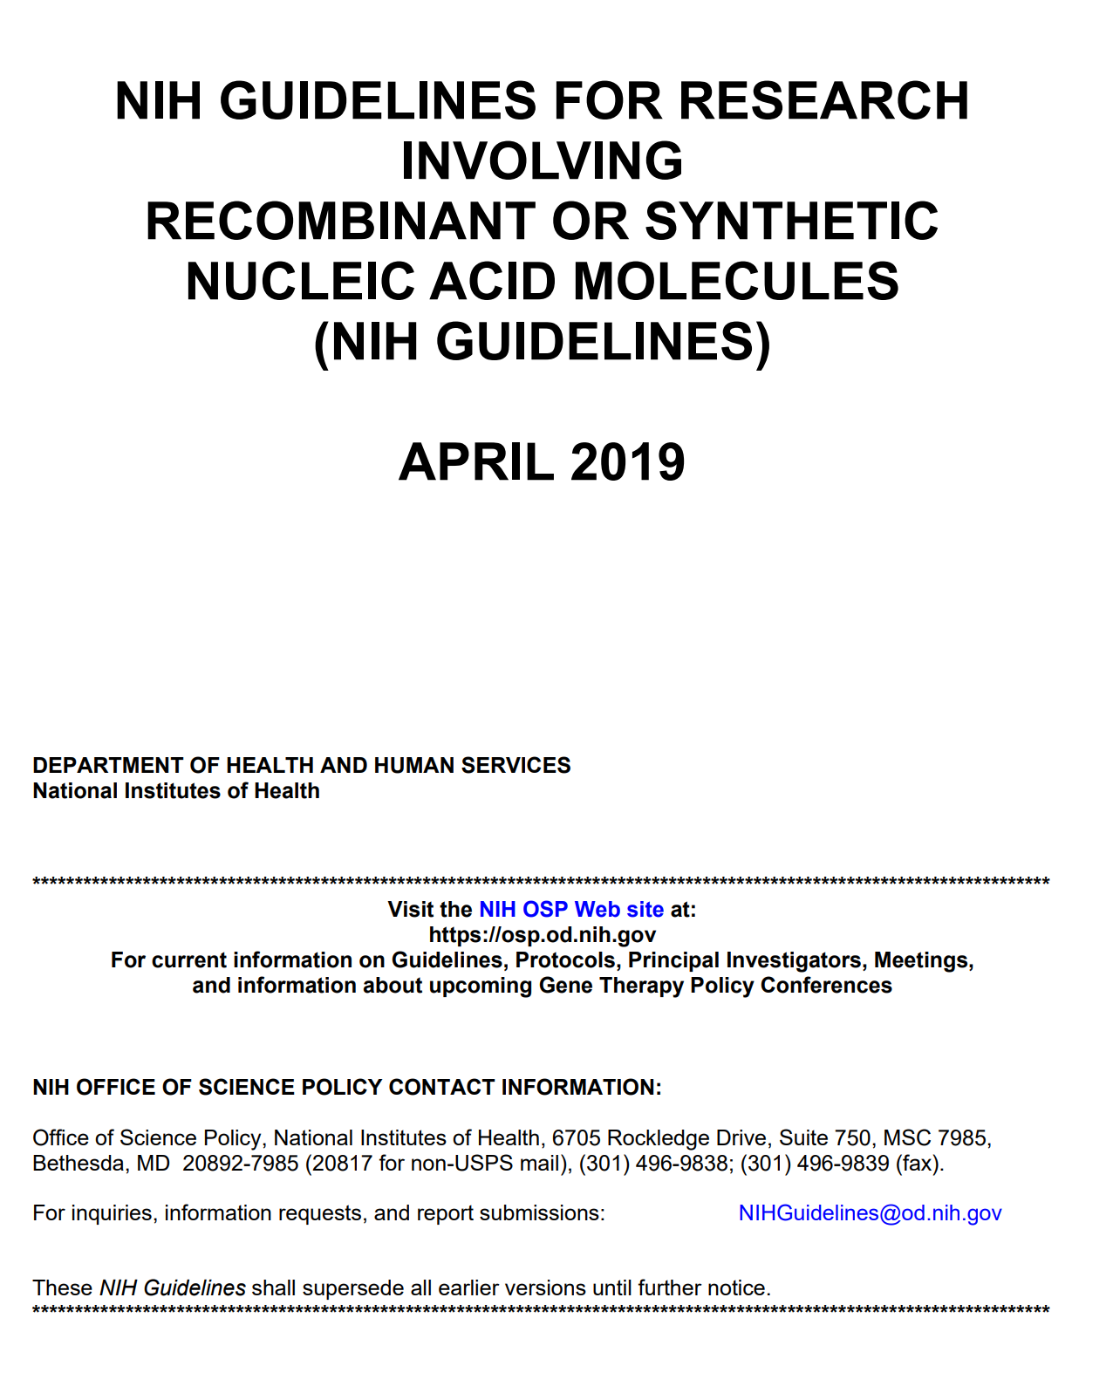
NIH Guidelines & IBCs
The NIH Guidelines are not “guidelines” that are optional recommendations.
The Guidelines are a model to promote safe work practices and containment strategies for constructing and using
  recombinant nucleic acid molecules
  synthetic nucleic acid molecules
  cells, organisms and viruses containing such molecules
All VA research involving recombinant or synthetic nucleic acid molecules research must comply with the NIH Guidelines.
For questions, please use Q&A box and address to “All Panelists.”
All Webinars will be recorded and posted within one week.

Slide 9

NIH Guidelines & IBCs
Assess potential risk to human health and environment
Evaluate containment levels per NIH Guidelines
Determine adequacy of facilities, SOPs, PI and lab personnel training and expertise
Ensure institutional and investigator compliance
Periodically review use of r/sNA for compliance
Must consist of no fewer than five (5) members
  Experience and expertise in r/sNA technology
  At least two (2) members not affiliated with the institution
Responsible for reviewing recombinant or synthetic nucleic acid molecule research conducted at or sponsored by the institution for compliance with the NIH Guidelines
For questions, please use Q&A box and address to “All Panelists.”
All Webinars will be recorded and posted within one week.

Slide 10
How does this apply to VA Biomedical Research?
For questions, please use Q&A box and address to “All Panelists.”
All Webinars will be recorded and posted within one week.

Slide 11
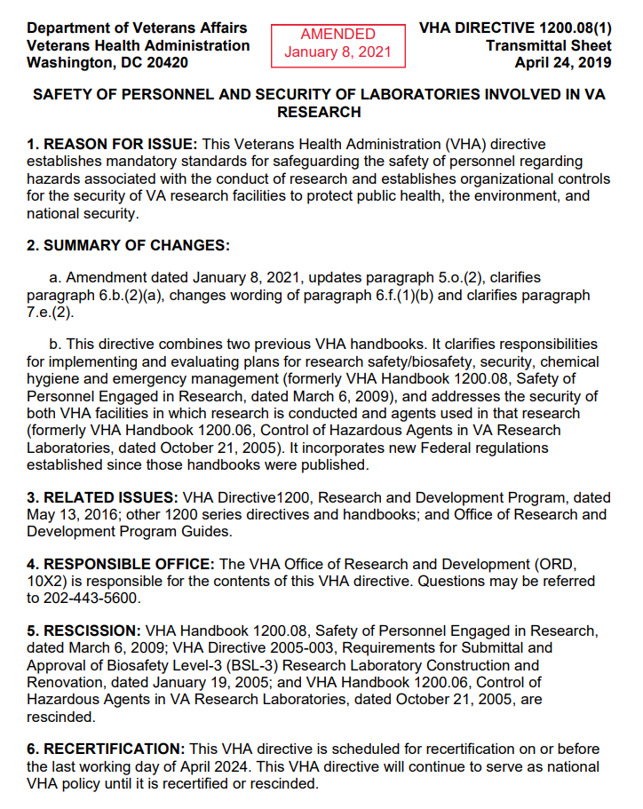
VHA Directive 1200.08(1)
“If a VA facility intends to permit the conduct of any research that that falls under the scope of the NIH Guidelines For Research Involving Recombinant or Synthetic Nucleic Acid Molecules (NIH Guidelines), it must establish its own IBC (internal) or obtain the services of another VA facility or an academic affiliate IBC (external).”
For questions, please use Q&A box and address to “All Panelists.”
All Webinars will be recorded and posted within one week.

Slide 12
VA Internal vs. External IBCs
67 Facilities Reported Conducting r/sNA Research
  Internal IBCs (n = 39)
    21 IBC separate from SRS
    17 IBC & SRS
    1 No Response
  External IBCs (n = 28)
    26 Academic Affiliate
    2 Another VA Facility
*Note: This data was provided by the VA Office of Research Oversight (ORO)*
For questions, please use Q&A box and address to “All Panelists.”
All Webinars will be recorded and posted within one week.

Slide 13
Types of Research Reviewed
For questions, please use Q&A box and address to “All Panelists.”
All Webinars will be recorded and posted within one week.

Slide 14
VHA Directive 1200.08(1)
VHA Directive 1200.08(1) defines IBC requirements for VA Facilities if the facility research program includes work that falls under the scope of the most current edition of the NIH Guidelines For Research Involving Recombinant or Synthetic Nucleic Acid Molecules.
Research & Development (R&D) Committee is responsible for establishing an internal or external IBC (if needed).
  If external, a Memorandum of Understanding (MOU) must be established.
The IBC is responsible for reviewing all research that involves non-exempt recombinant and synthetic nucleic acid molecules if the research is covered under Section I-C “General Applicability” of the NIH Guidelines.
The IBC must meet all requirements for membership, review of research, and other activities as outlined by the NIH Guidelines.
For questions, please use Q&A box and address to “All Panelists.”
All Webinars will be recorded and posted within one week.

Slide 15
VHA Directive 1200.08(1)
Procedures for a VA IBC review and approval of VA research must be described in local documents.
An internal IBC may share membership with the SRS or be constituted as a separate subcommittee of the R&D Committee.
The facility may assign other reviews to the IBC such as for research involving:
  Select Agents and Toxins
  Stem cell research
  Nanotechnology
  Infectious agents (bacteria, viruses, fungi, parasites, etc.) .
For questions, please use Q&A box and address to “All Panelists.”
All Webinars will be recorded and posted within one week.

Slide 16
VHA Directive 1200.08(1) (External IBC -VA Facility)
A VA research program may use an external IBC hosted by a second VA facility subject to the following conditions:
Internal to the second VA (and not an affiliate IBC);
Meet the NIH Guidelines requirement for community representation;
Knowledgeable regarding the containment facilities at the requesting VA facility;
Requesting VA facility must appoint a VA-compensated employee as a voting member to the IBC of the second VA facility; and
Requesting VA facility must establish and maintain registration with NIH-OSP indicating that the IBC at the second VA facility serves as the IBC-of-record.
For questions, please use Q&A box and address to “All Panelists.”
All Webinars will be recorded and posted within one week.

Slide 17
VHA Directive 1200.08(1) (External IBC – Affiliate)
VA research program may use an external IBC hosted by an academic affiliate, subject to the following conditions:
Establish an MOU to define roles and responsibilities for the VA facility and academic affiliate;
VA facility must establish and maintain registration with NIH-OSP indicating that the affiliate IBC serves as their IBC-of-record;
Affiliate IBC must review research in accordance with all VA policies and other Federal requirements;
IBC meetings minutes and other documents related to VA research must be provided to the SRS, R&D Committee, or the facility Research Office; and
At least one voting member of the external IBC must be a VA-compensated employee.
For questions, please use Q&A box and address to “All Panelists.”
All Webinars will be recorded and posted within one week.

Slide 18
IBC Challenges and Solutions Related to Review of VA Research Activities
For questions, please use Q&A box and address to “All Panelists.”
All Webinars will be recorded and posted within one week.

Slide 19
Common VA-Specific IBC Challenges
Procedures for the IBC review and approval of VA research involving rDNA were not described in local guidelines.
Protocols involving non-exempt s/rNA research were not reviewed and approved by an appropriately constituted IBC.
The IBC did not notify PIs in writing or electronically of the date of approval or of the assigned BSL for rDNA protocols.
IBC did not maintain registration as the IBC of record with NIH-OSP.
IBC members were not trained on the NIH Guidelines.
For questions, please use Q&A box and address to “All Panelists.”
All Webinars will be recorded and posted within one week.

Slide 20
Examples of Solutions to Common VA-Specific IBC Challenges
Issue: Procedures for the IBC review and approval of VA research involving rDNA were not described in local guidelines.
Resolution: Develop an SOP describing your site-specific review process.
Issue: Protocols involving non-exempt s/rNA research were not reviewed and approved by an appropriately constituted IBC.
Resolution: Establish a screening process at the research programming phase to alert PIs/Research Leads that an IBC application is needed. Remember that human subjects research activities, such as gene therapy or vaccine studies, may require IBC review and approval.
Issue: The IBC did not notify PIs in writing or electronically of the date of approval or of the assigned BSL for rDNA protocols.
Resolution: The Chair or Vice-Chair is responsible for Committee correspondence .
For questions, please use Q&A box and address to “All Panelists.”
All Webinars will be recorded and posted within one week.

Slide 21
Examples of Solutions to Common VA-Specific IBC Challenges (cont.)
Issue: IBC did not maintain registration as the IBC of record with NIH-OSP.
Resolution: Set a calendar reminder ran to submit the annual report in the OSP IBC-RMS.
Issue: IBC members were not trained on the NIH Guidelines.
Resolution: ORD will establish a list of fundamental safety/biosafety training modules for IBC members within the Cooperative Institutional Training Initiative (CITI) but each site must provide site-specific training, i.e., the SOP describing your committee’s review process, and any additional required training.
Issue: The IBC of record did not conduct annual assessments of VA laboratories as specified in the Affiliate IBC MOU.
Resolution: Establish an annual survey schedule for all laboratories listed on IBC applications.
For questions, please use Q&A box and address to “All Panelists.”
All Webinars will be recorded and posted within one week.

Slide 22
Types of Trainings Provided to IBC Members (n = 42)
For questions, please use Q&A box and address to “All Panelists.”
All Webinars will be recorded and posted within one week.

Slide 23
Common VA-Specific IBC Challenges
IBC meeting minutes did not contain sufficient detail to document what actions the committee has taken as reviews and approvals were not consistently documented in the IBC minutes.
For questions, please use Q&A box and address to “All Panelists.”
All Webinars will be recorded and posted within one week.

Slide 24
Solution: IBC Meeting Minutes Template
Meeting minutes are intended to:
  Serve as a record of the IBC’s proceedings
  Document that the IBC has fulfilled its review and oversight responsibilities.
Minutes should offer sufficient detail to capture major points of discussion and the committee’s rationale for particular decisions.
Minutes do not need to be transcripts or kept at a level of detail that attributes each remark to a specific individual.
For questions, please use Q&A box and address to “All Panelists.”
All Webinars will be recorded and posted within one week.

Slide 25
IBC Meeting Minutes Template
Call to Order
  Time the meeting started
  Number of voting members present
  Quorum was either “present” or “not present”
Conflict of Interest
  “No member of an Institutional Biosafety Committee may be involved (except to provide information requested by the Institutional Biosafety Committee) in the review or approval of a project in which he/she has been or expects to be engaged or has a direct financial interest”
Review of Prior Business
  Approval of previous minutes
  Capture any additional business
For questions, please use Q&A box and address to “All Panelists.”
All Webinars will be recorded and posted within one week.

Slide 26
IBC Meeting Minutes Template (cont.)
Protocols and Amendment for Review
  Summary of review provided by the primary and secondary reviewers to include:
  Applicable NIH Guidelines
    Section III-D-1, D-2, F-8, F-3, other
  Brief summary of the project
  Investigational Study Agent(s)/Toxin(s)
  Any comments from the committee
  Biosafety Level Assignment:
    Laboratory (e.g., BSL-1, ABSL-2, BSL-2, ABSL-2, BSL-3, and/or ABSL-3)
    Enhanced Work Practices, if any (e.g., double gloves, surgical mask, respiratory protection)
For questions, please use Q&A box and address to “All Panelists.”
All Webinars will be recorded and posted within one week.

Slide 27
IBC Meeting Minutes Template (cont.)
Protocols and Amendment for Review
  Occupational Health Requirements
    Vaccination requirements, respiratory protection, medical surveillance, etc.
  Training Requirements
    Laboratory Biosafety, Chemical Safety, OSHA Bloodborne Pathogens, etc.
  Motions on the disposition
    “A motion was made to approve the protocol as stated or A motion was made to approve the protocol pending the following changes:”
    Record the changes to be sent to the PI for reconciliation.
  Votes (For, Against and Abstain)
    List Committee Member(s) with conflicts, if any
For questions, please use Q&A box and address to “All Panelists.”
All Webinars will be recorded and posted within one week.

Slide 28
IBC Meeting Minutes Template (cont.)
New Business
  Safety and security incidents, non-compliance issues
  Capture the following:
    Discussion of the topic
    Any motions made
    Votes (For, Against and Abstain)
    Conflicts of interest
Additional Topics
  Trainings conducted during the meeting
Adjournment
  Time the meeting ended
Note: IBC Meeting Minutes Template will be available in ORD’s Biosafety Toolkit
For questions, please use Q&A box and address to “All Panelists.”
All Webinars will be recorded and posted within one week.

Slide 29
Common VA-Specific IBC Challenges
Issue: Update IBC MOU to ensure that it reflects current practices.
Resolution: Plan to review the MOU at a recurring frequency and whenever a change in circumstances warrant.
For questions, please use Q&A box and address to “All Panelists.”
All Webinars will be recorded and posted within one week.

Slide 30
IBC Memorandum of Understanding (MOU)
A written agreement between the VA Facility and an external IBC (either another VA Facility or a VA Facility’s affiliated university’s IBC) is required if a VA Facility wishes to utilize an external IBC.
ORD policy does not permit use of commercial (independent) IBCs.
Unlike reliance by a VA Facility on multiple Institutional Review Boards (IRBs), a single VA Facility does not utilize multiple IBCs.
For questions, please use Q&A box and address to “All Panelists.”
All Webinars will be recorded and posted within one week.

Slide 31
IBC MOU Process from ORD Request to ORD Approval
Step 1: Request to ORD
ORD sends IBC MOU template for using VA or affiliate IBC)
Step 2: VA Facility Reviews
VA Facility reviews and makes edits and returns back to ORD
Step 3: VA Facility sends filled in IBC MOU back to ORD; ORD will tell site when to send to other VA Facility or affiliate.
Step 4: IBC MOU reviewed and edited by other VA Facility or affiliate after ORD. Edits sent back to ORD by requesting VA Facility.
Step 5: If legal review required, OGC STAR is consulted. Otherwise, ORD negotiates edits. ORO is sent edited MOU prior to execution for their awareness.

Slide 32
Factors Impacting Interval from Request to Execution of a VA IBC MOU
Based on 45 IBC MOUs ORD has negotiated in the past 2 years, MOUs can be executed in as little as 7 days to a year (or negotiation fails in a few rare cases) due to the following key factors:
  Responsiveness of parties to addressing queries;
  Number of revisions made in the template IBC MOU;
  Financial or support to be provided for the IBC MOU; and/or
  Willingness to negotiate by parties.

Slide 33
ORD and IBC MOUs
VA Facilities relying upon an academic university’s IBC are not required to use a VA IBC MOU template, but ORD has developed a template that includes VA policy and is compliant with the NIH Guidelines.
If seeking a new IBC MOU, please make sure the institution’s IBC is willing to be the IBC for the VA Facility before contacting ORD.
For renewals of IBC MOUs, please allow ORD a minimum of three weeks for IBC MOU reviews.

Slide 34
IBC Resources Available
For questions, please use Q&A box and address to “All Panelists.”
All Webinars will be recorded and posted within one week.

Slide 35

Dedicated Biosafety and Biosecurity Query Mailbox: VHACOORDBIOSAFETY@VA.GOV
ORD has established a dedicated email location for addressing questions from VA Facilities on research biosafety and biosecurity.
VHACOORDBiosafety@va.gov is the email address to submit biosafety and biosecurity questions
ORD will provide responses on biomedical research laboratory topics related to:
  Biosafety and biosecurity risk assessment practices
  Handling and management of infectious microorganisms
  Biohazard and chemical waste management
  Personal protective equipment (PPE)
  Biosafety and biosecurity best practices
  Other biosafety and biosecurity topics
NOTE: Evaluate whether question should be submitted locally (e.g., local biosafety POC, SRS) before submitting to national ORD Biosafety and Biosecurity mailbox.
For questions, please use Q&A box and address to “All Panelists.”
All Webinars will be recorded and posted within one week.

Slide 36

How to Request Being Added to the
New ORD Biosafety and Biosecurity Distribution List
ORD has established a Biosafety and Biosecurity email distribution list to enhance communication with the biomedical research program stakeholders throughout VA.
ORD will use the distribution list to:
  Communicate reminders and updates on existing and emergent biosafety and biosecurity issues affecting biomedical research laboratory facility and work practices;
  Disseminate information about externally hosted training opportunities.
Open to anyone interested in Research Biosafety and Biosecurity.
How to Join If Interested: Please send an email requesting to be added to the Biosafety and Biosecurity distribution list to VHACOORDBIOSAFETY@VA.GOV.
For questions, please use Q&A box and address to “All Panelists.”
All Webinars will be recorded and posted within one week.

Slide 37
ORD Biosafety Toolkit
Available Educational Tools:
Compressed Gas Cylinders
Anesthetic Gases
Biological Safety Cabinets (BSCs)
Waste Segregation and Disposal
Laboratory Biosafety Sign Narrative and Template
Laboratory Biological Risk Assessment Narrative and Template
Toolkit: Research Laboratory Biosafety and Biosecurity
For questions, please use Q&A box and address to “All Panelists.”
All Webinars will be recorded and posted within one week.

Slide 38
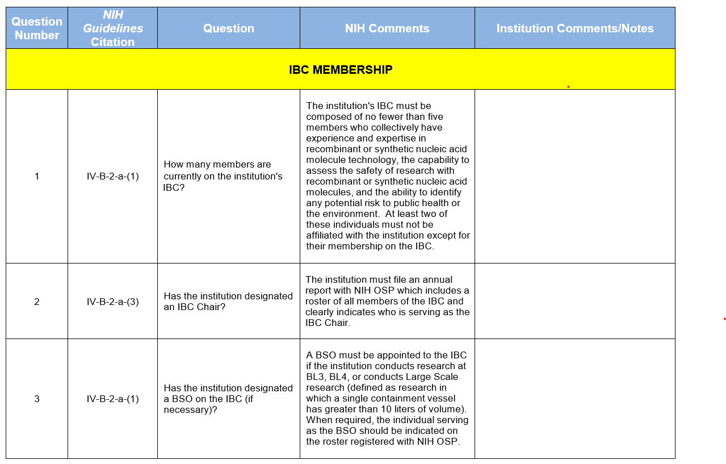
NIH IBC Self-Assessment Tool
Resource that institutions may use to evaluate their IBCs for compliance with the requirements articulated in the NIH Guidelines
Consists of 77 core questions relating to the requirements of the NIH Guidelines as well as best practices
Current Version(October 2021) (https://osp.od.nih.gov/wp-content/uploads/IBC-Self-Assessment-Tool-2021.docx)
For questions, please use Q&A box and address to “All Panelists.”
All Webinars will be recorded and posted within one week.

Slide 39
References
ORD Biomedical Research Laboratory Biosafety and Biosecurity Program
Toolkit: Research Laboratory Biosafety and Biosecurity
VHA Directive 1200.08. Safety of Personnel and Security of Laboratories Involved in VA Research, Veterans Health Administration, January 8, 2021.
Biosafety in Microbiological and Biomedical Laboratories (BMBL) 6th Ed., Centers for Disease Control and Prevention and National Institutes of Health, 2020.
NIH Guidelines for Research Involving Recombinant or Synthetic Nucleic Acid Molecules (NIH Guidelines), National Institutes of Health, 2019.
ABSA International , The American Biological Safety Association International
NIH Guidelines Frequently Asked Questions, National Institutes of Health
NIH Investigator Responsibilities under the NIH Guidelines, National Institutes of Health, October 2021
For questions, please use Q&A box and address to “All Panelists.”
All Webinars will be recorded and posted within one week.

Slide 40
References (cont.)
NIH IBC Self-Assessment Tool, National Institutes of Health, October 2021
NIH Incident Reporting Frequently Asked Questions, National Institutes of Health, May 2019
NIH Incident Reporting Template, National Institutes of Health, April 2019
OSHA Bloodborne Pathogens Standard (29 CFR 1910.1030)
IATA Dangerous Goods Regulations (Infectious Substances Shipping Guidelines) Pathogen Safety Data Sheets and Risk Assessment, Public Health Agency of Canada
General Microbiology Fact Sheet: OSHA/ABSA Alliance Program, Occupational Health and Safety Administration and ABSA International Alliance Program
Selected EPA-Registered Disinfectants, US Environmental Protection Agency
CDC and USDA Select Agents Regulations , Centers for Diseases Control and Prevention
For questions, please use Q&A box and address to “All Panelists.”
All Webinars will be recorded and posted within one week.

Slide 41
Availability of Recording
A recording of this session and the associated handouts will be available on ORPP&E’s Education and Training website approximately one-week post-webinar
Webinar #1 – Biosafety and Biosecurity Program: New Initiatives for VHA Facility Support
Webinar #2 – Foundations of a Biomedical Research Laboratory Biorisk Management Program
Webinar #3 – Institutional Biosafety Committee (IBC) Roles and Responsibilities to Support Recombinant or Synthetic Nucleic Acid Research in VA Biomedical Research Laboratories
An archive of all ORPP&E webinars can be found here: https://www.research.va.gov/programs/orppe/education/webinars/archives.cfm.
For questions, please use Q&A box and address to “All Panelists.”
All Webinars will be recorded and posted within one week.

Slide 42
Questions and Answers
For questions, please use Q&A box and address to “All Panelists.”
All Webinars will be recorded and posted within one week.

Slide 43
Please Complete the Survey!
Thank you!
For questions, please use Q&A box and address to “All Panelists.”
All Webinars will be recorded and posted within one week.

