Slide 1

CC 101:
A Journey into the Past, Present, and Future
October 5, 2022
Tony Laracuente, Director of Field Operations, ORD

Slide 2

Webinar
Housekeeping
Recording - This session is being recorded and the associated handouts will be available on ORPP&E’s Education and Training website within one-week post-webinar.
Close Captioning - Now available in the new Webex platform. Click the “CC” button at the bottom left of the Webex screen.
Experiencing Sound Issues? – Call in using the number in your Webex chat box or in your registration confirmation email.
Q&A - Please use the Q&A feature to submit questions.
  Be sure to send questions to “All panelists”.
  Questions will be addressed at the end of the webinar.
Webinar Archive - Most ORPP&E webinars can be found here: https://www.research.va.gov/programs/orppe/education/webinars/archives.cfm
Post-Webinar Evaluation Survey - We are grateful to all that complete the post-webinar evaluation survey. It will automatically pop up once the webinar is exited.
For questions, please use Q&A box and address to “All Panelists.”
All Webinars will be recorded and posted within one week.

Slide 3
Objectives – for today’s training
Training Section: | By the end of this section, you will:
Section 1: Understand a Cost Center | Look at CC 101 Quiz from almost twenty years ago! Understand what a Cost Center is and Definitions
Section 2: Understanding how to Calculate CC 101 | See what the parameters were for calculating 101
Section 3: Understanding the New CC 101 Model (in 2023) | Understand the changes and approach to the new formula
Q&A
Notes:
Jason -Section 1; John- Section 2; Kari- Section 2 and 3

Slide 4
Section 1: What is a Cost Center
What is a Cost Center?

Slide 5
Section 1: The Quiz
Can you identify the 7 programs used by VA research to break up the appropriation?
What is cost center 8110?
What is cost center 8134?
Does anyone remember CC 8102 and 8104? If so, are they still used anywhere?
What is Program 821?

Slide 6
Part 1:The Quiz
Who is the author of the CC101 formula?
Does CC101 matter in the future?
Does anyone check their CC 101 Allocation each year?
What is CC 103?

Slide 7
Part 1: Answer
As defined in VHA Financial Policy (Volume XIII - Cost Accounting - Office of Finance (va.gov))
  A mechanism used to accumulate costs incurred by area of responsibility or geographic region. Cost centers are represented by a four-to-six-digit code used to identify organizational elements throughout VA, e.g. 301000, [Veterans Benefits Administration (VBA)] Executive Director
A system to provide cost breakouts to the standard general ledger account system
A way to account for the distribution and expenditure of funds to the field by segregating into cost pools

Slide 8
Part 1: CC Definitions
CC101 – Administrative Support for the research office
CC 102 – Common Research Support (not used in quite some time)
CC 103 Merit Reviewed Medical Research
CC 105 –VMU
CC 106 – Centrally Directed Priority Areas
CC 108 – Career Development
CC109 – Other Designated Research
CC 110 – Research Career Scientist
CC 124 – Rehab R&D
CC 134 – HSR&D
CC 150 – Coop Studies and MVP

Slide 9
Part 1: Definitions - Programs
820 – VACO Support
821 – Biomedical Laboratory Research
822 – Rehab R&D
824 – HSR&D
825 – Coop Studies
826 – MVP
829 – Clinical Sciences

Slide 10
Part 2: What is this CC 101 Calculation anyway?
CC 101 Calculated at the beginning of the year
Painful Formula devised by a former AO and Director of Research Operations back a long time ago
Confusing?
Fair?
Functional?

Slide 11

Part 2: How was the CC 101 Calculated?

Slide 12
Section 2: Premise
To support the research office by providing a portion of “indirect support” based on size and complexity of program.
As defined by VA: CC 810100 - Administration and Common Research. Includes personal services of the support staff for the Associate Chief of Staff (ACOS) for Research, and all other costs associated with that activity in support of multiple research programs, projects, and laboratories. (Fund 0161)

Slide 13
Section 2: Perceptions and Reality
How can we run the program with this?
Is this really enough?
Do we pay investigators from this?
Service Contracts?
Compliance, the money grubber
How much is enough?
More than likely change in the future

Slide 14
Section 2: Calculating CC101
Initial Target Allowance (ITA)
Funky formula developed in the 80s and slightly modified. Many people have opined
Based on success of garnering research funding from all programs. Broken down by program.
So how is it calculated – 1996 vs 2003

Slide 15
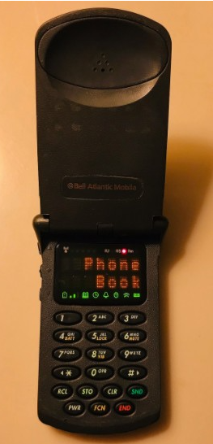
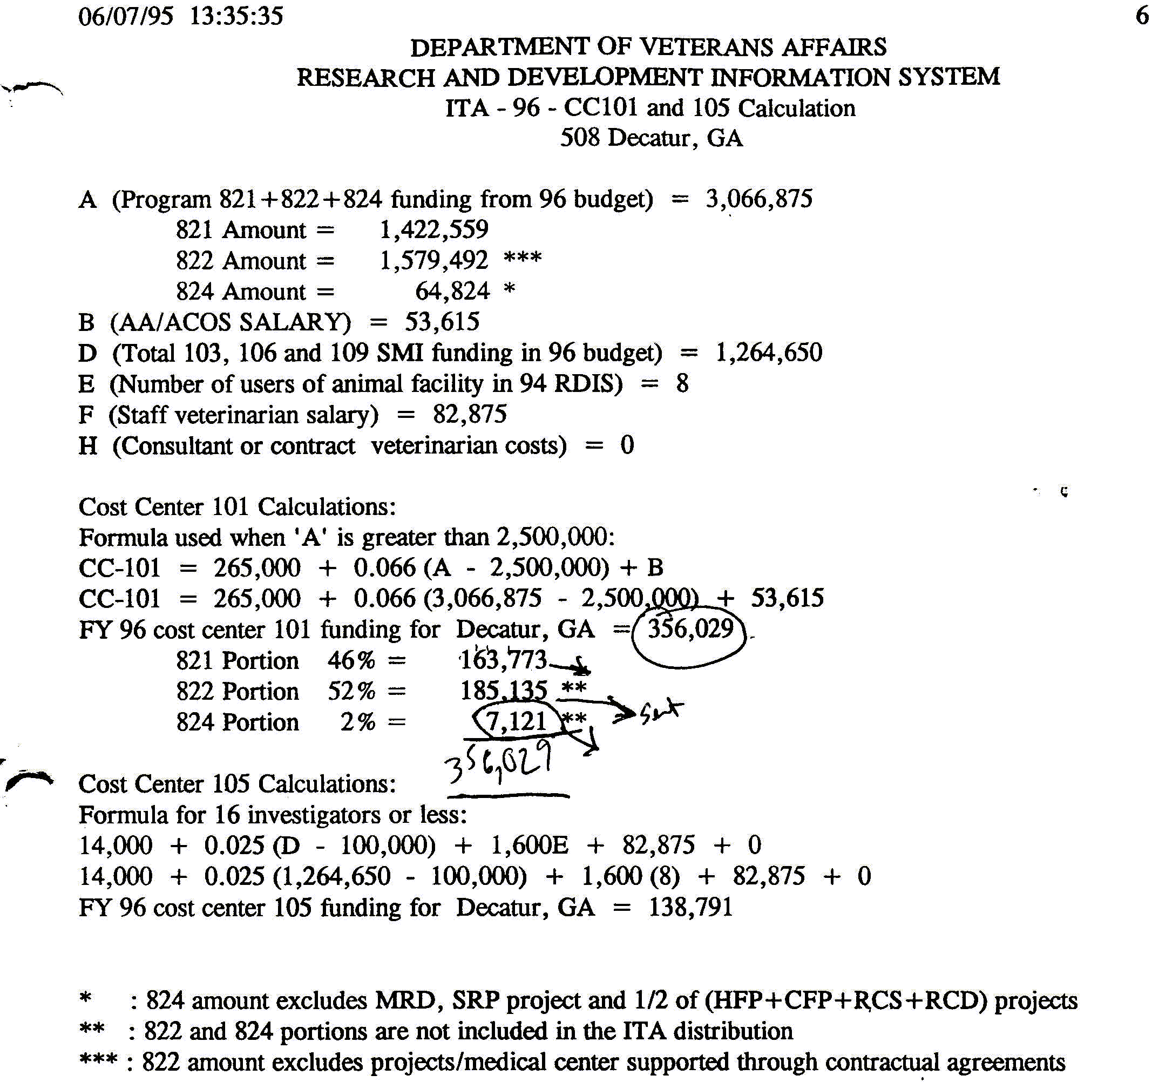
Section 2: Calculating CC101 -1996
Better call Tony

Slide 16
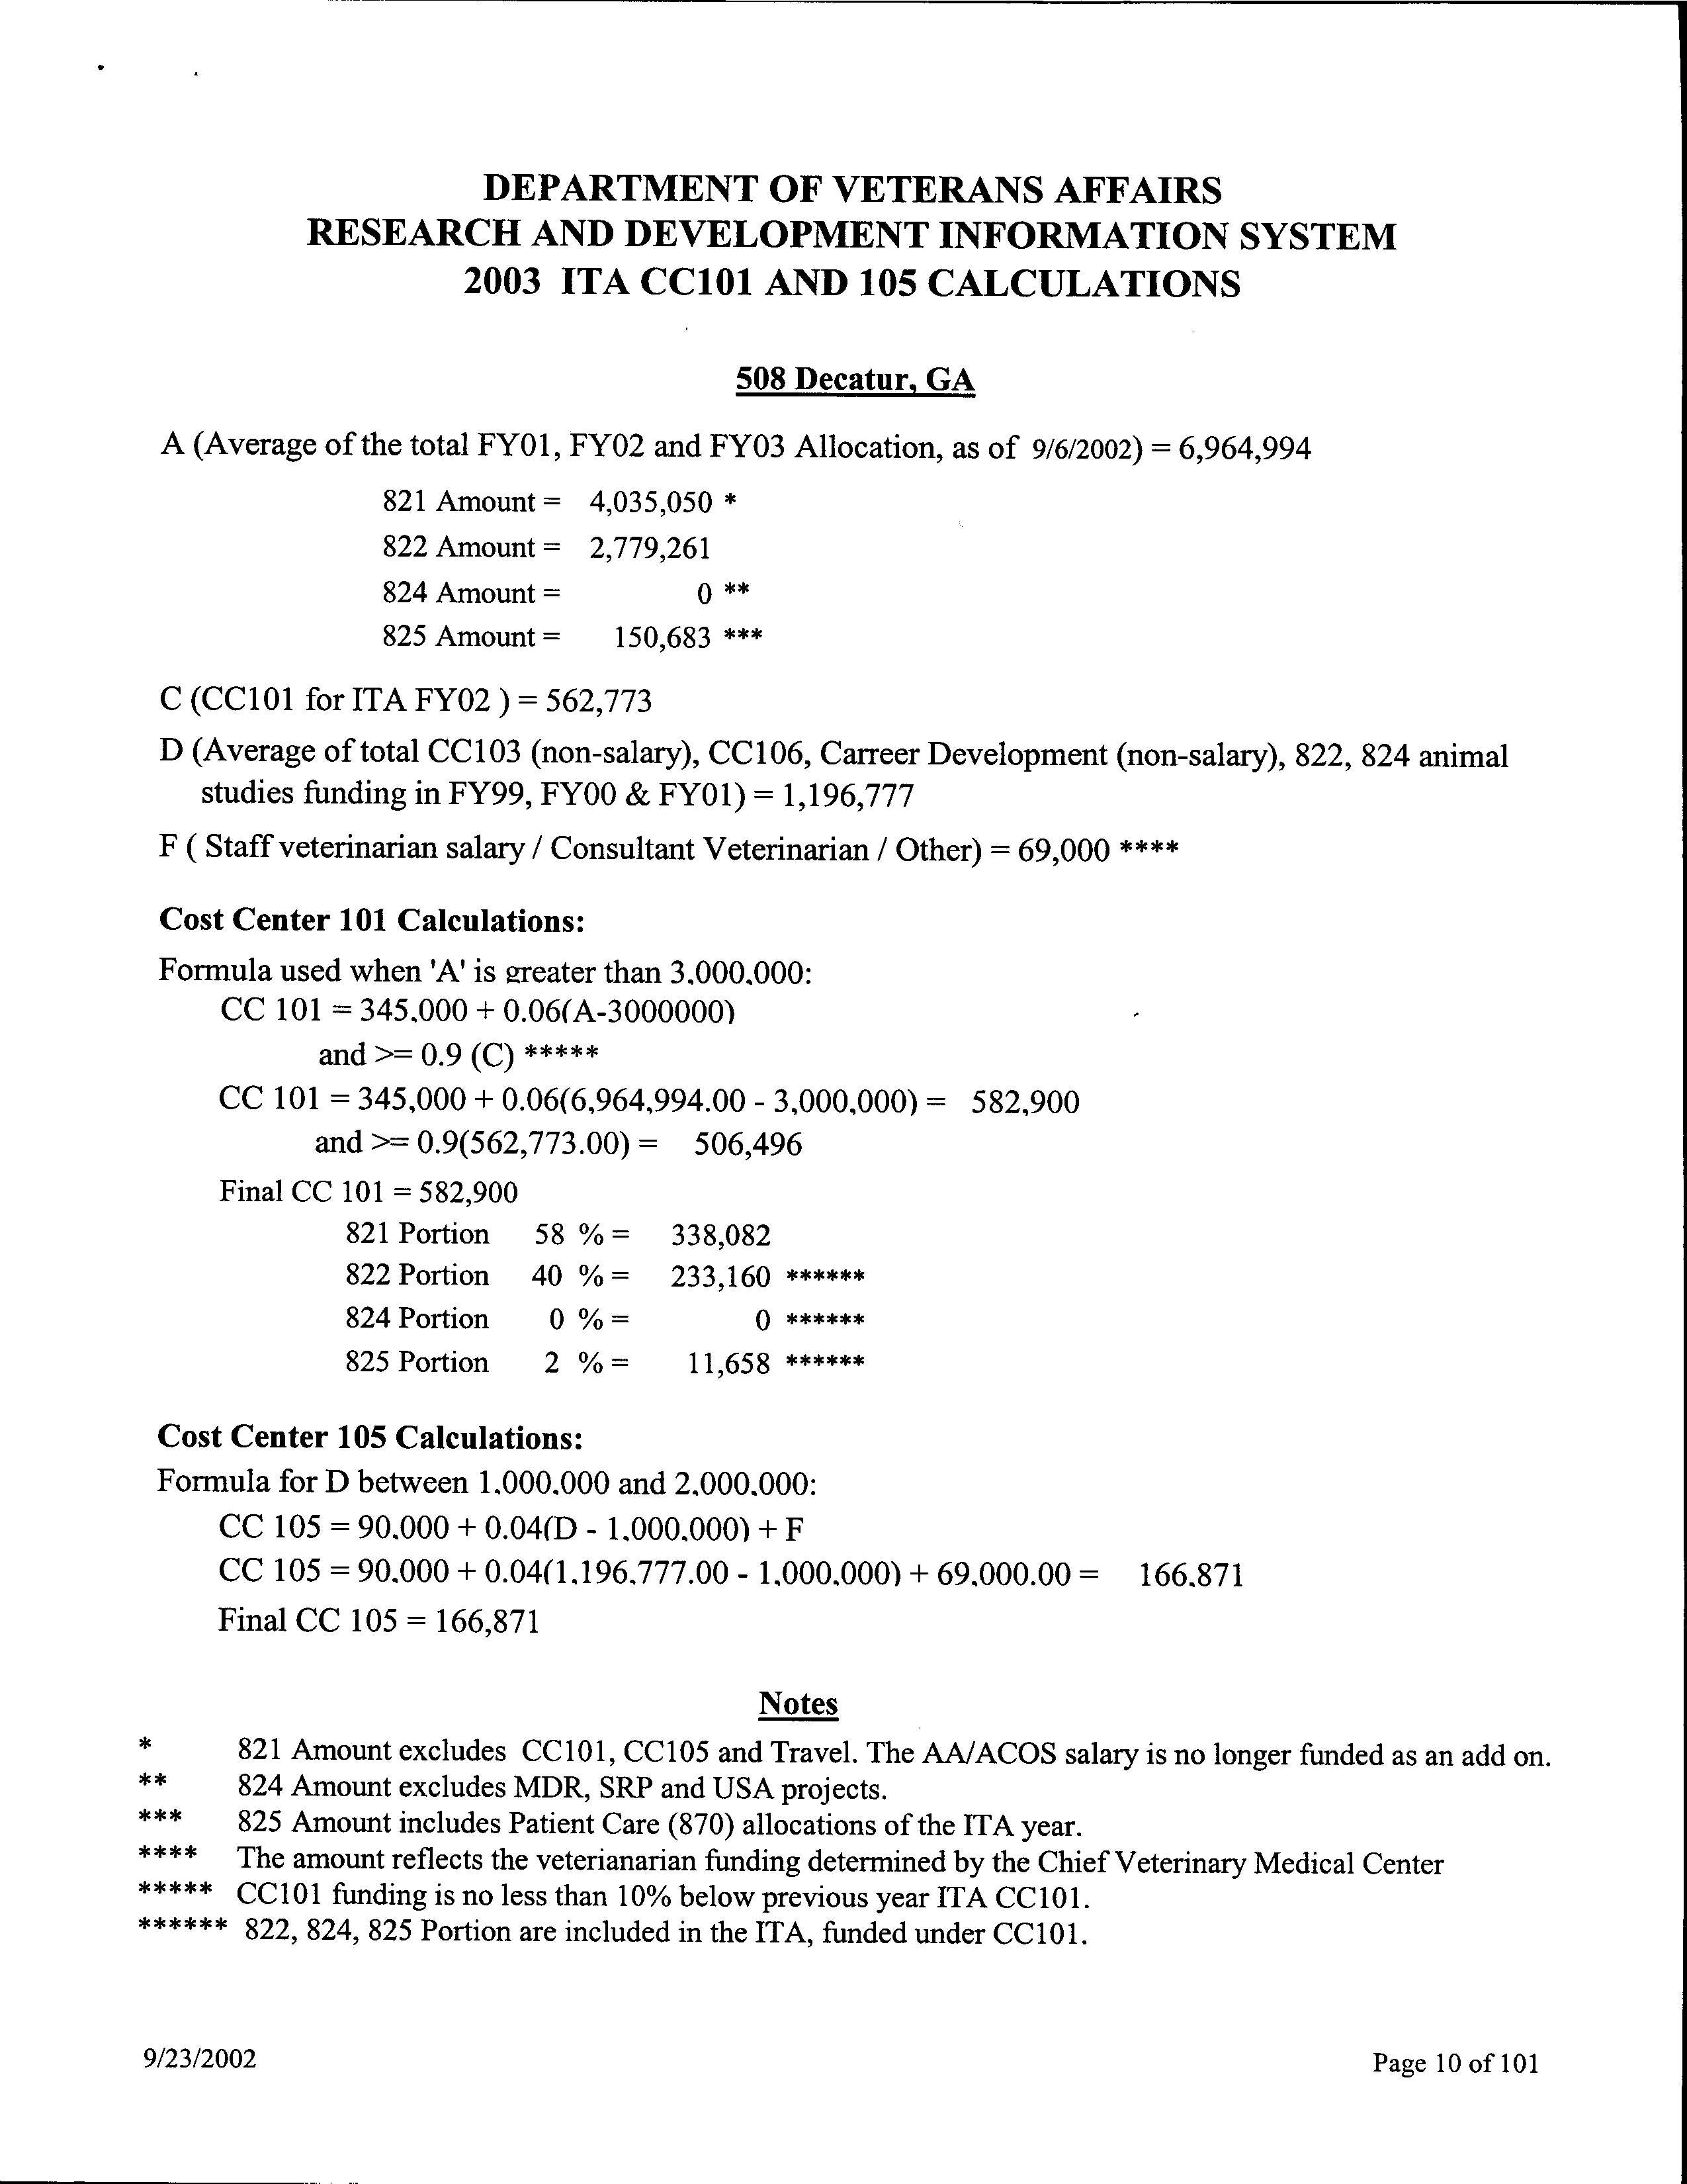
Section 2: Calculating CC101 - 2003

Slide 17
Section 2: Calculating CC101 - 2022
The base figure for CC 101 funds disbursed to each facility is calculated based on the average (A) of the last 3 years of executed total obligations across all Research Programs. The CC101 formula was updated for FY20 to better support small and medium size research activities. The “A” factor will now be the average of the past three years of obligations and $150,000 was established as a base level of CC101 support.
The base figure for CC 101 is calculated using the following formula:
• If A < 0 – 50,000, CC 101 amount = 0
• If A is $50,000 to $100,000, CC 101 = $150,000 + 0.11 (A)
• If A is $100,000 to $250,000, CC 101 = $150,000 + 0.21 (A)
• If A is $250,000 to $500,000, CC 101 = $200,000 + 0.31 (A - $250,000)
• If A is $500,000 to $1,500,000, CC 101 = $275,000 + 0.11 (A - $500,000)
• If A is $1,500,000 to $3,000,000 CC 101 = $300,000 + 0.08 (A - $1,500,000)
• If A > $3,000,000, CC 101 = $400,000 + 0.047 (A - $3,000,000)
“A” equals the average obligations at the facility for the previous three years.

Slide 18
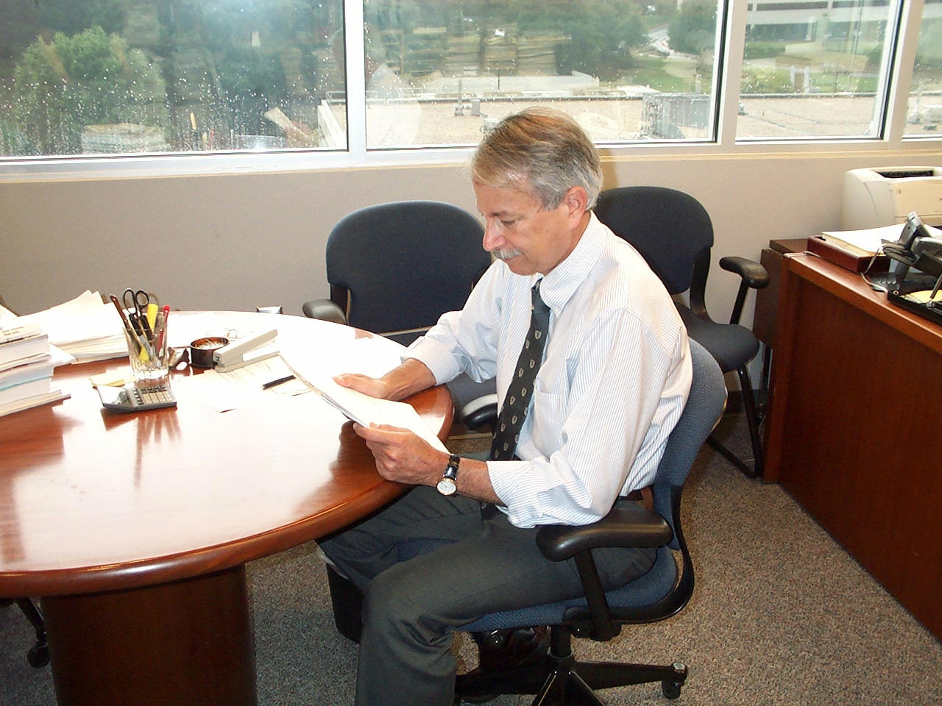
Section 2: AH! The ITA is here, I wonder if we have enough in 101?

Slide 19
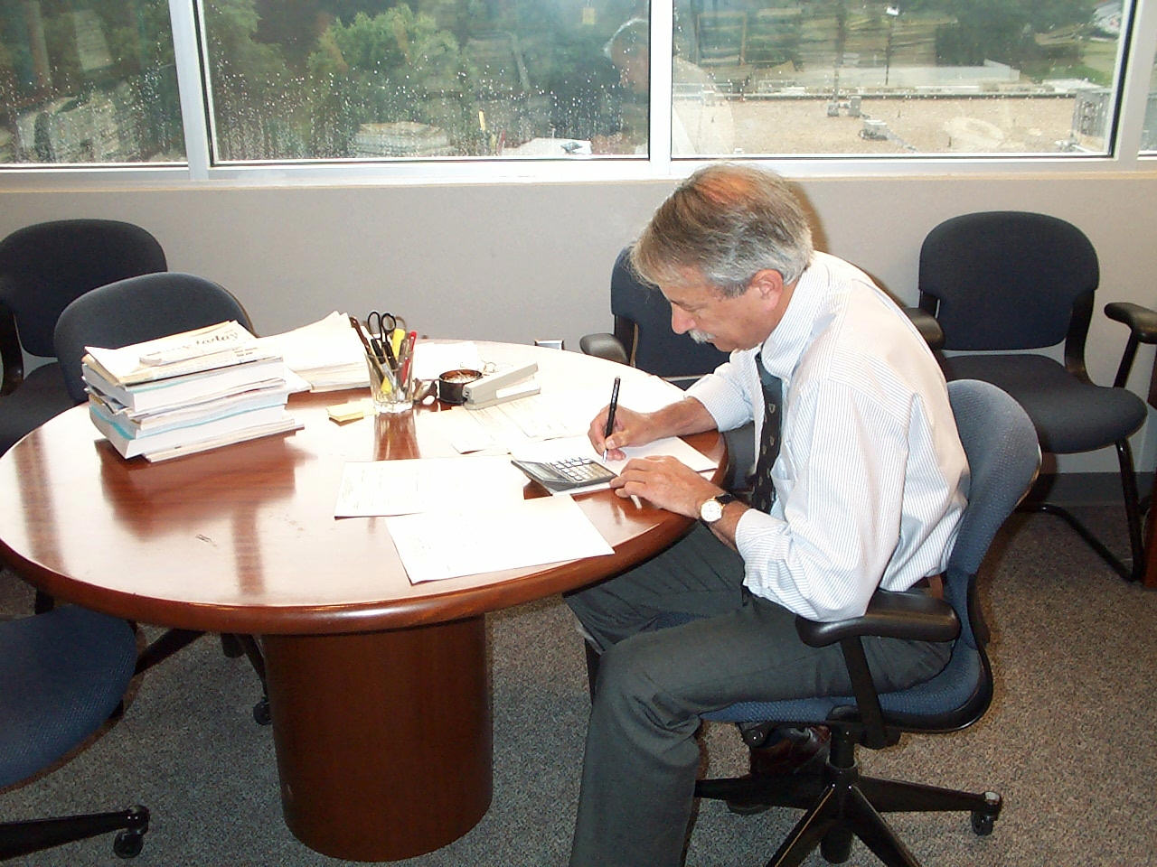
Section 2: Let me see here, you take your 103 add your 106 and 108
Divide by x subtract Y

Slide 20
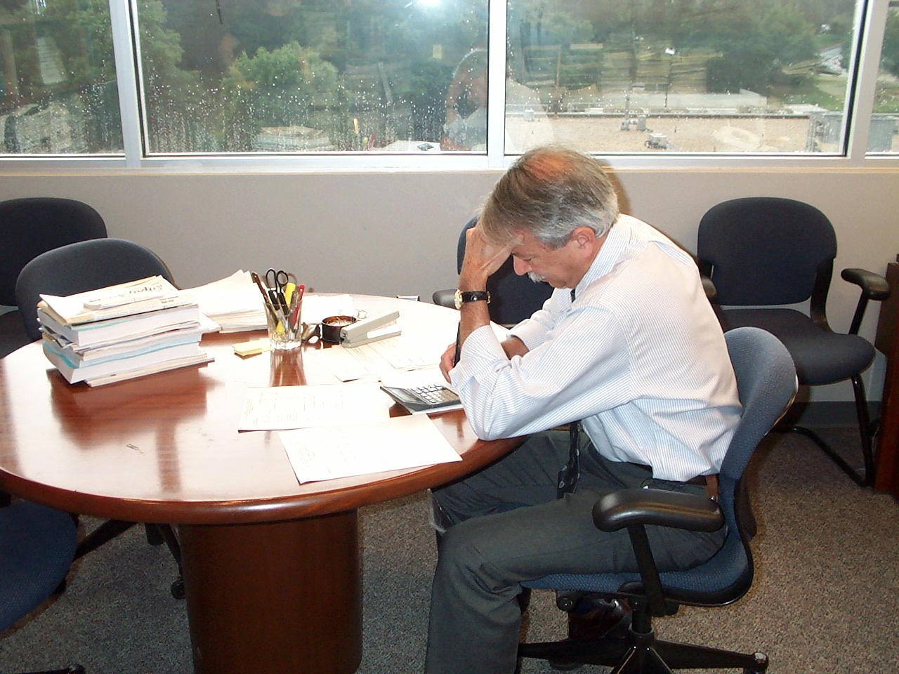
Section 2: HMMM! Who the heck thought this up!!!!!! Must be
Some Administrator!!!!

Slide 21

Section 2: Hey, this should be Tony’s job!!!! Let him figure it

Slide 22
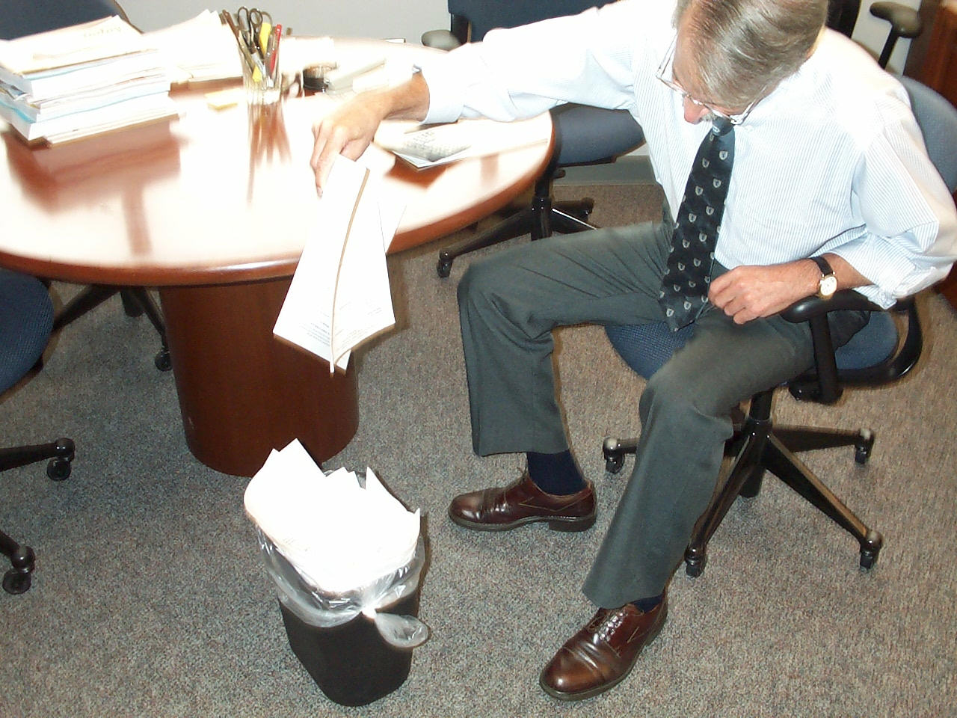
Section 2: I’m not worried about it, compliance, reports, service contracts
Purchasing, HR, and all for <10%…..Not bad!!!!

Slide 23
Section 3: The Updated CC 101 Model
With input from the field and our own thoughts, we did not feel that current 101 model was enough?
  If not, expand
  What do you use it for?

Slide 24
Section 3: We did not
With the new initiative and the increase in compliance and the overall changes since the 1980s, it was time to really look at it again.
  1990 – Allocations
  2022 - Expenditures
People and needs based

Slide 25
Section 3:So what is the new CC 101 model composed of?
A proposed solution is to develop the CC101 allocation based on discipline needs. Breaking out the formula into 5 different components will allow coverage of staff in the appropriate areas. In addition, funding for other support costs will be added as need. The model would support the following:
Admin officer and 1 PSA
Committee Managers
Grants Manager
Budget Office
HR/WOC support
Other support costs for service contracts etc.

Slide 26
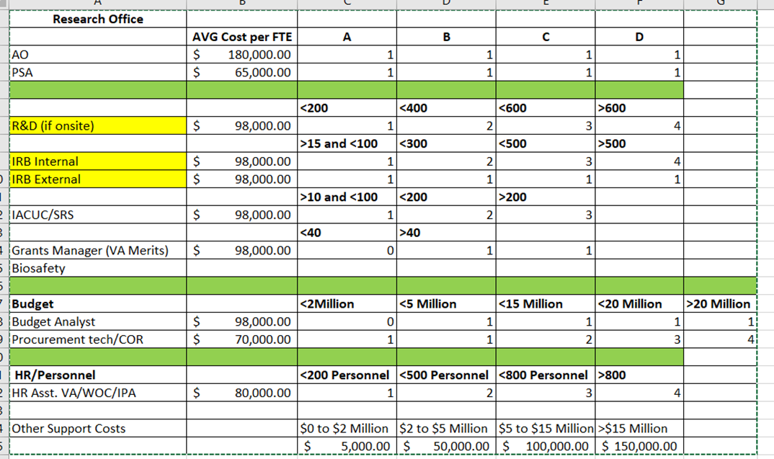
Section 3:So what is the new CC 101 model composed of?

Slide 27
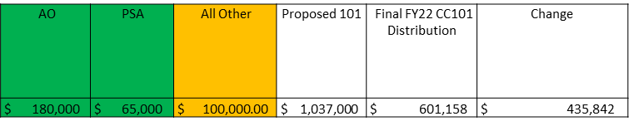
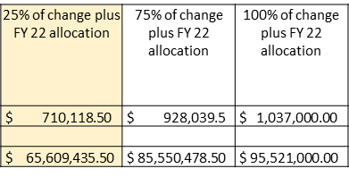
Section 3: So what is the new CC 101 model composed of?
Committees (R&D, IRB, IACUC, Projects) | Total for committees Amount | Personnel Value | Personnel Amount | Analyst | Asst. | Analyst | Asst | Grants Manager | Value | Grant Mngr Amount
3 | $ 294,000 | 2 | $ 160,000 | 1 | 2 | $ 98,000 | $ 140,000 | 20.5 | 0 | $ -

Slide 28
Section 3: Next Steps
Phased in over 3 years (25%, 75%, 100%)
Substantial increase in overall costs
Allow for staffing up over time
Allow for review and adjustment as needed

Slide 29
Section 3: FY 23 allocation
FY 23 allocation will be sent out as follows
  >Sites that did not receive 101 in 2022 will receive a notification from ORD for a discussion to determine if 101 is needed.
  Sites that received <350K in FY22 will be sent a request for a plan for utilization of the funds in FY 23.
  Sites that received >350K in FY will receive the funding with the expectation of full utilization by EOY.
A report will be required at the end of the year as part of the RDIS Annual Report
If at any time during the year, especially after reporting Q2 and Q3 expenditures reports, you will not spend down the funding then please return it for other uses.

Slide 30
Questions???????

