Slide 1
VA Innovation and Research Review System (VAIRRS)
Monthly Webinar
October 18, 2022

Slide 2

Webinar Housekeeping
Webinar
Housekeeping
Recording - This session is being recorded and the associated handouts will be available on ORPP&E’s Education and Training website within one-week post-webinar.
Close Captioning - Now available in the new Webex platform. Click the “CC” button at the bottom left of the Webex screen.
Experiencing Sound Issues? – Call in using the number in your Webex chat box or in your registration confirmation email.
Q&A - Please use the Q&A feature to submit questions.
  Be sure to send questions to “All panelists”.
  Questions will be addressed at the end of the webinar.
Webinar Archive - Most ORPP&E webinars can be found here: https://www.research.va.gov/programs/orppe/education/webinars/archives.cfm
Post-Webinar Evaluation Survey - We are grateful to all that complete the post-webinar evaluation survey. It will automatically pop up once the webinar is exited.
For questions, please use Q&A box and address to “All Panelists.”
All Webinars will be recorded and posted within one week.

Slide 3
Conflict of Interest (COI) Module for Investigators and Committee Members
Panelist:
Karen Jeans, PhD, CCRN, CIP Director of Regulatory Affairs, ORPP&E ORD | Christopher Britt, Esq. Program Director, Research Integration and Training Ethics Specialty Team, Office of General Counsel | Antonio Laracuente, MBA Director of Field Operations ORD | Angela Foster Program Manager Enterprise Research Data Systems, ORPP&E ORD

Slide 4

Bottom Line Up Front (BLUF)
Use of the Research COI module is OPTIONAL. There is no mandate to use the module or change your existing process.
An Office of Research and Development (ORD) Directive on Research Financial COI is not just published; ORD does not have a date for publication.
This webinar is to provide an overview of the IRBNet COI module. Sites may determine locally whether to use the IRBNet COI module.

Slide 5
Research Conflict of Interest (COI) Module for Investigators and Committee Members
  Create a new COI Disclosure
  Link Disclosure forms for submission
  Submit Disclosure forms
  View the status of a Disclosure
*The COI Module is OPTIONAL. There is no mandate to use the module or change your existing process.

Slide 6

Research Financial Conflict of Interest (COI) Module
The purpose of the IRBNet Conflict of Interest (COI) Module is to serve as the smart form version of the OGE 450 Alternative VA (“OGE 450 alt-VA”) COI disclosure form and support the COI review process.
Use of this module is OPTIONAL.
Today’s webinar will provide an overview of the investigator submission process and give an overview of the committee tools.
FCOI Administrator training will be provided if your
site chooses to use the IRBNet COI module.

Slide 7
Research Conflict of Interest (COI) Module for Investigators and Committee Members
  Create a new COI Disclosure

Slide 8
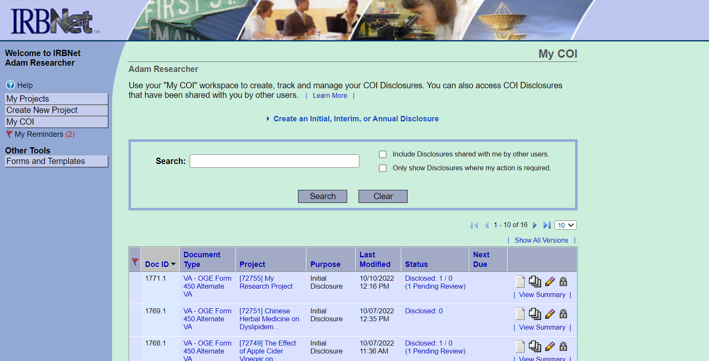
My COI Page

Slide 9
My COI Page

Slide 10
My COI Page

Slide 11
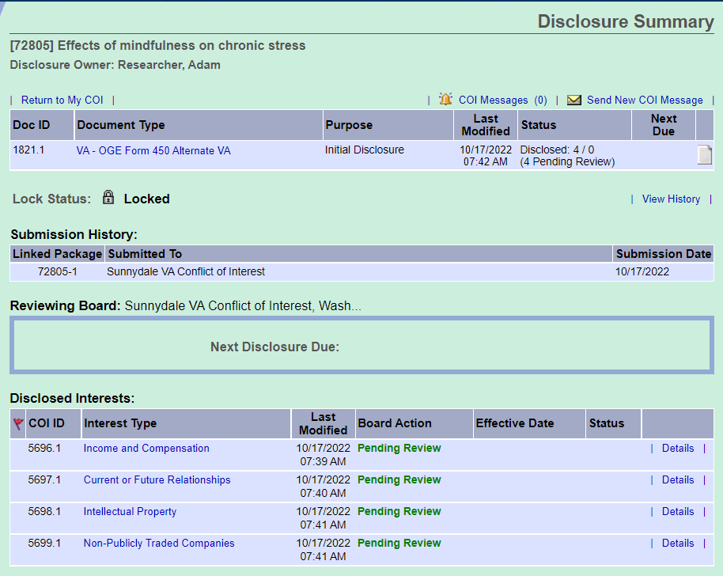
Disclosure Summary Page
The Disclosure Summary page includes all information for the submission.
Summary of the Disclosure submission
Boards to which the COI disclosure has been submitted
Interests that were included in the disclosure submission and the review status.

Slide 12
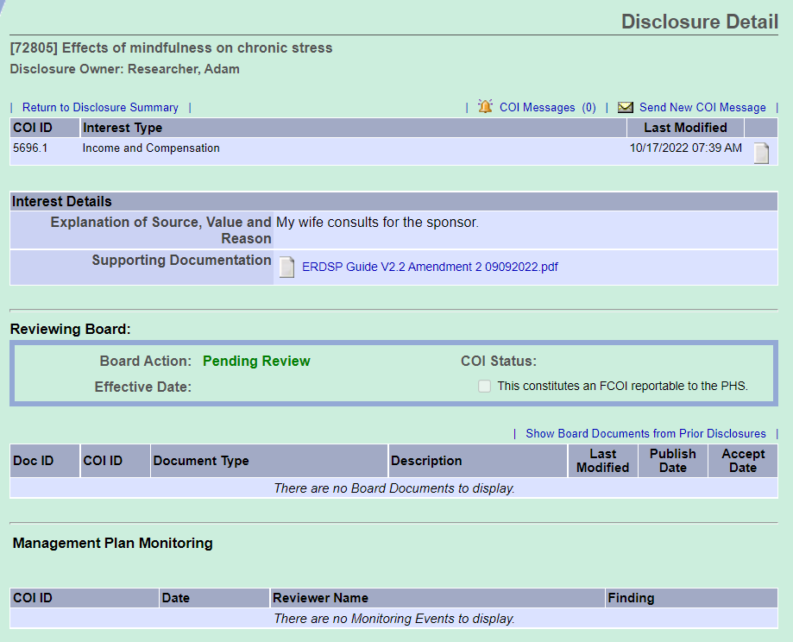
Disclosure Detail Page
The Disclosure Detail page includes all information for each interest.
Interest type
Interest details that were entered
when completing the OGC 450 alt-VA smart form at attached documents
Review status
Documents that were published by
The COI Administrator
Management Plan details

Slide 13
Create a New Research Financial COI Disclosure
To create a new OGE 450 alt-VA form, simply click “Create an Initial, Interim, or Annual Disclosure.”

Slide 14
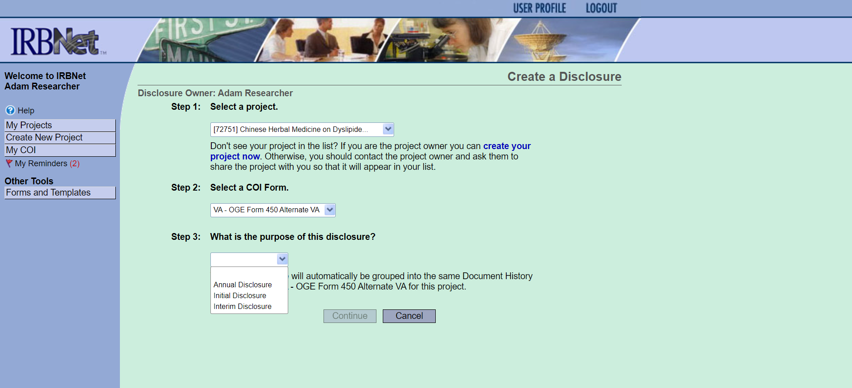
Create a New Research Financial COI Disclosure
Once you click the “Create an Initial, Interim, or Annual Disclosure”, you are routed to the Create a Disclosure page and have the option to select the appropriate project, COI form, and the purpose of the disclosure.

Slide 15
Create a New Research Financial COI Disclosure
After you selected the criteria for your disclosure, you are then taken to the smart form version of the OGE 450 alt-VA.
*Example of completed OGE 450 alt-VA form where no disclosures were indicated.

Slide 16

Research Conflict of Interest (COI) Module for Investigators and Committee Members
  Create a New COI Disclosure
  Link Disclosure forms for submission

Slide 17
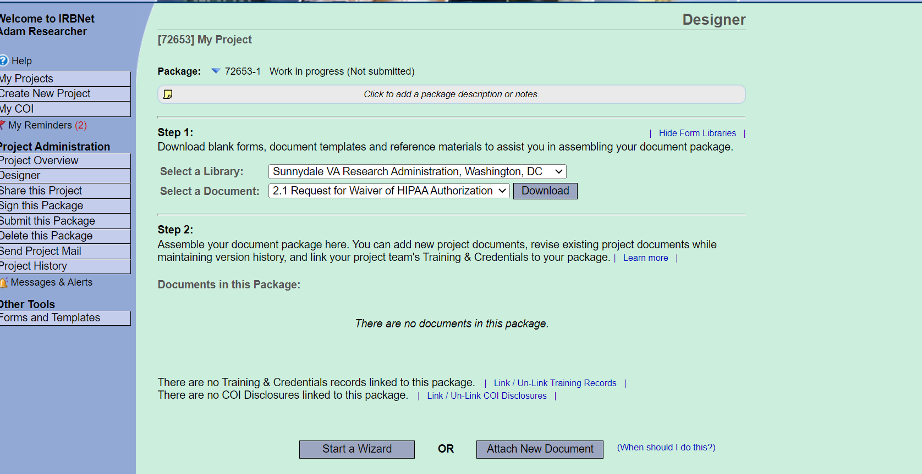
Link Disclosure forms for submission

Slide 18
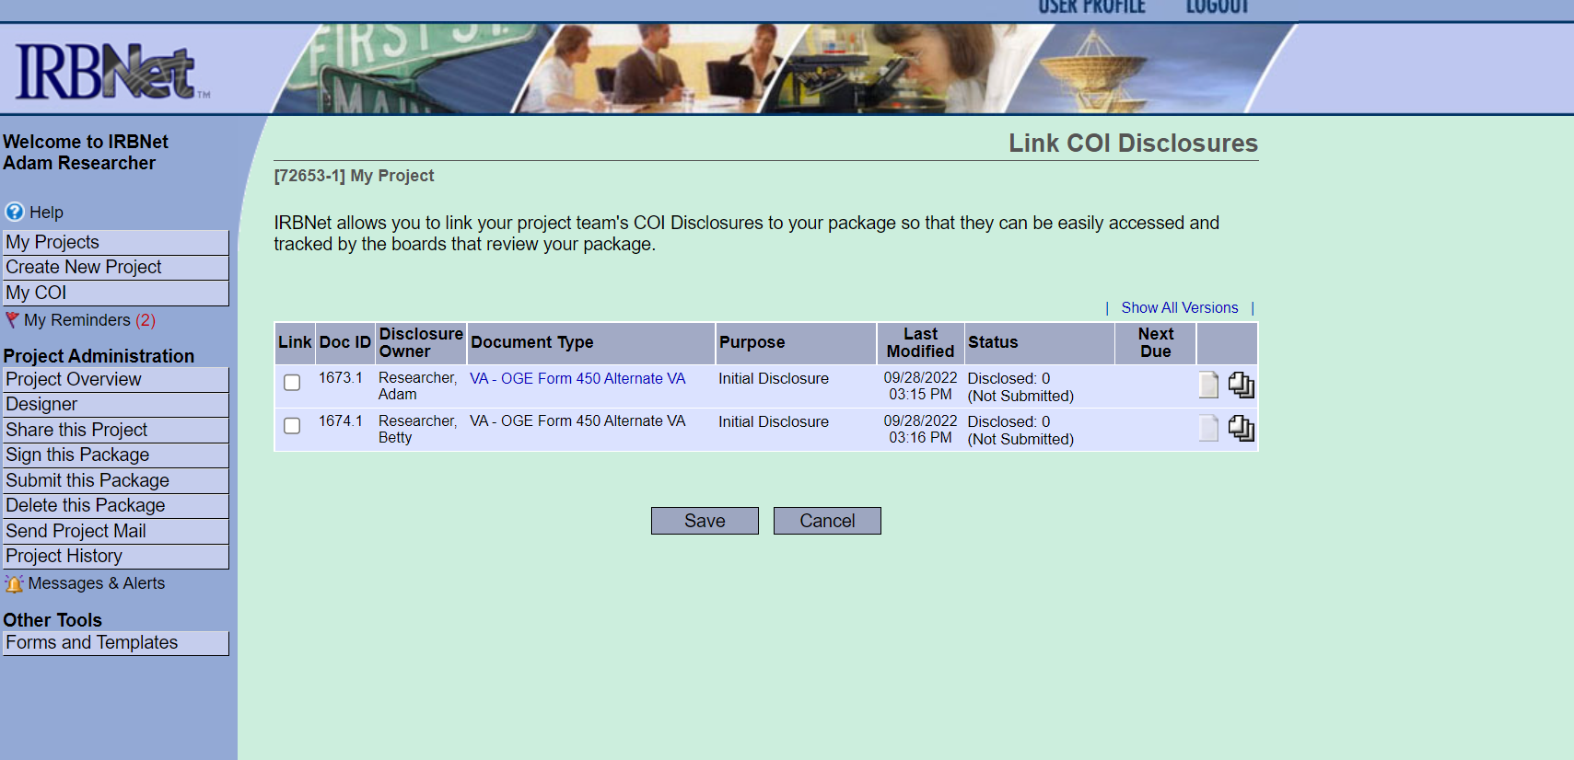
Link Disclosure forms for submission
Once you click “Link/Un-link COI Disclosures”, you will be presented with a list of disclosures for every study team member with access to the project. Select the OGE 450 alt-VA forms that you want to submit and click “Save”.

Slide 19
Research Conflict of Interest (COI) Module for Investigators and Committee Members
  Create a New COI Disclosure
  Link Disclosure forms for submission
  Submit Disclosure forms

Slide 20
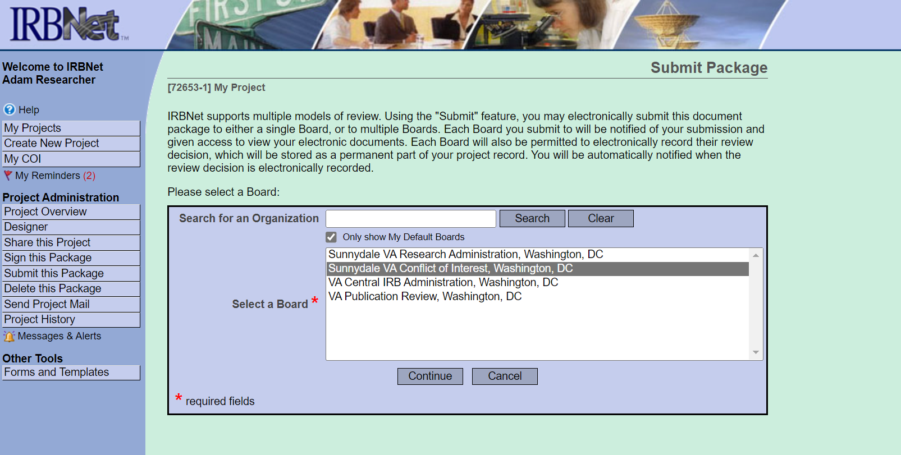
Submit Disclosure Forms
After all required disclosure forms are linked to the package, click the “Submit this Package” button, and select your facility’s COI workspace. Packages containing disclosure forms should only be submitted to the COI workspace. It is the responsibility of the project owner (someone with “Full” access) to submit the package. Always follow local COI SOPs.

Slide 21
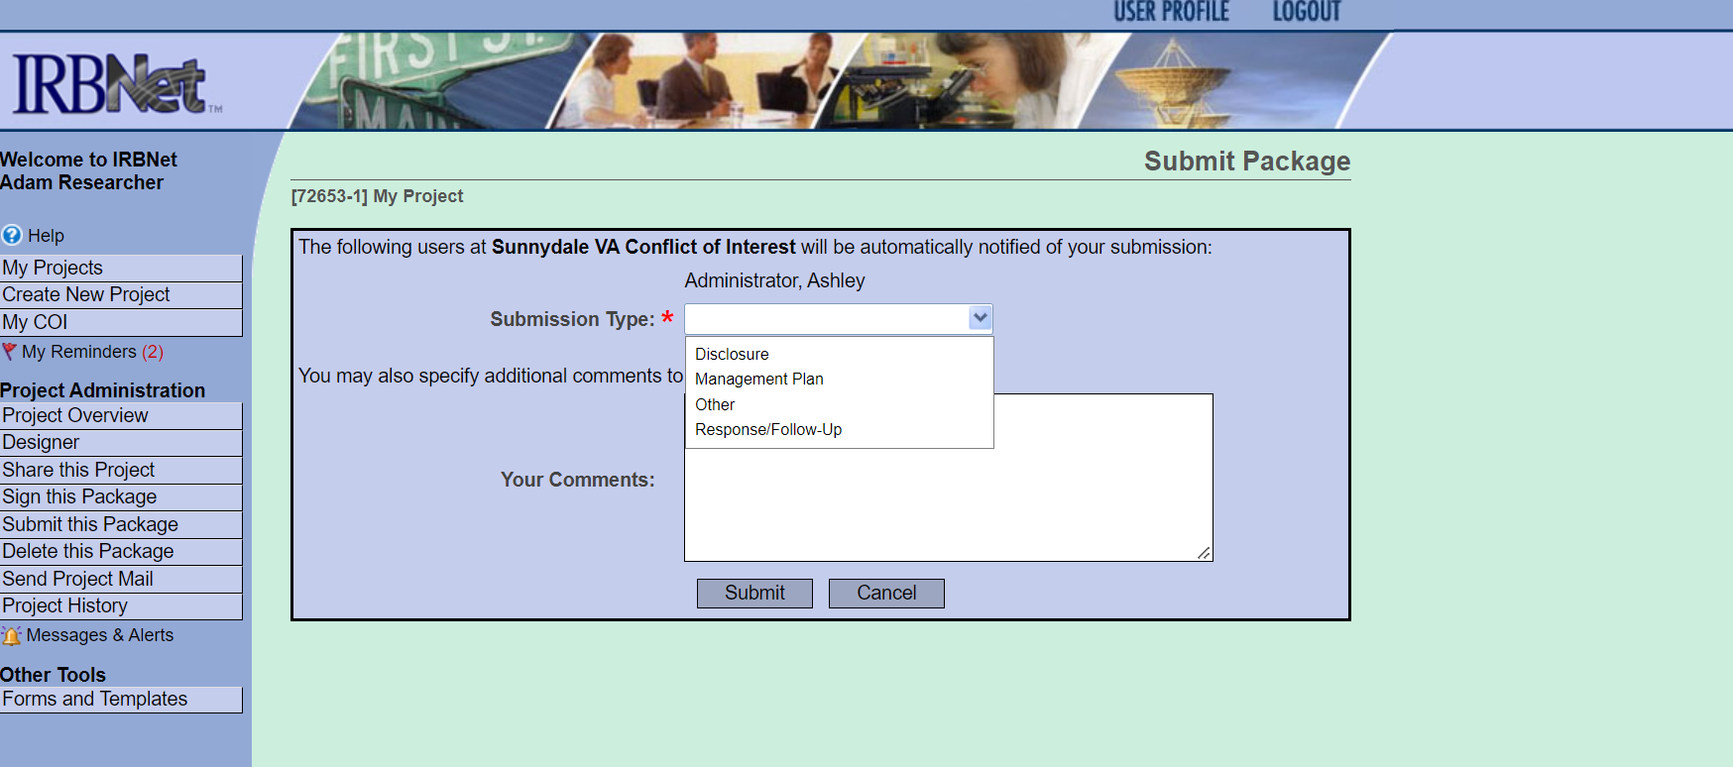
Submit Disclosure Forms
While submitting the disclosure, you can select the submission type as “Disclosure” and add comments.

Slide 22
Research Conflict of Interest (COI) Module for Investigators and Committee Members
  Create a New COI Disclosure
  Link Disclosure forms for submission
  Submit Disclosure forms
  View the status of a Disclosure

Slide 23
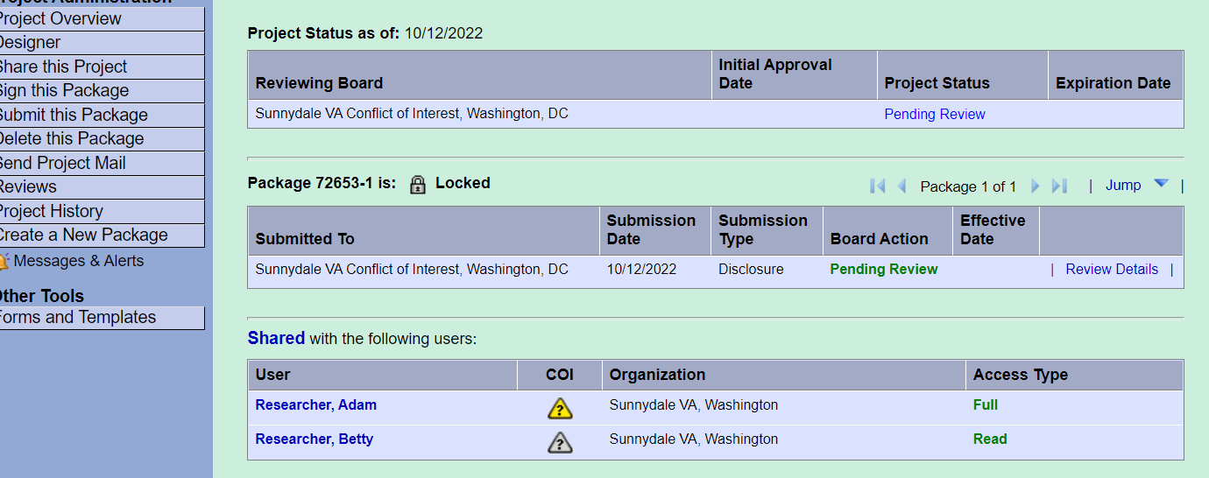
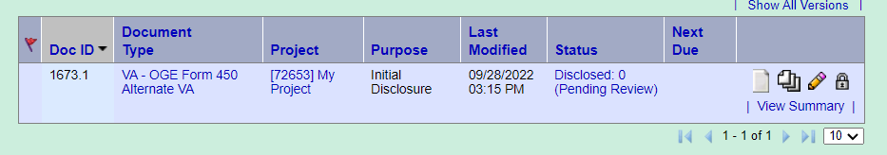
View the status of a Disclosure
Project Overview Page
View status of COI submission package
View status of each study team member’s COI review
My COI Page
View status and details of your COI submission

Slide 24
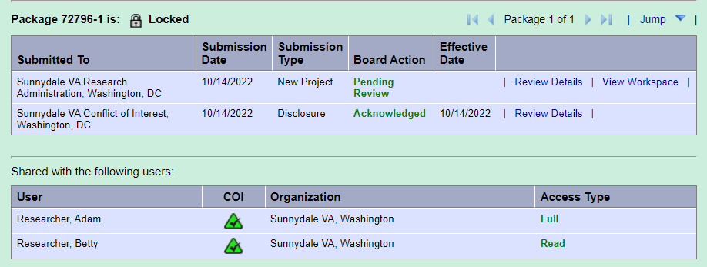
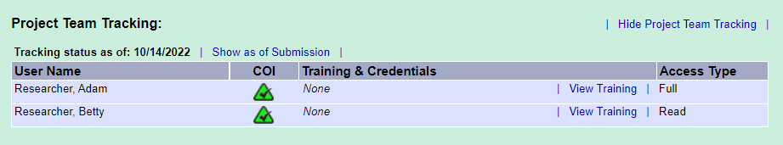
View the status of a Disclosure
The oversight committee(s) can view the COI status on the Project Overview page or on the Submission Detail page under Project Team Tracking.

Slide 25
Research Conflict of Interest (COI) Module for Investigators and Committee Members
  Create a New COI Disclosure
  Link Disclosure forms for submission
  Submit Disclosure forms
  View the status of a Disclosure
*The COI Module is OPTIONAL. There is no mandate to use the module or change your existing process.

Slide 26
Frequently Asked Questions
Q. What if my project isn't listed when I try to create my new COI Disclosure?
The list includes all the projects that you have access to in IRBNet. These are the same projects that are listed on your My Projects page. If you don't see your project listed, then there are two things you can do:
  • If you are the project owner but you have not yet created your project, do so before proceeding. To create a project, click the "Create New Project" option on the left menu.
  • If you are not the project owner, contact the project owner (typically the study coordinator or PI) and ask them to share the project with you in IRBNet. The project owner may need to create the project if they haven't already done so.
Q. What if a study team member isn’t listed when I try to link their disclosure?
Either they have not been shared on the project, or they have not completed their disclosure form.
Q. Where can I get help with questions about a disclosure or how to submit a disclosure?
A. For sites that choose to use the COI module, contact your local facility’s COI Administrator.

Slide 27
Questions?

