Slide 1

Interagency Agreements in Research
October 19, 2022
Jason Berlow, ORD IAA Manager, Finance
Tony Laracuente, Director, Field Operations
Kari Points, AO-Research, Iowa City VAMC
John Verwiel, Deputy Director of Finance

Slide 2
Objectives – for today’s training
Training Section: | By the end of this section, you will:
Section 1: Understanding an Interagency Agreement (IAA) | Understand what is an external vs internal IAA Understanding when an IAA is required Understand the role of G-Invoicing Understand who is the buyer and who is the seller Understand what is the legal authority for IAAs
Section 2: The Components of an IAA | Understand all the components of an IAA package Understand the Form 7600A (General Terms and Condition) and Form 7600B (Order) and how these impact G-Invoicing Understand what is a Statement of Work (SOW) Understand the other required documents for Requesting Agency (Buyer) Only
Section 3: Setting up the IAA | Understand the roadmap to secure an IAA Understand the roles between agencies
Section 4: Understanding Traditional Reimbursements vs advance collection and IAAs with NPCs | Understanding Traditional Reimbursement and Advance Collections Understanding how funding is transferred to the NPC
Q&A
Notes:
John

Slide 3

Section 1: Understanding an Interagency Agreement
Help!! Our team needs to setup an IAA for our Station, we can login together for this training!

Slide 4
What types of IAAs do we have at VA?
Interagency agreements is the term used to describe the procedure by which an agency needing supplies or services obtains them using another agency’s resources.
At VA we typically have two types of agreements:
External to VA IAAs (Interagency agreements) | Internal to VA IAAs (Intra-Agency Agreements )
Typically involve two government agencies: the requesting agency, which is the agency with the requirement, and the servicing agency which supplies, or services are exchanged from one to the other (i.e., between NIH and VA). | Referred to activity inside the VA where supplies or services are exchanged from one to the other (i.e., between the Clinical Appropriations and Research).

Slide 5
When is an Internal VA IAA required?
Required | Not Required
Purchasing a service or supplies from another department at your VAMC, such as pharmacy, MRI, X-Ray or laboratory tests. | Splitting Salary Cost between Research and Clinical, should be done by cost transfers and NOT an IAA/G-Invoicing. Cost transfers are the appropriate method when salary is involved for employees that would otherwise be split in appropriations and no tangible services are involved. VHA Finance and FSC have instructed ORD that this activity does not represent an exchange of supplies or services (buy/sell transaction) which would require an IAA.

Slide 6
What is Government Invoicing (G-Invoicing)?
Prior to FY 22, all internal and external IAAs used paper forms (i.e., 2269 and 7600A/B), however a VA-wide implementation of G-Invoicing (a federal government wide system to manage ALL IAAs) has begun.
The first phase was in FY 22 where all internal IAAs were mandated to be submitted through G-Invoicing replacing the 2269.
For FY 23, External agreements with other Federal agencies will be added to G-Invoicing by October 1, 2022, dependent on the readiness of the other federal agency.
Each station has a user administrator who sets roles in G-Invoicing (typically your Fiscal).
G-Invoicing maintains the same Treasury Forms (7600A/B), it just manages all the information in an electronic system.
G-Invoicing is not an accounting or procurement system. Financial transactions must still be recorded in FMS.
Training videos are available at the following link: FSC G-Invoicing Training Videos
The Financial Services Center (FSC) Intragovernmental Accounting Division maintains a SharePoint with more resources on G-Invoicing.
Notes:
John
Note: We need to be clear that cost transfers for split salaries such as CDAs or coordinators do not constitute a need for an intra- you have to be buying services such as lab, x-ray etc. Also, may want to put across appropriations for intra-

Slide 7
Who’s the buyer and who’s the seller?
Requesting Agency (Buyer): | Servicing Agency (Seller):
Requesting Agency (or office or appropriation)—analogous to “Buyer” The agency receiving the services or supplies Subject Matter Experts (SMEs) will determine based on their requirements if they need an IAA. Must be a Federal Agency. | Servicing Agency (or office or appropriation)—analogous to “Seller” or “Vendor” Subject Matter Experts (SMEs) will determine based on their capabilities they can offer service or supplies. Must be a Federal Agency.
Key Takeaway: An NPC cannot directly enter an IAA with another Federal Agency because it is not a Federal Agency. VA has authority to transfer IAA funding to the NPC (through Section 7364(b)(1) of Title 38) for this activity

Slide 8
What are the types of IAAs?
There are two types of interagency acquisitions:
Direct acquisition (most common IAA): The requesting agency places an order directly with the servicing agency’s that will directly provide a good/service. This does not require a Contracting Officer. This includes an IAA that transfers funding to the NPC.
Assisted acquisition (less common): The servicing agency and requesting agency enter into an interagency agreement pursuant to which the servicing agency performs acquisition activities on the requesting agency’s behalf, such as awarding a contract, task order, or delivery order. This requires a Contracting Officer (CO).
Key Takeaway: Negotiating the terms of IAAs and seeking the approvals between federal agencies is a very time intensive process, thus we recommend commencing negotiations multiple months prior to the need for the IAA Period of Performance to start.
Notes:
John

Slide 9
How is an IAA structured?
There are two main parts to an IAA, corresponding to each of the purposes:
  All IAAs must have clearly enumerated terms and conditions, requirements information, and funding information. However, the level of detail will vary based on the breadth of assistance to be provided (e.g., the period over which assistance will be provided, the number of offices requiring assistance) as well as the complexity and dollar value of the requesting agency’s individual requirements.
  The IAA must establish general terms and conditions (7600A) that govern the relationship between the requesting agency and the servicing agency.
  The IAA provides information that is required to demonstrate a bona fide need and authorize the transfer and obligation of funds (through the Order document, 7600B).

Slide 10
What legal authority authorizes IAAs?
The Economy Act (31 U.S.C.1535) authorizes agencies (in this case VA) to enter into agreements (7600A) to obtain supplies or services from another agency.
The Economy Act also provides authority for placement of orders (7600B) between federal agencies.
The Economy Act applies when more specific statutory authority does not exist (17.502-2 The Economy Act).
Key Takeaway: The Economy Act authorizes these buy/sell transactions between federal agencies, an IAA is NOT simply a method to transfer funding without an exchange of supplies or services

Slide 11
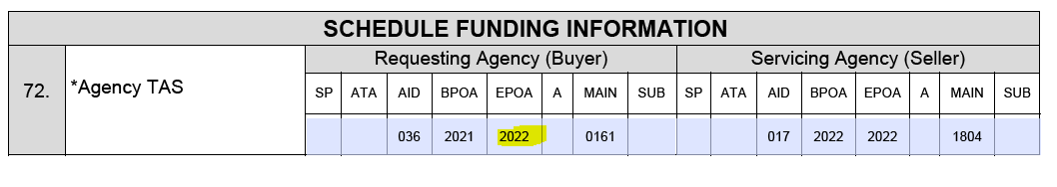
Economy Act Deobligation Requirements
The Economy Act requires funds received (from the Buyer Agency) where services have not been fully utilized be deobligated before the appropriation for the funding in the agreement expires. The specific criteria for determining when these deobligations must occur is provided in 31 United States Code § 1535 (Economy Act).
Key Takeaway: Obligating fund received through IAA must be applied the appropriation received and the obligation period cannot be extended beyond that period of availability.
Example from Order Form (7600B):
The available of funding expires on 9/30/22, thus it must be obligated or returned prior to 9/30/22

Slide 12
How do I determine if an IAA is necessary?
To determine if an IAA is necessary, you must determine if the requirement satisfies the Bona Fide Needs Rule (31 U.S.C. 1502(a)):
  The obligation must satisfy a need of the Research Mission that arose during the period of availability and must meet the purpose and availability of funds established in the Research appropriation (See Appendix D).
  The services that Research plans to purchase from another agency under the Economy Act IAA will be a “necessary expense” of the Medical & Prosthetic Research appropriation.
  The Medical & Prosthetic Research account is legally available to fund the necessary expenses in carrying out Research’s Program (38 U.S. Code § 7303 - Functions of Veterans Health Administration: research programs).

Slide 13


Section 2: The Components of an IAA​
I was told ORD Finance would provide guidance about what should be included in an IAA to purchase stapling services at my station!

Slide 14
Required IAA Forms/G-Invoicing Requirements
Requirement | Description
7600A (General Terms and Condition) Paper Form or G-Invoicing | The 7600A describes the general terms and conditions that will govern the relationship between the requesting agency and the servicing agency. The 7600A (GT&C) includes the responsibilities and respective roles that each party must carry out to ensure the effective management and use of an interagency contract.
7600B (Order) Paper Form or G-Invoicing | Requirements and funding information. The 7600B (Order) provides specific information on the requesting agency’s requirements sufficient to demonstrate a bona fide need. It also includes financial information that is required to authorize the transfer and obligation of funds for both the acquisition and the assistance provided by the servicing agency in connection with the acquisition.
Statement of Work (SOW) Can be uploaded to G-Invoicing | Use when the General Terms and Conditions (GT&C) does not provide enough detail and to include: Purpose Expectations of both agencies Schedule of deliverables with due dates Standard OGC IAA language Points of Contact for each agency
Other Required Documents for Requesting Agency (Buyer) Only | Determinations & Findings Memo (FAR 17.502-2(c)(3)) Obligation Document 1358 Funding Document, if VA is the Requesting Agency

Slide 15
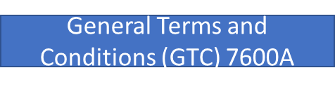

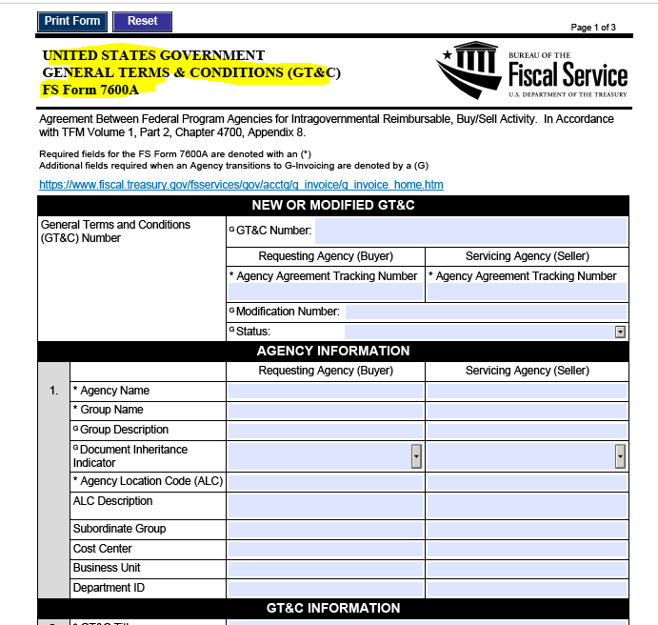
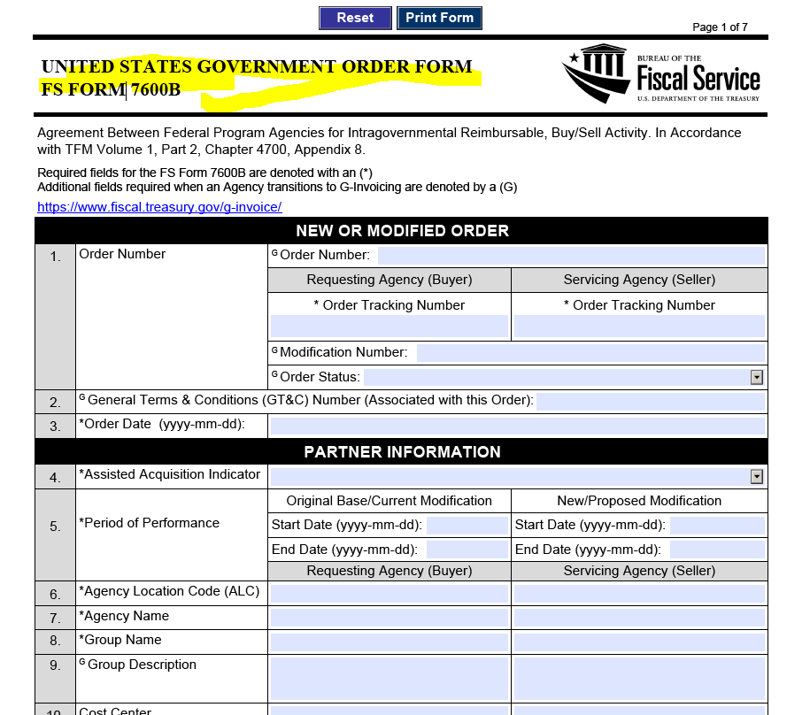
Paper IAA Forms (7600 A/B)
Key Takeaway: The required information submitted in the Paper Forms or G-Invoicing have the same requirements

Slide 16
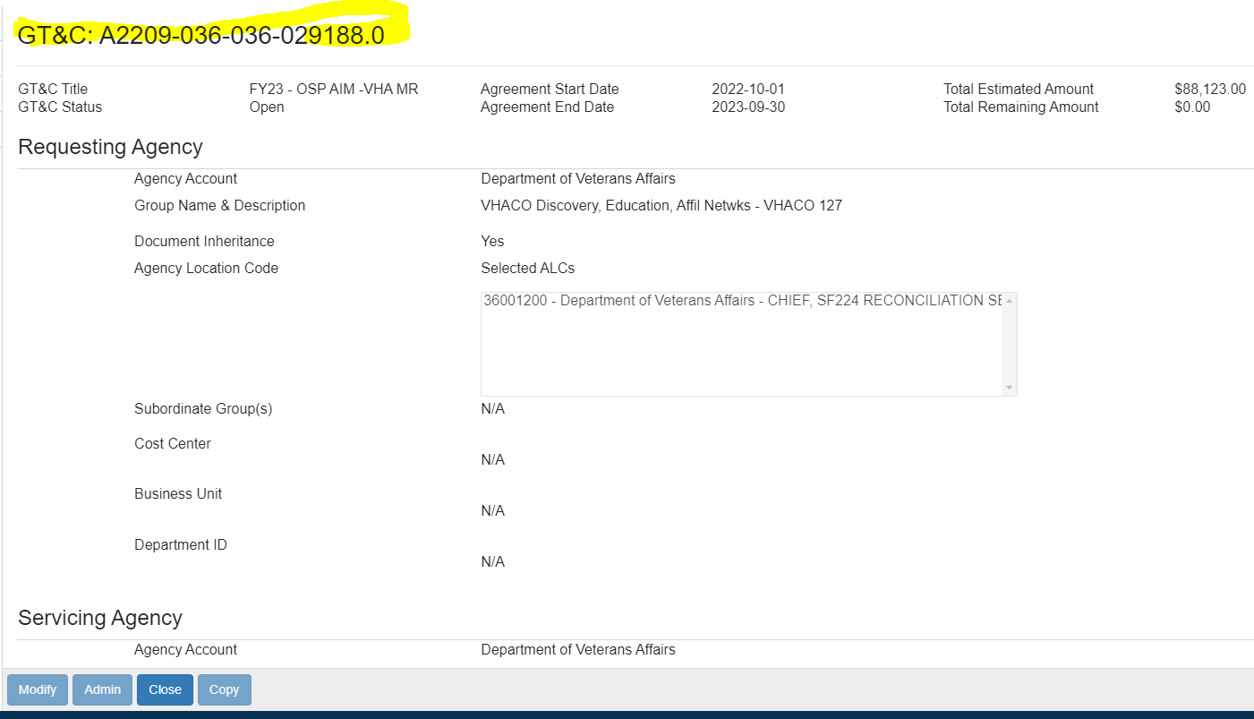
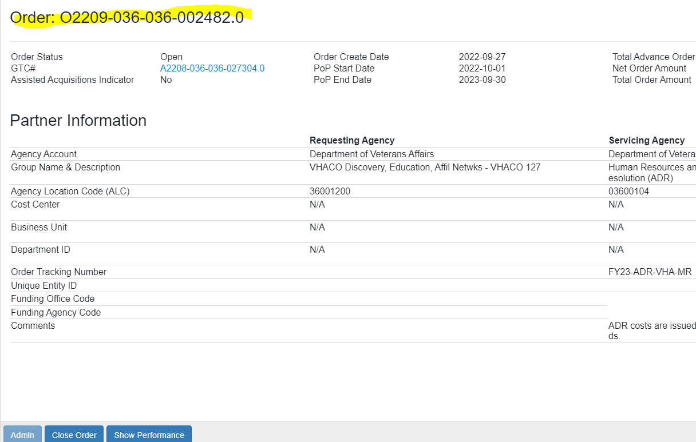
G-Invoicing Electronic Forms (7600 A/B)
Order Form (7600B)
Key Takeaway: The required information submitted in the Paper Forms or G-Invoicing have the same requirements

Slide 17
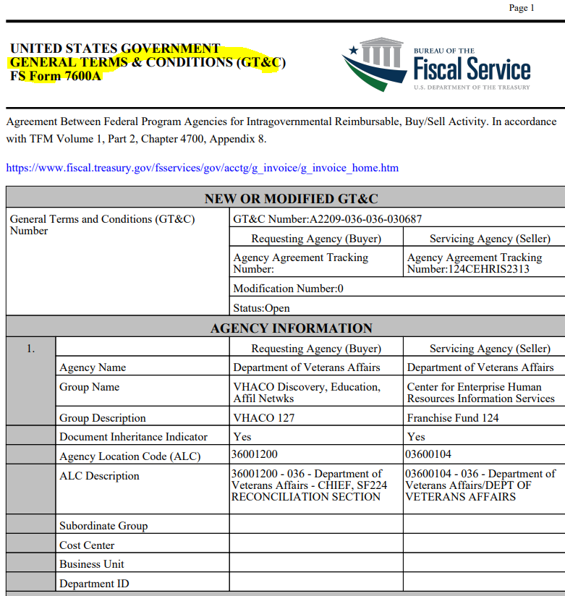
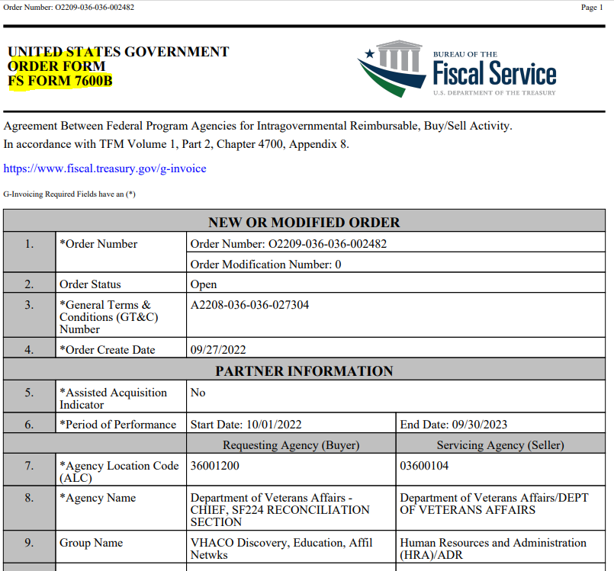
G-Invoicing Exported PDF Forms from System (7600 A/B)
Order Form (7600B)
Key Takeaway: The required information submitted in the Paper Forms or G-Invoicing have the same requirements

Slide 18
What is the purpose of the 7600A General Terms and Condition (GT&C)?
The purpose of the GT&C is to describe the products and services in order to establish a general understanding between the agencies.
  Where there will be an ongoing relationship of the types of services and products that management in the requesting agency is authorizing its personnel to acquire.
  The types of needs the servicing agency is prepared to acquire on behalf of the requesting agency.
The description of products and services in the GT&C is not intended to establish a bona fide need (established in the 7600B (Order)) and therefore may be as general or specific as the parties deem appropriate.
The delineation of roles and responsibilities is a critical component of the terms and conditions in the IAA.

Slide 19
When does the 7600A (GT&C) become effective?
The 7600A (GT&C) becomes effective when it is signed by authorizing officials of both agencies or such later date as specified in the agreement (either paper forms or G-Invoicing).
Do not commence the work before the IAA is signed, some review might need to occur!
However, a fiscal obligation is not created until the parties execute 7600B (Order), which requires the requesting agency to describe a bona fide need and to prepare funding documentation which must then be accepted by the servicing agency.

Slide 20
7600A (GT&C) - Period of Performance
It’s customary to have 5 years period of performance.
Recommendation: Select the period of performance based on your level of activity with the trading partner. If you have a yearly relationship with the trading partner, then a 5-year period of performance is suitable. Back dating is not allowed.
Do not make a one-year period of performance for a multi-year commitments, this creates extra work for your station. This is the purpose of the annual 7600B (Order).

Slide 21
7600B (Order): Requirements and funding information
What is the purpose of 7600B (Order) of the IAA? The 7600B (Order) typically documents the work performed and funding information for one year of the IAA. It is a requirements document to demonstrate a bona fide need. Its execution authorizes the transfer and acceptance of funds for typical one year of an IAA’s period of performance (in conjunction with a 1358 obligation document).
What information must be included in 7600B (Order) of the IAA? The 7600B (Order) must provide specific information on the requesting agency’s requirements sufficient to demonstrate a bona fide need. It also must include financial information that is required to authorize the transfer and obligation of funds.
When does 7600B (Order) become effective? The 7600B (Order) becomes effective when it is signed by authorizing officials of both agencies. The requesting agency incurs a fiscal obligation when the 7600B (Order) is accepted by the servicing agency.

Slide 22

Section 3: Setting up the IAA
How do I get this IAA done?

Slide 23

IAA Agreement Roadmap
1. Negotiations between federal agencies | 2. Draft IAA Documents | 3. ORD/OGC Review | 4. Approvals | 5. Formally Establish Agreement | 6. Start work and Transfer Funding
The Requesting Agency (Buyer) and the Servicing Agency (Seller) will discuss the possibility of collaborating on a buy/sell transaction | Both agencies will collaborate in drafting the 7600A/B and SOW/MOU (as applicable) Will be completed in G-Invoicing when possible | ORD Review is optional. Required if lifecycle costs are above $750K (7600A) | All parties sign the 7600A/B and SOW/MOU (as applicable) via paper forms or G-Invoicing | Submit signed agreement documents along with the VA Form 1358 Obligation (if VA is the buyer) or – G-Invoicing | If VA is the seller establish the IAA in FMS Initiate IPAC if receiving funding Start work as outlined in the SOW/7600A/ 7600B
The following slides provide further detail on each of
the six steps above

Slide 24
1. Negotiations between federal agencies
The requesting and servicing agencies must establish clear lines of responsibility for each step of the IAA process.
At this point determine if the other agency is live on G-Invoicing, some agencies are not live on G-Invoicing despite the 10/1/22 deadline. The preference is to always use G-Invoicing.
IAAs will need to establish:
  The IAA must document the understandings reached by the parties for what is included in this buy/sell transaction.
  The effective execution of an IAA is the shared responsibility of both the servicing agency and the requesting agency.
  The parties must work together in developing the terms and conditions that will govern their relationship and ensure their stakeholders – program, acquisition, financial, legal, and other interested personnel – understand how IAA will be managed.
  Which agency prepares the SOW, performance work statement, or statement of objectives.
  Which agency is responsible for establishing acceptance of deliverables.

Slide 25
2. Draft/Review IAA Documents
  Both agencies will collaborate in drafting the 7600A/B and SOW/MOU (as applicable) to ensure they are completed accurately, some critical errors we have seen in the past include:
    Incorrect funding information for both the buyer/seller making receiving reimbursement require revision of forms and required new approval.
    Forms signed without all required information.
    Forms signed for one agency with the partner information completed yet.
    Dates on the Period of Agreements (7600A) and Period of Performance (7600B) that conflict.
  Do not sign the forms yet, because they may require review!

Slide 26
2. Draft/Review IAA Documents
  Key Takeaway: From our experience in ORD, knowledge of IAA policies, procedures, regulations greatly varies across federal agencies so please keep that in mind during this step of the process.
  Be careful in interrupting IAA Guidance from the other agency without verifying its compliance with VA’s policies.
  Please reach out to the Office of Finance when any confusion arises during this phase.

Slide 27
3. OGC Review (Special Team Advising Research/Procurement Law Group)
Procurement Law Group review is only required for assisted acquisitions (or interagency acquisitions) which generally does not apply to Research IAAs
  Please note governing VA policy does not require legal review. See VA Financial Policy Vol. I Ch. 11a and 11b and VA Acquisition Manual M817.503 (all of which only require legal review for IAAs that happen to also constitute “interagency acquisitions”).
  You can always opt to request a procurement law legal review even when not required: https://dvagov.sharepoint.com/sites/OGC-Client/offices/PRLG/Lists/Request/Pending.aspx.
The OGC Special Team Advising Research (STAR) is recommended if you have any other concerns about the IAA documents, ORD can facilitate getting your IAA to the correct POC in STAR:
  STAR will primarily review the Statement of Work. Attorneys are assigned by Region; the list of STAR Attorneys (by Region) will be provided by ORD Finance.
  OGC Procurement Law will primarily review the Statement of Work and the 7600 A/B

Slide 28
3. ORD Finance Review of IAA Documents (not required)
We do NOT require that you submit your IAA documents for our review prior to approval, we just request that ALL stations adhere to the guidance in this presentation and the other VA wide guidance provided.
However, we do recommend that if any station is uncertain about any processes with IAAs to send a draft of the forms/or PDF exports of G-Invoicing to jason.berlow@va.gov and maria.negrete2@va.gov for a courtesy review to ensure the forms are completed correctly.
This will help ensure a smoother process with the IAA execution at your station.
This guidance is based on recent observations of stations completing IAA documents with multiple errors that required correction after approvals.

Slide 29
4. Approvals/Roles in G-Invoicing (separation of duties)
The table below details the roles/approval roles for the 7600A/B and assigned in G-Invoicing:
GT&C (Agreement) (7600A) |  | Order (Financial Document) (7600B)
Manager/Creator | The person who manages the Program and enters data to establish the agreement. (creates, edits, deletes, modifies, shares with the other partner, and submits document for approval) | Order Manager | The person who enters purchase requests (i.e., FCP Clerk) and familiar with costing information.
Initial Approver | The manager/supervisor who performs first (1st) review and approval of agreement. Should also sign the SOW. | Funding Official Approver | The person who manages the budget for the Program (i.e., Budget Analyst).
Final Approver (Cannot be the same staff members as the initial approver) | The manager who performs second or final review and approval of agreement. Should also sign the SOW. | Program Official Approver (Cannot be the same staff members as the Funding official approver) | The person who approves purchase requests (i.e., Approving Official).
Additional Considerations:
The Order also has a performance role (The person who certifies payments), this staff member cannot have any approver roles.
Any staff who record transactions in FMS should not have a role as approver in GT&C or Order; or certifier in Performance.

Slide 30
5. Formally Establish Agreement
 | Requesting Agency (Buyer): | Servicing Agency (Seller):
G-Invoicing | Ensure that both GTC (7600A) and Order (7600B) are fully signed in G-Invoicing Create 1358 Obligation to ensure funding is available for the other agencies IPAC through the G-Invoicing Performance section | Ensure that both GTC (7600A) and Order (7600B) are fully singed in G-Invoicing Establish agreement in FMS Initiate IPAC through G-Invoicing Performance Section
Paper Forms | Ensure that both the paper GTC (7600A) and Order (7600B) Create 1358 Obligation to ensure funding is available for the other agencies IPAC Send agreement to VAFSCAgreeementRepository@va.gov with the IAA Repository Cover Sheet (Appendix B) | Ensure that both the paper GTC (7600A) and Order (7600B) Send agreement to VAFSCAgreeementRepository@va.gov with the IAA Repository Cover Sheet (Appendix B) Establish the agreement in FMS

Slide 31
6. Start Work and Transfer Funding
A signed IAA agreement is not sufficient to TDA funding to a Station, the following needs to occur first:
  If VA is the seller (receiving the funding) the agreement needs to be established in FMS to Initiate IPAC if receiving funding (see Section 4 for more info).
  Initiate an Intergovernmental Payment and Collection (IPAC), which is the primary payment methodology used for reimbursable agreement transactions between federal agencies.
  In G-Invoicing (the performance section), triggers automated IPAC transaction that is the exchange of data for the previously agreed upon between the Requesting and Servicing Agencies has been completed.
  Start work as outlined in the SOW/7600A/7600B.
Key Takeaway: A signed IAA, is a just a step in the process and more work needs to be done to secure the funding, etc.

Slide 32

Section 4: Understanding Traditional Reimbursements vs Advance collection and IAAs with NPCs
Hey Research Office, “What’s Happening?” Have you seen the TDA for the NPC?

Slide 33
Understanding Reimbursement Types
Now that the agreement is signed, additional steps are required to transfer the funding to VA.
IAAs can either be a traditional reimbursement or an advance collection which have different accounting practices (see Appendix A).
It is critical to remember to also initiate an Intergovernmental Payment and Collection (IPAC), which is the primary payment methodology used for reimbursable agreement transactions between federal agencies (this is integrated into G-Invoicing).
  Only perform Billing Document (BD) for traditional reimbursements and NOT Advance Collections.
  Traditional Reimbursement receives an auto TDA while an advance collection receives a manual TDA.
Advance Collections are the preferred method (essentially the only method) for transferring funding to the Affiliated Non-Profit Corporation (NPC). This is due to the significant start-up cost required for an NPC to staff a project in addition to any other costs. Appendix A, details more about the entire process to transfer funding to the NPC.
Key Takeaway: IAAs where funding is transferred to the NPC add a significant more complexity thus it is imperative that you also understand the Accounting/FMS procedures to inform your Fiscal.

Slide 34
IAAs and the Non-Profit Corporations (NPCs)
VA is permitted to transfer funding received through IAAs to VA Affiliated NPCs (38 U.S.C. 7364(b)(1)) via a 1358 miscellaneous obligation.
During the negotiation phase with the other agency, it is critical to inform them of the requirement of an Advance Collection.
This funding was subject to the de-obligation requirement of the Economy Act (31 U.S.C. §1535(d)) prior to enactment of Section 7006 of P.L. 116-315 (on January 5, 2021), which amended 38 U.S.C. 7364(b)(1)) to provide an exemption to the Economy Act.
The amended authority to transfer appropriated funding (that is not from VA) to NPCs is below (38 U.S.C. 7364(b)(1)). TRANSFER AND ADMINISTRATION OF FUNDS:
  Except as provided in paragraph (2), any funds received by the Secretary for the conduct of research or education at a Department medical center or centers, other than funds appropriated to the Department, may be transferred to and administered by a corporation established under this subchapter for such purposes. Any amounts so transferred after September 30, 2016, shall be available without regard to fiscal year limitations, notwithstanding section 1535(d) of title 31.

Slide 35
IAAs and the Non-Profit Corporations (NPCs)
After consultation with the Office of General Counsel, we have identified that funding transmitted to the NPCs does not remain no-year because there is not an exemption to the Account Closure statute (31 U.S.C. §1552).
The amended Section 7364(b)(1) of Title 38 only provides an exemption to the deobligation requirement of the Economy Act (31 U.S.C. §1535(d)) meaning that stations and the NPC must complete the studies within 5 years of expiration of the ordering OGA’s funds (i.e., when the funds are cancelled under 31 U.S.C. § 1552).
To ensure NPCs comply with the Account Closure Statute, stations should provide the NPCs with the 7600B form (which contains the Period of Availability (POA) of the Seller/OGA’s funding). The stations and NPC should properly record this information in order to complete the study within 5 years of expiration of the ordering OGA’s funds (i.e., when the funds are cancelled under 31 U.S.C. § 1552).
Key Takeaway: IAAs are only between Federal agencies, thus formally the agreement is between the Research Station and the NPC. Through IAA policies the Research should be a key party in tracking the budget execution of the IAA

Slide 36
IAAs and the Non-Profit Corporations (NPCs)
If the ordering agency’s funds expire, VA will need to obtain additional funds from the ordering agency (through a new 7600B). The process will operate in a similar manner as if the ordering agency were contracting with a private vendor for a research study (award contract and record an obligation before the funds expire; cancel the obligation and use Current Year funds if the contract is not completed 5 years after the funds expire).
Any funding received from an OGA through an Interagency Agreement (IAA) to be transferred to an NPC will be accepted/collected into fund 0161R1 to account for funding to be transferred to NPCs. All reimbursable collections in 0161R1 must be transferred/obligated to the NPC per the Standard Operating Procedure (SOP) in Appendix A.
To accomplish this transfer, it is appropriate to use a VA Form 1358 obligating document under Approved Use 20 in Financial Policy, Volume II, Chapter 6, Appendix A, VA Form 1358 Approved Uses.

Slide 37
IAAs with NPCs
Locating this information will depend on the version of the Treasury IAA forms:
The Ending Period of Authority (EPOA) is FY 2022 for this Requesting Agency Buyer, meaning all funds must be obligated or returned by the NPC within 5 years or after 9/30/22

Slide 38
IAA Training Recap
Section 1: Understanding an Interagency Agreement (IAA)
  IAAs are complex transactions that require knowledge of guidelines and policies to properly execute an IAA.
Make yourself knowledgeable on the process so that you are aware when ensure that other federal agencies and your station fiscal are not properly following the guidance are properly executing the IAA.
Advance Collections and IAAs involving the NPCs add another layer complexity making it is critical to ensure the guidance are properly followed.
If you are ever uncertain about anything regarding an IAA, please reach out to us, if we don’t know the answer, we will contact our other stakeholders to find the answer for you.

Slide 39

Questions??

Slide 40
Appendix
Appendix A: Guidance to Properly Record IAAs in FMS and handle transferring funding to NPCs (when VA is the seller)
Appendix B: Useful Resources
Appendix C: ORD’s Authorities
Appendix D: Acronyms
Appendix E: Requirements for a Determination of Findings
Appendix F: Example of a Statement of Work (SOW) for inter- and intra-agency agreement

Slide 41
Appendix A: Guidance to Properly Record IAAs in FMS and handle transferring funding to NPCs
The FSC Intergovernmental Division provides a guidance on how record IAAs in FMS Intragovernmental Accounting Division - VA Intragovernmental Reimbursement RA Transaction Guide v3.2 May 2022.pdf - All Documents (sharepoint.com)
The guidance is more directed to traditional reimbursements; thus, it is critical to use this guidance that distinguishes between Traditional Reimbursement and Advance collections.
We have noticed confusion about how these reimbursements are recorded in FMS and the associated TDA process.
  The most critical guidance is to not enter a Bill of Collection (BD) in FMS for an advance collection.

Slide 42
Appendix A: Guidance to Properly Record IAAs in FMS and handle transferring funding to NPCs
FMS Transaction | Agreement Type/Process | General Ledger Posting | TDA
Reimbursable Agreement (RA) | Anticipated Collection | Debit: 4221 Credit: 4210 | N/A
Bill of Collection Transaction | Billing Document (BD) – established receivable for billed amounts for services rendered to Other Government Agencies | Debit: 1310/425G Credit: 5200/4221 | VHA Finance will process an automatic TDA to reimburse the stations for the amounts earned in the month following the collection. The amount earned is determined by the balances in the 425* general ledgers

Slide 43
Appendix A: Guidance to Properly Record IAAs in FMS and handle transferring funding to NPCs
FMS Transaction | Agreement Type/Process | General Ledger Posting | TDA
Reimbursable Agreement (RA) | CAHT/CALT tables. The CAHT/CALT will reflect the amount of the RA on the MAXIMUM AMOUNT line | Debit: 4221 Credit: 4210 | N/A
TRFL | Collect Advance | Debit: 4222 Credit: 42211 | Advance Recorded ORD Finance will manually TDA the funds once they are received on station
RJFL | Earnings Reported | Debit: 425G Credit: 4222
Key Takeaway: Do not perform a Bill of Collection (BD) with an Advance Collection

Slide 44
Appendix A: Guidance to Properly Record IAAs in FMS and handle transferring funding to NPCs
The Process is currently detailed in VHA Alert 2021-14 (Interagency Funding), Appendix 1 and detailed below:
The local VAMC Research Service and the local NPC must establish a Memorandum of Agreement (MOA) establishing the scope of work to be conducted and/or managed by the NPC. The MOA must be signed by the Chief Financial Officer of the VAMC and a representative of the NPC.
The local NPC must be established as a VA vendor to enable transfer of funds. To become a VA vendor, an NPC must first register with Dun and Bradstreet (https://www.dnb.com/duns-number/get-a-duns.html) and obtain a DUNS number. An NPC must also register with the System for Award Management (SAM), formerly Central Contracting Registration (CCR), at https://www.sam.gov.
The VAMC Research Service will coordinate with the VAMC fiscal Service to establish the Reimbursable Action (RA)/Interagency Agreement (IAA) in the Financial Management System (FMS) in accordance with VA Financial Policy Manual (Volume I Chapter 11A-Buy/Sell Transactions, 110503 IAA Administration) as an Advance Collection. A completed IAA will have an assigned VA Agreement Number and be uploaded into the IAA repository.

Slide 45
Appendix A: Guidance to Properly Record IAAs in FMS and handle transferring funding to NPCs
Establish an RA document in FMS that will create the CAHT/CALT tables. The CAHT/CALT will reflect the amount of the RA on the MAXIMUM AMOUNT line.
Enter the IPAC as a Collection from the other government agency (OGA). The IPAC must reference the following:
a. The full amount of the 7600B (Advance Collection).
b. The IAA agreement number established by the FSC.
c. The Transaction type will be TRFL (to collect advance).
d. The Reference document number will be the IAA number.

Slide 46
Appendix A: Guidance to Properly Record IAAs in FMS and handle transferring funding to NPCs
Once the IPAC has been accepted by the Treasury, the FSC will complete the transaction in FMS. This will record the advanced amount on the CAHT/CALT table on the ADVANCE AMOUNT line.
Funds are Manually Transferred (TDA’d) to the site (adding the funds in 0161R1 at the Station) upon request to ORD Office of Finance. Please provide a screenshot of the CALT table with the transaction code type TRFL with your request.
Funding that arrives on station should be reflected at the station level on the SALT table for 0161R1; funding should then be placed into the appropriate Fund Control Point (SASP table).
Obligate 1358 – to the NPC (full period of performance).
a. Set up 1358 directly from the established FCP for fund 0161R1 (Approved Use 20).

Slide 47
Appendix A: Guidance to Properly Record IAAs in FMS and handle transferring funding to NPCs
Process AV transaction against the 1358 as an Advance Payment to the NPC. This should comply with the VA Financial Policy Manual VA Financial Policy Manual Volume II Chapter 7C Advance Payments Section 070505 Public Advances related to Contractors and Grantees.
a. The AV transaction should reflect the full amount of 7600B.
b. Facility accounting manually advances funds with AV 01 transaction via Electronic Funds Transfer (EFT).
c. NPC receives the funding through the advance.
d. The advanced amount should reflect on the F859 Advance Report (in RSD).
e. NPC submits progress reports to the Facility Accounting and Research service.
f. As the Advance payment is earned (based on the progress reports) by the NPC, the AV must be reduced by offsetting (expensing) the 1358 with an AV 03 transaction.

Slide 48
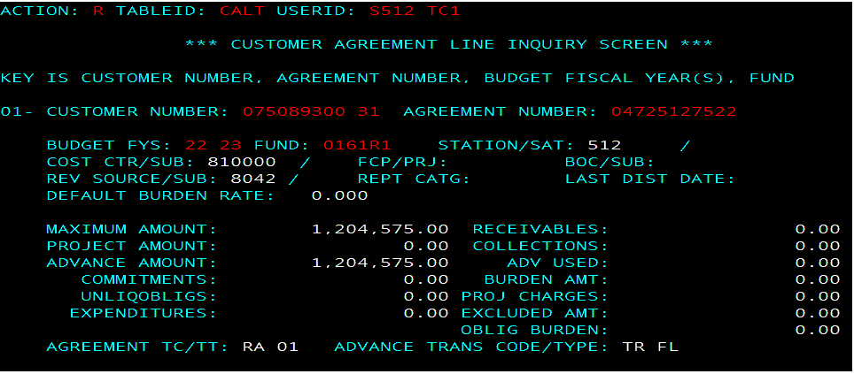
Appendix A: Guidance to Properly Record IAAs in FMS and handle transferring funding to NPCs
The FMS screenshot shows the RA established and the advance recorded in the TRFL

Slide 49
Appendix A: Guidance to Properly Record IAAs in FMS and handle transferring funding to NPCs
As advanced payments are offset against the 1358, RJ transactions should be entered into FMS to recognize earnings/revenue.
a. Enter RJ transaction, referencing the IAA agreement number and trans type FL.
b. After completion of the RJ transaction, the earned amount should be reflected on the CAHT/CALT tables on the ADV USED line.
12. At year end close out, the RA must be reviewed and closed out as appropriate.

Slide 50
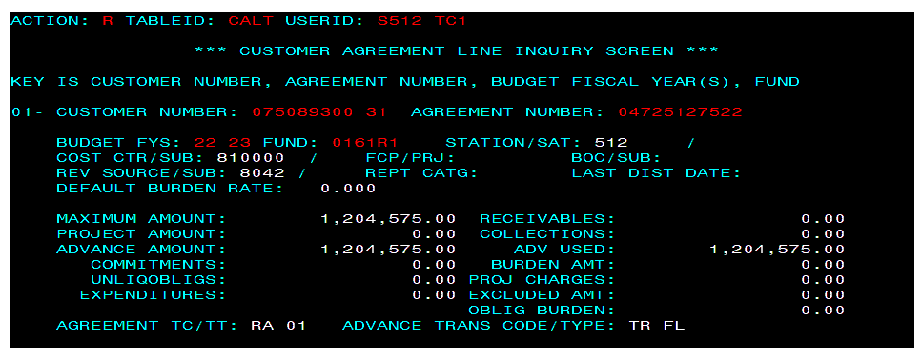
Appendix A: Guidance to Properly Record IAAs in FMS and handle transferring funding to NPCs
The RFJL transition records the advance collection as fully earned, to close the FY the Maximum Amount, Advance Amount, and Advance Used must match

Slide 51
Appendix B: Useful Resources
Instructions for FS Form 7600A: https://fiscal.treasury.gov/files/forms/fsform7600ainstructions.pdf
Improving the Management and Use of Interagency Acquisitions: https://obamawhitehouse.archives.gov/sites/default/files/omb/assets/procurement/iac_revised.pdf
FAR: 17.502-2 The Economy Act
38 U.S. Code § 7303 - Functions of Veterans Health Administration: research programs
The new Financial Policy chapter: Volume I, Chapter 11b Buy/Sell (G-Invoicing) (va.gov)
Non-G-Invoicing IAA guidance: Volume I, Chapter 11b Buy/Sell (Paper Form) (va.gov)
Financial Services Center (IAA SharePoint): Intragovernmental Accounting Division - Shared Documents - All Documents (sharepoint.com)
Volume I - General Accounting: https://www.va.gov/finance/policy/pubs/volumeI.asp
Intragovernmental Accounting Division: Intragovernmental Reimbursement Guide https://dvagov.sharepoint.com/sites/OITFSCCollaboration/IGOVFASPAC/Shared%20Documents1/Forms/AllItems.aspx
VA Acquisition manual (VAAM): https://www.va.gov/oal/library/vaar/vaarpdf.asp

Slide 52
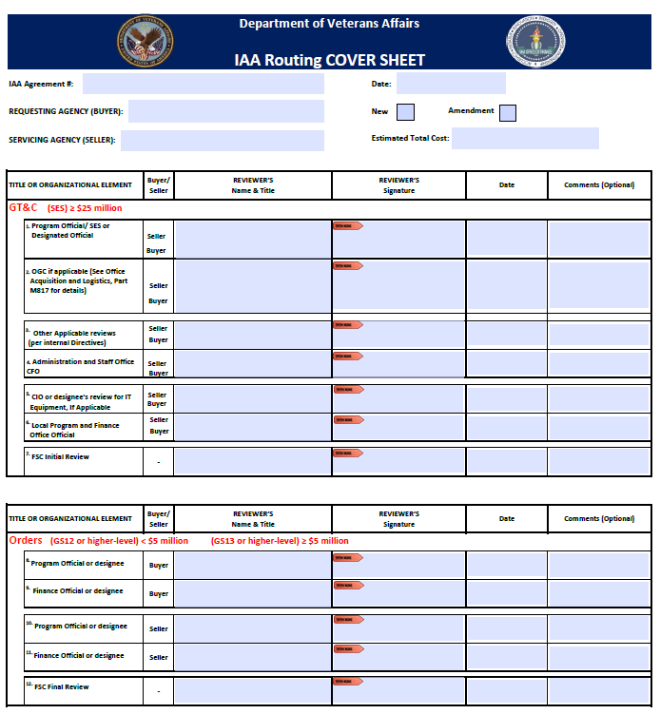
Appendix B: Useful Resources –
IAA Routing Sheet for Paper IAA Forms

Slide 53
Appendix C: ORD’s Authorities
ORD cannot enter into an agreement to request work that cannot be done within our own authorities.​
The following considerations should be taken into considerations when discussing work with an outside agency:​
  ORD’s Authoring Authority: 38 U.S. Code § 7303 - Functions of Veterans Health Administration: research programs​
  ORD’s Appropriations Language: FY 22 Enactment Appropriations Language
  VA Financial Policy Manual (Volume I, Chapter 11): Intergovernmental Reimbursable Agreements​
  Federal Appropriations Law: The Red Book (gao.gov)​

Slide 54
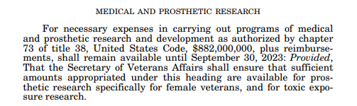
Appendix C: ORD’s Authorities
ORD Appropriations Language (FY 22 Enactment)

Slide 55
Appendix D: Acronyms
ALC Agency Location Code
BETC Business Event Type Code
BPN Business Partner Number
FASPAC Financial Accounting Systems Payment and Collection
GT&C General Terms and Conditions
IAA Interagency Agreement
IPAC Intra-governmental Payment and Collection
MADE Minimum Accounting Data Element
PM Program Manager
TAS Treasury Account Symbol
TP Trading Partner

Slide 56
Appendix E: Determinations and Findings - FAR 17.502-2(c)(3)
Requirements for determinations and findings. (1) Each Economy Act order to obtain supplies or services by interagency acquisition shall be supported by a determination and findings (D&F). The D&F shall-
(i) State that use of an interagency acquisition is in the best interest of the Government;
(ii) State that the supplies or services cannot be obtained as conveniently or economically by contracting directly with a private source; and
(iii) Include a statement that at least one of the following circumstances applies:
(A) The acquisition will appropriately be made under an existing contract of the servicing agency, entered into before placement of the order, to meet the requirements of the servicing agency for the same or similar supplies or services.
(B) The servicing agency has the capability or expertise to enter into a contract for such supplies or services that is not available within the requesting agency.
(C) The servicing agency is specifically authorized by law or regulation to purchase such supplies or services on behalf of other agencies.

Slide 57
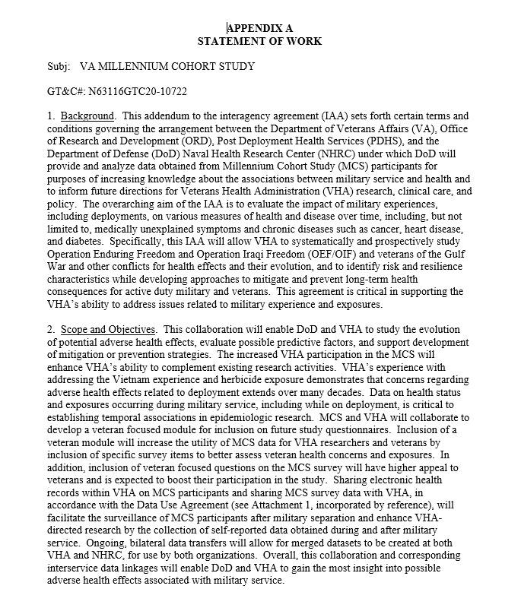
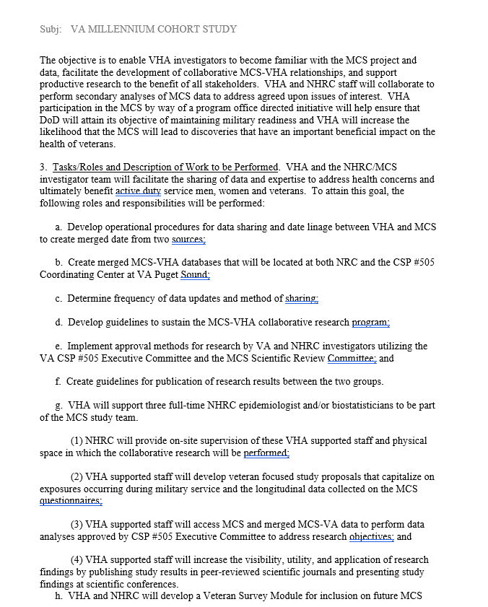
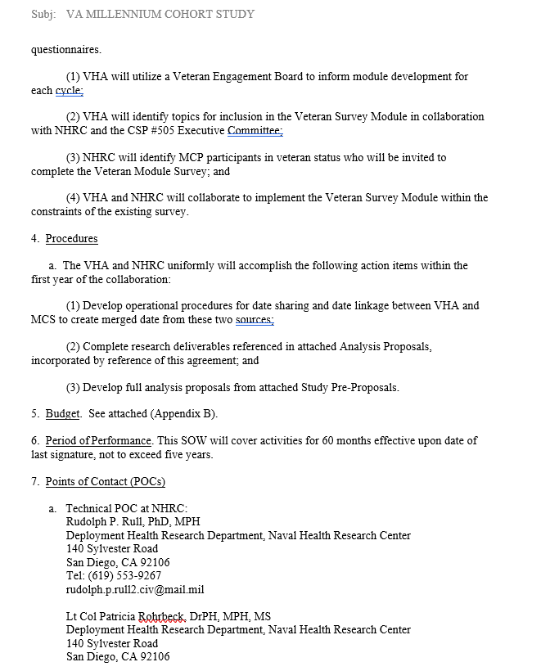
Appendix F: Example of a SOW for inter- and intra-agency agreement

