Slide 1
Introduction to this Webinar
VA Central IRB Updates
Don E. Workman, PhD - VA IRB Network Director

Slide 2
Topics to be Covered
  What does VA Central IRB approval mean?
  What is continuing review approval for a multi-site project?
  How is the VA Central IRB process structured?
  What Changes Have Been Made to the documentation?
  What is still to Come?
  New Project Forms

Slide 3
What does VA Central IRB approval mean?
  IRB approval requires all of the Criteria for Approval (38 CFR 16.111 and 21 CFR 56.111) to be met:
    Risks to subjects are minimized
    Risks to subjects are reasonable in relation to anticipated benefits, if any, to subjects, and the importance of the knowledge that may be expected to result
    Selection of subjects is equitable
    Informed consent will be sought from each prospective subjects or the subjects LAR in accordance with and to the extent required by regulation
    Informed consent will be appropriately documented, unless waived
    Where appropriate, the research plan makes adequate provisions for monitoring
    Where appropriate, there are adequate provisions to protect the privacy of subjects and maintain confidentiality of data

Slide 4
What does VA Central IRB approval mean? (Cont’d)
  That relevant VHA policies and their requirements have been met in the research
    That Central PO and ISSO review and approval have been granted
      Exceptions: at times CIRB approval is released before final ISSO review approval
  That the informed consent document conforms to VA specific language requirements
  That the requirements for waivers of HIPAA Authorization or Waivers or Alteration of Informed Consent or Informed Consent documentation have been met
  That, if applicable, a continuing review period, no less than annually has been set as appropriate to the degree of risk

Slide 5
What is continuing review approval for a multi-site project?
  The regulations and VHA policies do not articulate the requirements specific to multi-site research
  It is a re-approval of the whole research project
  Re-Approval of the whole project includes re-approval of the sites, their Investigators, and the Informed Consent documents

Slide 6
How is the VA Central IRB process structured?
  Notifications: 90, 60, and 30 days prior to expiration
    Notifications to the PI and to the LSI
    PI Continuing Review
    LSI Continuing Review Supplement
  Re-approval of the study is done at the PI level, and applies to all of the sites who are active and have submitted their supplemental CR application

Slide 7
  What Changes Have Been Made to the documentation?
  LSI Supplementary Continuing Review Applications are acknowledged (PI always got approval for the study as a whole)
      This is not an IRB approval, it is a site approval in the context of the whole project re-approval
  Anyone associated to the LSI project has access to the PI documentation
  PI Continuing Review application lists the sites and their status at the time of CR

Slide 8
What is still to Come?
  Revised approval template for the PI continuing review approval:
      Will list the sites re-approved with the study re-approval
  Memo clarifying the PI submission approval applies to all of the sites listed as active in the continuing review application

Slide 9
VA Central IRB
New Project Forms
Jessica Kroll, MA, CIP - VA Central IRB Administrator

Slide 10
Objectives
The VA Central IRB (CIRB) will share an update on recent changes to our forms.
This webinar will cover the following topics:
  Overview
  New Project Forms
  Process Updates
  What’s Next?

Slide 11
Overview

Slide 12
Why change CIRB Forms and Processes?
Align with required IRBNet wizards (Information & Project Cover Sheets)
Improve usability and provide better instructions for researchers
Eliminate unnecessary submission forms which will in turn:
  reduce inconsistencies across forms
  reduce submission errors and back and forth revisions
Focus on capturing relevant information for the CIRB to conduct an efficient and compliant review:
  eliminating duplicate questions across submission forms

Slide 13
New Project Forms

Slide 14
Overview of Form Changes
All CIRB forms have undergone minor formatting and administrative changes. These changes include new headers, new instructions, and improved fillable formatting.
The following slides will provide:
  Brief summary of significant changes made to each form.
  The date the form will be released for use.
  The date the new form must be used by.
  List of forms that will be discontinued.

Slide 15

Release of New CIRB Forms
The CIRB is releasing new forms in 3 scheduled phases:
1
Continuing Review Forms
Released on June 14th
2
Post Approval Submission Forms
Released on June 28th
3
New Project Submission Forms
Release Date October 25th

Slide 16
New Project Forms
Form | Summary of Significant Changes | Release Date | Must Use By
100 Protocol Template | Protocol Template has been assigned a Form Number - 100. This template will be used only for projects that involve subject interactions/interventions. New sections have been added to the Protocol Template to collect more comprehensive information and focus more on the multi-site aspects of the project. Revised to incorporate elements of Form 108 (Form 108 will be discontinued). Includes more detailed instructions on how to write the protocol. | 10/25/2023 | 01/02/2024
101 Protocol Template – Data/Specimen Only | New Form: This template will be used for data/specimen projects only. New sections have been added to the Protocol Template to collect more comprehensive information and focus more on the multi-site aspects of the project. Revised to incorporate elements of Form 108 (Form 108 will be discontinued). Includes more detailed instructions on how to write the protocol. | 10/25/2023 | 01/02/2024

Slide 17
New Project Forms
Form | Summary of Significant Changes | Release Date | Must Use By
105 Request for Exemption | No significant changes. | 10/25/2023 | 01/02/2024
107 Co-PI Supplement Different VA Facility | New Form: Replacing Form 105a and 108a. This new form can be used for exempt and non-exempt projects. However, this form is only required when there is a Co-PI at a different VA facility. Co-PIs from the same VA facility do not complete this form. | 10/25/2023 | 01/02/2024
109 Coordinating Center Supplement | Form Under Development: This form will be released in early 2024. Will be replacing Form 108b. | TBD | TBD
Information Sheet Wizard | For a lead PI completing the wizard, new questions were added, and existing questions were revised to ensure comprehensive project level information is captured. For a LSI completing the wizard, there were significant revisions. The LSI will no longer be required to answer questions that are specific to the overall project. The LSI will only be required to enter information as it pertains to their local site activity. | 10/25/2023 | 10/25/2023

Slide 18
Discontinued Forms
Discontinued Form | Where Information Will Be Captured | Discontinuation Date
104 NSI LSI No Intervention | Single Form 104 LSI Application for all LSI project types. | 01/02/2024
104a Co-LSIs added to New Project | Project Cover Sheet Wizard | 01/02/2024
105a Co-PISC Exempt New Project Supplement | Project Cover Sheet Wizard and if applicable, New Form 107 Co-PI at Different Facility | 01/02/2024
108 PISC New Project Application | Protocol Template, IRB Information Sheet Wizard, Project Cover Sheet Wizard, and ERDSP | 01/02/2024
108a Co-PISC New Project Supplement | Project Cover Sheet Wizard and if applicable, New Form 107 Co-PI at Different Facility | 01/02/2024
108b Coordinating Center Supplement | Form 109 (New Form Under Development) | TBD
110a Vulnerable Population Pregnant Women | IRB Information Sheet Wizard and Protocol Template | 01/02/2024
110b Vulnerable Population Prisoners | IRB Information Sheet Wizard and Protocol Template | 01/02/2024

Slide 19
Process Updates

Slide 20
Discontinuation of Form 108
All information that was captured in Form 108 will now be captured across the IRB Information Sheet Wizard, Project Cover Sheet Wizard, Protocol Template, and the ERDSP.
Project Cover Sheet Wizard will be the new source documentation when key study personnel are listed, added or removed from a project.
NOTE: A new Study Team Tracking wizard is currently under development with VAIRRS that will be released in the near future. More information will be shared with the field regarding the new Study Team Tracking wizard at an upcoming VAIRRS webinar.

Slide 21
Existing Projects with Old Forms
The CIRB will not require projects submitted prior to January 2, 2024 to convert old forms to new forms. For example, if a project was initially approved in 2021 with the old protocol template and Form 108, the study team is not required to update their study documents to the new protocol template.
NOTE: The only exception is the IRB Information Sheet wizard. The IRB Information Sheet wizard will be updated in IRBNet on October 25, 2023. When this update occurs, all projects with an existing IRB Information Sheet wizard will be prompted and required to answer the new questions in the form the next time the form is revised.
More information will be shared with the field regarding wizard changes at an upcoming VAIRRS webinar later this year.

Slide 22
LSI New Project Submissions
LSIs will no longer be required to include PI project level information in the submission.
Form 104 LSI New Project Supplement and IRB Information Sheet wizard were revised to remove all questions pertaining to PI project level information. These forms are designed for the LSI to provide local context information pertaining to their site’s involvement in the PI project.
All project level information (e.g., study procedures, risk level, expedited review category, waivers, etc.) will be described and approved within the PI project.
The PI is responsible for ensuring that all local participating site activities and procedures are described in the protocol and other applicable project materials.

Slide 23
Access to PI Project from LSI Project Overview Page
Local site study teams and local site research administration have access project level information through the PI project in IRBNet.
All project documentation (Protocol, PI Information Sheet Wizard, MODEL Documents, Determination Letters, etc.) can be accessed by navigating to the Project Overview page in IRBNet and clicking on the lead site “Details” hyperlink.
For detailed instructions on how to access the PI project, please refer to IRBNet Forms and Templates library (VA Central IRB Administration, Washington, DC – Documents for Researchers) and review the document titled “003-Instructions: Multi-Site Projects in IRBNet.”

Slide 24
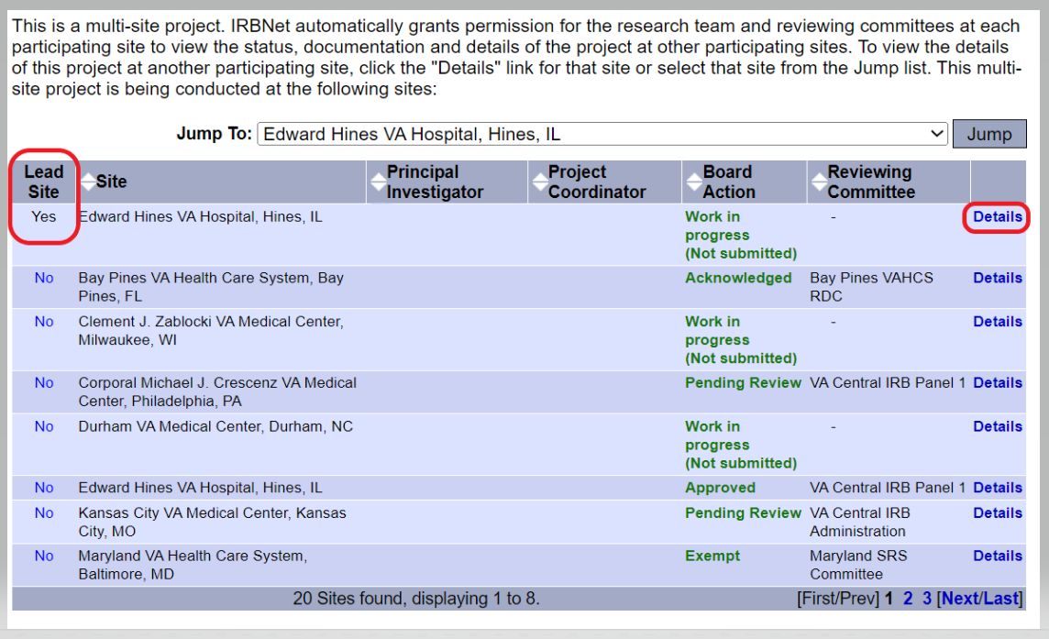
Access to PI Project from LSI Project Overview Page
NOTE: Refer to IRBNet Forms and Templates library (VA Central IRB Administration, Washington, DC – Documents for Researchers) and review the document titled 003-Instructions: Multi-Site Projects in IRBNet.

Slide 25
LSI Site-Specific Differences or Changes
LSI site-specific differences or changes that are submitted at the time of an LSI New Project submission or an LSI Amendment submission will require concurrence from the lead PI.
LSI site-specific differences or changes require the following:
The lead PI must provide a memo (or email) with concurrence of the site-specific differences and indicate that this will not be implemented across all participating local sites. The memo or email must be uploaded to the IRBNet package for VA Central IRB review.

Slide 26
Example of LSI Site-Specific Change
The LSI plans to submit an amendment to the VA Central IRB requesting approval to use a revised recruitment flyer at their local facility. The LSI redesigned a recruitment flyer that was approved as a MODEL document under the PI project by adding new images and new content (in addition to their local contact information). In this scenario, the PI must provide a memo or email concurring with the LSI change to the MODEL recruitment flyer and indicate that this change is site-specific and will not be implemented across other participating sites.
NOTE: If the PI plans to incorporate the LSI revisions into the PI MODEL recruitment flyer for other participating local sites to use, then the PI should not provide concurrence for the requested LSI change, but rather submit the change as a PI Amendment.

Slide 27
LSI Site-Specific Differences or Changes
Some local site-specific differences or changes must be approved at the PI project level and cannot be approved in an LSI submission.
If the LSI is requesting or planning site-specific differences to study design, procedures, or activities that are not currently approved under the PI project, the PI must first update their project via an Amendment package prior to the local site beginning procedures or activities that are not yet approved (e.g., use of a local site data source; local site establishing a non-VA collaboration with a University; changes that require revisions to project Waiver of Informed Consent, etc.).
The PI is responsible for ensuring that all local participating site activities and procedures are described in the protocol and other project materials.

Slide 28
PI Oversight
The PI team has a responsibility to review LSI New Project packages prior to the LSI submitting to the VA Central IRB to ensure the site is following the currently approved protocol and using the correct MODEL documents.
This will allow for a more efficient review process with the VA Central IRB and can reduce the need to unlock the LSI package for corrections.
NOTE: When the PI is also serving as an LSI, it is recommended to have the PI submit their LSI New Project first in order to serve as a model LSI application. This may streamline the submission process for other LSI New Project packages.

Slide 29
PI Project Documentation
PI project documents must stay up to date and always reflect what the project is currently approved for.
When an approved project submits an Amendment, all applicable documents must be updated if impacted by that change.

Slide 30
What’s Next?

Slide 31
Prepare for Upcoming Changes
Continue to always download VA Central IRB forms directly from IRBNet Forms and Templates library (VA Central IRB Administration, Washington, DC – Documents for Researchers) when they are needed to ensure the current version is being used and submitted with a package.
CIRB will continue to provide communications to the field through email, VAIRRS Newsletters, and our website over the next few months: https://www.research.va.gov/programs/orppe/vacentralirb/default.cfm
CIRB Researcher guidance and instructions will be updated by January 2nd and uploaded into our IRBNet Forms and Templates library.
Continue to use “Version Control” in IRBNet to maintain revision history of existing documents (e.g., use pencil icon to replace an existing document, rather than attach as a new document).
Contact VACentralIRB@va.gov with questions about the forms and process updates.

Slide 32
Questions?

