Slide 1

Finding, Reviewing and Executing Your Budget Allocations
November 9, 2022
Kari Points, AO-Research, Iowa City VAMC
Antonio Laracuente, Director of Field Operations
Jason Berlow, Management Analyst, Finance

Slide 2
Objectives – for today’s training
Training Section: | By the end of this section, you will:
Section 1: Key Terms, Key Programs, and Funding Time Frame | Understand key terms Understand key programs that receive funding Understand the Fiscal Year Funding Roadmap Understand key components about Budget Execution during a CR
Section 2: Locating your ITA, TDAs and Budget Allocation Reports in RAFT | Understand how to find your facility’s Initial Target Allowance (ITA), Transfer Disbursing Authority (TDA) and Budget Allocation Reports in RAFT Understand how to read and understand the pink sheets Learn to utilize RAFT on a regular basis
Section 3: Using the Status of Allowance (SOA) to locate undistributed funds and distribute to correct program and fund control point | Understand how to find undistributed funds on the SOA Understand how to use the TDA to determine how to distribute funds to the correct program and Fund Control Points
Q&A
Notes:
Jason -Section 1; John- Section 2; Kari- Section 2 and 3

Slide 3
Financial Education Resources
Federal Appropriations Law:
  Link: The Red Book | U.S. GAO
  We are looking into organizing a class by the Office of Finance
Certified Government Financial Manager (CGFM)
  Link: https://www.agacgfm.org/CGFM.aspx
  CGFM is a professional certification awarded by AGA, demonstrating competency in governmental accounting, auditing, financial reporting, internal controls and budgeting at the federal, state and local levels.
If you want to learn more about either of these opportunities, please contact Maria Negrete (Maria.negrete2@va.gov) who is maintaining the list of interested personnel.

Slide 4

Section 1: Key Terms, Key Programs, and Funding Time Frame
What would you say is an ITA?
Notes:
Jason -Section 1; John- Section 2; Kari- Section 2 and 3

Slide 5
Section 1: Key Terms
First, we must review a few key terms to help you understand the allocation process:
Term | Definition
Allocation | An amount or portion of a resource assigned to a particular recipient i.e., Investigator Award
Pink Sheet | An amount or portion of a resource assigned to a particular recipient i.e., Investigator Award. Pink Sheet shows the award amount per fiscal year. Other important information such as Service ID, Funding Dates and Program information compose the pink sheet. It is a critical document in budget management.
ITA - Initial Target Allowance | The ITA is the initial allocation to the facility research program at the beginning of each fiscal year based on programs and projects slated for funding in that Fiscal Year. The ITA may not include new starts or other funding such as CC101 or special projects.
TDAs - Transfer of Disbursement Authority | This is the document that sends and removes money to and from your station. The money arrives and is placed in the Research Program as undistributed until you work with your fiscal department to move to the most appropriate fund control points.
AACS - Automated Allotment Control System | The program in which to pull a list of TDAs, used to track the budget and allocations to Program Offices and VHA facilities.
RAFT - Research Analysis Forecasting Tool | This is a web-based software program that will help track all ORD allocated funds distributed to your facility. This is where you can access your pink sheets and ITA Budget Memo.

Slide 6
Section 1: Research Program Funding
Second, we must review the programs that receive funding
Program Code | Program
820 | ORD, Research Administration (CC 101), Fellows, ShEEP, LAMb
821 | Biomedical Laboratory Research (BLRD), Veterinary Medical Unit, Research Career Scientist, Career Development Awards, and Reimbursables
822 | Rehabilitation R&D
824 | Health Services R&D
825 | Cooperative Studies Programs
826 | Million Veteran Program (MVP)
829 | CSR&D (Clinical Sciences)

Slide 7
Section 1: Fiscal Year Funding Roadmap
Time Frame | September | October/Each New CR | FY 23 Enactment | Ad-Hoc
Activity | ITA Processing | TDAs Processing | TDAs Processing | TDAs Processing
Description | ORD’s Office of Finance (Program Budget Analyst) input ITAs in September in RAFT. The ITA contains funding for all ongoing projects based on the multi-year project budget. ITA – The ITA is based on the annualized CR of $882 million. | ORD Office of Finance will process TDAs (which are a pro-rated amount depending on CR length). Investigator accounts: Review on amount received and available amounts for spending They are broken out by Salary; All other; Travel. Need to determine What Fund Control Points need to receive these? Link TDAs with ledger. | ORD Office of Finance will process final full-year TDAs reflecting the full-year enactment. | ORD Office of Finance will process ad-hoc TDAs as requested by ORD Services to meet on-going pragmatic needs during the fiscal year.
How do I find? | RAFT | RAFT, Budget Memo Report, AACS (Program, Investigator, Ledger)

Slide 8
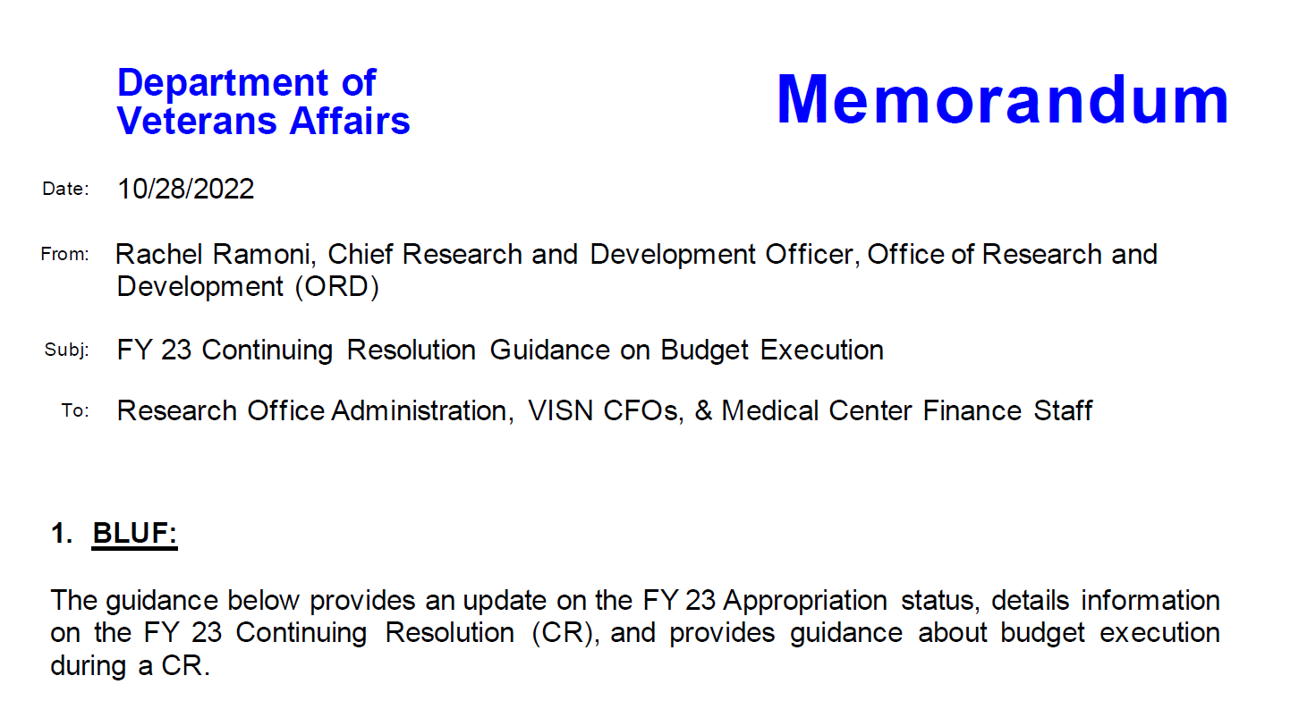
Section 1: Understand CR Memorandum
If you still have any challenges executing funding, please let us know.

Slide 9

Section 2: Locating your ITA, TDAs and Budget Allocation Reports in RAFT
Can you get me that ITA Report by COB, today, greatttt?

Slide 10
Section 2: Locating your ITA, TDAs and Budget Allocation Reports in RAFT
This section reviews the tools in RAFT needed to successfully identify, determine and execute your plan for allocating your budget.
  At the beginning of the year, you can pull your ITA from RAFT and make a budget allocation plan for your salaries and all other FCPs.
  RAFT provides TDA reports so you can see what has been allocated to your site outside the ITA.
  The Pink Sheet allows for you to see the funds allocated each fiscal year by project for each investigator.
Learn to utilize RAFT on a regular basis. The budget allocation and Pink Sheets are updated throughout the year, a successful AO/Budget Analyst should be viewing these periodically.

Slide 11
Section 2: Locating your Initial Target Allowance (ITA)
There is one ITA each fiscal year that is available in RAFT at the end of September or beginning of October.
The ITA tells you the planned budget allocation for each of your VA funded projects for that fiscal year.
From this report, you should develop a plan for the FCPs that you will distribute the funds to as the TDAs come in throughout the year.

Slide 12
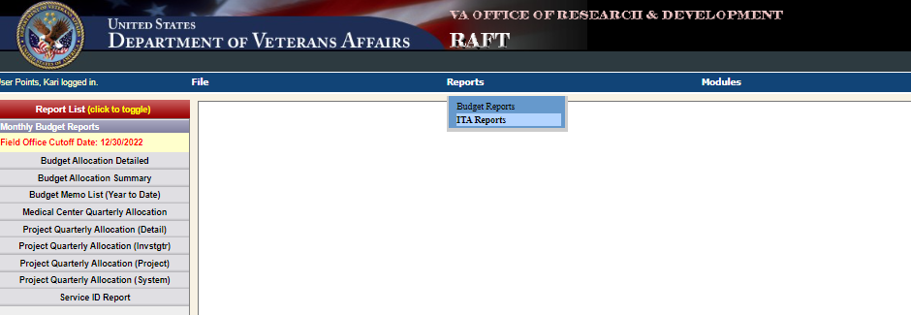
Section 2: Locating your ITA in RAFT
Go to Reports at the top of the screen and select "ITA Reports"

Slide 13
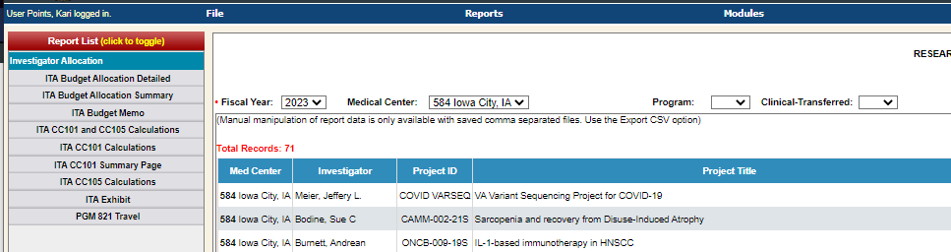
Section 2: Locating your ITA in RAFT
Steps
Click on Investigator Allocation on the left panel.
Select Fiscal Year and your Medical Center.
You can either leave the Program option blank or select an individual Program you want to view. The clinical-transferred box remains blank.

Slide 14
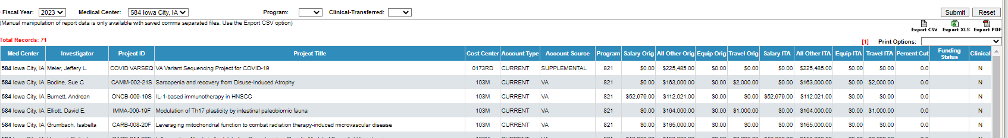
Section 2: Locating your ITA in RAFT
The ITA report will show you the budget allocation that has been established for each project and categorized as Salary, All Other, Equipment, and Travel.
  You have the option to export this report to Excel or PDF.
Just because the report states that funds are allocated to Salary or All Other, that does not mean you have to place the funds in those fund control points. If the funds are not needed for salary, put them in All Other. Section 2 of the August Training covered developing a plan for ITAs in more detail. The template for the spreadsheet has been sent out in August and again last week.

Slide 15
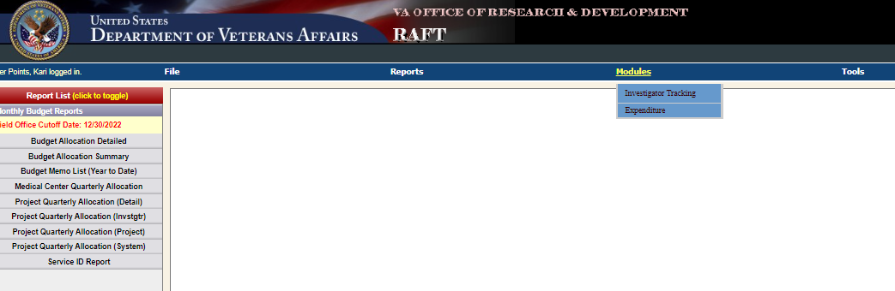
Section 2: Locating your Pink Sheet in RAFT
Go to Modules and select Investigator Tracking

Slide 16
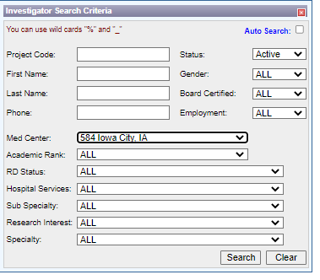
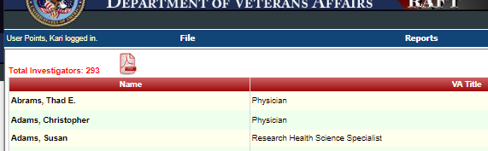
Section 2: Locating your Pink Sheet in RAFT
To view all active pink sheets, change the Status from Any to Active.
Click on the pdf symbol on the top left of the page. This will generate a pdf of all your pink sheets.

Slide 17
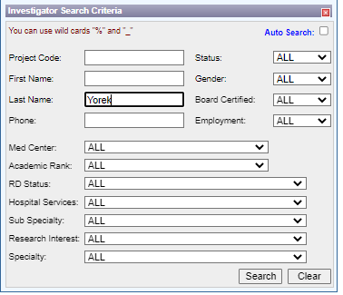
Section 2: Locating your Pink Sheet in RAFT
You can also pull the pink sheet report by investigator. Enter the investigator last name. Under Status, you can select All to pull up all pink sheets or select Active to just pull up current pink sheets.

Slide 18
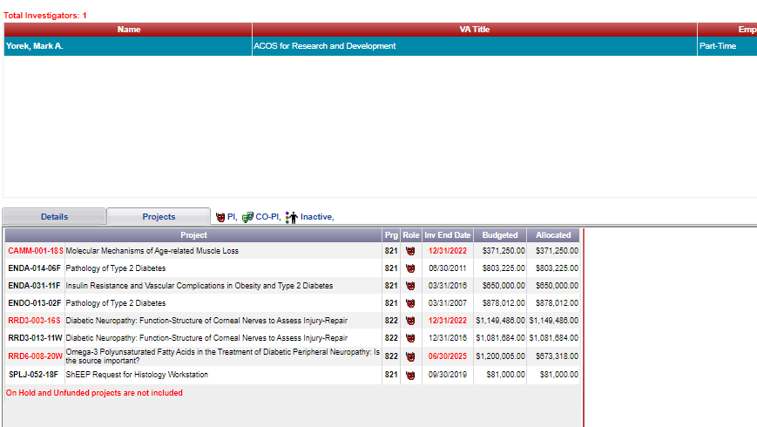
Section 2: Locating your Pink Sheet in RAFT
Click on the investigator name and then click on the Projects tab. All active projects will be in red.
Click on the project that you want to view the pink sheet. Select PDF and click Print.

Slide 19
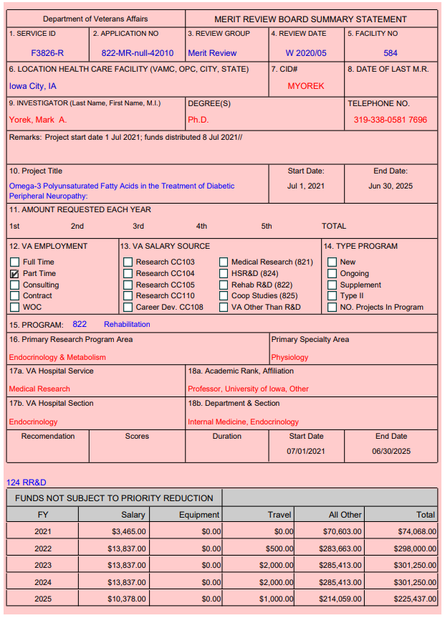
Section 2: Reading your Pink Sheet
The pink sheet will provide you with project information such as Service ID #, Start and End Dates, and most importantly: the funding allocated for each fiscal year of the award.
If you submit a project modification during the fiscal year, the pink sheet will be updated to reflect that request.

Slide 20
Section 2: RAFT Budget Allocation Reports
There are a variety of useful budget allocation reports that are available in RAFT.
These are updated regularly as new projects start, project modifications are approved, etc.
Recommend pulling the project quarterly allocation reports on at least a monthly basis.

Slide 21
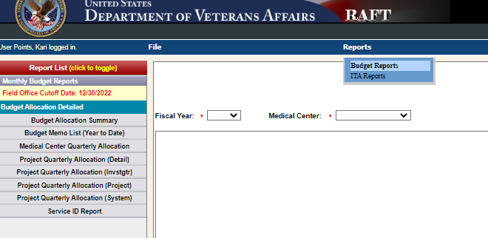
Section 2: Types of Budget Allocation Reports
Go to Reports – Budget Reports
All the Budget Reports are located on the left panel.
Once you pull a report, there is an option to export to excel or pdf.

Slide 22
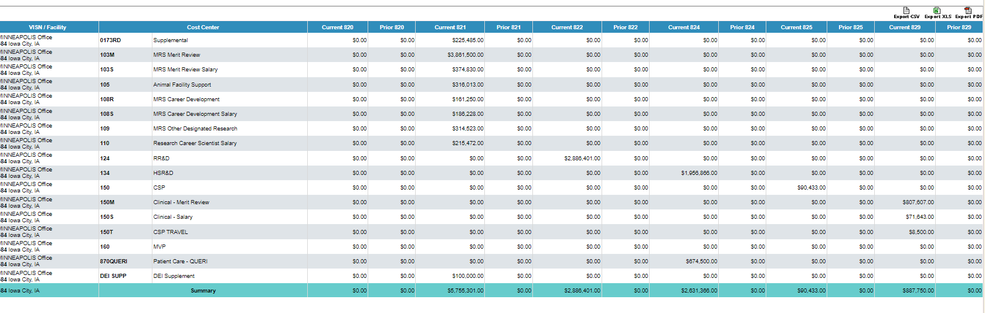
Section 2: RAFT Budget Allocation Reports
There are two useful reports to determine if you are going to receive any prior year or current year funds, the program the funds will be allocated to and if any funds will be allocated to the Medical Center (Program 870/QUERI).
The Budget Allocation Summary report provides a summary by Cost Center and shows the distribution of funding by Current Year and Prior Year by Program.

Slide 23
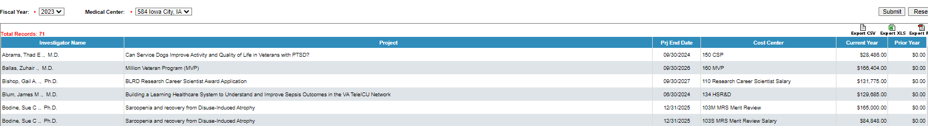
Section 2: RAFT Budget Allocation Reports
The Budget Allocation Detail Report breaks it down further and will provide you with a breakdown of the funding by project. This includes information by Investigator, Project Title, Project End Date, Cost Center and if funds are Current Year or Prior Year.

Slide 24
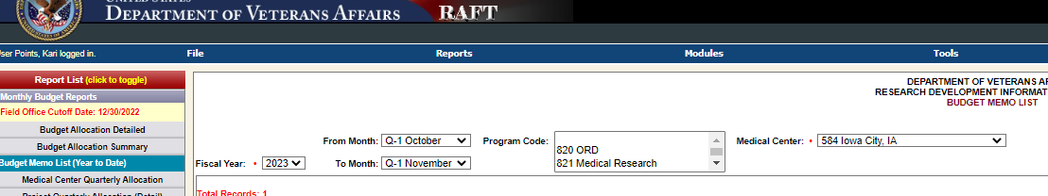
Section 2: Locating TDAs in RAFT
Transfer Disbursing Authority (TDA)
  There is a way to view the TDA’s in RAFT that were not part of the ITA.
Steps:
Select Budget Memo List on the left panel.
Select Fiscal Year, the range of months you want to view, the program (or leave blank for all) and your Medical Center.

Slide 25
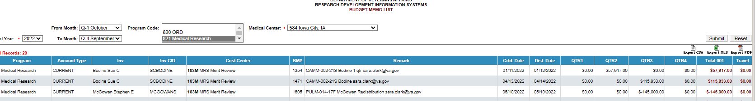
Section 2: Locating TDAs in RAFT
The next page will show you the project information, the distribution date, the quarter and the total amount of the TDA.
Note: This will only show you TDAs that were completed outside the original ITA such as new projects, modifications, etc. To view TDAs connected with the ITA, you will need to access AACS, or your fiscal will need to provide it.

Slide 26
Section 2: Types of Budget Allocation Reports
There are a variety of budget reports that categorize funding by overall station, cost center, program and investigator project.
Advice:
  Go into the system and play around with the budget reports. Determine what is most useful to you. Get used to doing this on at least a monthly basis as the reports are updated regularly.
  In particular, the Project Quarterly Allocation (investigator) is a useful tool. When printed to pdf, it gives you the investigator name, service ID, start and end date and the fiscal year allocation for that project. This is one that I print on the first of the month and have next to my desk to reference.

Slide 27

Section 3: Using the Status of Allowance (SOA) to locate undistributed
Has the funding arrived on station?
Notes:
John

Slide 28
Section 3: Using the Status of Allowance (SOA) to locate undistributed
Question: How do you know if you have funds that have arrived onsite?
  Answer: The Status of Allowance (SOA) will tell you!
You can get your SOA from your fiscal or you can download independently from the VSSC.
Funds that have arrived onsite and have not been processed, will show up in undistributed on the SOA.
The funds will be undistributed by Program, it is up to you to allocate them to the correct FCP. They must be distributed to the Program they have been sent under, but you do have flexibility in distributing to the FCPs within that program.
Notes:
John

Slide 29
Section 2: Using the Status of Allowance (SOA) to locate undistributed (view from a Station Fiscal)
Example of Program 81 undistributed funds:
In this example, you can see $152,593 is in undistributed on the SOA. This tells you that there is at least one TDA that has been sent to your site.
 | 0161A1 FY 2223
 | 0161A1 FY 2223 Prog 81
403 | 810034401 | 821 IC SALARIES | 1,542,136.01 | 709,886.03 | 832,249.98 | 892,501.71 | 0.00
4602 | 8100101GB | 821 IC S&S 22/23 | 5,293,356.75 | 2,765,658.74 | 2,527,698.01 | 2,382,698.01 | 1,002,909.19
 | Undist |  | 152,593.00 | 0.00 | 152,593.00 | 0.00 | 0.00
 | 0161A1 FY 2223 Prog 81 Total |  | 6,988,085.76 | 3,475,544.77 | 3,512,540.99 | 3,275,199.72 | 1,002,909.19

Slide 30
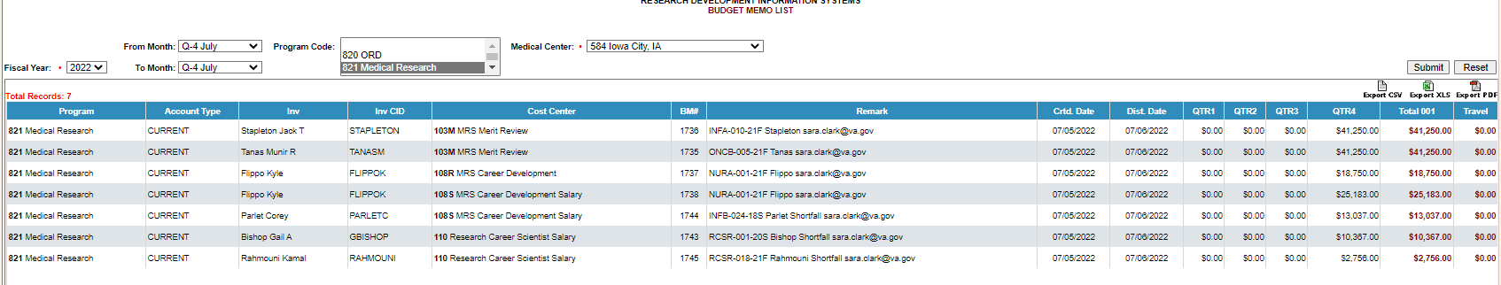
Section 3: Use TDA to determine FCPs
The undistributed balance in Program 81 from previous example was from the SOA dated 7/7/22. Pulling the report from RAFT for July 2022, I can identify the TDAs:
From the TDA report, I can determine that $51,343 should go into the Salary FCP and $101,250 should go into All Other FCP for Program 81.

Slide 31
Section 2: Using the Status of Allowance (SOA) to locate undistributed
The SOA will also tell you if reimbursables have arrived on site. Look under the 0161R1 or 0161X2 funds for undistributed:
In order to process the reimbursables, your Fiscal Office will need to provide you with the monthly F827 General Ledger Reports. This report will tell you the bill of collections that were paid that month so you can identify the reimbursement funds.
This will provide you with the information to request the cost transfer as well. Once the funds have been moved from undistributed to your reimbursable FCP, you need to request a cost transfer from the 0161A1 FCP that the expenses originally occurred.
 | 0161R1 FY 2122
 | 0161R1 FY 2122 Prog 81
011 | 810010101 | RESEARCH REIMB | 285,861.05 | 285,861.05 | 0.00 | 5,710.68 | 0.00
4615 | 8100101GB | RESEARCH REIMBURSEABLE IC | 232,157.76 | 232,157.76 | 0.00 | 0.00 | 93,750.00
 | Undist |  | 122,159.42 | 0.00 | 122,159.42 | 0.00 | 0.00
 | 0161R1 FY 2122 Prog 81 Total |  | 640,178.23 | 518,018.81 | 122,159.42 | 5,710.68 | 93,750.00
 | 0161R1 FY 2122 Total |  | 640,178.23 | 518,018.81 | 122,159.42 | 5,710.68 | 93,750.00
Notes:
Kari; Tony

Slide 32
Section 3: Using VSSC to find the SOA at your Station
A successful AO/Budget Analyst must also be able to pull these reports interpedently from VSSC.
  VSSC Link: VSSC - VHA Support Service Center
  SOA Link: SOACreateRpt - Report Viewer
See training from 6/23/22 regarding Using VSSC and reading the Status of Allowance (SOA): Finance Monthly Training Series: Using VSSC and reading the Status of Allowance (SOA)

Slide 33
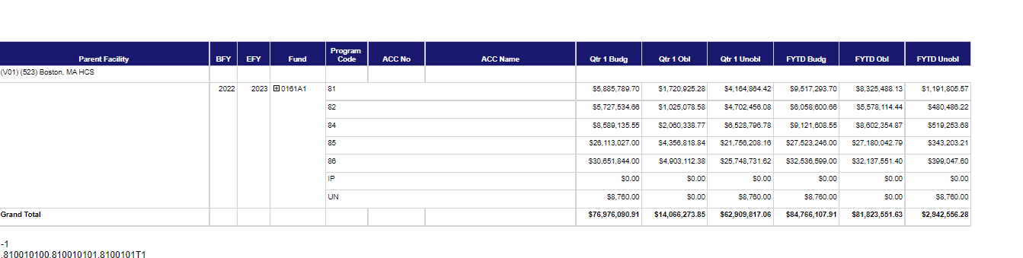
Section 3: Using the Status of Allowance (SOA) to locate undistributed (view from VSSC)

Slide 34
Final Takeaways
A successful AO/Budget Analyst must understand the interplay between ITAs, TDAs, and RAFT to successfully execute the Research Budget.
They must also understand the key reports in RAFT, from Fiscal, and VSSC that will perform their duties.
The tools presented are a critical resources to help you perform your duties, thus we recommend you prioritize time to learn these tools and how they can assist in your position.

Slide 35

Questions

Slide 36
Useful Resources
Past ORD Finance Training (sharepoint.com)

