Slide 1

Understanding and Balancing the Status of Allowance
December 7, 2022
Kari Points, AO-Research, Iowa City VAMC
Antonio Laracuente, Director of Field Operations
Jason Berlow, Management Analyst, Finance

Slide 2

Webinar
Housekeeping
Recording - This session is being recorded and the associated handouts will be available on ORPP&E’s Education and Training website within one-week post-webinar.
Close Captioning - Now available in the new Webex platform. Click the “CC” button at the bottom left of the Webex screen.
Experiencing Sound Issues? – Call in using the number in your Webex chat box or in your registration confirmation email.
Q&A - Please use the Q&A feature to submit questions.
  Be sure to send questions to “All panelists”.
  Questions will be addressed at the end of the webinar.
Webinar Archive - Most ORPP&E webinars can be found here: https://www.research.va.gov/programs/orppe/education/webinars/archives.cfm
Post-Webinar Evaluation Survey - We are grateful to all that complete the post-webinar evaluation survey. It will automatically pop up once the webinar is exited.
For questions, please use Q&A box and address to “All Panelists.”
All Webinars will be recorded and posted within one week.

Slide 3
Objectives – for today’s training
Training Section: | By the end of this section, you will:
Introduction: FY 23 Appropriation Status and Update on the Continuing Resolution and Update from IAA Training | Update on FY 23 Appropriation and CR Update on requirement for OGC review form IAA Training on (10/19)
Section 1: The importance of Status of Allowance (SOA) | Understand key terms Understand impact of different activities on the SOA Understand the need to keep up with the SOA Managing under the Continuing Resolution
Section 2: How to Get, Read and Interpret the SOA | Understand where to find the SOA Understand the different formats Understand other tools that are needed (RAFT, AACS, Running Balance, VSSC F20)
Section 3: Balancing | Understand how to Balance the Ceilings Understand how to track Salaries Understand how to track expenditures
Q&A
Notes:
Jason -Section 1; John- Section 2; Kari- Section 2 and 3

Slide 4
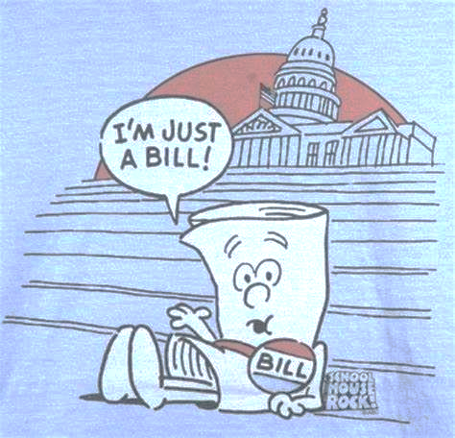
Introduction: FY 23 Appropriation Status and Update on the Continuing Resolution
Notes:
Jason -Section 1; John- Section 2; Kari- Section 2 and 3

Slide 5
FY 23 Appropriations Status
The FY 23 President’s Budget Request is $916 million.
Congress enacted the Continuing Resolution Act (P.L. 117-180). The CR provides funding through December 16, 2022 at an annualized amount of $882 million (to match the FY 22 Enactment).
Congress will now attempt to either pass a full year appropriation by December 16th (less likely) or extend the CR into January and into the next Congress (more likely).
For reference four (4) CRs occurred in FY 22, until enactment on March 11, 2022.
Key Takeaway: Remain flexible it is likely will have a long wait for a full-year appropriation.

Slide 6
FY 23 Execution Status
Current Year Funding:
  Funding has been distributed to the field (Transfer Disbursing Authority) to provide initial CR TDAs through December 16th.
  We sent out the CR Memo detailing guidance on how to execute during the CR.
  Sending out 1Q CC-101 - 1st week of December.
Prior Year Funding:
  The Field has been provided guidance with instructions on how to obligate all prior year funding by 1/16/23 or risk it being swept.
  Conduct your salary cost transfers for PP21-24 as soon as possible. To date only $9.6 million has been done. Avg. payroll is about $20 million/PP.
  Approximately $51 million available in the field.

Slide 7
OGC Review (of IAAs)
Procurement Law Group review is only required for assisted acquisitions (or interagency acquisitions) which generally does not apply to Research IAAs
  Please note governing VA policy does not require legal review. See VA Financial Policy Vol. I Ch. 11a and 11b and VA Acquisition Manual M817.503 (all of which only require legal review for IAAs that happen to also constitute “interagency acquisitions”).
  You can always opt to request a procurement law legal review even when not required: https://dvagov.sharepoint.com/sites/OGC-Client/offices/PRLG/Lists/Request/Pending.aspx
The OGC Special Team Advising Research (STAR) is recommended if you have any other concerns about the IAA documents, ORD can facilitate getting your IAA to the correct POC in STAR:
  STAR will primarily review the Statement of Work. Attorneys are assigned by Region; the list of STAR Attorneys (by Region) will be provided by ORD Finance.
  OGC Procurement Law will primarily review the Statement of Work and the 7600 A/B.

Slide 8

Section 1: The Importance of the Status of Allowance (SOA)
Track our money? What do you mean? Who can help us?
Notes:
Jason -Section 1; John- Section 2; Kari- Section 2 and 3

Slide 9
Section 1: Key Terms
Term | Definition
Status of Allowance | Report provided by Fiscal or within VSSC that gives you total Ceiling, total Obligations and Current Balance information for each program and fund control point (ACC) by Fiscal year.
Committed Expenditures | Orders that have been placed in VISTA that have received a transaction number but have not yet been obligated or in the case of Purchase Cards, reconciled and approved)
PAID | Personnel and Accounting Integrated Data (PAID) System. VA’s mainframe application that supports VA HR and payroll and benefits processes. For payroll purposes, PAID is used to process data for time and attendance and current VA payroll reporting requirements. PAID is a batch-driven system with nightly data processing runs and biweekly payroll runs
F20D Report | Daily Activity by Account Classification Code report: lists all FMS activity by ACC code for a period of time in the fiscal year.
AACS - Automated Allotment Control System | The program in which to pull a list of TDAs, used to track the budget and allocations to Program Offices and VHA facilities.
RAFT - Research Analysis Forecasting Tool | This is a web-based software program that will help track all ORD allocated funds distributed to your facility. This is where you can access your pink sheets and ITA Budget Memo.

Slide 10
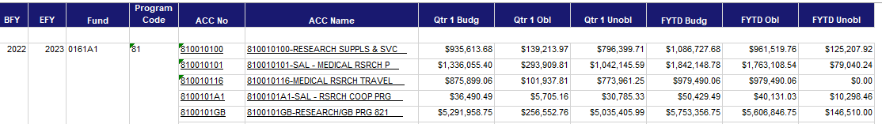
Section 1: The impact of different activities on the SOA
The SOA is like a Cash Flow Statement allowing you to quickly review your Cash received to date (allocations), Expenses (obligations and commitments) and your overall balance.
TDAs are the primary revenue source will appear in the Budg columns
Obligations, expense transfers, Purchase card order appear in the OBL columns
Your current balance appears in the FYTD Unobl
Fiscal can move Ceilings (Budg) within a program at a facility (ex. sal to all other)
Fiscal cannot move Ceilings across programs (ex. 81 to 82 or 84 to 81) or Fiscal Year (ex. BFY 22 to 23)

Slide 11
Section 1: Keeping up with the SOA
The SOA is the singular most important report available to provide you a picture of where your funds currently stand.
The SOA ties to the F20D and in some cases the Running Balances (the VISTA/IFCAP Checkbook).
It should be reviewed no less than weekly for the following:
  Items in undistributed
  Large balance changes
  Payroll distributions
  Accruals
As you get closer to the end of the year it becomes very important (this is what ORD Finance looks at).
The pretty effect – keeping a clean status.

Slide 12
Section 1: Managing under the Continuing Resolution
Continue to follow the guidance from the memo FY 23 Continuing Resolution Guidance on Budget Execution:
  Hiring: Continue to hire personnel for projects that are starting under the Schedule B Appointment Authority (under 5 CFR 213.3227(a) for Research Positions). Do not wait for the full-year enactment to start staffing projects. The required documentation to submit to Human Resources to initiate hiring remains unchanged during a CR.
  Interpersonal Agreements (IPAs) with Affiliated Non-Profit Corporations (NPCs): Obligations (1358s) may be obligated up to the determined time frame that can be afforded by the continuing resolution.
  Contracting: Submit your acquisition packages into RPO East as early as possible. If you have equipment purchases or service contracts that are needed at any time during the year, enter them into IFCAP and FORCE and request Fiscal to allow you to overcommit (VISTA) by showing them the ITA or funding sheets. This is critical to helping Contracting execute actions sooner.

Slide 13

Section 2: How to Get, Read, and Interpret the SOA
SOA? Can someone get me an SOA? BTW what does it mean?

Slide 14
Section 2: Where can I find the SOA?
The SOA can be found two different ways:
From the VSSC: | From your Budget (Fiscal) Office:
VSSC Link: VSSC - VHA Support Service Center SOA Link: SOACreateRpt - Report Viewer | Your Budget Office can provide you with the SOA. Some sites have set-up SharePoint or shared folders for the SOA to be placed in daily. Others request the SOA via e-mail as needed.

Slide 15
Section 2: What are the differences in VSSC and Budget?
VSSC | Budget Office/FISCAL
Will only show FMS data. It will not show any funds that are committed but not obligated. Remember: Committed funds include contracts not yet awarded and obligated, 1358 transactions not yet obligated by Fiscal and purchase card transactions that have not been reconciled. Will only show the ACC number assigned to the FCP. It will not have the FCP number. | Should show the committed (IFCAP pending) amounts if your Fiscal balances to IFCAP. This will only be for the quarter that you are in and will not show committed items for future quarters. It will also show the FCP numbers.

Slide 16
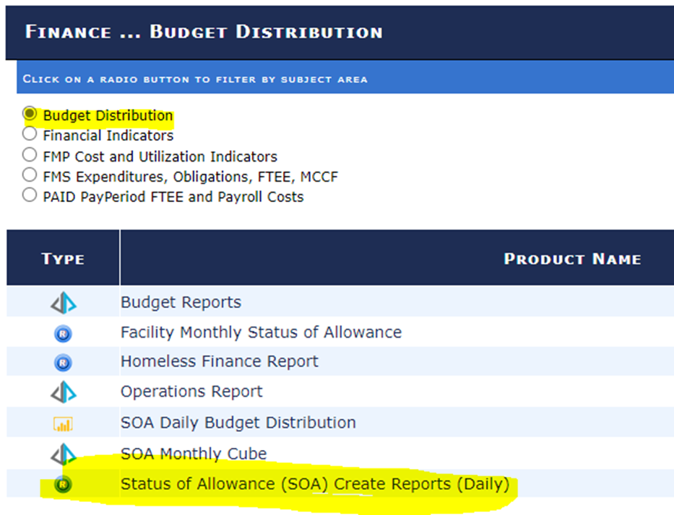
Section 2: Using VSSC

Slide 17
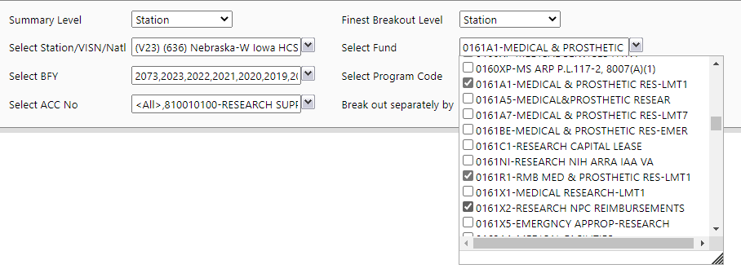
Section 2: Using VSSC
To view entire SOA for Research appropriation
You will want to select "Select All" for Select BFY, Select Program Code, Select ACC No, and Break out separately by. You can narrow it down by program and ACC code if you want to view only that specific information.

Slide 18
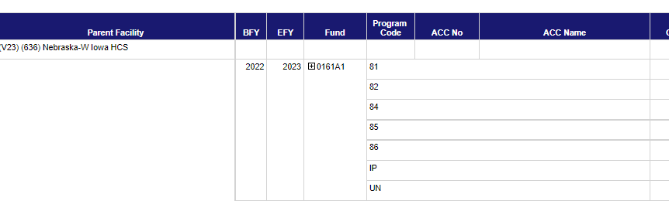
Section 2: Using VSSC
The report will show a breakdown by Program.
To see a breakdown by FCP, click on the plus sign next to 0161A1.

Slide 19
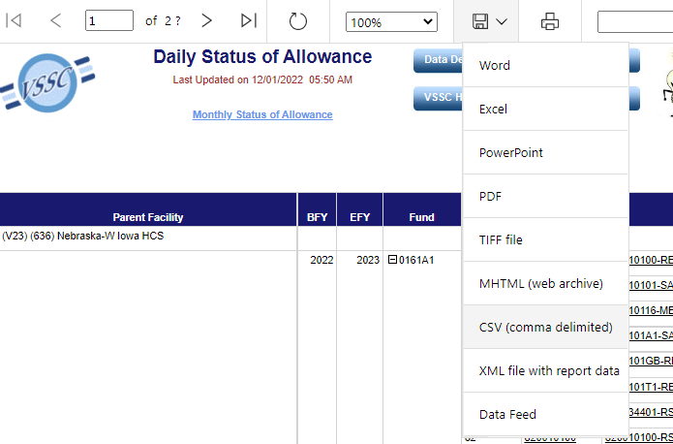
Section 2: Using VSSC
The best way to view the SOA.
Export it to Excel or CSV depending on how you want to view and utilize the format.

Slide 20
Section 2: Using VSSC
The VSSC will also break down:
The budget, obligated, and unobligated amounts by the Quarter you are in. You should just focus on the overall year-to-date amounts

Slide 21
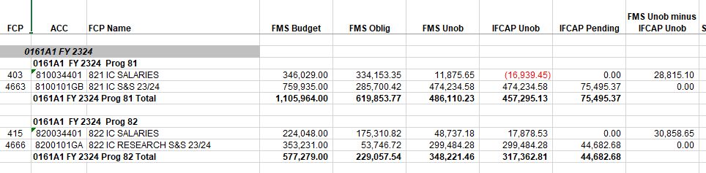
Section 2: Using Budget SOA
FCP number
Ideally, the SOA you receive from your Budget Office should look similar to this example. It will have the FCP number, only show the FMS year-to-date information and have information from IFCAP that provides you with the pending (committed) IFCAP transactions.

Slide 22
Section 2: What other tools are available
RAFT – allows you look up funds sent by ORD to the station and can be broken down by PI, Program, and date range.
Running Balance – IFCAP works like a checkbook. Broken down into two sections. The VISTA side and the FMS side.
F20D – gives you daily activity to the control point (VSSC).
Purchase Card Reports – tells you what transactions have not been reconciled.

Slide 23
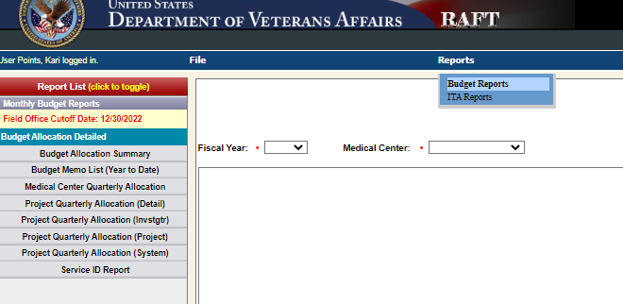
Section 2: Types of RAFT
Go to Reports – Budget Reports
All the Budget Reports are located on the left panel.
Once you pull a report, there is an option to export to excel or pdf.
View November 2022 training for more information regarding RAFT reports:
Finance Monthly Training Series: Finding, Reviewing and Executing your Budget Allocations (va.gov)

Slide 24
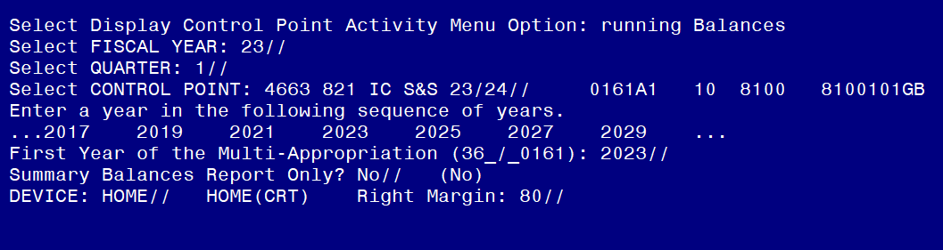
Section 2: Running Balance

Slide 25
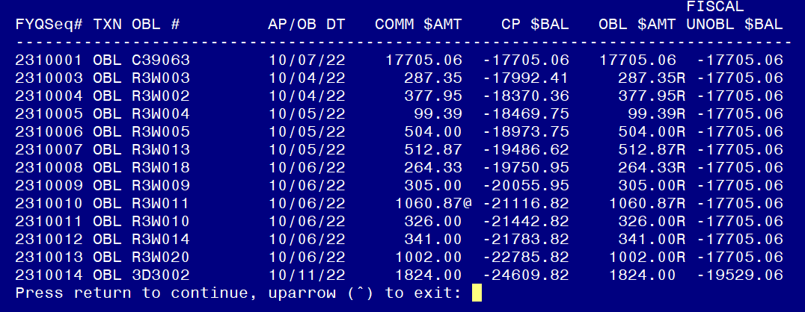
Section 2: Running Balance
The 1st section of your Running Balance (top) reflects all transactions processed through VistA/IFCAP.

Slide 26
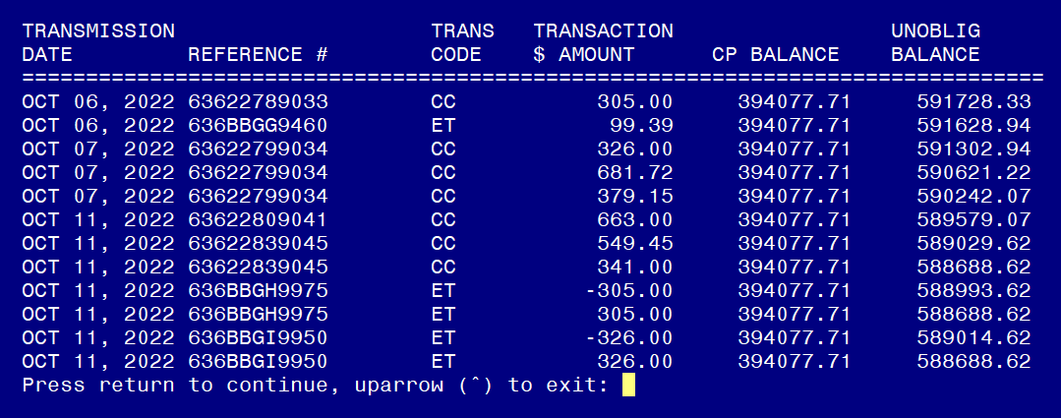
Section 2: Running Balance
All transactions and payments processed through FMS Section will transmit back to VistA/IFCAP and are listed on the 2nd section (bottom) of the running balance.

Slide 27
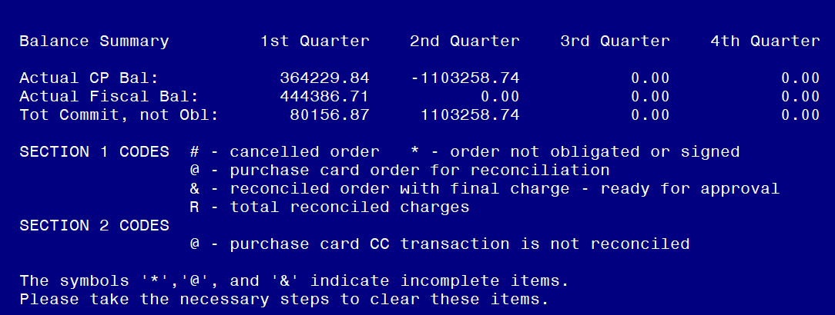
Section 2: Running Balance
The final section of the Running Balance shows you:
1) The Actual CP Balance: This is the amount unobligated remaining in the FCP and includes pending transactions.
2) Actual Fiscal Balance: This is the amount unobligated and does not include pending transactions. It should match the unobligated amount on the SOA if your Fiscal balances to IFCAP.
3) Total Commit, not Obl: This is the committed amount that is pending obligation.

Slide 28
Section 2: Running Balance
Pay attention to orders with these symbols as they are incomplete items. Particularly important when closing out prior year funds as you will need to know about any open orders.

Slide 29
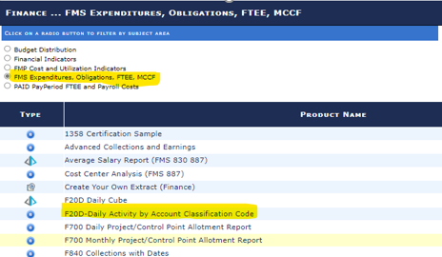
Section 2: F20D
The F20D report in the VSSC allows you to view obligations that have hit FMS on a daily basis. It also allows you to review obligations for a specific date range.

Slide 30
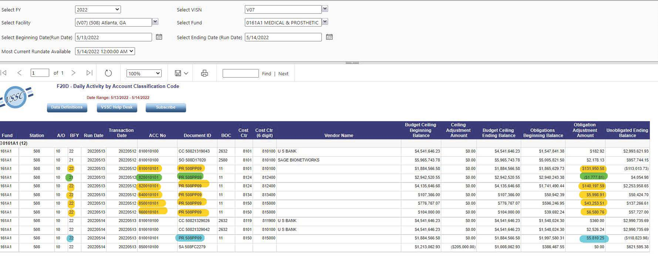
Section 2: F20
*Orange is normal Pay *Green is PY Pay *Blue is a reject

Slide 31
Section 2: Open Purchase Card Menu
If you have the approving official menu option in IFCAP, you can pull open orders (unreconciled) by Purchase Card Holder. This will allow you to know the amount committed but not obligated by each Purchase Card Holder.
This is particularly important when closing out prior year as you want to be closing out all open orders from FY22 right now. These open orders should be closed so that you can be doing cost transfers prior to the January sweep.
Work with each purchase card holder to determine the status of their open orders. If items will not be delivered in December, close the purchase order and create a new one using FY23/24 funds.
It is difficult to do cost transfers when you have items in pending as you need to factor in those amounts when requesting the cost transfer. In addition, ORD cannot see what you have in pending so the funds will get swept if the orders are not completed by January.

Slide 32
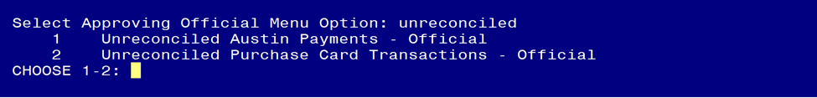
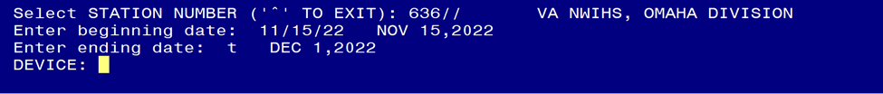
Section 2: Open Purchase Card Menu
Select #2: Unreconciled Purchase Card Transactions
Enter beginning and end date
The next report will show you the status of each unreconciled purchase card order sorted by purchase card holder.

Slide 33

Section 3: Balancing
Where are we? Do I have enough money?
Why is fiscal saying, NO!?
Notes:
John

Slide 34
Section 3: Balancing Ceilings
The ceiling is the FMS Budget column on the SOA. It represents the amount of funds you have received for the year.
It is important to balance your ceilings as TDAs come in throughout the year. The ceilings should be balanced to whatever system you use to track your budget (WinRMS, excel). Each time you ask Fiscal to place a TDA into a FCP, you should check the SOA the next day to ensure that it balances. You should periodically balance your ceilings to ensure that no changes have been made that you are not aware of.
Balancing your ceilings means that the following all have the same amount for the FCP you are balancing:
The funds in your FMS Budget column on the SOA.
The TDA amounts that you have received and requested that Fiscal place in the FCP.
The amount that you have allocated for that FCP into your tracking database.
Notes:
John

Slide 35
Section 3: Balancing Ceilings
Ceiling Moves:
You should request a ceiling move from Fiscal if you have a deficit in a FCP but not in the overall program. Note: You can move ceilings amongst a program but not across programs.
  For example: If you have a deficit in a Salary FCP but have a surplus in an All Other FCP within the same program, you can ask Fiscal to move Ceilings from the All Other FCP to the Salary FCP to correct the deficit.
Moving ceilings to correct deficits makes the SOA easier to read and has a "pretty effect". After the Ceiling move request, you should balance the ceilings again to ensure the move was correctly completed.
The ceiling move should also be adjusted in your tracking method (WinRMS, Excel) so that you can ensure you stay balanced to the SOA.

Slide 36
Section 3: Tracking Salaries
Salary Data comes from the PAID report. You can obtain the PAID report two (2) ways:
  Download into WinRMS
  Fiscal sends you the PAID Report
Regardless of how you obtain the data, you need to balance your salary expenditures to the SOA.
If you utilize WinRMS, it does salary projections, so you still need to track your salary expenditures using excel in order to ensure you are balanced to the SOA throughout the year.

Slide 37
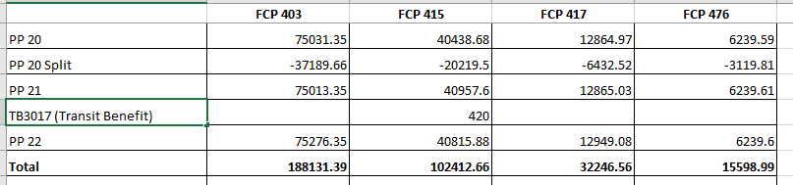
Section 3: Tracking Salaries
WinRMS will provide a sum for each salary FCP as it downloads each pay period.
If you use a different method to track your salary, you will need to total all individuals in that FCP so you can have the overall expenditures.
Below is a simple tracking method where the total charged by FCP for each Pay Period can be added as you move throughout the year.

Slide 38
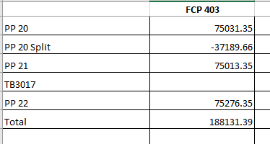
Section 3: Tracking Salaries
As you are adding each Pay Period to the tracking spreadsheet, you should ensure that the expenditures balance to the SOA.

Slide 39
Section 3: Tracking Salaries
If you don't balance, check the PAID report and Daily F20s to see if you can determine why you don't balance.
Things to look for:
  TSP Transactions
  Transit Benefit charges
  Prior Year – WinRMS does not decipher between fiscal years when it does a salary download. The F20 will tell you if a portion of the salary was actually charged to prior year FCP.
  Fiscal Adjustments

Slide 40
Section 3: Tracking All Other Expenditures
Like Salary Expenditures, whatever tool you use to manage your budget needs to be rolled up to the FCP level so you can balance your expenditures to the SOA.
The first step is to determine the total amount of expenditures for the FCP in your budget tracking database (WinRMS/Excel). This should include all obligated and committed/pending orders.
The second step is to pull the FMS Obligated amount from the SOA and add the committed/pending total from IFCAP.
  Unless your Fiscal provides you with IFCAP pending on the SOA, you will need to determine the pending amount in IFCAP to balance.
  You can determine the Pending Amount using the tools described earlier in Section 2: Running Balance, Open Orders Menu.

Slide 41
Section 3: Tracking All Other Expenditures
The amounts from Step 1 and 2 should match.
Example Step 1 – Expenditure Amount from WinRMS FCP 4663 =

Slide 42
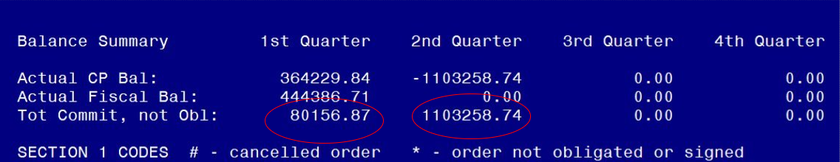

Section 3: Tracking All Other Expenditures
Step 2: IFCAP Pending Amount = $80,156.87+1,103,258.74 = $1,183,415.61
  SOA FMS Obligated Amount = $285,700.42
  Total = $1,469,116.03

Slide 43
Section 3: Tracking All Other Expenditures
What to do if you don't balance.
  Use the tools mentioned in Section 2:
    Check the Running Balance Report
    Check the F20 FMS Daily Report
  Talk to your Purchase Card Holders – Did they do an adjustment to a purchase card order?
  If you can't find the discrepancy, you can also reach out to your Fiscal Office for assistance.

Slide 44
Summary
Understanding the SOA is critical to budget management.
Keeping up with the SOA takes a bit of work but it allows you to see drastic changes, missing funds and most importantly where you stand overall by program and appropriation.
You have to make sure you separate CY from PY so you can clean up PY.

Slide 45

Questions

Slide 46
Useful Resources
VSSC - VSSC - VHA Support Service Center (va.gov)
AACS -https://vhaarcwebaacsp2.vha.med.va.gov/AACSHome/index.jsp

