Slide 1
Bi-Monthly Updates in Human Research Protections
Office of Research Protections, Policy, & Education (ORPP&E) VHA Office of Research and Development (ORD)
December 14, 2022

Slide 2

Please use the Q&A feature to submit questions.
  Please do not use Chat to send in questions.
  Be sure to send questions to “All panelists”.
We would be ever so grateful if you would complete the post-webinar evaluation survey that pops up once you exit the webinar.
Experiencing sound issues – you can call in using the number included on the handouts and on your registration confirmation email that you received.
Webinar
Housekeeping
A recording of this session and the associated handouts will be available on ORPP&E’s Education and Training website approximately one-week post-webinar
An archive of all ORPP&E webinars can be found here:
https://www.research.va.gov/programs/orppe/education/webinars/archives.cfm
For questions, please use Q&A box and address to “All Panelists.”
All Webinars will be recorded and posted within one week.

Slide 3
Purpose
The purpose of this bi-monthly webinar is to update the VA research community on the following December topics:
  VA Facility Implementation of the Centers for Disease Control and Prevention (CDC) Expanded Access Program (EAP) for use of Tecovirimat (TPOXX®) for Mpox
    Summary of Changes Revised Protocol (Version 6.2, dated October 24, 2022)
    New VA DocuSign Tool
    Updated Guidance: Patients sending copies of signed ICD and VA Form 10-5345
    Status of IMED release for CDC IRB-approved consent document (ICD) and TPOXX specific VA Form 10-5345
  Commercial IRB Issues and Resolutions, and
  Common Questions and Answers from ORD’s Regulatory Shared Mailbox.

Slide 4
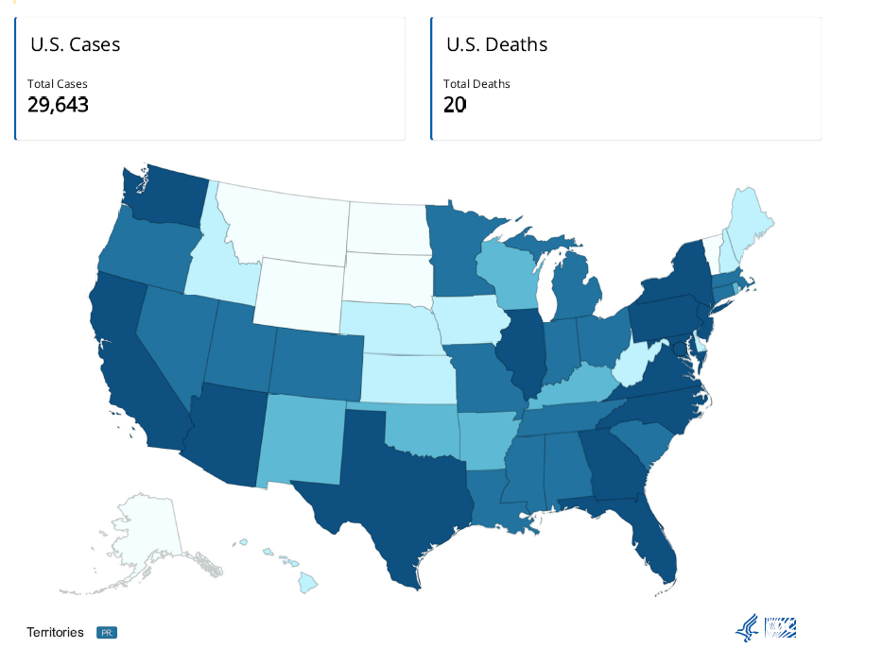
Monkeypox/Orthopoxvirus Cases: December 13, 2022
Reference: https://www.cdc.gov/poxvirus/monkeypox/response/2022/us-map.html#print

Slide 5
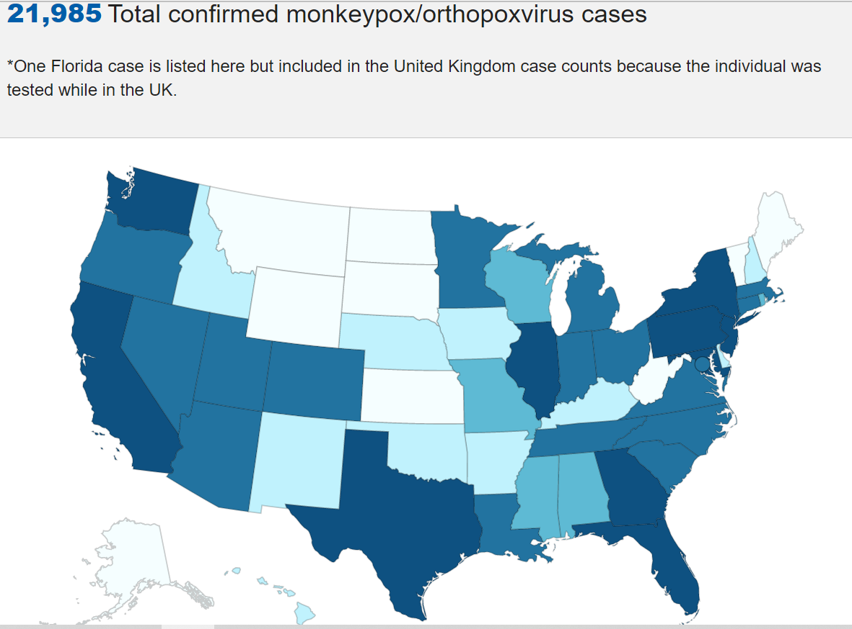
Mpox/Orthopoxvirus Cases: December 13, 2022 Compared to September 13, 2022
Reference: https://www.cdc.gov/poxvirus/monkeypox/response/2022/us-map.html#print

Slide 6
VA Facility Implementation of the CDC Expanded Access Program for Use of Tecovirimat (TPOXX®) for Mpox
Eighty-one (81) VA Facilities are currently approved to participate in the CDC EAP for Tecovirimat using CDC’s Investigational New Drug Application (IND) for the Program.
  Seventy-nine (79) VA Facilities are relying upon the CDC IRB
  Two (2) VA Facilities are relying upon their own internal IRBs
This EA-IND protocol allows access to and use of TPOXX for treatment of orthopoxvirus infections, including Mpox.
The name of the CDC Protocol: Expanded Access IND Protocol: Use of Tecovirimat (TPOXX®) for Treatment of Human Non-Variola Orthopoxvirus Infections in Adults and Children.

Slide 7
CDC EA-IND Tecovirimat Program for Mpox
ORD and the Office of Research Oversight (ORO) have established mechanisms for VHA Facilities to rely upon the CDC Institutional Review Board (IRB) to participate in the expanded access program and are coordinating many of the supporting regulatory needs to the Program.
The CDC’s EA-IND Tecovirimat Program for Mpox does not meet the definition of research under the Common Rule. However, the Program:
  Requires IRB approval, and
  Requires VA Research and Development (R&D) Committee approval.
Neither ORD nor ORO are involved in the procurement or processes to procure Tecovirimat.

Slide 8
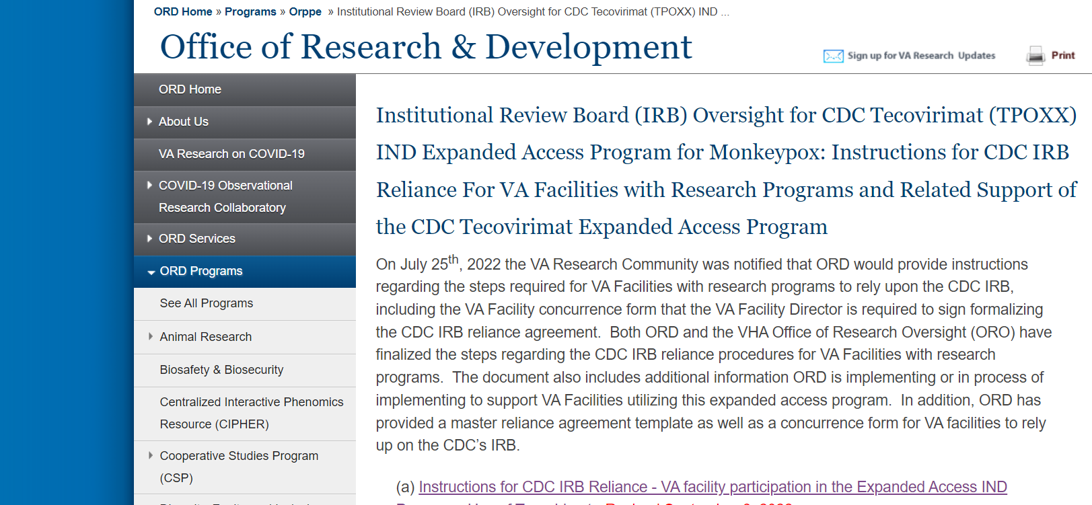
CDC EA-IND Tecovirimat Program for Mpox (cont.)
ORD has established a webpage that is frequently updated describing the steps and current forms supporting implementation of this Program:
https://www.research.va.gov/programs/orppe/CDC-IRB-TPOXX-EAIND-Program.cfm

Slide 9


CDC EA-IND Tecovirimat Program for Mpox:
PROTOCOL CHANGES INFORMED CONSENT TOPICS

Slide 10


CDC EA-IND Tecovirimat Program for MPOX:
Summary of Protocol Changes
Revised Protocol 6.2 (October 24, 2022)

Slide 11
CDC EA-IND Tecovirimat Program for Mpox:
Revised Protocol Version 6.2 (October 24, 2022)
The CDC IRB reviewed and approved a revised protocol (Version 6.2, dated 10-24-2022) with the CDC IRB approval letter dated 10-26-2022 located at https://www.cdc.gov/poxvirus/monkeypox/pdf/6402-CDC-IRB-Approval-Amendment.pdf.
A central information security review and central privacy review with approvals were completed for the revised CDC protocol (Version 6.2, dated 10-24-2022) and posted on ORD’s webpage for the Program located at https://www.research.va.gov/programs/orppe/CDC-IRB-TPOXX-EAIND-Program.cfm.
The CDC revised protocol Version 6.2 (dated 10-24-2022) did not change the CDC IRB-approved informed consent document.
  The current CDC IRB-approved informed consent document is Version 6.1 dated 08-10-2022.

Slide 12
CDC EA-IND Tecovirimat Program for Mpox:
Revised Protocol Version 6.2 (October 24, 2022) – cont.
Added Tecovirimat treatment availability through a randomized controlled clinical trial (Study of Tecovirimat for Human Monkeypox Virus – “STOMP”) under Section 2.1 Tecovirimat Eligibility of the protocol.
Section 2.1 states that “Providers should inform patients about STOMP and maximize the opportunity to provide tecovirimat treatment to patients through enrollment in STOMP. Use of Tecovirimat under this EA-IND protocol should be for patients whose voluntary participation in STOMP is not feasible (e.g., a clinical trial site is not geographically accessible)”.
There are no VA Facilities at the present time participating in STOMP.
List of STOMP participating institutions located at https://www.stomptpoxx.org/stompsites.
Added clarifying language regarding the labeled contraindication of IV Tecovirimat use in patients with severe renal impairment and certain exceptions allowed based on individual risk-benefit assessment and clinical determination by the treating providers in consultation with CDC.

Slide 13
CDC EA-IND Tecovirimat Program for Mpox:
Revised Protocol Version 6.2 (October 24, 2022) – cont.
Updated oral Tecovirimat dose for infants weighing less than 3 kg and dose preparation instructions for children who weigh less than 3 kg or weigh between 3 kg to less than 6 kg per FDA recommendations.
  Corresponding Attachment 3: Opening Capsules and Mixing with Food/Liquid Instructions was also updated accordingly.
Added clarifying language regarding clinical considerations for treatment duration beyond the standard 14-day course at a short increment of extension with monitoring for clinical improvement, virologic response or lack of response to reassess continuation or discontinuation for treatment.
Added information on the implementation of online registry required for new providers and transition to electronic Patient Intake and Clinical Outcome forms.
Added selected adverse events of interest for monitoring and reporting to CDC.

Slide 14
CDC EA-IND Tecovirimat Program for Mpox:
Tecovirimat (TPOXX) IND Online Registry for Providers and Facilities
The Tecovirimat IND Online Registry allows for convenient, time-efficient, and secure completion and return of EA-IND forms to CDC.
New providers and affiliated medical facilities providing Tecovirimat under the EA-IND protocol must register with the Tecovirimat IND online registry starting October 28, 2022.
Through the registry, providers can submit forms, including:
  Form FDA 1572
  Patient Intake Form
  Clinical Outcome Form (optional)

Slide 15
Tecovirimat (TPOXX) IND Online Registry for Providers and Facilities:
Providers Instructions
Providers who have returned required IND forms prior to the online registry transition are grandfathered in as participating providers under the EA-IND.
Any providers with valid email addresses on record should have received emails providing them access to the electronic Patient Intake and Clinical Outcome forms on October 25, 2022.
  If you have not, please register online.
Staff members of the provider are added through the provider’s registration.
  Staff members do not enter their own separate registrations but will receive a registry confirmation email for a verification step to gain access to the electronic TPOXX IND forms.
Any questions about the registry and transition to electronic tecovirimat IND Patient Intake and Clinical Outcome forms can be directed to CDC IMS TPOXXIND (eocevent477@cdc.gov).

Slide 16
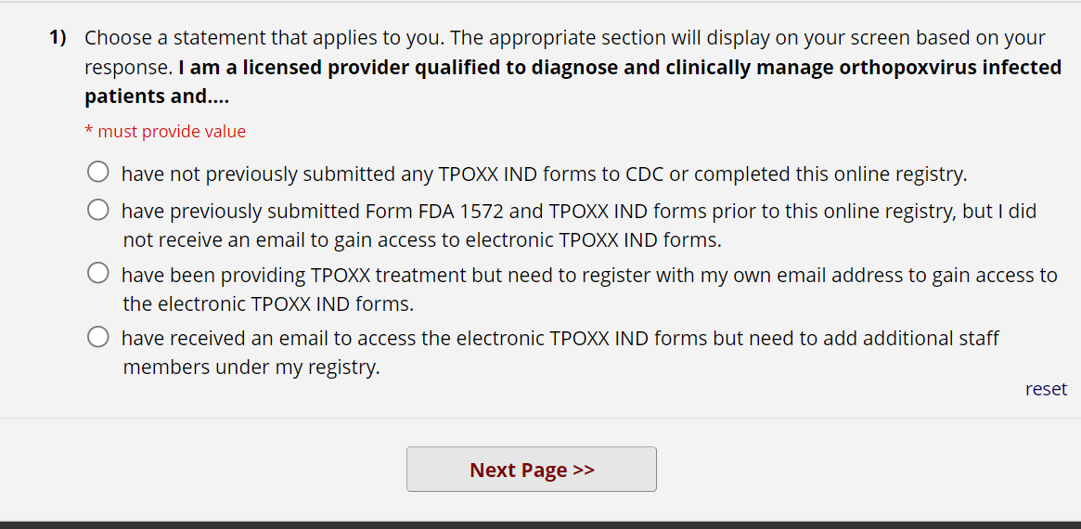
For Providers: Tecovirimat (TPOXX) IND Online Registry
Adding staff members
Tecovirimat (TPOXX) IND Registry for Providers/Facilities (cdc.gov)

Slide 17
CDC EA-IND Tecovirimat Program for Mpox
INFORMED CONSENT ISSUES

Slide 18
CDC EA-IND Tecovirimat Program for Mpox:
Informed Consent
The CDC IRB requires patients or their legally authorized representatives (LARs) to sign and date the CDC-IRB approved informed consent form unless an exception from informed consent applies.
The likelihood of a patient with Mpox meeting the criteria for an exception from informed consent is unlikely.
A copy of the signed and dated patient’s CDC IRB-approved informed consent form is not required to be returned to CDC. It would only be required as per the CDC IRB-approved protocol if the signed informed consent forms cannot be maintained at the treating facility/institution, which is not applicable for VA Facilities.
A copy of the patient’s executed consent form (not just the signature page) must be kept by the VA Facility.
A VA Form 10-5345 (Release for and Authorization to Release Health Information) is also to be completed and placed in the patient’s medical record.

Slide 19
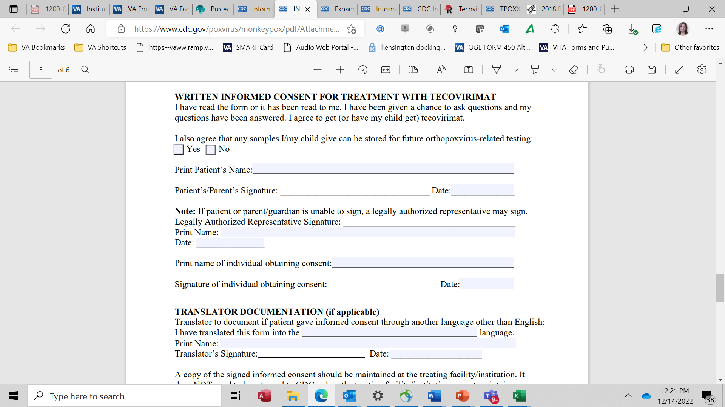
CDC IRB-Approved Informed Consent Reminder
The CDC IRB has approved the informed consent form with a requirement for the date and signature (including the printed name) of the individual obtaining consent.
Please remember to complete this requirement.

Slide 20

Many Patients in the CDC EA-IND Tecovirimat Program for Mpox are Not Consented in the VA Facility
Consent obtained remotely and not in a face-to-face physical interaction.

Slide 21
Remote Consent – Methods to Obtain Patients’ Executed Documents as Approved by the CDC IRB
Physical return of signed IRB-approved informed consent document and VA Form 10-5345 to the VA Facility’s treating provider.
VA DocuSign
Digital image (photograph/image) of each page of the executed CDC IRB-approved informed consent document and VA Form 10-5345 is sent to treating provider:
a. Taken by treating provider/provider’s team, or
b. Taken and sent by patient or patient’s LAR (when consent obtained from LAR).
4. VA iMED (deployment in January, 2023)

Slide 22
CDC EA-IND Tecovirimat Program for Monkeypox:
Informed Consent Mechanisms: VA DocuSign
ORD coordinated with the VA DocuSign team within the Office of Information and Technology (OIT), Development, Security, and Operations (DevSecOps) to develop streamlined procedures for using VA DocuSign for this Program.
ORD has developed a guidance document (September 6, 2022) titled, “ORD Guidance: Instructions for Use of VA DocuSign for VA Facilities Conducting the CDC Expanded Access Program: “Use of Tecovirimat (TPOXX®) for Treatment of Human Non-Variola Orthopoxvirus Infections in Adults and Children” (IND 116039/CDC #6402).

Slide 23
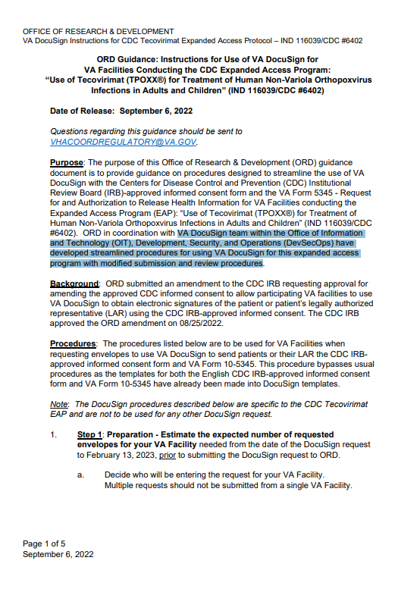
ORD Guidance on Use of VA DocuSign for the CDC EA-IND Tecovirimat Program
ORD Guidance:
Instructions for Use of VA DocuSign for VA Facilities Conducting the CDC Expanded Access Program: “Use of Tecovirimat (TPOXX®) for Treatment of Human Non-Variola Orthopoxvirus Infections in Adults and Children” (IND 116039/CDC #6402)

Slide 24
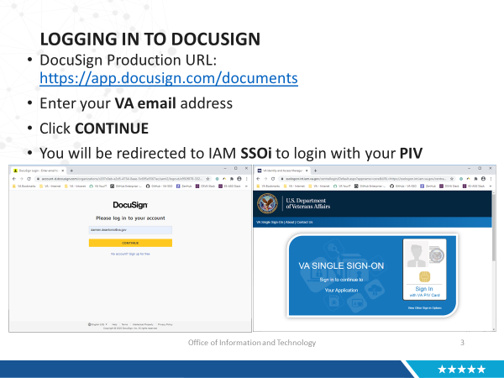
CDC EA-IND Tecovirimat Program for Mpox: Additional Job Aid Tool for VA DocuSign
The VA DocuSign Team and ORD developed a step-by-step user guide in a PowerPoint format that takes users through how to implement VA DocuSign for patients.
The VA DocuSign Job Aid for the CDC EA-IND Tecovirimat Program for Mpox is located at ORPP&E’s webpage for this Program under Additional Supporting Tools and Documents.

Slide 25
CDC EA-IND Tecovirimat Program for Mpox:
Digital Images
The CDC IRB has approved obtaining digital images (digital copies) of the CDC IRB-approved informed consent document with the executed signatures in lieu of the original signed and dated document.
  The VA Form 10-5345 may also be sent in this manner for this program.
Three methods:
  VA treating clinician takes the images;
  VA patient takes the images and sends via MyHealthe Vet; and/or
  VA patient takes and images and sends via his/her personal equipment.

Slide 26
CDC EA-IND Tecovirimat Program for Mpox:
Digital Images – VA Treating Clinician Takes the Images
The images are taken by the VA treating clinician or delegate by using a VA-approved videoconferencing platform.
The treating clinician or delegate takes a screen shot of each page as the patient holds up the page on the screen.
The VA treating clinician or delegate may also use a Government Furnished Equipment (GFE) iPhone, if available to take the images.
NOTE: VA Employees’ personal cell phones may NOT be used.

Slide 27
CDC EA-IND Tecovirimat Program for Mpox:
Digital Images – VA Patient Uses My Healthe Vet
The VA patient is sent the informed consent document and VA Form 10-5345.
The VA patient signs and dates the CDC IRB-approved informed consent form and VA Form 10-5345 at home and takes a digital image of each page.
The VA patient sends each page via MyHealtheVet secure messaging.

Slide 28
CDC EA-IND Tecovirimat Program for Mpox:
Digital Images – VA Patient Uses Personal Equipment (not MyHealtheVet)
Some VA patients may not have MyHealtheVet accounts and want to send images of the executed documents using personal computers or personal cell phones.
VHA cannot require or demand that a VA patient or their LAR send sensitive information, including personally identifiable information (PII) or protected health information (PHI) by a non-secure method in order to receive treatment or participate in a VA study.
If the VA patient wishes to use his or her personal computer or phone to send the images to VHA, the patient must be told prior to sending the images that there is a risk when sending sensitive information in an insecure manner. The risk includes loss of control of the documents. For example, the documents could be intercepted and received by a non-VA system.

Slide 29
CDC EA-IND Tecovirimat Program for Mpox:
Digital Images – VA Patient Uses Personal Equipment (not MyHealtheVet) (cont.)
If the VA patient wishes to use his or her personal computer or personal cell phone to send the images after being informed of the risks of using non-secure methods, it becomes the patient’s choice on how to return the forms.
VHA will accept the images from the patient.

Slide 30
Digital Images – VA Subjects Use Personal Equipment (not MyHealtheVet)
Important Considerations for VA Research Studies
This method has been vetted through numerous VHA Program Offices in addition to approval by the applicable IRB (for the CDC EA-IND Tecovirimat Program).
The IRB is responsible by regulation for the process and documentation of informed consent as per 38 CFR §16.111(a)(4) and (a)(5):
  (4) Informed consent will be sought from each prospective subject or the subject’s legally authorized representative, in accordance with, and to the extent required by, §46.116.
  (5) Informed consent will be appropriately documented or appropriately waived in accordance with §46.117.
If a study Investigator wished to allow VA subjects to use his/her personal cell phone to send images of the IRB-approved informed consent document to the study team, the IRB of Record for the study must grant approval.

Slide 31
CDC EA-IND Tecovirimat Program for Mpox:
Informed Consent Mechanisms: iMED
ORD and the VA iMED team will be deploying the CDC IRB-approved consent document and the VA Form 10-5345 template for the TPOXX program in January of 2023.
A national webinar will be held to demonstrate the use of the CDC EA-IND Tecovirimat IRB-approved informed consent document and VA Form 10-5345.
Prior to the webinar, instructions will be sent to all VA Facility iMED coordinators on deployment.
  The instructions are similar to the Mayo Clinic Convalescent Plasma for COVID-19 iMED national deployment of IRB informed consent document approved by the Mayo Clinic IRB.

Slide 32



Commercial (Independent) IRBs Questions Received by ORD and ORD-Approved Commercial IRBs

Slide 33
Commercial Issue: Master Protocol Changes
Over a dozen questions/requests have been received by ORD and each of ORD’s approved commercial IRBs in the last 30 days requesting changes to the master protocol, primarily on privacy or record retention issues.
  “Please include language in the protocol that written HIPAA authorization will be obtained from the subjects.”
  “Insert that VA will maintain records in accordance with VHA Record Control Schedule 10-1”.
  “Insert in protocol that any non-Veterans enrolled in the study must be given a Notice of Privacy Practice.”
  “Insert in protocol the location of records to be maintained for the VA _________.”

Slide 34
Commercial IRB Issue: Master Protocol Changes
ORD wishes to reinforce that industry-sponsored protocols are not written with specific participating institution requirements in the protocol.
No industry-sponsored clinical trial is ever going to have VA specific requirements within the protocol.
Very few industry sponsored clinical trial protocols will have any references to HIPAA because industries are not covered entities.
The commercial IRB application forms do not contain the level of detail to complete the VA Form 10-250, which then subsequently requires additional work by the VA Facility Privacy Officers in communication with the study team.

Slide 35

Questions and Answers from ORD’s Regulatory Mailbox

Slide 36
Question #1: IRB Tie Votes
Question: Our IRB voted on a study event to determine whether it was an unanticipated problem involving risks to subjects or others, and the vote was tied. How should the IRB handle a tied vote?

Slide 37
Question and Answer: IRB Tie Votes
Question: Our convened IRB voted on a study event to determine whether it was an unanticipated problem involving risks to subjects or others, and the vote was tied. How should the convened IRB handle a tied vote?
Response: If a tie vote is not addressed in the IRB standard operating policies and procedures, refer back to how a majority is defined. When there is a tie vote and majority is defined as a simple majority, there is no majority vote – the motion on the table fails that the IRB voted upon. However, when a motion fails, the convened IRB will typically entertain another motion in order to have an approved action (if approvable) on the item.

Slide 38
Question #2: Informed Consent Requirements – Specimen Banking Date of Destruction
Question: Is it required to include the destruction date if the specimen banking is not included in IRB-approved informed consent document? If yes, what is the timeline or duration allowed?
Sample Language:
“Blood samples are being collected from you as part of this study. Future use of samples will be limited to analysis and testing necessary to support regulatory approval for the LungLB test as described in this consent form. The sponsor will keep the specimens until regulatory approval is obtained or not pursued.”

Slide 39
Informed Consent Requirements – Specimen Banking Date of Destruction: Regulatory Considerations
Two key Common Rule regulations for IRB considerations:
  The Common Rule requires that the prospective subject or the legally authorized representative must be provided with the information that a reasonable person would want to have in order to make an informed decision about whether to participate, and an opportunity to discuss that information. 38§16.116(a)(4)
  Basic Element of Consent: A statement that the study involves research, an explanation of the purposes of the research and the expected duration of the subject’s participation, a description of the procedures to be followed, and identification of any procedures that are experimental. 38§16.116(b)(1)

Slide 40
Question: and Answer: Informed Consent Requirements – Specimen Banking Date of Destruction
Question: Is it required to include the destruction date if the specimen banking is not included in IRB-approved informed consent document? If yes, what is the timeline or duration allowed?
Response: Neither the Common Rule nor ORD policy in VHA Directive 1200.05(2) specifically state that a date of destruction for biospecimens must be included in the informed consent language. Individual IRBs have the discretion to decide whether or not a specific date of destruction is required as part of information to be conveyed to a prospective subject.

Slide 41
Question #3: Approvals of Non-VA Biobanks
Question: If an IRB approves a human subjects study that includes the industry sponsor banking the biospecimens, does ORD or the Office of Research Oversight (ORO) accept the use of non-VA biobank? Also, does the VA Facility need to track the non-VA biobank?

Slide 42
Non-VA Biobanks: Prior ORD “Off-Site Biobanking Waiver”
In the past, ORD had a voluntary off-site biobanking waiver process for review and approval of non-VA biobanks storing and using VA biospecimens.
The voluntary ORD off-site biobanking waiver program ended on April 1, 2017. The waiver program was never VA policy.
The discontinuation of the off-site specimen banking/storage waiver program was never intended to suggest that specimens collected from VA research may not continue to be stored/banked outside of the VA with the appropriate approvals.

Slide 43
Question and Response: Approvals of Non-VA Biobanks
Question: If an IRB approves a human subjects study that includes the industry sponsor banking the biospecimens, does ORD or ORO accept the use of non-VA biobank? Also, does the VA Facility need to track the non-VA biobank?
Response: Neither ORD nor ORO has a role in approving or accepting the use of non-VA biobanks for industry-sponsored clinical trials. However, the Cooperative Research and Development Agreement (CRADA) addresses the biospecimen use by the non-VA entity. There is no need for VA to track the use or approval of the non-VA biobank for these industry-sponsored biobanks.

Slide 44
ORD and ORO Activities for the PRIM&R Annual Conference: December 12-15, 2022
The Public Responsibility in Medicine and Research (PRIM&R) Annual Conference is a virtual event from December 12-15, 2022.
Session: ORD and ORO has taped an on-demand session listed as:
  A11: A Dialogue With the Department of Veterans Affairs (VA): A Federal Agency’s Challenges and Solutions in Working with External IRBs to Facilitate Implementation of the Cooperative Research
  The session is listed on the PRIM&R agenda for December 12, 2022 from 11:45 a.m. EST to 12:45 p.m. EST and is available for viewing by registered attendees starting on December 12, 2022.

Slide 45
Summary
ORD continues to work on guidance and tools to support VA Facilities.
ORD continues to communicate with the commercial IRBs to address issues and develop solutions and disseminate the information to the VA research community.

Slide 46
Availability of Recording
A recording of this session and the associated handouts will be available on ORPP&E’s Education and Training website approximately one-week post-webinar.
An archive of all ORPP&E webinars can be found here: https://www.research.va.gov/programs/orppe/education/webinars/archives.cfm.

Slide 47
Contact Information
ORD Regulatory Box: VHACOORDREGULATORY@VA.GOV

Slide 48
References
ORD webpage: Institutional Review Board (IRB) Oversight for CDC Tecovirimat (TPOXX) IND Expanded Access Program for Monkeypox: Instructions for CDC IRB Reliance For VA Facilities with Research Programs and Related Support of the CDC Tecovirimat Expanded Access Program
CDC webpage: Information for Healthcare Providers on Obtaining and Using TPOXX (Tecovirimat) for Treatment of Monkeypox | Monkeypox | Poxvirus | CDC
VA Specific Requirements for Informed Consent and HIPAA Authorizations When Using a Commercial IRB (September 14, 2020)
VHA Directive 1200.05(2): Research and Development Committee (January 7, 2019) at VHA Publications
ORD’s Policies and Guidance Documents webpage at https://www.research.va.gov/resources/policies/

