Slide 1

VA Funding Requirements Training to
Principal Investigators
December 14, 2023
Jason Berlow, CGFM, ORD Finance
Erin Olson, CGFM, ORD Finance
Kari Points, Iowa City VAMC

Slide 2
Section 1: The VA Research Appropriation
Appropriation Law:
  Article I, Section 9, of the U.S. Constitution, “no money shall be drawn from the Treasury, but in Consequence of Appropriations made by Law.”
  There are some basic concepts that are fundamental for your understanding of how you can obligate/expend funding from the Medical and Prosthetics Research Appropriation in your program or station. Most of these references are codified in the: Principles of Federal Appropriations Law, also known as the Red Book (GAO’s multi-volume treatise concerning federal fiscal law).
  GAO updates the Red Book’s content with new laws, federal court rulings, and appropriations law decisions.

Slide 3
FY 24 Appropriations Status
The second CR expires on January 19, 2024 (for the VA).
When Congress returns from winter recess, they will have very few days to pass another CR or enact full-year appropriations bills.
Continue to follow our CR guidance, as we anticipate we will be in CR beyond January 19th, this means:
  During this time, stations should continue to obligate current year (0161A1 24-25) for all necessary payroll, purchase cards, intergovernmental personnel agreements (IPAs) needed through the end of the CR.​
  Non-severable contracts should not be obligated past the CR period.
  Continue to follow ORD guidance for Prior Year funding, do not execute cost transfers.​

Slide 4
How does the VA differ from NIH Studies?
VA Intramural Funding | NIH Funding to Extramural Investigators
The VA is an intramural funding program. It is NOT a granting agency (we do not have grant making authority in ORD). A Principal Investigator (PI) does not receive a “grant” from the VA. They receive awards through merit reviews. When VA funds a project, VA distributes funding on an annual basis subject to the availability of appropriations. VA awards need to be spent in the year that they are appropriated. There is no carryover like there is for NIH. ORD limits project carryover to 2% due to past recissions from Congress. More restrictions on expenditures (example: vendors, IT) | When NIH funds a grant, they fund for the entire award amount. There is no carryover like there is for NIH. This can go to the University or Non-Profit (NPC). Covers effort and salary for clinicians as a direct line-item cost (vs. VERA protected effort for clinician salary that is NOT a direct line-item cost for VA merit reviews)

Slide 5
Section 2: What are the specific rules that a PI should know?
Hiring at the VA (slow process):
Work with PI to determine an appropriate GS-level based on budget availability.
Check to see if there is a nationally classified Position Description that you can use. If not, do you have one locally or is there one that you can use as a basis in the Power BI. Work with your HR liaison to review.
Do they have an individual in mind and want to complete a non-competitive recruitment?
  There are two direct hiring authorities available for research positions.
    MSA – This is for full-time positions. Part-time positions under the MSA authority are limited to one year, are non-renewable, and receive no benefits.
    Schedule B – This is for part-time positions above GS-11.
Reminder: Make sure the budget allows for hiring at the pay grade prior to processing. Factor in initial hiring, costs of benefits (benefit rate can be >40%) and cost of living increases over the award. Any performance awards which the employee receives is paid from the project budget.

Slide 6
Section 2: What are the specific rules that a PI should know?
Intergovernmental Personnel Agreements (IPAs)
The selected individual must be an employee of the affiliate (University) or of VA Non-profit foundation (MVBRF) for a minimum of 90 days prior to the start of the IPA and must be on a career appointment status. Graduate Research Assistants and students do not qualify.
Prior to the initial IPA, the individual must complete all HR credentialing requirements and Research trainings requirements.
The initial IPA may not exceed 2 years but may be extended for an additional 2 years. After the individual has reached a cumulative total of 4 years, they must be removed from the IPA program for a minimum of 1 year before they can be put on another IPA. New policy forthcoming, you must follow current guidelines.
When budgeting for an IPA, factor in costs of living increases.
It is important to note that the VA will not pay for any accrued leave. This means that any leave that is not used by the individual regardless of when earned will not be paid when the IPA is terminated.
No costs may be incurred to an IPA until the IPA is fully executed.

Slide 7
Section 2: What are the specific rules that a PI should know?
Purchase card limits are set at $10,000 for supplies and $2500 for services (see slide for how to increase limit and exceptions).
Any purchase requests exceeding that limit must go to VA Contracting. This process takes months and requests need to be made early.
Check with the purchasing agent to verify if vendor is approved by the VA. If not, a vendor request form must be filled out and approved prior to purchasing.
If items will be reoccurring at set times throughout the year and the total amount of items is above the purchase card limit, this needs to also go to VA contracting.

Slide 8
Section 2: What are the specific rules that a PI should know?
Unauthorized Commitments: When an individual places an order with a vendor for goods or services but exceeds their purchasing authority (authorized based on dollar amount and/or type of good(s)/service(s) being procured) or does NOT have the purchasing authority to spend government funds.
What does this mean for the PI?
  A PI cannot commit the government to a purchase as they do not have the authority. Here are examples that you can provide to investigators:
    A freezer breaks down in the laboratory and the investigator calls in a service team for repair. The PI submits the invoice for payment. This is NOT allowed as the investigator did NOT have the purchasing authority to spend government funds. He/she must first notify the purchasing agent and receive approval prior to the freezer being serviced.
    A freezer breaks down over the weekend and the PI goes out and purchases a new one. Then submits a request for reimbursement on Monday. This is also NOT allowed as purchase needs to be acquired through the VA purchasing agent.
    A PI wants to attend a conference and purchases their flight. Later requests reimbursement. This is NOT allowed as flights need to be purchased through Concur.

Slide 9
Section 3: Best Practices
PIs must Pay close attention to underspending on their projects. Is there a good reason for this such as:
  Delays in hiring
  Delays in contract for services or equipment
  Failure of a significant piece of equipment required to conduct the study
  Catastrophic event that damages facilities
If yes, then PI must submit a Project Modification Form (PMO) request to VACO to reallocate funds to a later fiscal year due to funds being underspent due to a situation as one described above.
A PMO should only be requested once during the time span of the project. It is not to be used on a year-to-year basis.
A PMO should be requested as soon as the need is anticipated and not at the end of the funding period.

Slide 10
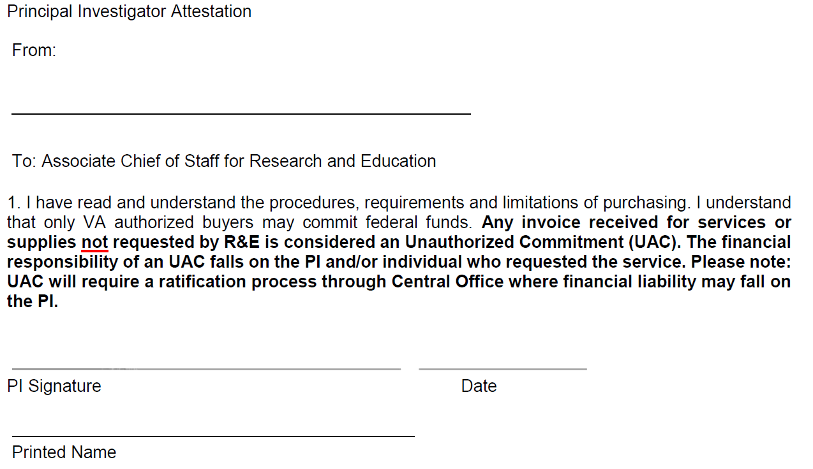
Section 4: PI Attestation Documentation

