Slide 1

R&D CONTRACTING BASICS
Submitting a Procurement Package
December 15, 2022
SETH CUSTER
Division Chief
VHA R&D Contracting Division

Slide 2

Webinar
Housekeeping
Recording - This session is being recorded and the associated handouts will be available on ORPP&E’s Education and Training website within one-week post-webinar.
Close Captioning - Now available in the new Webex platform. Click the “CC” button at the bottom left of the Webex screen.
Experiencing Sound Issues? – Call in using the number in your Webex chat box or in your registration confirmation email.
Q&A - Please use the Q&A feature to submit questions.
  Be sure to send questions to “All panelists”.
  Questions will be addressed at the end of the webinar.
Webinar Archive - Most ORPP&E webinars can be found here: https://www.research.va.gov/programs/orppe/education/webinars/archives.cfm
Post-Webinar Evaluation Survey - We are grateful to all that complete the post-webinar evaluation survey. It will automatically pop up once the webinar is exited.
For questions, please use Q&A box and address to “All Panelists.”
All Webinars will be recorded and posted within one week.

Slide 3
R&D Contracting Division
Who are we?
  1 team, 9 total staff – all East Time Zone
  Seth Custer – Division Chief/Supervisor
  Contracting Officers/Contract Specialists:
    Michael Haydo
    Lynn Portman
    Ann Marie Stewart
    Millicent “Mel” Covert
    Robin Simmons
    Rachael Talbott
    Shannon Hukriede
  Jaclyn Ferreira – Procurement Technician

Slide 4
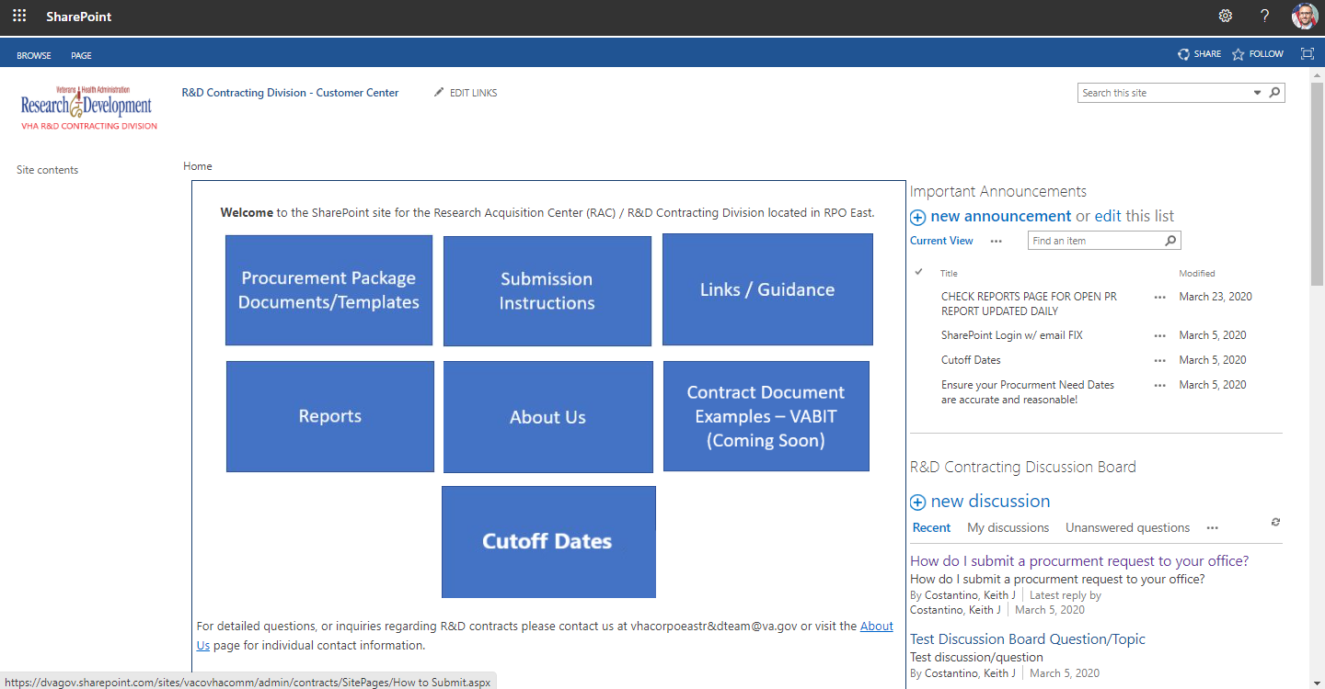
R&D Contracting Division
Where to find us?
  R&D Contracting Customer Center
  Home - R&D Contracting Division - Customer Center (sharepoint.com)

Slide 5
Objectives – for today’s training
Training Section: | By the end of this section, you will:
Section 1: Resources for Procurement Package Guidance | Know where to go to find what I need Know what checklist(s) to utilize for guidance Know who I can reach out to for help
Section 2: Documents Required for a Complete Procurement Package | Know which documents are required in a procurement package Understand why documents are to be included
Section 3: How to Submit and What to Expect Next | Tips for a good FORCE submission Know standard PALT expectations for research requirements Know where to look for status updates on procurement actions
Q&A
Notes:
Jason -Section 1; John- Section 2; Kari- Section 2 and 3

Slide 6

Let’s Get Started!
Notes:
Jason -Section 1; John- Section 2; Kari- Section 2 and 3

Slide 7
Resources for Procurement Package Guidance
Where do I begin?
  Determine type of procurement – Supply, Service, or Affiliate
  R&D Contracting Customer Center: Home - R&D Contracting Division - Customer Center (sharepoint.com)
    Set Up for your convenience… use this!
    Continuing to remake and update
  VHA Customer Reference Guide: CRG - Customer Procedures (sharepoint.com)
What if I need help?
  R&D Customer Center / Submission Instructions: R&D Contracting Division - Customer Center - How to Submit (sharepoint.com)
  Procurement Technician: Jaclyn Ferriera
  Division Chief/Supervisor: Seth Custer
  Contract Specialist/Contracting Officer
Notes:
CLICK/SHOW R&D Contracting Customer Center Site

Slide 8
Procurement Package – What to Include
What is standard?
  Procurement Checklist
  Requirement Document – SOW, PWS, SON
  Market Research
  Independent Government Cost Estimate (IGCE)
  6500.6
Other documents
  Acquisition Plan
  Justification & Approvals (J&A) / Limited Sources Justification (LSJ)
  COR Nomination Letter
  FITARA/BTT/ARM Approval
  Site-Specific Information (Memo to File)

Slide 9

Procurement Package – What to Include

Slide 10
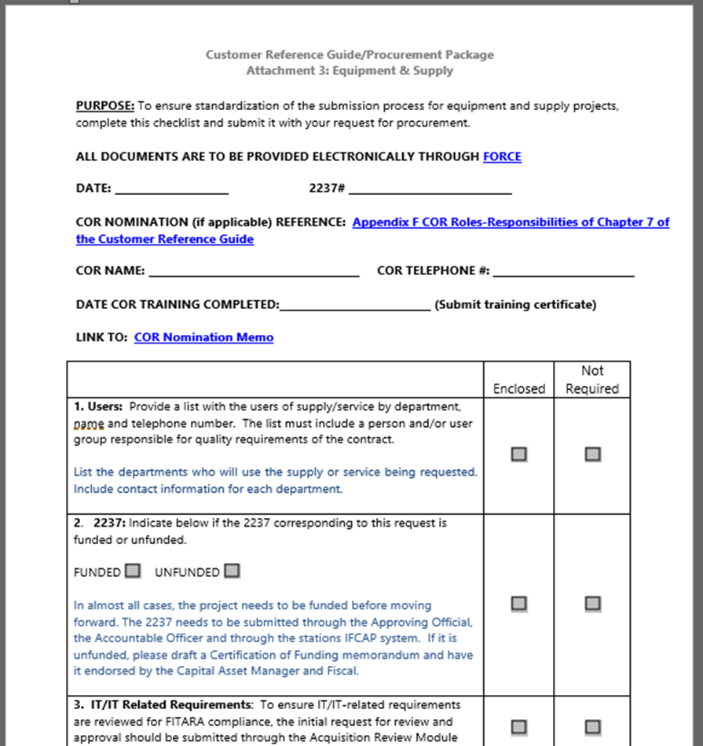
Procurement Package – Notes
Procurement Checklist
  You tell us what goes in the package!
  Pick most appropriate for type of procurement
  Take this seriously, answer honestly
  At a minimum, we should always see:
    SOW/PWS/SON
    Market Research
    IGCE
    6500.6
    Funding/2237
  Procurement Checklists: CRG - Customer Procedures (sharepoint.com)

Slide 11
Procurement Package – Notes
Requirements Document – SOW, PWS, SON
  Foundation of the requirement
  Start early
  Use clear, direct language… layman’s terms
  Be consistent – tense, tone, terminology
  Be thorough
  Include deliverables/schedule
  Make no assumptions - if it’s not in, it’s not required!
  Templates available
    VABIT: Home - VHA Acquisition Business Intelligence Tool (VABIT) (sharepoint.com)
  SOW Guidance: CRG - SOW PWS SOO (sharepoint.com)
  SOW Writing Guide: CRG - Appendix A SOW Writing Guide (sharepoint.com)

Slide 12
Procurement Package – Notes
Market Research
  Critical piece to drive the acquisition
  Collaborative effort…you know the market!
  The more, the better – be thorough
  SAM registration! ***
  Contracting contributions
    Sources Sought Notice
    Past procurements
    Web/Database searches
    Small Business size determination
    Set-aside strategy
  Market Research Guidance: CRG - Market Research (sharepoint.com)

Slide 13
Procurement Package – Notes
Independent Government Cost Estimate (IGCE)
  Should be developed from multiple sources of information (independent)
  Good market research drives good IGCE
  Sets pricing structure for contract
    Line items should relate to tasks or deliverables in SOW/PWS/SON
    Commercial standard
    Include options/out-years, if required
  Drives review requirements and contributes to lead time
  IGCE: CRG - Independent Gov Cost Estimate (sharepoint.com)
  Guidelines for Developing IGCE: CRG - Appendix B IGCE Guide (sharepoint.com)

Slide 14
Procurement Package – Notes
Security Checklist – 6500.6
  Required for all acquisitions
  Purpose is to determine if contract requires access to VA systems or sensitive information
  Joint review by CO, PO, ISSO, COR/POC/PM
  If security considerations are not applicable, must be signed by the COR/POC
  Complete Appendix A Checklist:
  6500.6 Guidance: Contract Requirements for Security (sharepoint.com)
  Hyperlinks throughout to take to the pdf version for checklist

Slide 15
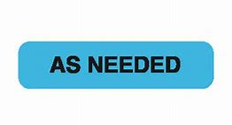
Procurement Package – What to Include

Slide 16
Procurement Package – Notes
Acquisition Plan
  Required $7M and above
  IPT required $7M and above – requires charter and formal documentation
  Purpose is to document the agreement between the COR/POC/Requestor and the Contracting Officer
  Provides clear documentation and guidance regarding program objectives
  Formally captures everything covered previously to ensure agreement and direction
  Engage early, can work on some of this before submitting to FORCE
  Acquisition Planning: Acquisition Planning (sharepoint.com)

Slide 17
Procurement Package – Notes
Justification & Approvals (J&A) / Limited Sources Justification (LSJ)
  J&A if open market; LSJ if FAR 8 (GSA/FSS)
  Be sure to use right template based on size and source
    Links available on R&D Customer Center
  Only use if there is truly only ONE viable source or affiliate
  Most critical sections are the justification and market research portions
  Sole source is verified by sources sought announcement
  J&A/LSJ Info/Templates: Other than Full and Open Competition (OFOC) (sharepoint.com)

Slide 18
Procurement Package – Notes
COR Nomination Letter
  COR vs Technical POC
  CORs are now RECOMMENDED, not required
  POCs should do almost all of same tasks (overseeing performance, certifying invoices, etc), just without formal delegation
  We will look to utilize CORs for more complex actions
  COR Guidance/Templates: COR Guidelines (sharepoint.com)

Slide 19
Procurement Package – Notes
FITARA/BTT/ARM Approval
  Federal Information Technology Acquisition Reform Act (FITARA)
  Applicable to all VA IT/IT-Related Requirements
  Driven by the Product/Service Code Selected: Product Service Codes (PSCs), Federal Supply Codes (FSCs), Federal Supply Groups (FSGs) (outreachsystems.com)
  PSC/FSC starting with D### (Services) and 7@## (Supplies) – IT and Telecom
  Link below includes overview and link to great SOP (see Policies on right of page)
  What is required?
    Must process approval to ensure item/service procured can access the network/VA information
    Initiated/Driven by COR/POC, Contracting Officer is one step in approval process
  FITARA Information: FITARA | Office of Information and Technology (va.gov)

Slide 20
Procurement Package – Notes
Local Site-Specific Information (Memo to File)
  Notes for the Contracting Office
  Narrative summary
  Desired evaluation factors/methodology
  Specify date requirements
  POCs for the action
  Distribution of Contract

Slide 21

FORCE Submission
Notes:
Jason -Section 1; John- Section 2; Kari- Section 2 and 3

Slide 22
FORCE Submission – Notes
FORCE Tips
  Select the correct site when submitting (RPO East R&D)
  Two fields for amounts
    Estimated Action Amount (or IGCE) = base year total only
    Estimated Total Amount (or IGCE Total) = total contract value
  IGCE should include pricing estimates for total contract value
  Approve 2237 after FORCE status changes to “Planning” (sends 2237 to R&D rather than NCO)
  Submit appropriate request type (New Requirement, Modification, TO, Option)
  If Mod, TO, Option, then include contract number in title

Slide 23
FORCE Submission – Notes
FORCE Tips (continued)
  Use R&D documents/templates rather than local NCO
  Title/Description should be clear to state what we’re buying
    (no vendor name, person’s name, abbreviations, etc)
  Need Dates should be realistic
    Urgent/short timelines – reach out to Seth/Jaclyn to discuss
  Do not populate CO name in new submissions
  Do not sign where CO is supposed to sign (especially J&A/LSJ)
  Do not submit 2237s for modifications, unless CO requests
  Return vs Cancel 2237

Slide 24
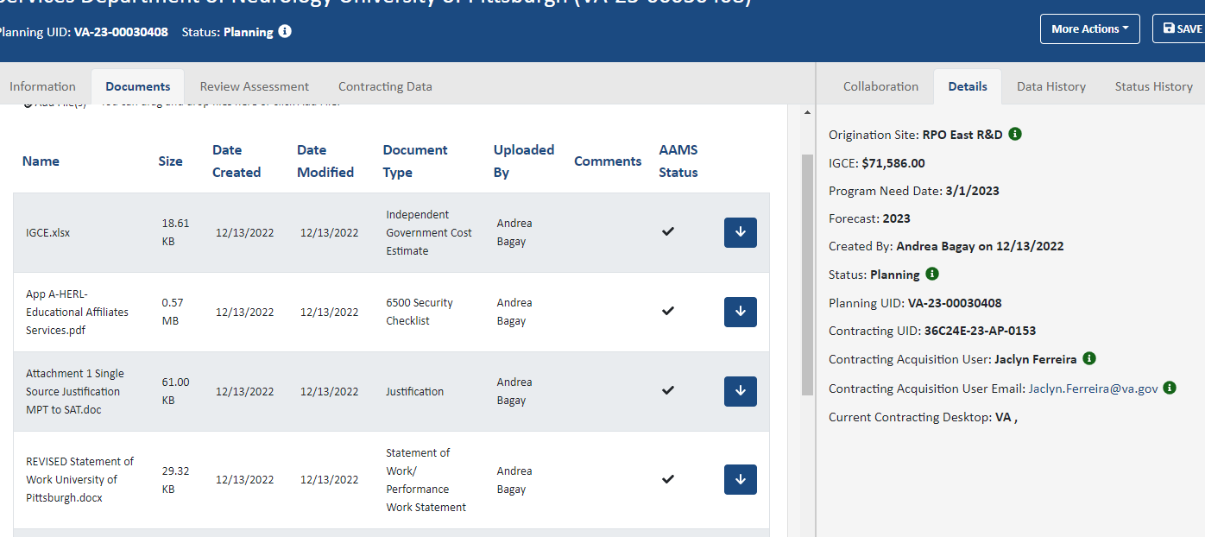
FORCE Submission – Notes
FORCE Tips (continued)
  To upload additional documents after initial submission and action is assigned (action in Planning status), click the icon on the new document to “upload to AAMS”; we will not get the document without this step; checkmark will display if done correctly; confirm with Contracting to ensure upload complete (Details tab).

Slide 25
What to Expect - PALT
PALT – Procurement Action Lead Times
  Standard requirements less than $250k 60-90 days
  Actions between $250k and $500k 120 days
  Actions between $500k and $7M 150 days
  Actions greater than $7M 180 days
Procurement Cutoff Dates for End of Year Execution
  Standard requirements less than $250k June 30
  Actions between $250k and $500k June 15
  Actions between $500k and $7M May 1
  Actions greater than $7M April 1

Slide 26
Communication Throughout
Assignment Message
  Automated email for each FORCE action assignment
Status Updates
  Working to post spreadsheet for open workload
  Tony sends out Open Workload
Communication with Contracting
  Know who is working your action
  Stay in touch!

Slide 27

Questions

