Slide 1
Status Brief Regarding the Impact of
18 U.S.C. § 209 on VA Research Programs
Presented By:
C. Karen Jeans, PhD, CCRN, CIP – Director of Regulatory Affairs
Antonio Laracuente, MBA – Director Field Operations
VHA Office of Research and Development (ORD/14RD)
Briefing Date: December 19, 2023

Slide 2
Bottom Line Up Front
The purpose of today’s presentation is to provide guidance to the field on the implementation of new legislation under the Joseph Maxwell Cleland and Robert Joseph Dole Memorial Veterans Benefits Improvement Act of 2022 (Cleland Dole Act, beginning page 2482) on the following:
  Outside earned income for the conduct of VA Research
This legislation resolved a major impediment to VA research.

Slide 3
Summary of Issue
In the past, VA employees who had compensated appointments believed they could accept compensation from an affiliate or NPC to conduct VA research outside their VA tour of duty at the VA Facility under Without Compensation (WOC) appointments.
But the Department of Justice (DOJ) concluded that the WOC exception to 18 U.S.C. § 209 did not apply if the employee had a compensated appointment. Thus, VA compensated employees who conducted VA Research outside their VA tour of duty could not be compensated by a non-Federal entity to work on VA research even if they held a separate WOC appointment (unless the State Treasury exception applied).
In December of 2022, President Biden signed into law the Joseph Maxwell Cleland and Robert Joseph Dole Memorial Veterans Benefits and Health Care Improvement Act of 2022 (Cleland-Dole Act).
This law included a provision (codified at 38 U.S.C. § 7382(b)) to address the guidance VA received from DOJ by providing a legislative solution to the 18 U.S.C. § 209 violation.
Notes:
Most VA researchers have a dual appointment with a university / academic affiliate
Historically, many are compensated part-time by VA and part time by other sources (e.g. university, NPC) for work done at VA funded by different sources
This applies to Principal Investigators as well as other employees working on the research

Slide 4
Section 7382: Cleland-Dole Act:
Legislative Solution on Outside Earned Income
‘‘(b) OUTSIDE EARNED INCOME FOR RESEARCH FOR THE DEPARTMENT.—
(1) Compensation from a nonprofit corporation established under subchapter IV of this chapter, or a university affiliated with the Department, may be paid, without regard to section 209 of title 18, to an employee described in paragraph (2), for research conducted pursuant to section 7303 of this title if—
‘‘(A) the research has been approved in accordance with procedures prescribed by the Under Secretary for Health;
‘‘(B) the employee conducts research under the supervision of personnel of the Department; and
‘‘(C) the Secretary agreed to the terms of such compensation in writing.
‘‘(2) An employee described in this subsection is an employee who has an appointment within the Department, whether with or without compensation, and without regard to the source of such compensation.’’

Slide 5
Agency Requirements to Implement Section 7382 of the Cleland-Dole Act
Section 7382 cannot be implemented by VA without implementing policy. Therefore, ORD and the Office of General Counsel (OGC) worked together to develop implementation guidance into proposed VHA Directive 1200.13 (Financial Conflicts of Interest in Research) which is scheduled for publication in calendar year 2024.
Pending publication of VHA Directive 1200.13, ORD worked with OGC Ethics Specialty Team (EST) to publish VHA Notice 2023-09(1), (Outside Compensation for Performance of VA Research) to provide immediate implementation of Section 7382 with procedural steps.
VHA Notice 2023-09 was originally published with an implementation date of December 31, 2023, for actions regarding existing projects. It was amended on December 5, 2023, to change the implementation date to February 29, 2024.

Slide 6
Agency Requirements to Implement Section 7382 (cont.)
VHA Notice 2023-09 is implemented with delegations of authority from the Secretary to the Under Secretary, then to the Medical Center Directors allowing for approval of the terms of the outside compensation.
Copies of both the Notice and the Delegation of Authority are included as appendices with this webinar.
Facilities will need to be-in-compliance with VHA Notice 2023-09 by February 29, 2024.
  Note: If your VA Facility investigators were exempt due to a State Treasury exception status, the process only applies to new projects initiated after January 1, 2024.

Slide 7
Who Are the Primary Responsible Parties to Implement
VHA Notice 2023-09?
VA Medical Facility Director (MCD) – Approving Official
Chief of Staff (COS)
  Can be delegated by MCD to be approving official.
Associate Chief of Staff for Research and Development (ACOS/R&D)
  Reviews and forwards requests,
  Ensures decisions are entered into VAIRRS, and
  Notifies the PI of decision.
  Please note that the Administrative Officer/Research can assist with these activities
Chair of VA Facility Research and Development (R&D) Committee
  Ensuring that each review assesses the request with regard to project budget appropriateness, the effort required to conduct the project, and the rationale for outside compensation.

Slide 8
Who Are the Primary Responsible Parties to Implement
VHA Notice 2023-09? (cont.)
Principal Investigator:
  Submits the project, including the project budget, through VAIRRS to the R&D Committee.
  Ensures that the following information is provided when the VA NPC or Affiliate is providing compensation to individuals who hold a VA-compensated appointment to perform the proposed VA research outside their paid tour of duty.
    Justification as to why the project requires salary support to VA-compensated employees (this could be the Affiliate-VA MOU outlining the effort and hours for all projects).
  Submits, in writing, modifications to the employee’s salary after final approval that require funder or sponsor approval or are considered substantial (>25% change to the approved effort or hours) to the ACOS/R&D for review (or to the COS if the ACOS/R&D is the PI).

Slide 9
Actions to Be Taken Now for Existing Projects: Step 1
Projects performed at VA facilities where the State Treasury Exception applied do not need to take this action.
Identify all active VA existing research projects where outside compensation is paid directly to any individual who also holds a paid VA appointment to perform the VA research.
Ensure that each project has an updated VA Innovation and Research Review System (VAIRRS) Project Cover Sheet and completed Study Team Tracking wizard.
Make sure the funding source is accurate and updated in VAIRRS.
Identify the VA employees that are receiving outside compensation and mark accordingly (explained at end of training).

Slide 10
Actions to Be Taken Now for Existing Projects: Step 2
Complete the Memorandum: Request for Outside Compensation from the Affiliate of VA NPC
  Delineate the project, effort, and proposed amount of outside compensation;
Have the ACOS Review and forward to the Approving Official (MCD or COS); and
If the Approving Official approves, the memorandum is filed in VAIRRS with a copy provided to the Affiliate or NPC.

Slide 11
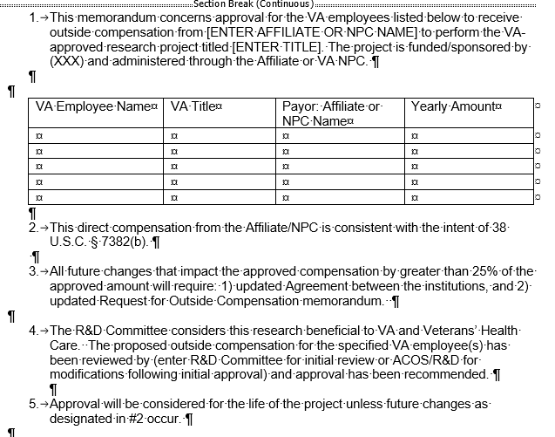
Sample Memo

Slide 12
Actions to Be Taken Now for Existing Projects: Step 3​
If the approving official disapproves, one the following must occur:
  The VA employee, such as the VA investigator or VA research staff employee, must decline the additional salary support and restructure the budget.
  The VA NPC or Affiliate must develop a Memorandum of Understanding (MOU) to reimburse VA for the investigator and staff effort.
  The award must be assigned to another VA investigator without a financial conflict of interest to serve as the VA investigator. The primary investigator can no longer act as a VA investigator on the VHA portion of the study.
  The award must be closed at VA and fully moved to the Affiliate. If this is the option pursued, consideration must be given to all administrative, regulatory and data management issues associated with the proper conduct of the study.

Slide 13
Actions to Be Taken for New Projects
The only difference with New Projects is that the required review must be done and the outside compensation approved prior to the project initiating. This action applies to all projects regardless of the State Treasury Exception.
The Chair of the R&D Committee must ensure that each review assesses the request with regard to:
  project budget appropriateness,
  the effort required to conduct the project, and
  the rationale for outside compensation (i.e., why the work cannot be completed during the employee’s VA tour of duty).
The Chair of the R&D Committee must review the memorandum submitted by the ACOS/R&D if the ACOS/R&D is the employee conducting the research.

Slide 14
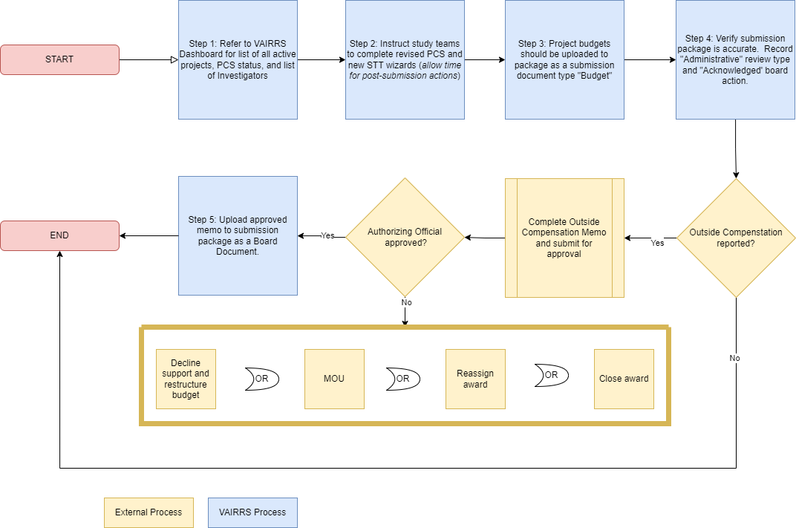
Demonstration

Slide 15
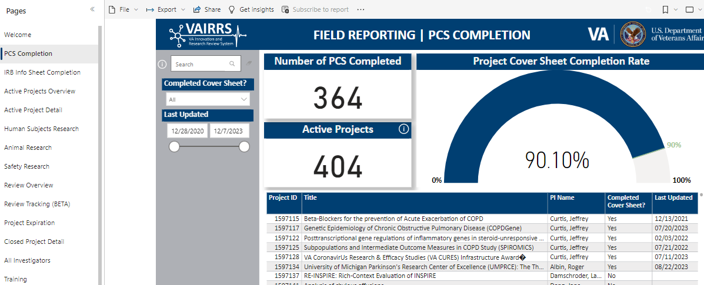
Demonstration – Step 1
https://dvagov.sharepoint.com/sites/VHAORPPE/VAIRRS/SitePages/Dashboards.aspx

Slide 16
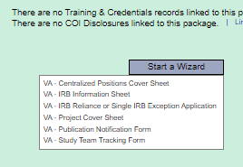
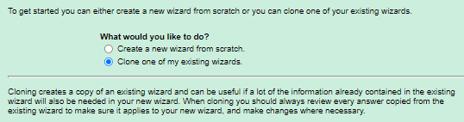
Demonstration – Step 2
1
2

Slide 17
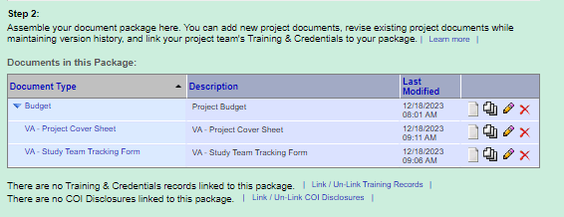
Demonstration – Step 3

Slide 18
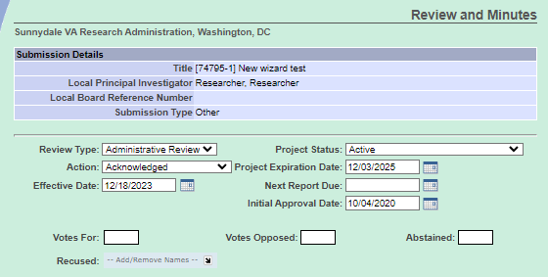
Demonstration – Step 4

Slide 19
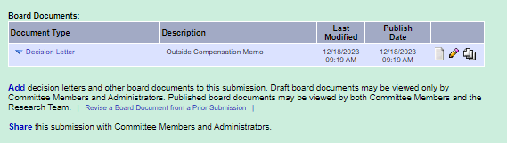
Demonstration – Step 5

Slide 20
References
The Joseph Maxwell Cleland and Robert Joseph Dole Memorial Veterans Benefits and Health Care Improvement Act of 2022 § 182 (2022),
VHA Notice 2023-09(1): Outside Compensation for Performance of VA Research (November 28, 2023; amended December 5, 2023) located at VHA Publications
ORD Webpage: Outside Compensation Guidelines located at Outside Compensation Guidelines: Guidance under development (va.gov)
  Delegation of Authority from Secretary to the Under Secretary - Outside Compensation
  Delegation of Authority from Under Secretary to Facility Directors
  Matrix: Scenarios and Considerations for Outside Pay to VA Compensated Investigators and Staff Engaged in VA Research
Sample Memo -

