Slide 1
Bi-Monthly Updates in Human Research Protections
Office of Research Protections, Policy, & Education (ORPP&E) VHA Office of Research and Development (ORD)
June 28, 2023

Slide 2

Please use the Q&A feature to submit questions.
  Please do not use Chat to send in questions.
  Be sure to send questions to “All panelists”.
We would be ever so grateful if you would complete the post-webinar evaluation survey that pops up once you exit the webinar.
Experiencing sound issues – you can call in using the number included on the handouts and on your registration confirmation email that you received.
Webinar
Housekeeping
A recording of this session and the associated handouts will be available on ORPP&E’s Education and Training website approximately one-week post-webinar
An archive of all ORPP&E webinars can be found here:
https://www.research.va.gov/programs/orppe/education/webinars/archives.cfm
For questions, please use Q&A box and address to “All Panelists.”
All Webinars will be recorded and posted within one week.

Slide 3
Discussion Items
The purpose of this bi-monthly webinar is to update the VA research community on the following June topics:
  Updates to the CDC TPOXX Expanded Access Program (EAP) for Mpox, including:
    CDC IRB-approved revised protocol (Version 6.3, dated May 5, 2023),
    CDC IRB-approved revised informed consent document (Version 6.3, dated May 5, 2023) and release of revised VA DocuSign version,
    CDC Regulatory Affairs Office’s clarification to ORD on procedures to revise “lead clinical provider”, and
    CDC request for obtaining information on VA Facilities wishing to close the CDC TPOXX EAP.

Slide 4
Discussion Items (cont.)
  Student research issues
  Commercial IRB issues, including revisions in the following documents:
      VA Specific and Selected 2018 Common Rule Informed Consent Requirements When Using an Independent-Commercial IRB, and
      Checklist for VA Facilities Using Independent Commercial IRBs-ICDs and Combined ICD-HIPAA Authorizations.

Slide 5
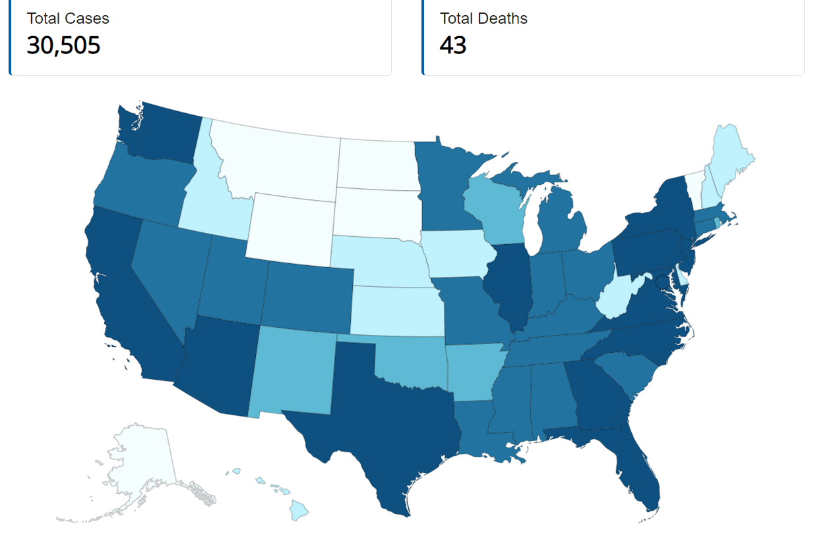
Monkeypox/Orthopoxvirus Cases: June 21, 2023
Reference: https://www.cdc.gov/poxvirus/mpox/response/2022/us-map.html#print

Slide 6
VA Facility Implementation of the CDC Expanded Access Program (EAP) for Use of Tecovirimat (TPOXX®) for Mpox
Eighty-one (81) VA Facilities were approved to participate in the CDC EAP for Tecovirimat using CDC’s Investigational New Drug Application (IND) for the Program.
  Seventy-nine (79) VA Facilities rely upon the CDC IRB.
  Two (2) VA Facilities rely upon their own internal IRBs.
This EA-IND protocol allows access to and use of TPOXX for treatment of orthopoxvirus infections, including Mpox.
The name of the CDC Protocol: Expanded Access IND Protocol: Use of Tecovirimat (TPOXX®) for Treatment of Human Non-Variola Orthopoxvirus Infections in Adults and Children.

Slide 7
CDC EA-IND Tecovirimat Program for Mpox
ORD and the Office of Research Oversight (ORO) established mechanisms for VHA Facilities to rely upon the CDC Institutional Review Board (IRB) to participate in the expanded access program and are coordinating many of the supporting regulatory needs to the Program.
The CDC’s EA-IND Tecovirimat Program for Monkeypox does not meet the definition of research under the Common Rule. However, the Program:
  Requires IRB approval, and
  Requires VA Research and Development (R&D) Committee approval.
Neither ORD nor ORO are involved in the procurement or processes to procure Tecovirimat.

Slide 8
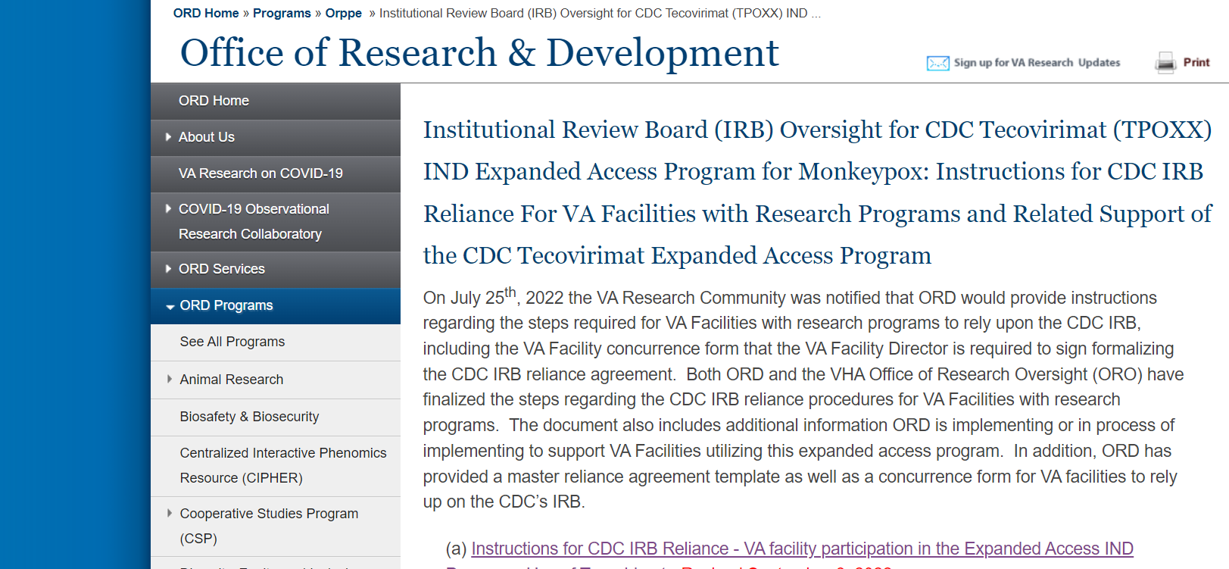
CDC EA-IND Tecovirimat Program for Mpox (cont.)
ORD has an ORD webpage describing the steps and current forms supporting implementation of this Program:
https://www.research.va.gov/programs/orppe/CDC-IRB-TPOXX-EAIND-Program.cfm

Slide 9
CDC Expanded Access Program for Use of Tecovirimat (TPOXX®) for Mpox: Revised Protocol and Informed Consent Document
The CDC revised the protocol and informed consent document (ICD).
  Current CDC IRB-approved protocol is Version 6.3 (May 5, 2023)
  Current CDC IRB-approved informed consent document (ICD) is Version 6.3 (May 5, 2023).
CDC published the revised protocol and ICD on June 7th on the CDC TPOXX EAP website at Information for Healthcare Providers: Tecovirimat (TPOXX) for Treatment of Mpox | Mpox | Poxvirus | CDC.
CDC IRB approval of the EAP IND protocol will expire on July 23, 2023. The CDC EAP IND program is expected to undergo IRB continuing review prior to expiration.

Slide 10
CDC EAP IND Program: Revised Protocol Version 6.3; May 5, 2023
Summary of protocol revisions approved by the CDC IRB under expedited review:
  Added/updated relevant information from the 2022 Mpox response;
  Included relevant updates from the CDC’s published interim clinical guidance for treatment of mpox, treatment considerations based on severity of Mpox disease, revised text regarding clinical trial (STOMP) for Tecovirimat treatment;
  Added clarifying text regarding duration therapy and available information regarding Tecovirimat resistance; and
  Updated the instruction for enhanced clarity regarding completion of Patient Intake, Clinical Outcomes, MedWatch forms for submitting to CDC with text clarification on evolving outbreak or public health emergency situations that may change reporting requirements.

Slide 11
CDC EAP IND Program: Revised Protocol Version 6.3; May 5, 2023 (cont.)
Summary of protocol revisions approved by the CDC IRB under expedited review:
  Added clarifying text on no patient-specific results being reported back to providers and patients on Tecovirimat resistance and PK testing.
  Revised summary on the clinical use of Tecovirimat for treatment of NV-OPXV-infected patients (2007-2021) and added a summary of Tecovirimat clinical uses during the 2022 Mpox response.
Protocol revisions do not impact privacy or information security.

Slide 12
CDC EAP IND Program: Revised Informed Consent Document
Version 6.3; May 5, 2023
Informed consent document revisions approved by the CDC IRB under expedited review include:
  Updates clarifying that patient-specific tecovirimat resistance result cannot be reported due to CLIA regulations,
  Clarified purpose of optional specimen and blood sample,
  Revised the text under “What about privacy?” for enhanced clarity,
  “Mpox” substituted for “monkeypox” in multiple sections, and
  Rephrasing of some sentences for clarity.

Slide 13
Revising Your VA Facility’s Template if Using VA DocuSign
If your VA Facility is currently using VA DocuSign for the CDC TPOXX IND EAP program, please do the following:
  Send the following information to the DocuSign SaaS email (IAMDocuSignPOCs@va.gov)
    Subject line: SR 2839 Monkey Pox study (VA Name and Location)
    Submit a revised table (Word version located on ORD’s TPOXX IND EAP website): Example:
Name of VA Facility: Central Arkansas Veterans Healthcare System
ORD ID Number | 123
Number of Envelopes Approved by ORD | 15
Treating Clinicians and Usernames | Treating Clinicians and User Emails
S. Doe | s.doe@va.gov
A. Study Coordinator | a.studycoordinatory@va.gov
A. Nurse | a.nurse@va.gov
J. Doe | j.doe@va.gov

Slide 14
Revising Your VA Facility’s Template if Using VA DocuSign (cont.)
The table contains the following information:
  Site PIs (Treating Clinicians) Names and emails
  ORD DocuSign Line ID # (for your VA Facility)
  The number of approved envelopes
  Usernames:
    List the first and last names of the treating clinicians and treatment team members who will send the DocuSign envelopes (such as the treating clinician’s nurse or coordinator) containing the informed consent form and the VA Form 10-5345 to obtain the signatures with the patient or LAR and who will be obtaining consent.

Slide 15
Revising Your VA Facility’s Template if Using VA DocuSign (cont.)
The DocuSign team has already updated the master CDC TPOXX IND EAP informed consent document for Version 6.3 (May 5, 2023).
IAM will notify the individuals listed as the study point of contact and PI of IAM approval via email.

Slide 16

What is Required if Your VA Facility Wishes to Voluntarily Close the CDC Tecovirimat EAP for Mpox at Your Site?

Slide 17
Closure Procedures for VA Facilities Using the CDC IRB for the CDC Tecovirimat EAP for MPOX If Your Site Chooses to Close
Email the CDC Regulatory Affairs Office at regaffairs@cdc.gov and include the answers to these questions:
  How many patients have been treated with Tecovirimat at your site?
  Does your pharmacy have any Tecovirimat at your site?
Please copy the following on your email to the CDC Regulatory Affairs Office:
  Irbrelianceandsirbexceptions@va.gov
  Priscilla.Craig@va.gov
  Elizabeth.Clark3@va.gov
Close the program with your VA Facility’s Research and Development (R&D) Committee after the CDC Regulatory Affairs office acknowledges the VA Facility’s email notifying them of closure.

Slide 18
Closure Procedures for VA Facilities Using the CDC IRB for the CDC Tecovirimat EAP for MPOX (cont.)
The CDC Regulatory Affairs Office is requesting assistance on identifying VA sites that wish to close the CDC TPOXX IND EAP.
  Eight (8) VA Facilities have already closed the program at their sites.
ORD will do a data call in mid-July for currently active VA Facilities requesting the following information:
  Current site investigators and sub-investigators;
  Confirmation that each listed Investigator/clinician is included in the TPOXX IND Online Registry; and
  Request to inform ORD and CDC if site wishes to close the CDC TPOXX IND EAP.

Slide 19

What if There is a Change in the Lead Clinical Provider/Lead Investigator?

Slide 20
What is Required if a VA Facility’s Lead Clinical Provider/Lead Investigator) Changes?
Anytime the lead clinician (i.e., site investigator) changes (Box 1 of Form FDA 1572), regaffairs@cdc.gov should be alerted of who the new site investigator is and who they are replacing.
The new site investigator should register via the TPOXX IND Online Registry, which includes completing and signing Form FDA 1572.

Slide 21
Instructions from CDC for Lead Clinician Provider (Site Investigator) and Sub-Investigators
Lead clinicians (i.e., site investigators) need to register under the CDC TPOXX IND EAP by completing the TPOXX IND Online Registry prior to or no later than 7 calendar days of first prescribing or administering Tecovirimat, including:
  Completing and signing Form FDA 1572, which serves as an agreement to abide by the IND regulations for use of Tecovirimat under the CDC-held EA-IND protocol.
A licensed clinician who is trained and qualified to manage and care for patients with orthopoxvirus or Mpox virus infection can serve as the lead site investigator on the Form FDA 1572 (Box 1).
  Other healthcare providers involved in patient care can be listed as sub-investigators in Box 6 of Form FDA 1572.
One signed Form FDA 1572, with all other healthcare providers providing care listed in Box 6 as sub-investigators, suffices for all Tecovirimat treatments administered under the EA-IND at the same facility.

Slide 22
Summary of CDC TPOXX IND EAP Updates
An ORPP&E update will be sent to the field this week summarizing the updates with inclusion of the content on ORD’s TPOXX IND EAP webpage
The CDC updated the revised protocol (Version 6.3) and ICD (Version 6.3) on May 5, 2023 with publication on its website on June 7, 2023.
If your VA Facility is currently using VA DocuSign for the ICD, please update your VA Facility’s template by submitting a table with the required information to the DocuSign SaaS email (IAMDocuSignPOCs@va.gov) under the subject line: SR 2839 Monkey Pox study (VA Name and Location).
  An example table (Word version) is located on ORD’s TPOXX IND EAP webpage.
Please notify CDC’s Regulatory Affairs Office at regaffairs@cdc.gov if the lead clinical provider is changing.
ORD will do a data call in July to obtain CDC-requested information on:
  current clinicians,
  registry status, and
  sites wishing to close the CDC TPOXX IND EAP.

Slide 23

Student Research

Slide 24
ORD Policies and Trainee/Student Research
ORD policies directly related to trainee/student research are described in VHA Directive 1200.02(1): Research Business Operations, Paragraph 10.
ORD policy defines “trainees” and includes specific requirements for trainees/students wishing to conduct research involving VHA, including using VA data and/or specimens.

Slide 25
ORD Policies and Trainee/Student Research: Key Policy Statements within VHA Directive 1200.02(1), Paragraph 10
b. Trainees as defined above may conduct research at a VA medical facility and serve as a co- or sub-investigator, use VA data, or use human biological specimens that have been collected within VA for clinical, administrative, or research purposes. Trainees who do not fulfill the requirements specified above cannot participate in VA research unless the VA medical facility Designated Education Officer seeks a waiver from the Chief Academic Affiliations Officer or designee, and the CRADO.

Slide 26
ORD Policies and Trainee/Student Research: Key Policy Statements within VHA Directive 1200.02(1), Paragraph 10 (cont.)
c. Trainees must have a VA Investigator sufficiently experienced in the area of the trainee’s research interest to serve as the PI. The PI is responsible for ensuring that the trainee:
(1) Complies with all applicable local VA medical facility, VA, and other Federal requirements including those related to human subjects or animal safety, use of radioactive substances, information security, privacy, and other research processes;
(2) Completes or terminates the study in an orderly fashion prior to leaving VA in accordance with all applicable local, VA, and other Federal requirements;
(3) Provides the VA Research Office with an inventory of all research records to be retained at VA in accordance with the Record Control Schedule 10-1.
d. Students from unaffiliated academic institutions in the community may not be permitted to conduct student projects in VA or be given a WOC appointment for the sole purpose of conducting student research.

Slide 27
What are the Two Most Common High Volume Queries ORD Receives Related to Trainee/Student Research?
Is the proposed activity research?
How can VA employees conduct the proposed trainee/student research if there is no academic affiliation with the VA Facility and/or there is no VA Principal Investigator?

Slide 28
Scenario for Discussion
This is an actual case with facts presented initially as follows:
  A trainee who is a VA employee is working on a dissertation in nursing.
  The VA Facility has an academic affiliation with the trainee/VA employee’s university educational program/nursing program.
  There is no control group in the proposed project.
  The VA employee/trainee has completed VAEDA, and the VAEDA determination states the activity is not research and is quality improvement.
What questions should be asked?

Slide 29
Scenario for Discussion (cont.): Questions and Comments Initially Made by ORD
Dissertations are research.
Is the proposed activity a dissertation or something else?
VAEDA determinations are based on self-entry; the determination must be validated.
ORD requested that the following questions be sent to the VA employee/trainee:
1. What is the degree program – PhD or DNP?
2. Is the project being done as a dissertation or a capstone?
3. Will the project require IRB approval at the University?

Slide 30
Scenario for Discussion (cont.): Responses to Questions
What is the degree program – PhD or DNP?
Response: The degree program is Doctorate of Nursing Practice (DNP).
2. Is the project being done as a dissertation or a capstone?
Response: The project is being done as a capstone.
3. Will the project require IRB approval at the University?
Response: “Affiliated” University requires IRB approval.
What next question should be asked next based on the responses?

Slide 31
Scenario for Discussion (cont.): Next Question Based on Responses
The responses indicate that the degree program is a Doctorate of Nursing Practice (DNP).
Capstones are not usually research activities.
The question asked in follow-up was:
Does the project actually require approval by the IRB or is the IRB required to make a determination that the activity is not human subjects research?
Response: The University IRB submission is for their IRB to make a determination that the project is not human subjects research.
Scenario conclusion: After review of the proposed activity, it is confirmed that the proposed activity is not research.

Slide 32
Scenario for Discussion (cont.): What If?
What if:
  The proposed project involved a VA employee/trainee conducting a dissertation for the employee’s PhD from a non-affiliated university at your VA facility.
  The proposed project submitted by a student/trainee was determined to be human subjects research by the University IRB, but the reviewer at the VA Facility determined that the project was not human subjects research (or the reverse).
  The student/trainee who is a VA employee proposing to conduct the research project is from a VA Facility that does not have a research program and wishes to conduct the research at your VA facility with a research program.
  The student/trainee proposing to conduct the research project cannot find a VA Principal Investigator (PI) and contacts the research office.

Slide 33

Take Home Messages to Remember for Trainee/Student Research
ORD polices for trainee/student research in VHA Directive 1200.02(1) are not optional.
Academic affiliation agreements are executed between institutions; not students.
If the proposed project is not research, research has no role in approving the project.

Slide 34



Commercial (Independent) IRB Issues

Slide 35
Inclusion of VA and Select 2018 Common Rule Requirements into VA Informed Consent Documents
All of ORD’s approved Commercial IRBs expect VA Facilities to add VA-specific informed consent requirements into the model informed consent documents (ICDs) prior to submission to the Commercial IRB.
All VA research requiring IRB-approved ICDs is required to include the applicable 2018 Common Rule ICD elements. However, the majority of VA studies overseen by ORD-approved Commercial IRBs are sponsored by industry.
Studies sponsored by industry, unlike studies sponsored by the National Institute of Health (NIH), do not routinely include the 2018 Common Rule Requirements in model ICDs.

Slide 36
Inclusion of VA and Select 2018 Common Rule Requirements into VA Informed Consent Documents (cont.)
In April, ORD released new tools and a checklist to facilitate review of VA studies sponsored by industry and to assist VA Facilities and their study teams:
  These tools have been revised based on user input and released with a version date of 06-28-2023:
    VA Specific and Selected 2018 Common Rule Informed Consent Requirements When Using an Independent-Commercial IRB
    VA HIPAA Authorization Requirements When Using an Independent (Commercial) IRB
    Checklist for VA Facilities Using Independent Commercial IRBs-ICDs and Combined ICD-HIPAA Authorizations

Slide 37
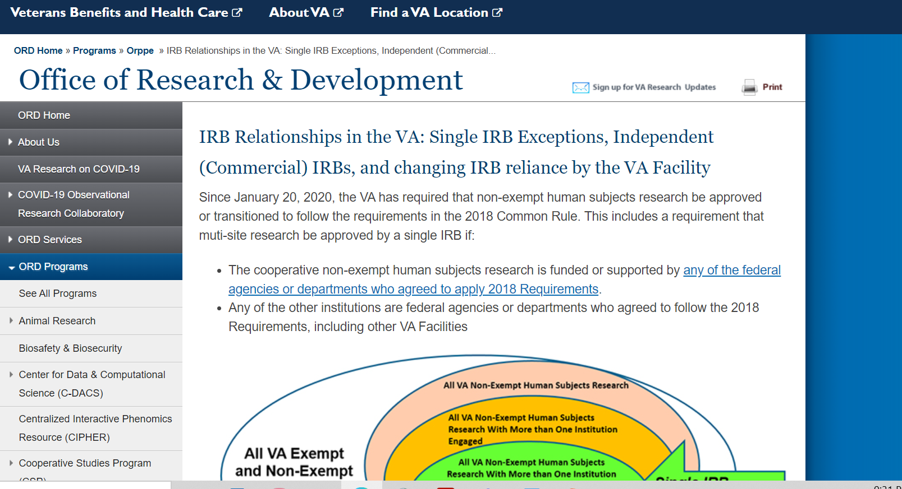
Tools: Inclusion of VA and Select 2018 Common Rule Requirements into VA Informed Consent Documents
The revised Tools and Checklists will be available on ORD’s webpage at IRB Relationships in the VA: Single IRB Exceptions, Independent (Commercial) IRBs, and changing IRB reliance by the VA Facility and in the VAIRRS Standard Library

Slide 38
Revised Tool: VA Specific and Selected 2018 Common Rule Informed Consent Requirements When Using an Independent-Commercial IRB (06-28-2023)
Revisions include :
  Removed prior statement on page 1 that the VA Form 10-0493 must be submitted with the independent (commercial) IRB application submission.
  Clarified that for VA required language related to (a) treatment for research-related injury and (b) costs for research, the following statement in comments:
    It is preferred (but not required by ORD policy) that sponsors remove their template language addressing research-related injuries if present.
  Added additional statements in the “Comments” for VA required language applying to studies with a Certificate of Confidentiality (CoC) that the language is only applicable if the study already has a CoC.

Slide 39
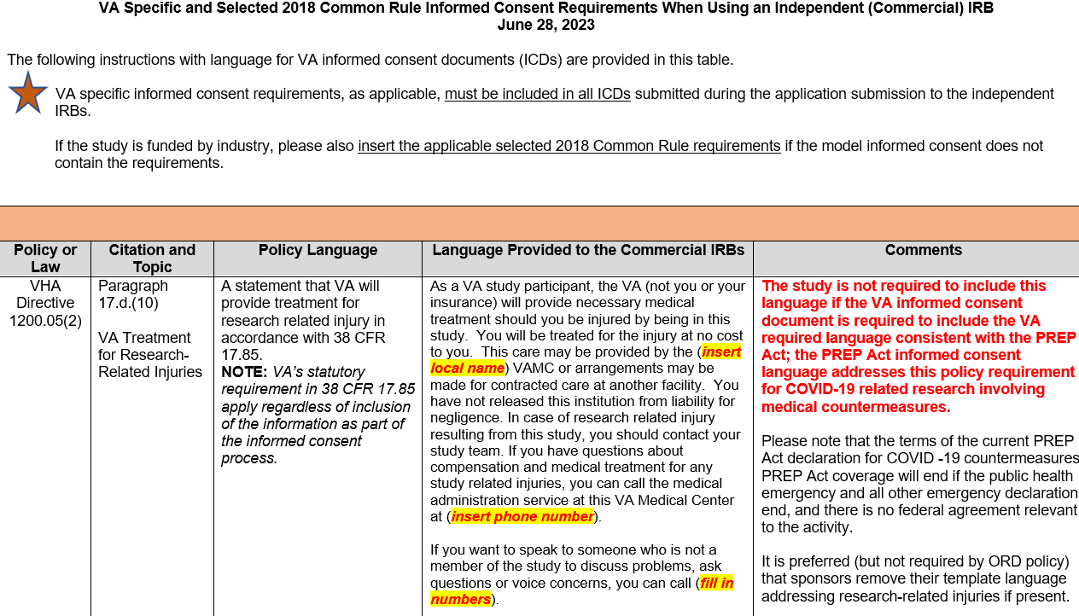
Excerpt from Revised Tool: VA Specific and Selected 2018 Common Rule Informed Consent Requirements When Using an Independent-Commercial IRB

Slide 40
Revised Tool: VA HIPAA Authorization Requirements When Using an Independent (Commercial) IRB (06-28-2023)
Revisions include:
  Added clarifying statement that the VA authorization language when combined with the ICD is a replacement for the model authorization language where applicable.
  Added additional comment to assist with determining whether a combined ICD with the HIPAA authorization language can be used as follows:
    If there is optional banking of identifiable data or biospecimens, the HIPAA authorization language for research cannot be combined with the ICD
    If the IRB has approved the use of subjects’ LARs to consent, the HIPAA authorization language for research cannot be combined with the ICD.

Slide 41
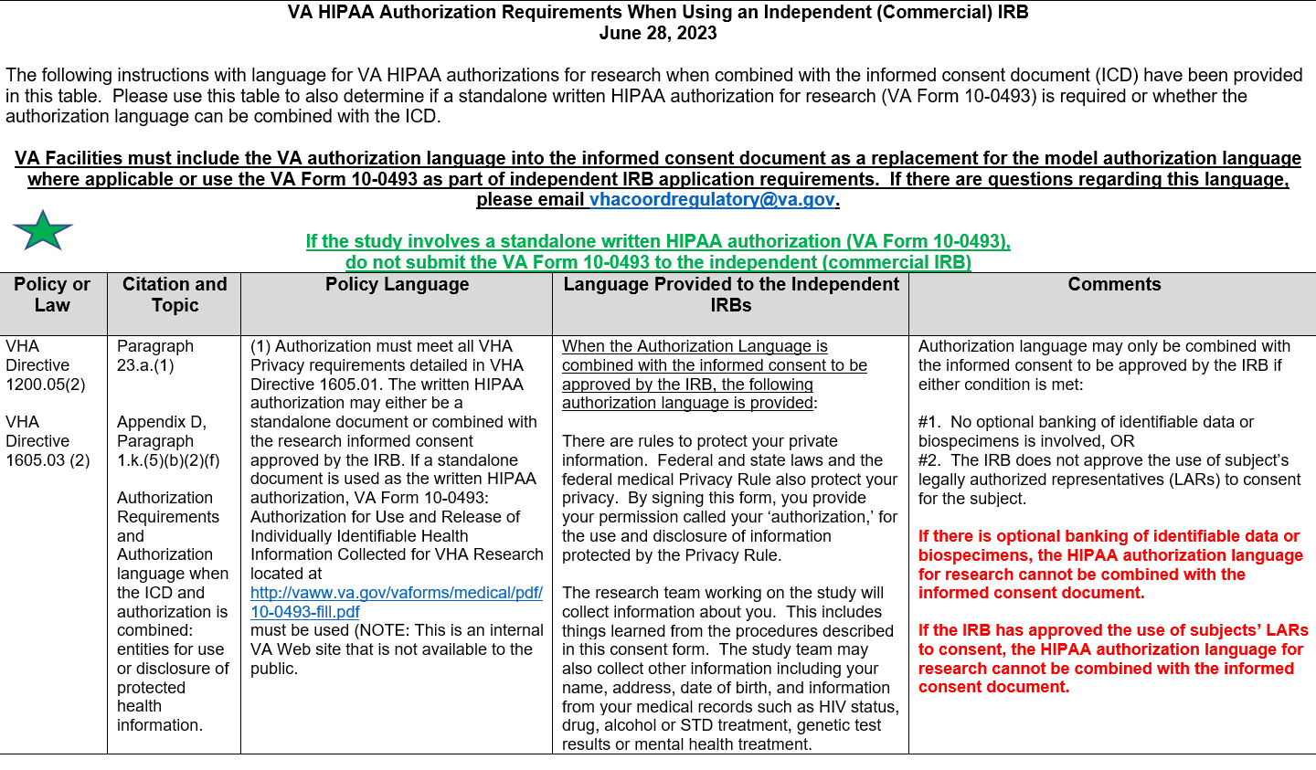
Excerpt from Revised Tool: VA HIPAA Authorization Requirements When Using an Independent/Commercial IRB

Slide 42
Checklist For VA Facilities Using Independent (Commercial) IRBs
(06-28-2023)
Revisions include:
  Adding links within the applicable sections to the location of the tools; and
  Renaming and clarifying content within Section 4 (VA HIPAA Authorization Document Requirements When the HIPAA Authorization Document is Combined with the Informed Consent Document) to indicate when the section is to be used to assist study teams.

Slide 43
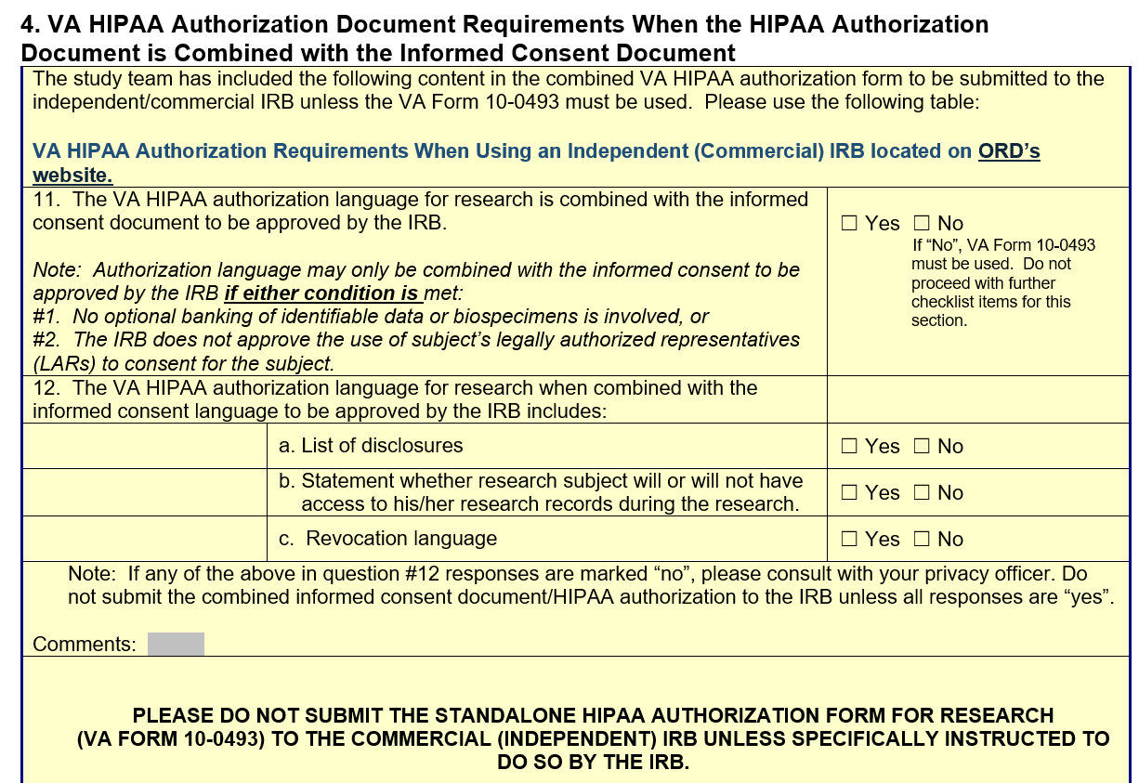
Excerpt of Checklist: VA Specific Elements

Slide 44
Role of ORD-Approved Commercial IRBs With Submission Informed Consent/HIPAA Authorization Language
ORD-approved Commercial IRBs are responsible for compliance checks during the intake to verify that the applicable VA specific elements and specific 2018 Common Rule Requirements are present.
The ORD-approved Commercial IRBs will turn back the submission if the submission is not complete (e.g., applicable VA specific elements are not present in the submitted ICD).
The applicability of some of the specific 2018 Common Rule requirements may require IRB determination and cannot be ascertained by the submitting VA study team.

Slide 45
Update on Recent Request by ORD to VA Study Teams with Active Studies Approved by Advarra IRB
On May 24th, ORPP&E sent an update to the VA research community that VA Investigators of currently active studies approved by ORD would receive a letter from ORD asking for those study teams to conduct a self-assessment by June 23, 2023 of their current approved ICDs if the study was enrolling study subjects or actively following subjects.
The self-assessments were requested to assist the Advarra IRB, but ORD wants to reinforce that it is the responsibility of the reviewing IRB to ensure the IRB-approved ICDs meet all applicable requirements.
ORD wishes to thank the study teams that have responded or provided information to ORD of their status. ORD will be following up with the study teams that have not had an opportunity to respond to assist.

Slide 46
Summary of Commercial IRB Issues
The revised checklist and tools are being placed in the VAIRRS standard library in addition to being available on ORD’s webpage for commercial IRB content.
The endorsement letter was not revised but is also being placed in the VAIRRS standard library in addition to being available on ORD’s webpage for commercial IRB content.
ORD continues to communicate with the Commercial IRBs to address issues and develop solutions and disseminate the information to the VA research community.

Slide 47
Availability of Recording
A recording of this session and the associated handouts will be available on ORPP&E’s Education and Training website approximately one-week post-webinar.
An archive of all ORPP&E webinars can be found here: https://www.research.va.gov/programs/orppe/education/webinars/archives.cfm.

Slide 48
Contact Information
ORD Regulatory Box: VHACOORDREGULATORY@VA.GOV

Slide 49
References
CDC webpage: Information for Healthcare Providers on Obtaining and Using TPOXX (Tecovirimat) for Treatment of Monkeypox | Monkeypox | Poxvirus | CDC
ORPP&E webpage: IRB Relationships in the VA: Single IRB Exceptions, Independent (Commercial) IRBs, and changing IRB reliance by the VA Facility
Tecovirimat (TPOXX) IND Registry for Providers/Facilities (cdc.gov)
VAEDA Tool: https://vhacdwdwhvda01.vha.med.va.gov/vaeda/home#/
VHA Directive 1200.02(1): Research Business Operations (March 10, 2017; amended September 6, 2017) at VHA Publications
VHA Directive 1200.05(2): Research and Development Committee (January 7, 2019; amended March 3, 2020 and January 8, 2021) at VHA Publications

