Slide 1
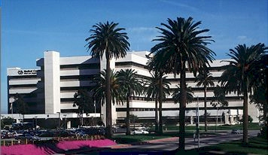
Negotiating & Budgeting For Industry Sponsored Studies
CRADA’s – A Success Story
Brentwood Biomedical Research Institute
VA Greater Los Angeles Healthcare System

Slide 2
Ron Waldorf
Director, Research & Educational Affairs
Brentwood Biomedical Research Institute
VA Greater Los Angeles Healthcare System
(310) 312-1554 x221
Waldorf@BrentwoodResearch.org
100 CRADA’s since 9/2011
70 Currently Active
14 in a ‘Pending’ mode

Slide 3
CRADA ‘TEAM”
NPC
PI
OGC/TTP
STAR
VA R&D

Slide 4
Studies come from PI’s
If new PI to BBRI, confirmation of PI status
Determine if: Basic Science, Investigator Initiated, Device, Clinical Trial (Phase #) or Data Collection project
If new to CRADA’s, I explain the process and, if needed, direct them to the VA R&D/TTP hyperlink
Contact can be Collaborator (Sponsor) or Clinical Research Organization (CRO)
If new, I stress the fact that ‘federal law is pretty unforgiving’ and that any changes could delay the process of getting approval because of TTP/OGC involvement, including any discussion of IP rights, licensing fees, royalties, etc.

Slide 5
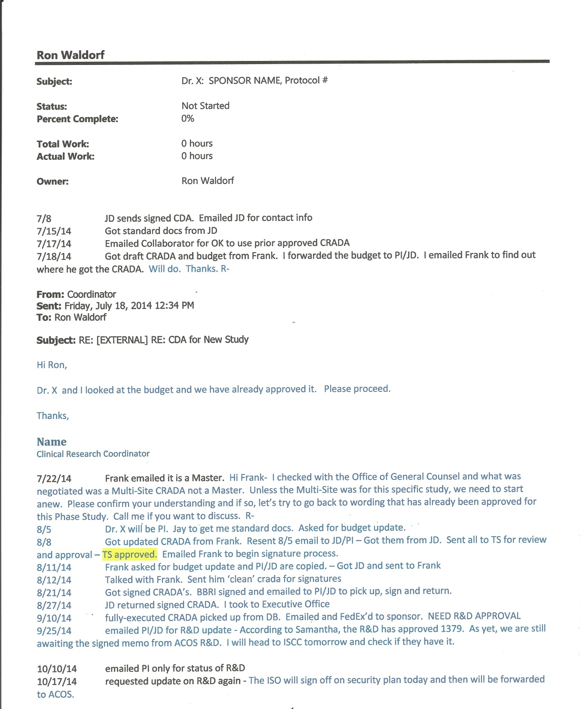

Slide 6
CRADA Process
Initial Contact – CDA’s Handled by R&D & STAR
Initial CRADA questions:
  Master, Single-Site, Multi-Site
  If new to CRADA, send TTP website and make sure contact person is aware of how CRADA’s are negotiated
  Budget negotiated directly between PI and Collaborator/CRO with final NPC approval.
COI and HIPAA Document (if COI is an issue, send directly to Ethics Group for review).
STAR review, comments, conference calls / direct contact if needed, final approval
Signatures (PDF, Originals)

Slide 7
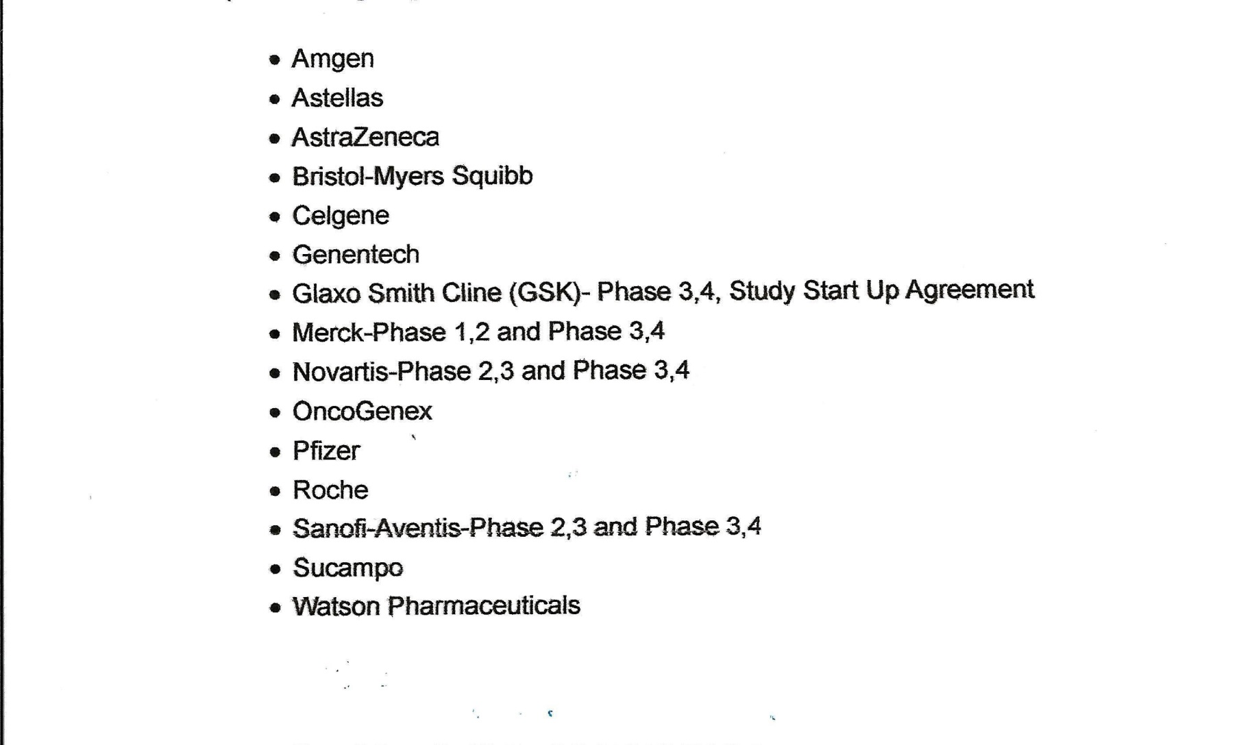
Master CRADA List

Slide 8
Make sure you know how to “Protect for Track Changes”
If Master, Collaborator or CRO will send an ‘unprotected’ document.
You need to request a current approved version from OGC and do a comparison.
Review the Appendix to make sure no further ‘legalese’ is added. Should just be SOW (Protocol) and Budget terms and conditions of payment.

Slide 9
Most Frequent CRADA Issues
Definitions
Inventions & Discoveries
Publication Time Frames
CRO language

Slide 10
Conflict of Interest Document
Conflict of Interest

Slide 11
HIPPA Document
HIPPA Consent

Slide 12
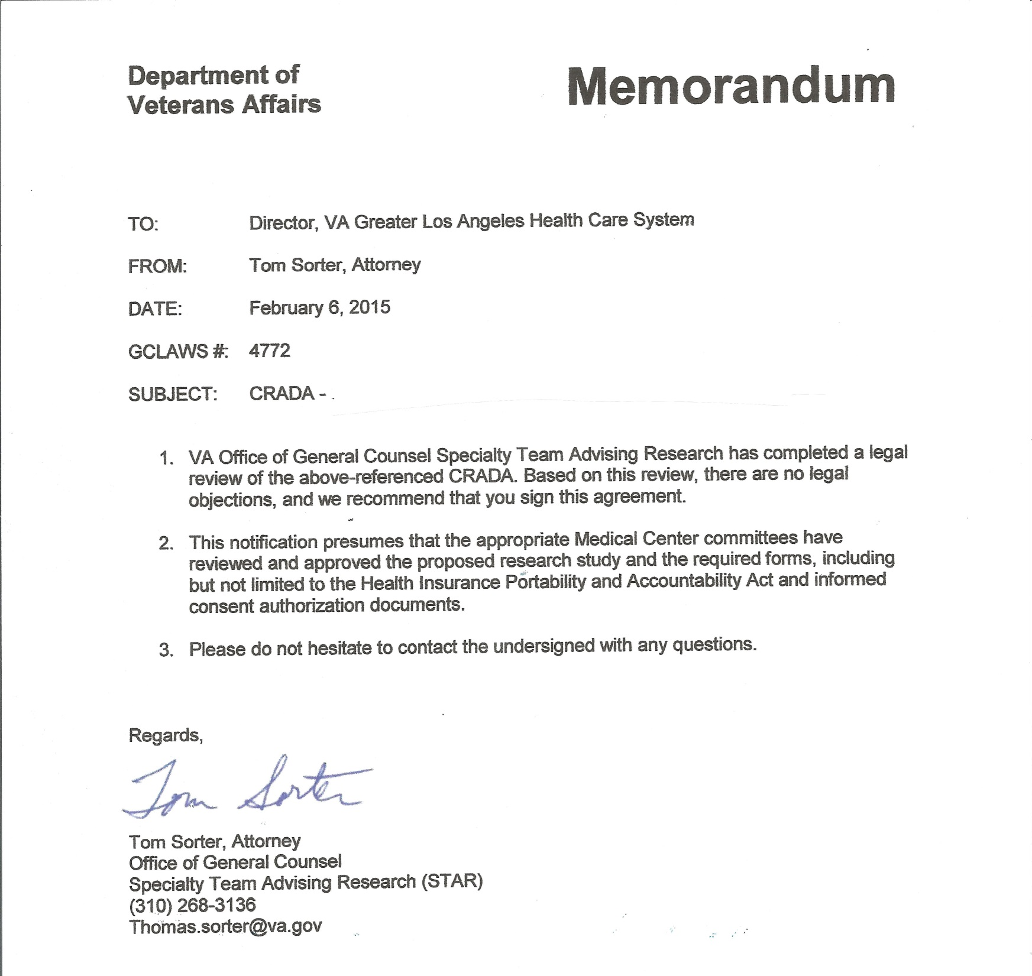

Slide 13
Negotiating For
Industry Sponsored Studies
Q & A
Brentwood Biomedical Research Institute
VA Greater Los Angeles Healthcare System

Slide 14
The Budget Process
The Initial Offer To The Final Approved CRADA Budget
“Thinking On A
Labor-Costing Basis”

Slide 15
Facilities Human Protection Program (FHPP) Surcharge:
  10% of total direct costs for human studies
BBRI Indirect Cost Rate: 20%
VA IRB Fee’s
  Initial Review $1,500
  Modifications $500/ea.
  Annual Continuations $500/ea.
Pharmacy Fee’s
  $1,500 Set-Up
  $500 Annual
Storage Fee’s
Other
  IRB Preparation
  Start-Up (non-refundable)
  Advance (refundable)
  Patient Payments
  Patient Travel & Lodging
  VMU Costs
  7. VA Legal from BBRI Adm.

Slide 16
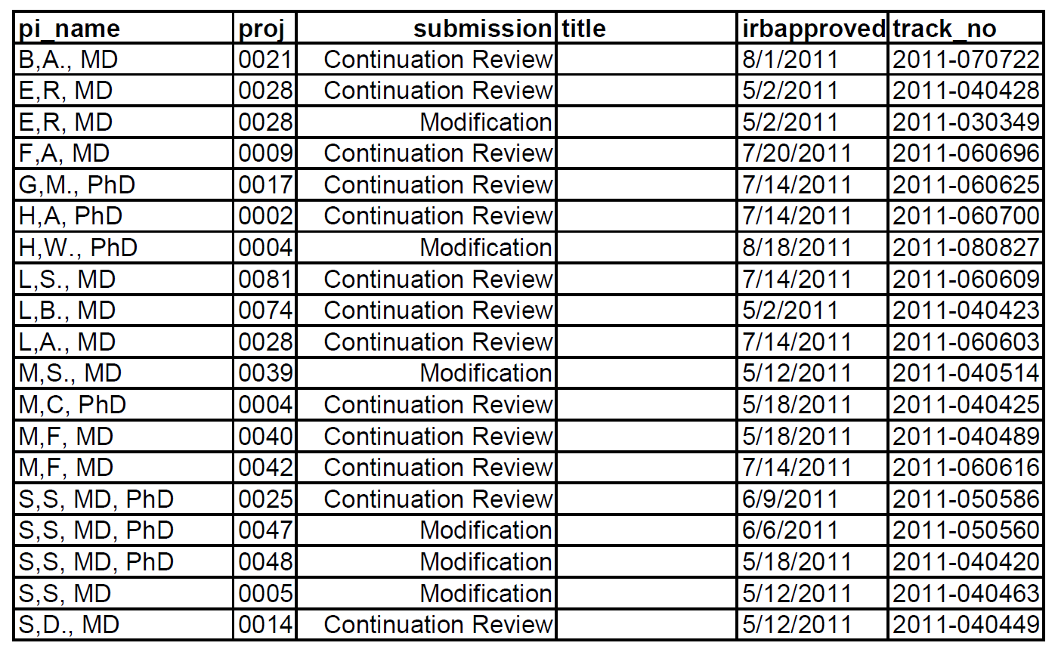
IRB Tracking for Modifications/Continuations

Slide 17
What is the IMPACT Process?
Mechanism to reimburse the Medical Center for above Standard of Care (SOC) services provided to research protocols.

Slide 18
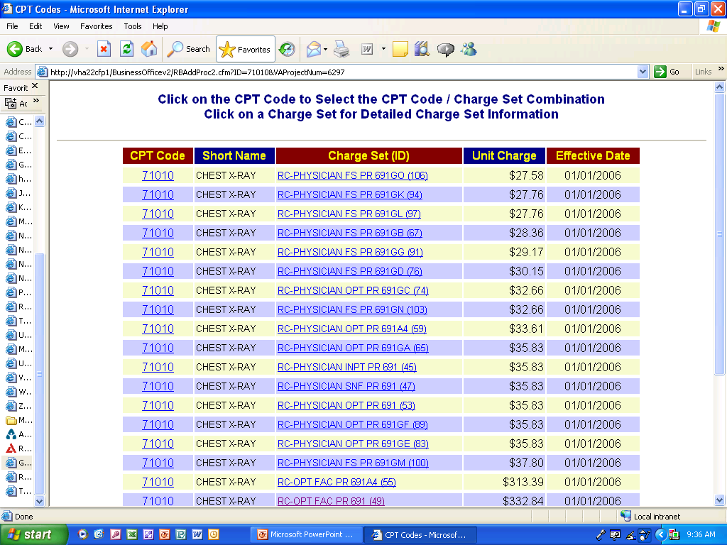

Slide 19
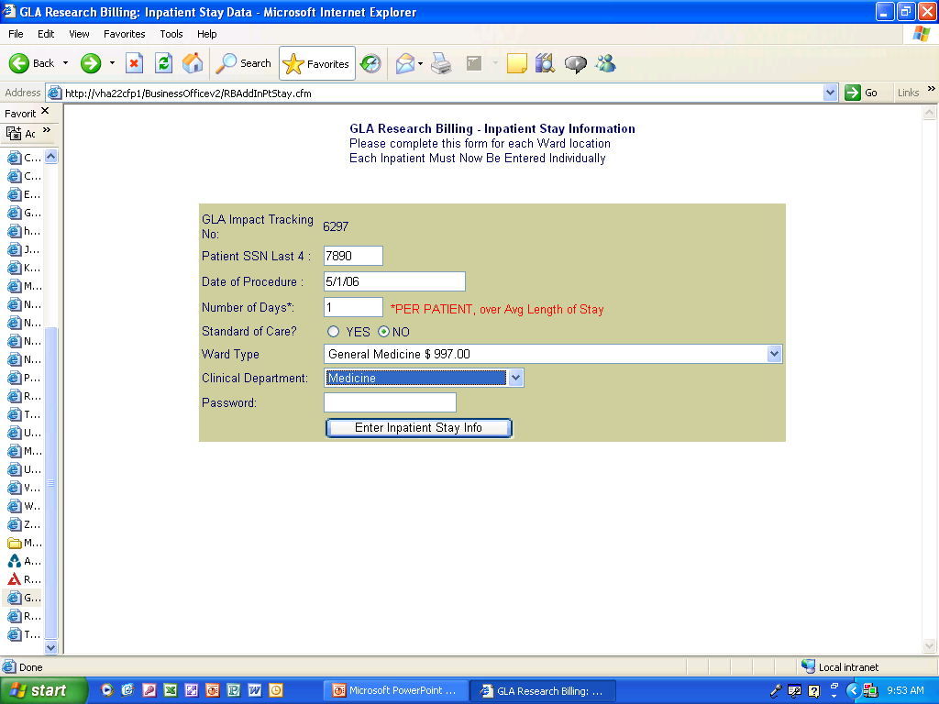

Slide 21
Example #1
Simple Basic Science
CRADA Budget

Slide 22
Budget breakdown
Animal cost | price 1 rat | # of animals |  |  | Total
10 groups of 10 male SD rats 250-274 g – 100 * 40.15 | 48.18 | 100 |  |  | $4,818
Per diem | price per rat/day | # of animals | # of days
Per diem for 100 rats for 1 month (4 weeks, 31 days) = 100 * 31 * 0.74 | 1.07 | 100 | 31 |  | $3,317
Salary | Monthly Salary + Benefits | # of months
Lab Tech (3 months) | 3,906 | 3 |  |  | $11,718
Contract fees
establishment ACORP, contract protocol, etc… |  |  |  |  | $4,000
Principal Investigator Administration Fees
PI |  |  |  |  | $5,000
Co-Investigator |  |  |  |  | $5,000
Sub-Total |  |  |  |  | $33,853
Indirect cost BBRI - 20% |  |  |  |  | $6,771
Total Cost |  |  |  |  | $40,624
Terms of Payment: Payment in Full at Execution of CRADA

Slide 23
Example #2
Simple Clinical Trial
CRADA Budget

Slide 24
Sponsor Budget
This is the INITIAL Budget. It is the Starting Point
Think Cost and Time When Initially Reviewing the Budget
What Study Points will Need to be Analyzed and the Cost to Perform These Tasks or Procedures
Allow For the Unexpected
Notes:
Depending on what you are studying this is where an itemized budget usually has a $ amount attached.

Slide 25
Example #2
(Initial Budget Based on Forms)
Completed Case Report Form | Amount
Baseline Form | $670.00
Surgery Form | $590.00
1 Week Follow-up Form | $190.00
1 Month Follow-up Form | $250.00
3 Month Follow-up Form | $250.00
6 Month Follow-up Form | $250.00
12 Month Follow-up Form | $250.00
Long-Term Follow-up Form– every 6 months following the 12 Month Follow-up visit | $190.00
6 Minute Walk Test Section – performed at each required follow-up visit | $80.00
CAMPHOR Quality of Life Form | $100.00
Medication Form | $125.00
Adverse Event Form | $250.00
Adverse Event Update Form | $250.00

Slide 26
Example #2
(Final Budget Based on Forms)
Completed Case Report Form | Amount
Baseline Form | $1895.00 ( 65% difference but I added in other test)
Surgery Form | $1075.00 (45% difference)
1 Week Follow-up Form | $1365.00 (approx 80% difference)
6-Week Follow-up Form | $1365.00
3 Month Follow-up Form | $1565.00
6 Month Follow-up Form | $1565.00
12 Month Follow-up Form | $1565.00
Long-Term Follow-up Form– every 6 months following the 12 Month Follow-up visit | $1565.00
6 Minute Walk Test Section – performed at each required follow-up visit | Included in Visits
CAMPHOR Quality of Life Form | Included in Visits
Medication Form | Included in Visits
Adverse Event Form | $312.00
Adverse Event Update Form | $312.00

Slide 27
Example #3
Complex CRADA Budget

Slide 28
Budget Example.xlsx

Slide 29
Budget Discussions and Counters
1. Counter Back Offers to the Collaborator with numbers that will work with/in your Budget
2. Consider Cost per hour for Medical History & Exams, Coordinator, Research Assistant etc.
3. Make sure your overhead is correctly stated in the Final Budget
4. Make sure Final Budget is a figure per patient that makes sense and is enough to cover costs

Slide 30
Budget Negotiating Plan
1. If the Collaborator counters back- Consider explaining your decisions before accepting the counter. For instance the amount of experience the PI and Coordinators have, location (CA, NY may be higher), the economy.
2. Set up conference calls to explain your stance to all decision makers.
3. When all fails and you are confident the numbers are fair, have the PI speak with the Collaborator or the person actually approving the budget.
4. Have a bottom line number in mind per visit in case you have to move items around.

Slide 31
FINAL APPROVED BUDGET
Once budget has been approved
1. Signatures needed by the Collaborator (or financial organization)
2. Signature by the PI
3. Ready for insertion into the CRADA

Slide 32
Budgeting For
Industry Sponsored Studies
Q & A
Brentwood Biomedical Research Institute
VA Greater Los Angeles Healthcare System

Slide 33
Negotiating & Budgeting For
Industry Sponsored Studies
Ron Waldorf
Director, Research & Educational Activities
Brentwood Biomedical Research Institute
VA Greater Los Angeles Healthcare System

