Slide 1
A Dialogue With VA
Kristina Borror, Cynthia Boudreaux, Karen Jeans, and Molly Klote

Slide 2
Disclosures:
I have no relevant personal/professional/financial relationship(s) with respect to this educational activity
Molly Klote, MD, CIP
C. Karen Jeans, PhD, CCRN, CIP
Kristina Borror, PhD
Cynthia Boudreaux, MEd

Slide 3
Objectives
Update the VA and other interested parties on infrastructure changes and proposed VA policy
  VA Innovation and Research Review Service (VAIRRS)
  VA Electronic Determination Aid (VAEDA)
  Single IRB Provision (38 CFR 16.114)
    Urban myths
    Work towards implementation of the Cooperative Research (Single IRB) provision
      Process and policy revisions
      Use of commercial IRBs by VA Facilities in multi-site research

Slide 4
VA Innovation and Research Review System: VAIRRS
Committee based commercial product – IRBNet
Tiered roll out over 2-3 years
Authority to Operate (ATO) in place
Standardized forms, templates, letters
Business intelligence platform for dashboards
In person training – “super users”

Slide 5
VAEDA
Demonstration

Slide 6

January 20, 2020: Date of Compliance with
Cooperative Research (Single IRB) Provision

Slide 7
Single IRB Provision: Cooperative Research
38 CFR §16.114
a) Cooperative research projects are those projects covered by this policy that involve more than one institution. In the conduct of cooperative research projects, each institution is responsible for safeguarding the rights and welfare of human subjects and for complying with this policy.
(b)(1) Any institution located in the United States that is engaged in cooperative research must rely upon approval by a single IRB for that portion of the research that is conducted in the United States. The reviewing IRB will be identified by the Federal department or agency supporting or conducting the research or proposed by the lead institution subject to the acceptance of the Federal department or agency supporting the research.
(2) The following research is not subject to this provision:
Cooperative research for which more than single IRB review is required by law (including tribal law passed by the official governing body of an American Indian or Alaska Native tribe); or
(ii) Research for which any Federal department or agency supporting or conducting the research determines and documents that the use of a single IRB is not appropriate for the particular context.
(c) For research not subject to paragraph (b) of this section, an institution participating in a cooperative project may enter into a joint review arrangement, rely on the review of another IRB, or make similar arrangements for avoiding duplication of effort.

Slide 8
Urban Myths about the Cooperative Research (Single IRB) Provision in 38 CFR §16.114
Urban Myth #1: A single IRB must be used whenever VA is engaged in multi-site non-exempt human subjects research.
Answer: False. Exceptions are allowed in two circumstances as follows:
(i) Cooperative research for which more than single IRB review is required by law (including tribal law passed by the official governing body of an American Indian or Alaska Native tribe); or
(ii) Research for which any Federal department or agency supporting or conducting the research determines and documents that the use of a single IRB is not appropriate for the particular context.

Slide 9
Urban Myths about the Cooperative Research (Single IRB) Provision in 38 CFR §16.114
Urban Myth #2: A single IRB must be used for all participating VA and non-federal agency sites when industry is sponsoring a clinical trial.
Answer: False. The cooperative research provision apply to research which is covered by the 2018 Requirements of the Common Rule. Industry is not a federal agency.
However, if multiple VAs were participating in an industry-sponsored clinical trial, all of the VA sites must use a single IRB unless an exception applied because the VA sites are conducting the multi-site research. The non-federal sites (e.g., academic institutions) are not required to follow the 2018 Requirements because the study is not supported by federal funds and therefore not subject to its requirements.

Slide 10
Urban Myths about the Cooperative Research (Single IRB) Provision in 38 CFR §16.114
Urban Myth #3: VA does not support the cooperative research provision (single IRB) in 38 CFR §16.114.
Answer: False. VA fully supports the use of a single IRB whenever possible. VA’s demonstrated that commitment over 10 years ago when it established the infrastructure to stand up and support the VA Central IRB. VA has learned through its extensive experience that one size does not fit all. Some flexibility does not undermine the VA’s commitment to use of a single IRB in VA research when it supports human subjects protections and also supports efficiency.

Slide 11

One IRB is not another IRB
How can I be sure the IRB is competent?
What is the particular expertise of the IRB for the study you are doing?
How far do we go?
  Ask for their IRB SOP?
  Ask for their IRB roster?
  Ask to audit the IRB?
TRUST BUT VERIFY!
1

Slide 12
VA’s Work Towards Implementation of the Cooperative Research (Single IRB) Provision
Working with other federal agencies and non-federal agencies and institutions
Standardized processes for requests and processing by VA Facilities:
  Pilot of application form completed
  Standardizing process and dedicating resources for higher volume
List of proposed exceptions in review
Policy revision to support single IRB use

Slide 13
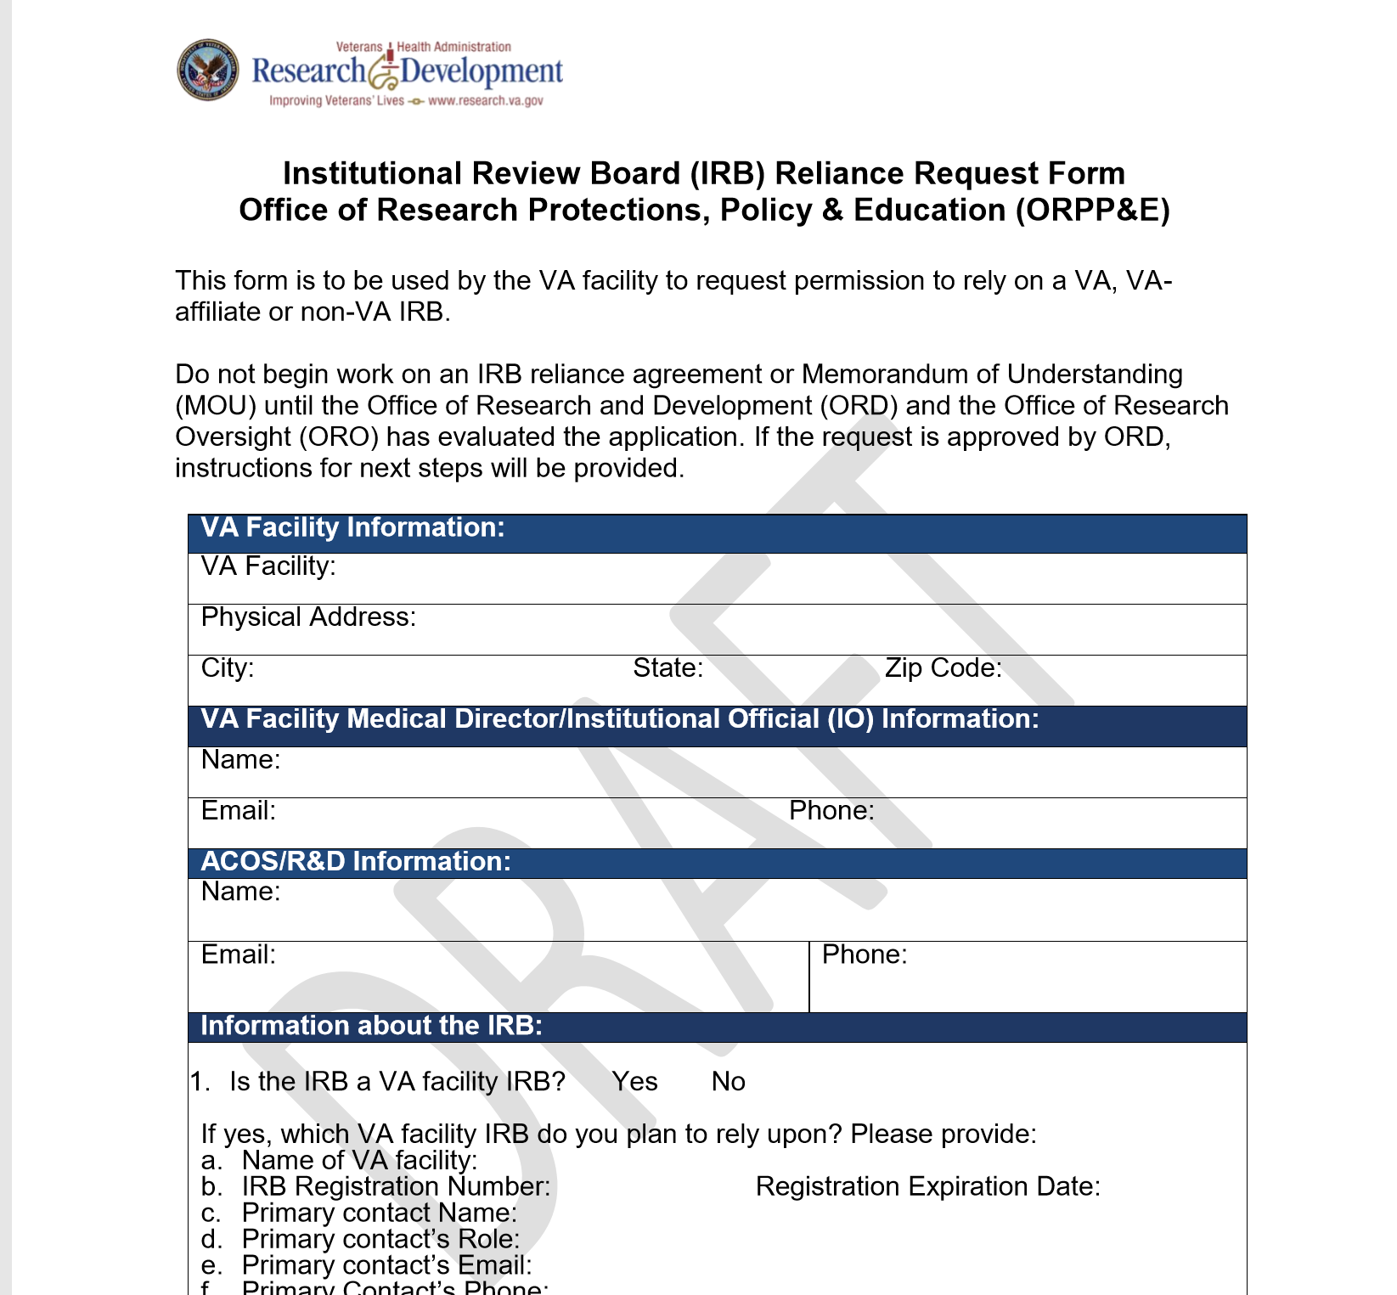
Application Form: Request for Change in IRB Review for Single or Multiple Studies

Slide 14
Facilitating Use of Single IRBs in VA Research:
Use of Commercial IRBs For Defined Set of VA Research Activities
Use of commercial IRBs currently not allowed by policy in VHA Directive 1200.05
  ORD working towards rapid policy revision
Identified and have resolved major issues with VHA Privacy, VA Office of Information Security, VA Office of Information Law, and Office of Research Oversight regarding requirements
  Federal Acquisition Requirements (FAR)
  Information Security for communication and transmission from VHA to the non-VA electronic information system
  Federal Records Act and data ownership of records sent by VHA and processed by non-VA IRB
  Health Insurance Portability and Accountability Act (HIPAA) and the Privacy Act of 1974

Slide 15
What’s Next
Guidance and policy revisions related to 38 CFR §16.114 cooperative research (single IRB) provision
Policy revisions for primary VA policies related to the roles of IRBs and institutional responsibilities of the VA Facility’s Research and Development Committee
  VHA Directive 1200.05
  VHA Directive 1200.01

Slide 16
Questions?

Slide 17
Thank You

