Slide 1
Post Pandemic Case Studies
Don E. Workman, PhD, and Michelle Christiano, CCRC, CIP
February 8, 2023

Slide 2
Privacy Topics
Disclosure Authorities
Future Use
Privacy Research Incidents
  Invalid or Missing HIPAA Authorizations
Genetic Tests and Health Information
Deceased Subjects and HIPAA Authorizations

Slide 3
Disclosure Authorities
VHA applies five statues simultaneously (and their implementing regulations) to all disclosures of PII/PHI:
  Freedom of Information Act (FOIA), Title 5 United States Code (U.S.C.) 552, implemented by Title 38 Code of Federal Regulations (CFR), Sections 1.550-1.562
  The Privacy Act, 5 U.S.C. 552a, implemented by VA at 38 CFR 1.575-1.582
  The VA Claims Confidentiality Statute, 38 U.S.C. 5701, implemented by 38 CFR Section 1.500-1.527
  Confidentiality of Drug Abuse, Alcoholism and Alcohol Abuse, Human Immunodeficiency Virus (HIV) Infection, and Sickle Cell Anemia Health Records, 38 USC 7332
  HIPAA (Public Law 104-191), implemented by 45 CFR Parts 160 and 164

Slide 4
Disclosure Authorities
These five statutes govern the VHA records:
  Collection;
  Maintenance;
  Use and access; and
  Release or disclosure.
The most stringent statute applies.
If you cannot release under one of the statutes, then you are stopped from making the disclosure.

Slide 5
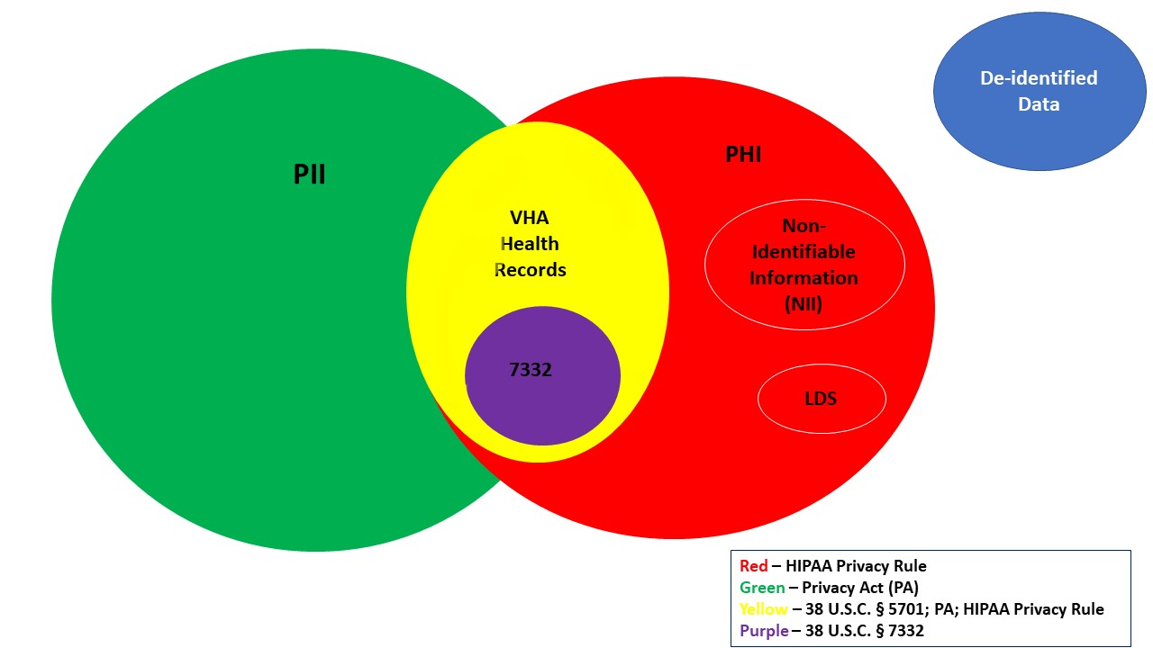
Relationship Among Federal Privacy Laws and Regulations for VHA Data

Slide 6
Disclosure Authorities for Research
Valid HIPAA Authorization from the research subject meets requirements for all privacy statutes.
An approved HIPAA Waiver of Written Authorization provides HIPAA Privacy Rule authority but does not give Privacy Act, 38 U.S.C. 5701 or 7332 authority to disclose outside VA.
Privacy Act and 38 U.S.C. 5701 requires a contract or agreement to be in place that allows sharing for research activities
  Requests for contracts or agreements initiate at the facility research office
  Type of applicable contract or agreement is determined by Office of General Counsel (OGC) Special Team Advising Research (STAR)
38 U.S.C. 7332 requires written assurances to not identify any subjects in in any report of such research or disclose subject identities in any manner.
Notes:
The required 38 U.S.C. 7332 assurances may be in the Protocol or a Data Protection Plan.

Slide 7
Future Use of Data
Collecting Sensitive Personal Information (SPI) for future use, with respect to an individual, means any information about the individual maintained by an agency, including the following: (1) education, financial transactions, medical history, and criminal or employment history; and (2) information that can be used to distinguish or trace the individual’s identity, including name, social security number, date and place of birth, mother’s maiden name, or biometric records. SPI is a subset of VA Sensitive Information/Data. See 38 U.S.C. 5727.
  SPI is synonymous and interchangeable with “Personally Identifiable Information” which is any information that can be used to distinguish or trace an individual's identity, such as their name, social security number, biometric records, etc. alone, or when combined with other personal or identifying information which is linked or linkable to a specific individual, such as date and place of birth, mother’s maiden name, etc. Information does not have to be retrieved by any specific individual or unique identifier (i.e., covered by the Privacy Act) to be personally identifiable information.
  NOTE: The term “Personally Identifiable Information” is synonymous and interchangeable with “Sensitive Personal Information for future use including banking and subsequent uses by other research projects requires HIPAA authorization from the subject or their personal representative.

Slide 8
Future Use of Specimens
Collecting specimens
  Optional
  Mandatory
Identifiable or De-identified
  Coded can be both
What data is attached to the specimen?
  Other concerns from a Common Rule perspective
  Not a privacy issue but was the subject consented to allow the use of the specimen and/or data?
Notes:
Decide which you are doing

Slide 9
Future Use
A registry which includes the optional collection and banking/storage of PII to contact potential subjects for future use cannot be created with only a waiver of written HIPAA authorization.
A HIPAA-compliant authorization is required to allow for the optional banking of the subject’s PII.

Slide 10
Future Use
The expiration date for optional banking for future use on the VA Form 10-0493, page five, should be selected as:
“Data use and collection will expire at the end of this research study. Any study information that has been placed into a repository to be used for future research will not expire.”

Slide 11
Future Use
An individual’s contact information (name, phone number, email address, etc.) placed within a VHA repository for future use is still PHI.
  The use of this contact information must be covered under the new study’s HIPAA waiver prior to use for recruitment purposes.

Slide 12
Privacy Research Incidents
All privacy incidents, including:
  Invalid HIPAA Authorizations
  Missing HIPAA Authorizations
  Lack of Authority to Disclose
Must be reported timely to the facility Privacy Officer and entered into Privacy and Security Events Tracking System (PSETS).

Slide 13
Invalid HIPAA Authorizations
HIPAA Authorizations must meet the content requirements of VHA Directive 1605.01, Paragraph 14.b. to be valid.
Failure to obtain signature and date signed by subject or personal representative.
Authorization is invalid if missing either.

Slide 14
Invalid HIPAA Authorizations
Failure to obtain signature and date signed by subject or personal representative on Page five (Consent for Future Unspecified Use of Specimen)
  This does not negate the entire HIPAA Authorization if they signed on Page four
  The team can simply obtain a new page five

Slide 15
Missing HIPAA Authorization
Failure to obtain a HIPAA Authorization at all from a subject results in the inability of the VA Investigator to use the data collected from that subject UNTIL:
  The subject signs a HIPAA Authorization; OR
  The IRB or Privacy Board approves a Waiver of HIPAA authorization due to the inability to obtain signature on a HIPAA Authorization.

Slide 16
Lack of Authority to Disclose
VHA disclosed PII/PHI pursuant to an invalid authorization or without legal authority, e.g., pursuant to a waiver of HIPAA Authorization only.
Disclosure may have been to a study sponsor, affiliate or other non-VA entity.
If authority for the disclosure cannot be rectified, the VA will ask for the recipient to return or destroy the data.

Slide 17
Genetic Tests and Health Information
The HIPAA Privacy Rule definition of ‘health information’ includes genetic information.
  Genetic information, with respect to an individual, means information about: (1) the individual’s genetic tests, (2) the genetic tests of the individual’s family members, (3) the manifestation of a disease or disorder in the individual’s family members, or (4) any request for, or receipt of, genetic services, or participation in clinical research which includes genetic services, by the individual or any of the individual’s family members.
  A genetic test means an analysis of human DNA, RNA, chromosomes, proteins, or metabolites, if the analysis detects genotypes, mutations, or chromosomal changes. Genetic test does not include an analysis of proteins or metabolites that is directly related to a manifested disease, disorder, or pathological condition.
  Genetic services means genetic tests, genetic counseling (including obtaining, interpreting, or assessing genetic information), or genetic education.

Slide 18
Genetic Tests and Health Information
It is possible to have de-identified genetic information following the requirements of the HIPAA Privacy Rule for de-identification under Expert Determination but not under Safe Harbor.
DNA sequencing that meets the definition of a genetic test would be considered a patient identifier that would have to be removed for any protected health information (PHI) to be de-identified unless and an Expert determined otherwise in a written analysis report as outlined in the HIPAA Privacy Rule de-identification provisions.

Slide 19
Deceased Individuals & HIPAA Authorizations
HIPAA Privacy Rule extends to decedent data for 50 years after date of death.
However, Privacy Act falls away upon death and provides no protects for the data.
And lastly, 38 U.S.C. 5701 and 38 U.S.C. 7332 continues to protect the data until VHA no longer maintains the records.

Slide 20
Deceased Individuals & HIPAA Authorizations
VHA Directive 1605.01, page 92, section 34(b)(4) Deceased Individuals: VHA may use, or disclose, individually-identifiable health information, excluding 38 U.S.C. 7332-protected information, of a decedent for research purposes without authorization by a personal representative, and absent review by an IRB or privacy board, as long as, VHA receives the following:
  Oral or written representation that the individually-identifiable health information sought will be used or disclosed solely for research on decedents, or
  Documentation of the death of such individual, if requested by VHA, and
  Representation that the individually-identifiable health information for which use or disclosure is sought is necessary for the research purposes.

Slide 21
Deceased Individuals & HIPAA Authorizations
But when not conducting decedent research and a subject dies, the authorization signed by the subject automatically expires and is invalidated.
If data exists in study, it is not to be removed but there should no be further access/use or disclosure of their data.
However, the research team can submit a waiver to request continued use or obtain a signed authorization from the personal representative.

Slide 22
Deceased Individuals & HIPAA Authorizations
Personal Representatives (VHA Directive 1605.01 Paragraph 5) have authority if:
They have been appointed as executor of the estate of a deceased individual, OR
Are the next of kin using the familial hierarchy.
  Spouse, Adult Children, Parents, Aunt/Uncle, Niece/Nephew

Slide 23
Q&A Discussion

Slide 24
VA Central IRB: Lessons Learned

Slide 25
COVID-19
Capabilities for remote research operations
Docu-Sign, and iMedris
Competence in remote work
Avoid making adjustments to the informed consent process outside the scope of IRB approval

Slide 26
Mpox and TPOXX
You can provide an expanded access IND drug to a clinician, but that does mean they understand their responsibilities as an FDA-regulated Clinical Investigator
EAPs and Emergency Use
We can engage rapid processes to facilitate VA facilities and IRB Reliance agreements for these situations

Slide 27
Distributed Research Model
Responsibility for making not-human-subjects research determinations
Do local sites need to be notified, and if so, what information would be useful?

Slide 28
CRADAs, DUAs and MTAs: need to start at the local level
Potentially significant delay in getting to R&D Committee when the final ISSO review requires the study team to provide a copy of the DUA for instance before signing off on the study.

Slide 29
VA Central IRB approval and local ISSO, Privacy review?
What does VA CIRB review include?
Some facilities have a redundant IRB review?
From the MOU:
5. The VA Central IRB Privacy Officer and Information System Security
Officer (ISSO) Representatives will perform the required privacy and
information security reviews. The local Privacy Officer does not conduct a
separate privacy review of studies overseen by the VA Central IRB.
However, the local ISSO may need to review some studies overseen by
the VA Central IRB due to local project-specific information security
issues. In those cases, the VA Central IRB ISSO Representative will work
with the local ISSO to address the issues.

Slide 30
RDCs and VA IRBs should communicate with the VA CIRB!
Central IRB is a sub-committee
Open to feedback about ICF, other determinations
Local context review: Built into Research Office pre-review
Open office hours? Attend meetings?
Resolution of issue pertaining to FDA warnings about Buprenorphine: How best to share?

Slide 31
VA CIRB is external but also internal to VA
Comparison to Commercial IRBs
Contrast with Commercial IRBs

Slide 32
Process changes in IRBNet:
VA CIRB adoption of PISC/LSI model for exempt research
VA CIRB Guidance on multiple PI’s

Slide 33
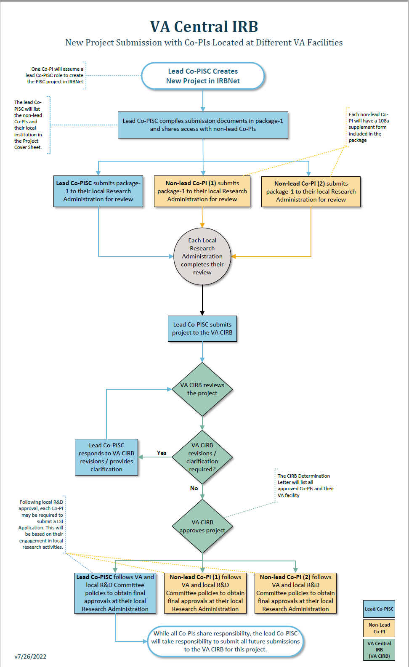

Slide 34
Management of approved documents in IRBNet
VA CIRB use of “stamping” to “publish Board documents”

Slide 35
Exploring new models for VA IRBs
VA Central IRB, Panel #3
Four facilities (soon to be eight), one IRB process

Slide 36
The opportunity for a VA IRB Network
Shared SOPs, forms, guidance, and training
Career ladder for IRB professionals
Shared best practices using IRBNet, engaging with regulations and VA policies
Turning the disparate HRPPs into a learning HRPP network
  Absorbing and adapting to ORO audit findings
  Shared solutions to common problems

Slide 37

Questions

