Slide 1

Jump Starting CADE Awards!
Biomedical & Clinical Research Services
December 12, 2019

Slide 2
Today’s Discussion
Overview of BLRD and CSRD Career Development Program
Our Philosophy and Need to Execute Timely
How Can We Best Help Each Other

Slide 3
Brief Overview of CADE

Slide 4
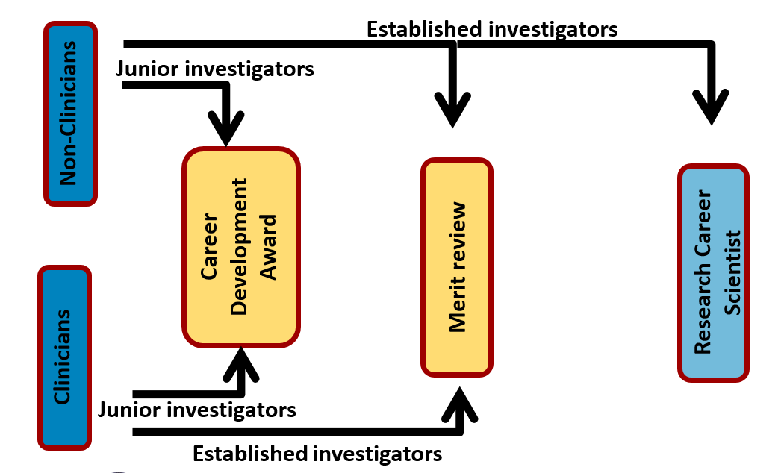
Research Career Pathways

Slide 5
Long History of Rich Support and Success with CADE
Over 50 years track record providing mentored research training
MANY awardees who stay with our VA are scientific leaders, administrative leaders, etc.
Currently we have:
Approximately 4 years ago, a summer institute for awardees was established, and is now conducted annually. The last meeting generated the basis for this discussion -
Service | # Awardees | # VAMC with CADE Awardees
BLRD | 58 | 33
CSRD | 65 | 28

Slide 6
Focus of the Program is CDA2 Level
Up to 5 years; $75k/year in research support plus up to $30k startup in year 1
Eligible applicants are within 5 years of their terminal degree(M.D., Ph.D., D.Sc., etc.) or clinical training following their terminal degree (i.e., internship, fellowship)
PI salary support (up to 6/8ths for clinicians or 8/8ths for non-clinicians)
Awardees strongly encouraged to apply for independent VA Merit Awards in their final year
Must be a U.S. Citizen
CDA-2 (IK2)
CDA-2 (IK2)

Slide 7
Some CDA1 Level Awards Are Available
CDA-1 (IK1)
  Must be a U.S. Citizen
  2 years of salary support (up to 6/8ths for clinicians or 8/8ths for non-clinicians)
  Eligible applicants are within 2 years of their terminal degree (M.D., Ph.D., D.Sc., etc.) or training experience following their terminal degree (i.e., internship, fellowship, post-doc)
  Offered by RRD for any discipline and by BLRD & CSRD for licensed MD psychiatrists, US military Veterans and HBCU applicants only
  Research support is provided by mentor and is intended to generate preliminary data and publications to support a CDA-2 application

Slide 8
Research Support: Focus on HBCUs
GOAL: 1) to increase the number of individuals from underrepresented groups who pursue career paths in research at VAMCs, and 2) to partner with HBCUs in order to help advance health care for Veterans
Must be located at an HBCU institution and within two years of obtaining terminal degree (MD, PhD, DSc, etc.)
Must not have been a PI/Co-PI on a peer-reviewed independent research grant/award

Slide 9

Research Support: Focus on U.S. Military Veterans
GOAL: For Veterans of US military service to gain early entry to a VA research career and enhance our Veteran-centric research program with their relevant perspective
Must be within two years of obtaining terminal degree (MD, PhD, DSc, etc.)
Must not have been a PI/Co-PI on a peer-reviewed independent research grant/award
CDA-1 for Military Veterans
  2 yrs
  75% salary support
  Mentored award

Slide 10
CDA-1 for Psychiatry
Must have an accepted LOI for a CDA-1 level application for the current review cycle
Must be within two years of obtaining the terminal degree (M.D./Ph.D.) or training experience immediately following the terminal degree (i.e., internship, fellowship, post-doc)
Must not have been a PI/Co-PI on a peer-reviewed independent research grant/award

Slide 11
Career Development Transition Award (CDTA) for Psychiatry
Must be a VA psychiatrist who has successfully competed for their first BL/CS Merit Review
A minimum 5/8ths VA-paid clinical appointment at the time of application
A funded CSR&D or BLR&D Merit Award at the time of application
An active research program located in VA space

Slide 12
Research Support: Focus on Psychiatry Pathway
New
CDA-1
2 years
75% salary support
CDA-2
3-5 years
75% salary support
CDTA
5 years
Independent award
Mentored award
Mentored award
75% salary support
New

Slide 13
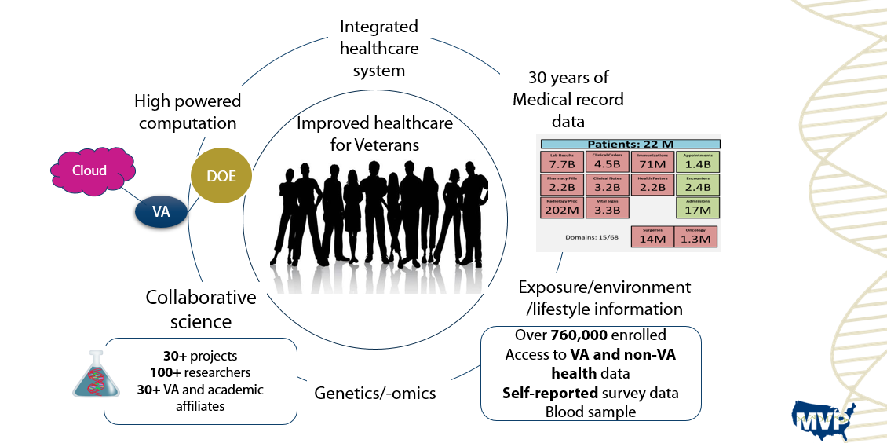
CADE Applications May Make Use of Million Veteran Program

Slide 14
Our Philosophy for the CADE Program
VA has a critical need for strongly trained clinicians and non-clinicians to be the next generation of scientists and VA leaders
Setting the program up similar to NIH K award makes VA very competitive in attracting applicants
The mentoring team is critical to the success of an award, from the Letter of Intent stage through completion and onto independence
Our investment is extremely valuable – salary support plus research support, etc.
AVERAGE TOTAL COST OF AN MD: $1,412,291
AVERAGE TOTAL COST OF A PHD: $963, 404

Slide 15
Our Discussion Today
We need these awards to execute smoothly and efficiently once approved to be funded
Awardees talk to us about how challenging it is to even know how to spend their money:
  Contracting
  Hiring
  Etc.
We hold a start up call with new awardees to walk through the orientation steps
We need your help to make sure that this is working at the local level
Let’s Talk!

Slide 16
Resources & Contact
VA Research Main Website: https://www.research.va.gov/
BLRD & CSRD Career Development Program: https://www.research.va.gov/services/shared_docs/career_dev.cfm
Career Development Mailbox: vhacadereview@va.gov

Slide 17

Questions

Slide 18
Career Development Deadlines
SERVICE | LOI SUBMISSION DEADLINES | LOI SUBMISSION ADDRESS | CONTACT
Biomedical Laboratory R&D | May 1 November 1 | vhacadereview@va.gov | vhacadereview@va.gov
Clinical Science R&D | May 1 November 1 | vhacadereview@va.gov | vhacadereview@va.gov
Health Services R&D | April 15 October 15 | robert.small@va.gov | Robert Small Robert.small@va.gov
Rehabilitation R&D | May1 November 1 | rrdreviews@va.gov | Shirley Groer, PhD shirley.groer@va.gov

Slide 19
How do you get started?
VA research is an intramural program:
  VA RFAs are not publicly available
  In order to receive research funding you must be employed by the VA (generally at least a 5/8ths appointment)
  Applications for ORD funding must have the support of the VA Medical Center Director
  An investigator on the mentorship team must have current VA Merit Review funding (specific requirements vary by service and RFA)
Find a VA researcher who is willing to mentor you (generally needs to be someone in the field of research you wish to pursue)
Contact the research office at your local (affiliate) VA Medical Center
  Give you copies of the appropriate RFAs
  Obtain a letter of support from VAMC Director with a commitment to give you a VA appointment if you are selected for an award
  Help you navigate the application and approval process

Slide 20
General Advice for Preparing Your CDA Application
Think about your research interests:
  Can they address a problem that significantly affects Veterans?
  How will your innovations improve their lives?
  Is your project idea distinct enough from your mentor’s research that it can be developed into your own, independent line of inquiry?
Select your mentorship team (especially your primary mentor) carefully! They should be well-established but also have the TIME and DESIRE to help you develop into an independent researcher.
Grantsmanship counts, but it is also HARD, and good grantsmanship takes EXPERIENCE! Your mentors should be helping you put together your application.
Demonstrate previous success (first-author papers) and a commitment to pursuing a research career (especially important for clinicians).
Know the rules! (e.g. Letter of Intent submission dates, eligibility requirements, budget caps, etc.)

