Slide 1
Town Hall:
Life under the Revised Common Rule
Dial in: (213) 929-4232
Access Code: 187-335-702
Slides in “Handout” Tab
Hosted by ORPP&E and ORO P&E
June 26, 2019

Slide 2
Presenters
Dial in: (213) 929-4232
Access Code: 187-335-702
Slides in “Handout” Tab
Molly Klote, MD
C. Karen Jeans, PhD, CCRN
Soundia Duche, MA, MS
Kristina Borror, PhD
Priscilla Craig
Annette Anderson, MS
Paska Permana, PhD
Titles and contact information can be found on the last slide

Slide 3

Timeline: The 2018 Requirements of the Federal Policy for the Protection of Human Subjects (the Revised Common Rule)
January 19, 2017
January 22, 2018
June 19, 2018
July 19, 2018 to January 21, 2019
January 21, 2019
January 20, 2020
Final Rule revising the Common Rule published with effective date of January 19, 2018 except for cooperative research provisions
Interim Final Rule published to delay effective and compliance date to July 19, 2018
Final Rule published to delay compliance date to January 21, 2019 while permitting use of three-burden reducing provisions during a delay period
Delay period in effect except for use of the three burden-reducing provisions
(ORD did not allow use of allowance of no continuing review of certain categories of research during this period.)
Effective and compliance date for the 2018 Requirements except for the cooperative research provisions
Compliance date of cooperative research provisions (38 CFR §16.114(b))
*The cooperative research provisions require use of a single IRB for institutions engaged in cooperative research by Federal departments conducting or supporting the research unless single IRB review is required by law or the Federal department conducting or supporting the research determines and documents that the use of a single IRB is not appropriate for the particular context.

Slide 4

VHA Directive 1200.01:
Current Regulatory Situation
Spring 2018
January 24, 2019
January 24 to April 30, 2019
May 1, 2019
Sep 1, 2019
VHA Directive 1200.01
pre-concurrence process
VHA Directive 1200.01 Issued
Discretionary Enforcement of new requirements in VHA Directive 1200.01 or substantial alterations
Discretionary Enforcement ends. All policies in VHA Directive 1200.01 must be complied with as of this date.
Discretionary Enforcement of new requirements in VHA Directive 1200.01 or substantial alterations

Slide 5
Overview of Session
Dial in: (213) 929-4232
Access Code: 187-335-702
Slides in “Handout” Tab
Surveying the field
ORD and ORO Resources
Updates from Directors, ORPP&E and ORO-P&E (Policy & Education)
Profiling Practices
  Phoenix VA: The 2018 Requirements: Implementation Strategy
  VA Central IRB: Continuing review and transitioning research
Q&A session

Slide 6
Dial in: (213) 929-4232
Access Code: 187-335-702
Slides in “Handout” Tab
Surveying the field

Slide 7
Poll 1: Implementing the 2018 Requirements
Which is true of your facility (select all that apply)?
Forms and SOPs have been updated with the 2018 requirements
IRB has begun reviewing protocols under the 2018 requirements
Exempt determinations have been made under the 2018 requirements
Review of protocols under the 2018 requirements is on hold
Question isn’t applicable to me given my role

Slide 8
Poll 2: Challenges with Implementing the 2018 Requirements
Select your top 2 challenges with implementing the 2018 Requirements.
Review of exempt studies
Summary of key information in the Informed Consent Form
Transitioning studies to the 2018 rule
Working under two Common Rules (pre-2018 and 2018 Requirements)
No challenges. All is Good!

Slide 9
Poll 3: What has been most helpful?
What have you found most helpful in implementing the 2018 Requirements (select one)?
ORPP&E and ORO webinars
Moon shoot documents: Tools published by ORPP&E in January 2019
PRIM&R and other non-VA sponsored trainings
Networking with colleagues at other VA facilities
Information exchange on listservs

Slide 10
Poll 4: Learning about ORD policies
In what way would you prefer to learn about ORD Policy? (select one)
Cyberseminars
Email consultation
FAQs
Formal guidance documents
Telephone consultation

Slide 11
ORD and ORO Resources
ORD Guidance Documents: https://www.research.va.gov/resources/policies/default.cfm
ORPP&E Webpage: https://www.research.va.gov/programs/orppe/default.cfm
Moon Shoot Documents/Sample Documents: https://www.research.va.gov/programs/orppe/policy/draft/default.cfm
ORPP&E FAQs: https://www.research.va.gov/programs/orppe/policy/faq.cfm
ORPP&E Webinar Recordings: https://www.research.va.gov/programs/orppe/education/webinars/default.cfm
ORO-P&E Webinar Recordings: https://www.vapulse.net/groups/vha-office-of-research-oversight
ORPP&E Regulatory Mailbox: vhacoordregulatory@va.gov
ORO Checklists and Audit Tools: https://www.va.gov/ORO/orochecklists.asp
ORO P&E Mailbox: OROPE@va.gov

Slide 12
Updates
Molly Klote, MD
Director, ORPP&E
Kristina Borror, Ph.D.
Director, ORO-P&E
&

Slide 13
ORO Experience
Issues Found
  SOPs
  Waiver of informed consent
  Informed consent requirements/elements
  Exemption determination
Developed a self-test on 2018 Common Rule:
  https://www.classmarker.com/online-test/start/?quiz=rea5c1c05a9041bc

Slide 14
Profiling Practices

Slide 15
The 2018 Requirements (Revised Common Rule) Implementation Strategy
Paska A. Permana, Ph.D.
Human Research Protection Program Officer
Phoenix VA Healthcare System

Slide 16
Educate, Educate, and more Education
Research Admin staff:
  Weekly or biweekly; discussions
Research Committees (IRB, R&DC, SRS):
  During monthly meetings; 10-15min presentation
CRCs:
  During monthly meetings; 20-25min presentation
Investigators:
  During study preparation prior to submission for committee review (ongoing)

Slide 17
Educational Topics - Examples
Directive 1200.05 (Research Admin, IRB, R&DC, Investigators, CRCs):
  ICF, waiver of ICF
  IRB-Exempt process
  Studies no longer requiring CR
Directive 1200.01 (Research Admin, R&DC, IRB):
  Responsibilities, e.g. COI, subcommittees
  Review requirements/process: e.g. non-Veteran, designated review
Directive 1200.08 (Research Admin, SRS)

Slide 18
Revision of Policies and Procedures
Policies and procedures:
  Forms
  SOP
  Database tracking:
    Studies under pre-2018 Requirements
    Studies under 2018 Requirements

Slide 19
Where Are We Right Now?
Current status:
  10 human research submitted under 2018 requirements:
    2 have received ACOS/R Notices to Proceed
    1 IRB-Exempt
    7 under committee review

Slide 20
Continuing Review &
Transitioning Research
Annette Anderson, MS
VA Central IRB Administrator
Office of Research Protections, Policy, and Education

Slide 21
VA CIRB Forms: Continuing Review and Transitioning Research to the 2018 Rule
PISC Studies that require continuing review must complete VA CIRB Form 115a, “Application for Continuing Review: Principal Investigator/Study Chair”
  No significant changes to the application based on the revisions to the Common Rule
VA CIRB Reviewers complete VA CIRB Form 114a, “Reviewer Checklist for Continuing Review: Principal Investigator/Study Chair”
VA CIRB Form 114a covers three activities for studies subject to the pre-2018 rule and the 2018 rule:
  Continuing review and approval of expedited studies undergoing CR
  Continuing review and recommendation for continued approval of studies undergoing convened board review
  Transition of pre-2018 studies meeting specific VA CIRB criteria

Slide 22
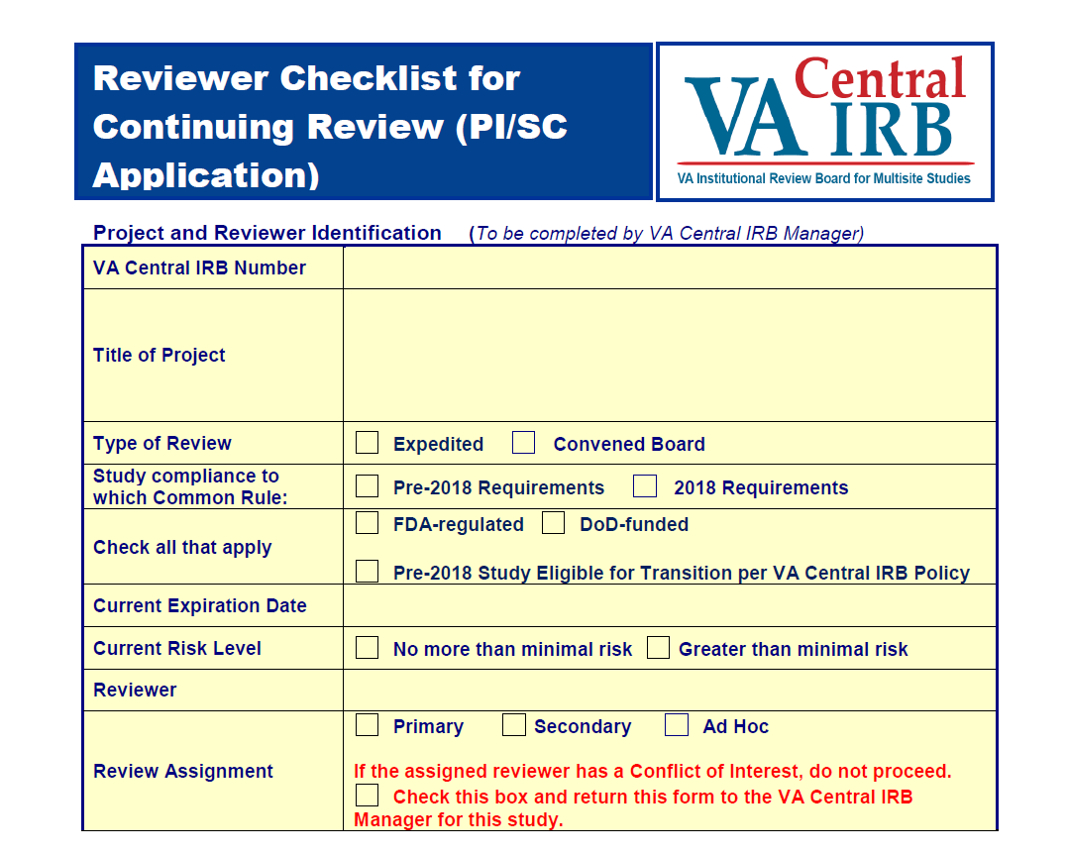
VA CIRB Form 114a: Section 1
Project and Reviewer Identification

Slide 23
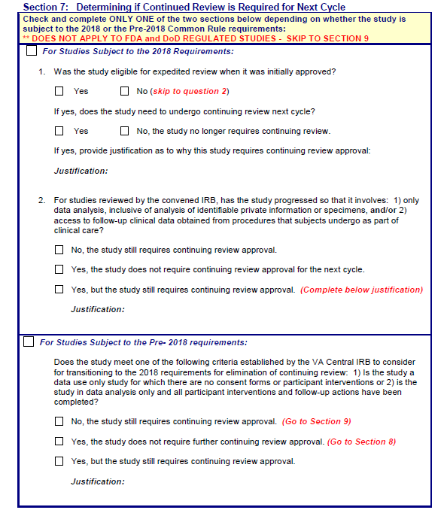
VA CIRB Form 114a: Section 7
Determining if CR is Required Next Cycle

Slide 24
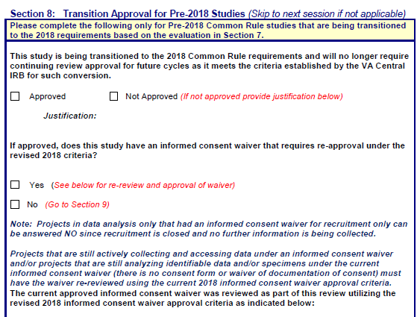
VA CIRB Form 114a: Section 8
Transition Approval for pre-2018 Studies

Slide 25
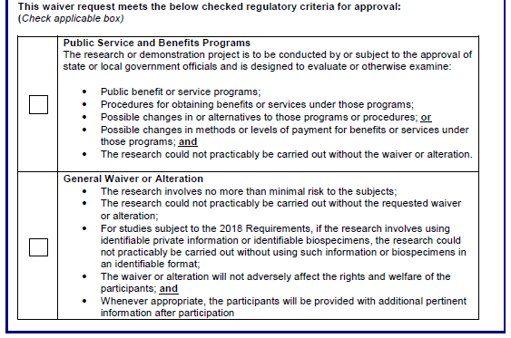
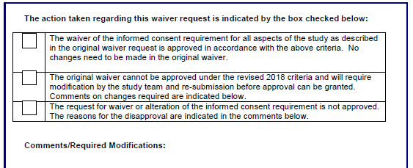
VA CIRB Form 114a: Section 8 (cont.)
Transition Approval for pre-2018 Studies

Slide 26
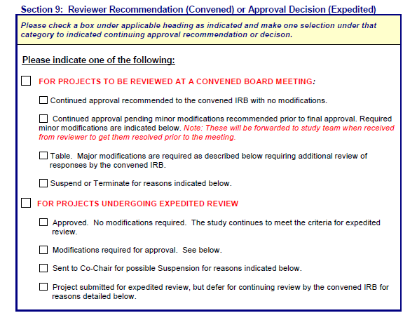
VA CIRB Form 114a: Section 9
Reviewer Recommendation or Approval Decision

Slide 27
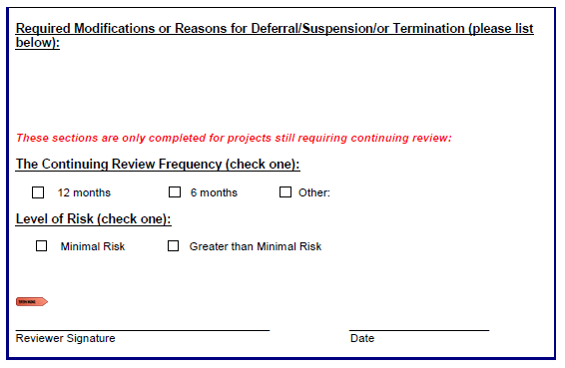
VA CIRB Form 114a: Section 9 (cont.)
Reviewer Recommendation or Approval Decision

Slide 28
Open Q&A Session

Slide 29
Important Links
Final Rule for the Delay (published June 19, 2018)
Revised Common Rule (published January 19, 2017)
  Pages 7259 to 7274 contain the Text of the Final Rule
Current Common Rule
VHA Directive 1200.05
VHA Directive 1200.01
ORD Policies and Guidance Documents
ORPP&E Cyberseminars

Slide 30
Presenter Contact Information
Office of Research Protections, Policy, and Education | Office of Research Oversight | Profiling Practices Presenters
Molly Klote, MD Director, ORPP&E (formerly PRIDE) Office of Research Development Veterans Health Administration 1100 1st Street NE Room 626 Washington DC 20002 Phone: (202) 443-5605 Mary.klote@va.gov | Kristina Borror, PhD Director of Policy and Education ORO | VHA Office of Research Oversight Mailing Address: 810 Vermont Ave., NW (10R), Washington, DC 20420 Physical Address: 811 Vermont Ave., NW, Room 7-214, Washington, DC 20420 Phone: (202) 632-8304 Email : kristina.borror@va.gov http://www.va.gov/oro/ | Annette Anderson, MS IRB Administrator VA Central IRB Office of Research Protections, Policy, and Education Office of Research and Development Veterans Health Administration Phone: (202) 443-5649 Email: Annette.Anderson3@va.gov
C. Karen Jeans, PhD, CCRN, CIP Associate Director of Regulatory Affairs, ORPP&E VHA Office of Research and Development Department of Veterans Affairs 810 Vermont Avenue, NW (10P9) Washington, DC 20420 Phone: (202) 443-5712 Email: c.karen.jeans@va.gov | Priscilla Craig Health Science Specialist ORO | VHA Office of Research Oversight Policy and Education Workgroup (OROPE) 811 Vermont Avenue, NW Washington, DC 20420 Phone: (202) 445-8849 E-mail: priscilla.craig@va.gov | Paska Permana, PhD Research Health Scientist Human Research Protection Program Officer Phoenix VA Health Care System 650 E. Indian School Road (RS/151) Phoenix, AZ 85012-1892 Phone: (602) 277-5551 x6085 Email: Paska.Permana@va.gov
Soundia A. Duche, MA, MS Chief, Education and Training/Program Analyst Department of Veterans Affairs Office of Research Protections, Policy, and Education (ORPP&E) Office of Research & Development 810 Vermont Ave., NW Washington, DC 20420 Phone: (202) 443-5658 E-mail: soundia.duche@va.gov

