Slide 1
VA Innovation and Research Review System (VAIRRS)
Monthly Webinar
November 28, 2022

Slide 2
Webinar Housekeeping
Webinar Housekeeping
Recording - This session is recorded, and the associated handouts will be available on ORPP&E’s Education and Training website within a week after the webinar.
Close Captioning - Now available in the new Webex platform. Click the “CC” button at the bottom left of the Webex screen.
Experiencing Sound Issues? - Call in using the number in your Webex chat box or in your registration confirmation email.
Q&A - Please use the Q&A feature to submit questions.
Be sure to send questions to “All panelists”
Questions will be addressed at the end of the webinar
Webinar Archive - Most ORPP&E webinars can be found here: https://www.research.va.gov/programs/orppe/education/webinars/archives.cfm
Post-Webinar Evaluation Survey - We are grateful to everyone who completes the post-webinar evaluation survey, which will automatically pop up once the webinar is exited.
For questions, please use the Q&A box and address to “All Panelists.” All webinars will be recorded and posted within one week.

Slide 3
Contents
01 Welcome
04 Announcements
05 VAIRRS Ambassador Highlight: VA Greater Los Angeles Healthcare System
Presented by: Cody Knight IRBNet/iMedRIS System Admin & Quantitative Core Team, VA Greater Los Angeles Healthcare System (VISN 22) - Medical Research Service

Slide 4
Important Announcements
Multi-Site and Expired Studies Data Validation
VAIRRS Mentor Program
VAIRRS
University
VAIRRS is requesting each research program review the multi-site and expired studies at their facility. VAIRRS sent out an email to administrators with an explanation on how facilities can validate and reconcile both multi-site and expired projects.
VAIRRS is pleased to introduce an improved VAIRRS Mentor Program! The purpose of the VAIRRS Mentor Program is to aid facilities that require advisory support from a subject matter expert within VA research. We will release more information about the program in the coming months.
VAIRRS is preparing to launch VAIRRS University in December 2022! VAIRRS University is an educational initiative designed to optimize VAIRRS-specific training for VA research employees in order to foster an educated and self-reliant end-user group.
Subscribe to the VAIRRS Newsletter to keep up with important announcements and program updates: https://public.govdelivery.com/accounts/USVHA/subscriber/new?topic_id=USVHA_1952

Slide 5
VAIRRS Ambassador Highlight
VA Greater Los Angeles Research
Cody Knight
IRBNet/iMedRIS System Admin & Quantitative Core Team - Medical Research Service

Slide 6
VA GLA Research Administration
Michael Ong, M.D. Ph.D., ACOS for Research
Scott Krahl, Ph.D., Deputy ACOS for Research
Taigy Gooding, Dr.PH, AO for Research
Elizabeth Corey, Ph.D., HRPP Administrator
Fredricka Martin, Ph.D., Animal Program Compliance Officer
John Berard, Ph.D., IACUC/SRS Coordinator
Giselle Henry, R&D Coordinator
Daniela Macias, IRB Coordinator
Alissa Simon, IRB Coordinator
Margaret Roch , Admin Coordinator

Slide 7
VA GLA Research Overview
530 Active research projects
273 Active IRB projects
52 Active CIRB projects
79 Active IACUC projects
138 Active SRS projects
160 Active R&D only projects
40 Active QA/QI projects
981 Registered users in IRBNet
230 Active principal investigators
$33,920,257 total research support
$15,893,605 from VA
$12,759,570 from NIH
$2,946,695 from pharma/biotech
$656,005 private foundations
$324,745 academic institutions
$1,339,638 other federal

Slide 8
Implementation Timeline
July 1, 2019 – February 1, 2020
Implemented the iMedRIS system
December 1, 2020 – December 15, 2020
IRBNet committee coordinator training
January 11, 2021 – January 14, 2021
IRBNet super user training
January 1, 2021 – March 22, 2021
Gathering study documents for import
February 26, 2021 – April 5, 2021
Only urgent submissions allowed in iMedRIS
March 1, 2021 – March 31, 2021
IRBNet user registration project
March 1, 2021 – March 11, 2021
Provided 7 IRBNet trainings for researchers
Recorded 1 training (available on our SharePoint)
March 21, 2021
Data import into IRBNet
March 29, 2021 – April 2, 2021
Study documents imported into IRBNet
Granting users access to their projects
April 5, 2021
Fully launched IRBNet system
No longer accepting any submissions in iMedRIS

Slide 9
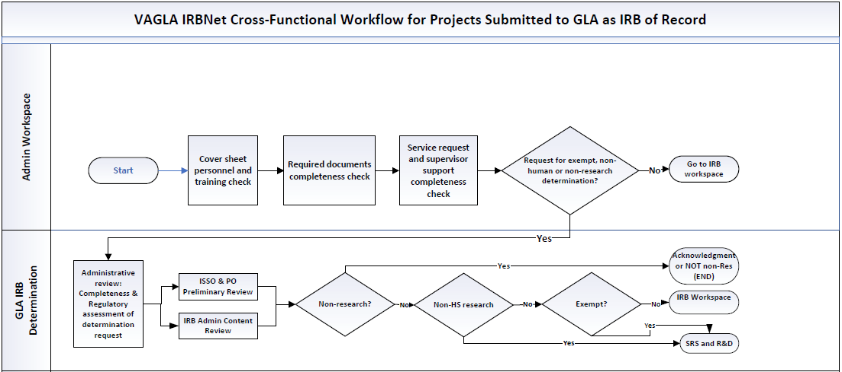
VA GLA IRB Workflow

Slide 10
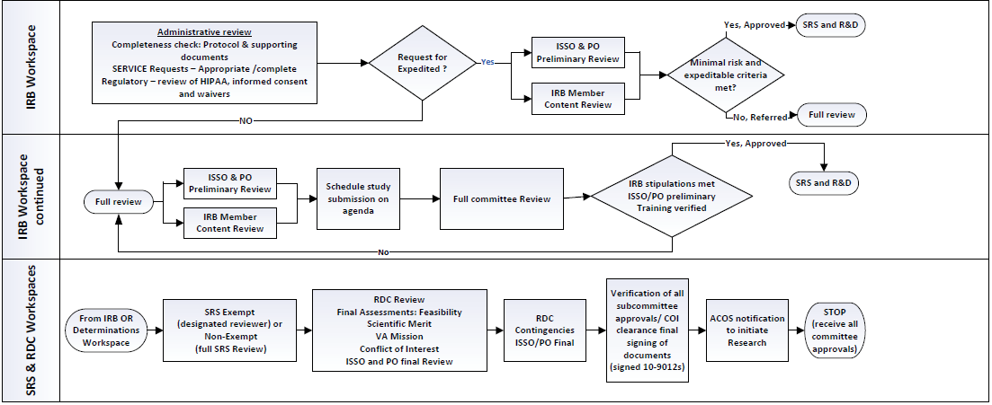
VA GLA IRB Workflow Cont.

Slide 11
VA GLA Tagging Strategy
Virtually everything that may need to be reported on or audited in the future gets tagged on the project, unless the data is available through some other reporting system.
Tags are used as a convenience, allowing us to see data about the project from the submission manager screen, instead of needing to open the project and read through it to find that information.
Example: it was decided by our IRB team that they would like to have the IRB risk level tagged and available on the submission screen.
Most tags originated from reports needed over the past few years (i.e., ORO audit, director's report, monthly report for leadership, etc.).
Existing tags are reviewed and updated on a regular basis, with weekly discussions during IRBNet meetings.
We use global tags for project-specific data and submission tags for submission-specific or processing-specific data.
Since 2-3 different IRB coordinators can work out of the same submission queue, coordinators must tag their name to a submission once they start working on it to prevent any double work or overlap among coordinators.

Slide 12
VA GLA Administration Tags
01-Alissa
01-Cody
01-Daniela
01-Elizabeth
01-John
01-Margaret
02-AnnualRpt
02-Co-Inv-Add
02-Co-Inv-Remove
02-FCOIRev
02-FWD-CIRB
02-ISSOPrelim
02-LSI-CIRB-GLA-Initial-Pkg
02-PI-Transfer
02-PO-Prelim
02-Staff-Req
02-Sub-Inv-Add
02-T-NCR-AnnRpt
02-TrainRev
03-ExtIRB-Advarra
03-ExtIRB-CDC
03-ExtIRB-Com
03-ExtIRB-NCI
03-ExtIRB-WCG
03-IACUC
03-IRB
03-Non-VA-AD
03-QA-QI
03-RDC
03-SRS
03-VA-CIRB
04-IRB-Exempt
04-IRB-Ex-Ltd
04-NonHSEngage
04-NonHSRes
04-NonRes
04-SRS-Exempt
05-NoServices
05-Services
05-SuperSign
26-Dispense-N
26-Dispense-NY
26-Dispense-ON
26-Dispense-OY
26-Dispense-Y
26-NO-RxIND
26-RxIND

Slide 13
VA GLA SRS Tags
01-Cody
01-John
01-Margaret
02-IACUC-Triennial
02-Staff Req
02-SvcSignoff
03-ExtIRB-ADVARRA
03-ExtIRB-CDC
03-ExtIRB-NCI
03-ExtIRB-WCG
03-IACUC
03-IRB
03-IRB-Exempt
03-NotHumanSubRes
03-RDC
03-SRS
03-SRS-Exempt
03-VA-CIRB
03-VA-CIRB-Exempt
04-ABSL-1
04-ABSL-2
04-ABSL-2+
04-BSL-1
04-BSL-2
04-BSL-2+
04-BSL-3
04-BSL-4
05-Chemicals-Requiring-License
05-Controlled-Substances
05-Dual-Use-Research-of-Concern
05-Human-Specimens/Cell-Lines
05-Ionizing-Radiation/Radioisotopes
05-Isoflurane
05-NIOSH-List-Chemicals
05-Other-Infectious-Agents
05-Physical-Hazards
05-Recombinant-Nucleic-Acids
05-Transport-of-Infectious-Items
05-Viral-Vectors
08-CRC
08-NoSvcs
08-NucMed
08-PALMS
08-Pharmacy
08-Radiology
08-SuperSign

Slide 14
VA GLA IACUC Tags
01-Cody
01-John
02-Process-TBD
03-Cat
03-Chinchilla
03-Gerbil
03-Hamster
03-Mouse
03-Pig
03-Rabbit
03-Rat
04-PainCat:B
04-PainCat:C
04-PainCat:D
04-PainCat:E
05-Appendix-9
06-Multi-Survival-Surgery
06-Non-Survival-Surgery
06-Survival-Surgery
07-Sepulveda
07-UCLA
07-USC
07-WLA
08-Animal-Cancer-Cells/Cell-Lines
08-Animal-Use-Terminated
08-Food/Fluid-Restriction
08-Hazardous-Agents
08-Housed-in-Lab
08-Non-VA-Controlled-Substances
08-Prolonged-Restraint
08-VA-Controlled-Substances

Slide 15
VA GLA IRB Tags
01-Alissa
01-Cody
01-Daniela
01-Elizabeth
01-Margaret
02-AnnualRpt
02-Co-I-Staff-Req
02-LAPSE
02-PI-Transfer
02-Prelim-ISSO
02-Prelim-PO
02-SvcSignOff
02-Train-Rev
03-IACUC
03-IRB-A
03-IRB-B
03-RDC
04-SRS
04-SRS-Exempt
05-NCR
05-OCR
05-TNCR
06-ExceptionReq
06-Exempt-Ltd
06-Initial-Exp
06-Initial-FB
07-GTM
07-Min
08-Device
08-Drug
09-Broad-IFC
09-ICF
09-WDC-Partial
09-WDC-Whole
09-WIC-Partial
09-WIC-Screen
09-WIC-Whole
10-HIPAA-Auth
10-HIPAA-N/A
10-WHIPAA-Partial
10-WHIPAA-Screen
10-WHIPPA-Whole
11-Contract
11-CRADA
11-DUA
11-LOU
11-MOU
11-MTA
12-Children
12-Cog-Impaired
12-Employees
12-Int-Sites
12-Non-Vets
12-Prisoners
12-Surrogate-Involved
13-Chart-Review-Only
13-Ex-Access
13-Flagging
13-HUD/HDE
13-REPO-add
13-Repository/Registry
13-Specimen
13-Sponsored
13-Unfunded
14-Colab-Procedures
14-DOD
14-Multi-Federal
14-Multi-Non-Federal
14-sIRB-Exception
14-sIRB-Rely
15-CRC
15-No-Services
15-Nuclear-Medicine
15-Path/Lab
15-Pharmacy
15-Pumonary
15-Radiology/Imaging
15-SuperSign

Slide 16
VA GLA IRB Tags Continued…
16-Exp-Cat1a
16-Exp-Cat1b
16-Exp-Cat2
16-Exp-Cat3
16-Exp-Cat4
16-Exp-Cat5
16-Exp-Cat6
16-Exp-Cat7
16-Exp-Cat8a
16-Exp-Cat8b
16-Exp-Cat8c
16-Exp-Cat9
16-Exp-MinorChg
17-NExe-Cat1
17-NExe-Cat2
17-NExe-Cat3
17-NExe-Cat4
17-NExe-Cat5
17-NExe-Cat6
17-NExe-Cat8
17-OExe-Cat4
19-DoNotProcess

Slide 17
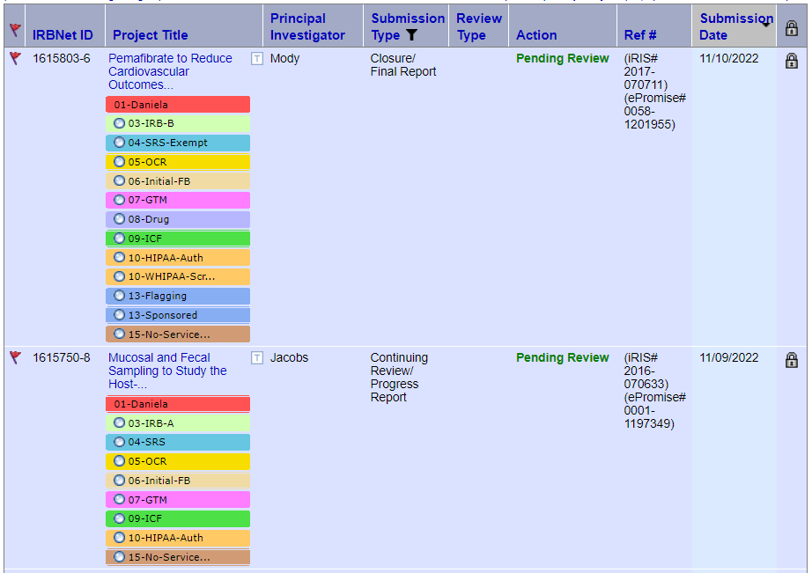
IRB Tagging Example

Slide 18
Post Go-Live Weekly Meeting
Weekly team meeting with all the committee coordinators and system admins to discuss:
Submission processing strategies
When to do parallel reviews v. sequential reviews
When to do ISSO/PO preliminary reviews for different types of projects
When to do the COI review for different types of projects
What should be a published board document
When to use various types of tags – what committee workspaces to tag in
Any updates to our local supplemental documents
Any updates to our committee reviewer checklists
Any staffing changes to our administration team and what training they need
Any updates to regulations and/or news from ORPP&E, OGC, ORD, etc.
Talk about any edge cases and how to handle them moving forward
This weekly meeting has been key to our post go-live success. The meeting keeps everyone on staff in the loop and provides an open forum to discuss any technical issues or questions related to IRBNet.

Slide 19
Reporting Strategy
An SQL database was created on a local SQL server.
The database closely resembles all the insight reports that IRBNet sends us daily.
Weekly import brings about 50 insight reports into the database, as well as all TMS training data and CITI training data.
After the import occurs, a series of scripts are run against the data to organize it and output it in a readable format with all necessary data into a handful of reports.
Example 1: “All Project Statuses Report” combines all the data from the project status insight reports, allowing an individual to see all projects statuses for a particular project across all committee workspaces, as well as all the report due dates and expiration dates for all committees in one report output.
Example 2: “IRB Tags Report” will take all global tags used in the IRB workspace and combine it with the IRB project status data.
Example 3: “CITI/TMS Training Output Report” tracks all users linked to active projects within IRBNet and ensures they have the minimum training requirements needed for a particular project.
These reports are distributed via email to various stakeholders on a weekly or monthly basis, depending on the needs of those members. They are reviewed by system admin to find inconsistencies in the data and processing to ensure high quality maintenance of data.

Slide 20
Document Library
We take all the VAIRRS documents and upload them into the VA GLA committee libraries.
We want to make it is as simple as possible for our users to locate their needed documents. The idea being, if you are initiating an IRB project or an IACUC project, then all necessary documents needed to start your project should be found in the one GLA IRB or GLA IACUC document library. This prevents researchers from needing to search around in multiple libraries.
To keep our own document library up to date, we regularly check the VAIRRS libraries for any updated documents and then update them in our local libraries.

Slide 21
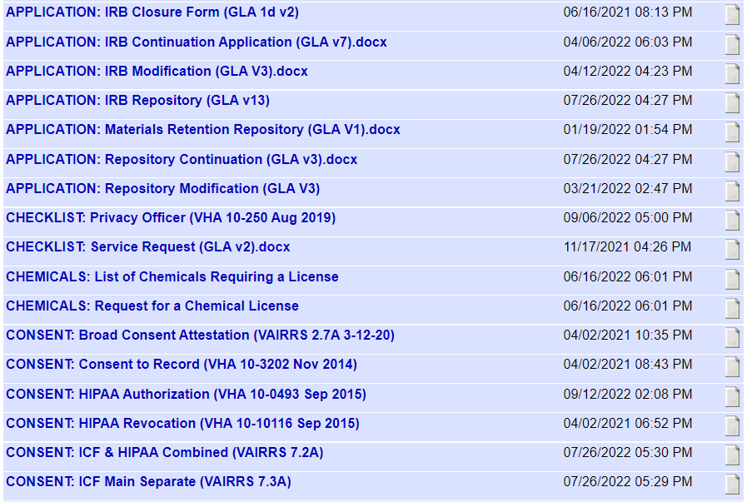
IRB Document Library Example

Slide 22
Questions?

Slide 23
Contact Information
Cody Knight
IRBNet/iMedRIS System Admin & Quantitative Core
Team - Medical Research Service
Cody.Knight@va.gov
For general VAIRRS support, please contact VAIRRS@va.gov

