Slide 1
Research in the Inpatient Mental Health Unit: A Case Study
December 10, 2019

Slide 2
Introductions
Stephen D. Bartlett, RPh, MSPH, VA Eastern Colorado HCS, CO
Fred J. Hendler, MD, PhD, Robley Rex VAMC, Louisville, KY
Ryan Holliday, PhD, VA Eastern Colorado HCS, CO

Slide 3
Objective
Identify and discuss key considerations that an IRB should take into account when reviewing research proposals that involve subjects undergoing inpatient mental health treatment, to include patients who are involuntarily committed to treatment.

Slide 4
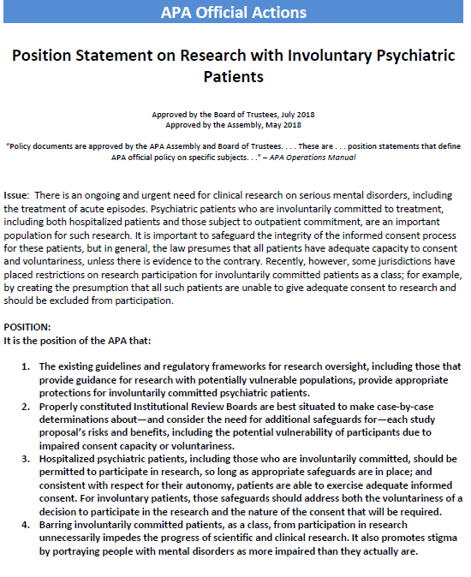
APA Issued a Position Statement on Research with Involuntary Psychiatric Patients
Ongoing and urgent need for clinical research on serious mental disorders, including the treatment of acute episodes
Psychiatric patients who are involuntarily committed to treatment are an important population for such research
Important to safeguard the integrity of the informed consent process for these patients, but in general, the law presumes that all patients have adequate capacity to consent and voluntariness, unless there is evidence to the contrary
Some jurisdictions have placed restrictions on research participation for involuntarily committed patients as a class; by creating the presumption that all such patients are unable to give adequate consent to research and should be excluded from participation

Slide 5
Capacity to Consent in Mental Health Research
A prospective subject’s ability (capacity) to consent for a research study is not dependent on his/her admission status
Consultation with the treating provider or some other form of examination may be necessary to determine capacity to consent
The process selected should be clearly outlined in the protocol
Assessments can be used to assess prospective subjects’ understanding of the following:
That the study involves research
What the research entails
That the research is separate from clinical treatment and will not affect the subject’s admission status
That withdrawal from the research study will not affect the subject’s clinical treatment or admission status

Slide 6
Veteran Homelessness and Suicide Risk
Veterans are at heightened risk for suicide (1.5 times greater than the civilian population)
Homeless Veterans appear at elevated risk compared to the general Veteran population, with high rates of suicide (81.0 per 100,000 vs. 39.0 per 100,000)

Slide 7
Preventing Suicide among Veterans
The VA has mandated a number of evidence-based approaches to prevent suicide (e.g., psychotherapy, Safety Planning)
However, in cases in which acute suicide risk is elevated, a psychiatric hospitalization may be warranted
In these instances, individuals deemed to be a danger to themselves who are also unwilling to consent to hospitalization may be hospitalized involuntarily

Slide 8
Suicide-Focused Interventional Research
Suicide remains a low-based rate event
This impacts the study of these behaviors and thus its prevention
Providers must often weigh the rights of the participant with the potential utility of findings
Additionally, study outcomes often do not solely focus on suicidal ideation or self-directed violence (e.g., psychiatric symptoms, engagement in future treatment)

Slide 9
Considerations for Suicide-Focused Research
Before discussing case scenarios, consider how the following may impact your perceptions of ethics:
If the study were focused on substance use rather than suicide?
If the Veteran were homeless versus not homeless?
If the Veteran were compensated or not compensated?
If the Veteran were voluntarily versus not voluntarily hospitalized?

Slide 10
Scenario 1: Administration of a Survey to Homeless Veterans at Risk for Suicide
Study involves administration of a survey to homeless Veterans currently hospitalized at a VAMC hospital
The survey is to better understand factors related to the Veteran’s recent admission that can be targeted to prevent future admissions
How might these factors relate to research ethics:
Inclusion of suicide-focused measures (e.g., recent suicide attempt)
If the Veteran were homeless
Compensation for participation
Voluntary admission to the hospital
Any additional factors to consider?

Slide 11
Scenario 1: Key Ethical Considerations for the IRB
Why is it important to target this population (i.e., homeless Veterans) while hospitalized as opposed to conducting this study on an outpatient basis?
What are the risks to subjects participating in this research study?
How might compensation impact ethical considerations?
What factors could be discussed or included a priori to decrease risk to the research subject and increase understanding?
Notes:
First Respondent: Fred

Slide 12
Scenario 2: Administration of an Intervention to Homeless Veterans at Risk for Suicide
In addition to the survey, the researchers want to include an intervention as part of a feasibility study to assess the effectiveness of the intervention
The intervention will consist of 3 sessions of enhanced treatment in addition to usual care
The intervention will be offered to research subjects free of charge while admitted and will continue to be offered once they have been discharged from the hospital
The purpose of the intervention is to try to decrease thoughts about suicide and future risk for suicide-related hospitalization
Participants will be monitored during their hospitalization and up to 3-months post-discharge

Slide 13
Scenario 2: Key Ethical Considerations for the IRB
How might the inclusion of an intervention alter ethical considerations?
How might the research intervention affect the subject’s hospitalization and care?
How might the subject’s admission status (voluntary vs. involuntary) impact ethical considerations?
What factors should providers and researchers consider to ensure the subject’s rights are protected?
Are there potential alternatives that still would answer the research question?
Notes:
First Respondent: Steve

Slide 14
Scenario 3: Efficacy of an Suicide-Focused Intervention on Homeless Veterans
Following the successful completion of the feasibility trial, the researchers now want to conduct a randomized controlled trial comparing the intervention in scenario 2 to usual care
Veterans that are randomized to the intervention arm will be offered the option to re-commence usual care following completion of the research study (i.e., 3 months post-discharge)

Slide 15
Scenario 3: Key Ethical Considerations for the IRB
How might ethical considerations differ for scenarios 2 and 3?
What key issues/questions should be raised with the study team about the study design?
Are there aspects of this study that could benefit from being re-designed?
Notes:
First Respondent: Fred

Slide 16
Questions

Slide 17
Contact Information
Stephen D. Bartlett, R.PH., MSPH
Research Pharmacy Manager, Investigational Drug and Specialty Pharmacy Section
Rocky Mountain Regional VA Medical Center
Chair, Colorado Multiple Institutional Review Board
VA Central IRB Co-Chair
Stephen.Bartlett2@va.gov
Fred Hendler, M.D., Ph.D.
Chief, Hematology/Oncology
Chair, Health and Human Subject Subcommittee
Robley Rex VA Medical Center
VA Central IRB Co-Chair
Fred.Hendler@va.gov
Ryan Holliday, PhD
Clinical Research Psychologist
Rocky Mountain Mental Illness Research, Education and Clinical Center for Suicide Prevention
VA Central IRB Member
Ryan.holliday@va.gov

