Slide 1
Future Roles of the VABBB
New/understudied topics
Multi-omic molecular studies
Biomarker discovery
“Better outreach” “Regulatory issues” “Tissue disbursement”
“Incorporate the VABBB living registry by collecting samples and data before death”
“Need to be bigger, better, and broader…more samples, more molecular and pathological characterization, and need to really tie in the clinical data.”
“What are the steps to link different brain banks… to link different types of data?”
“Combining molecular characterization, sequencing , proteomics, pathology…”
“Longitudinal blood samples” “…would be a tremendous addition at relatively little cost.” “PBMCs”
“Muscle, skin, other tissues…central and peripheral tissues” “peripheral nerve axons” “Dural fibroblasts”
“Correlating -omics and deep phenotyping” Bulk RNA-Seq, single cell and single nuclei RNA-Seq
“We know there are different changes in different cell types.”
“Comparing fast vs slow progressors, inflammatory response…”
“A mechanism to track the experiments done with samples and make it available …recovering research that has already been generated from use of the brain bank resources, so that other researchers can leverage the data.”
“Need CONTROLS!” “Collecting samples from spouses and relatives”
“Discovery and validation of PET tracers… against TDP-43 for example.” “Glutaraldehyde-fixed tissue for EM”
“The importance of postmortem tissue in ALS research really can’t be understated.”
Defining decedent groups and comparing pathology and molecular differences.
So then the plan is…

Slide 2
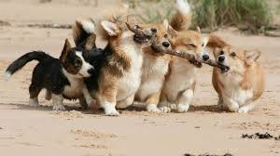
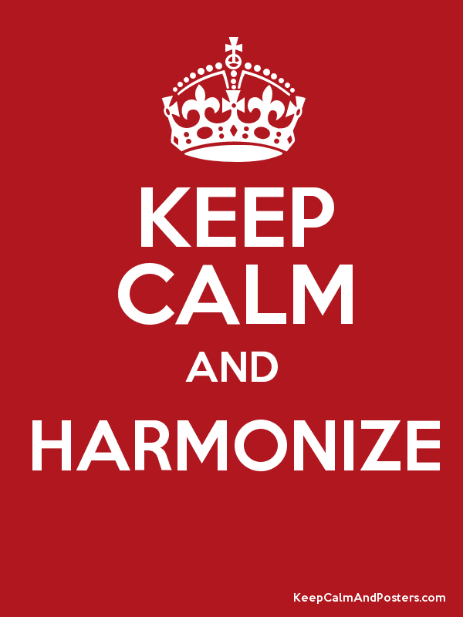
Collect and analyze everything* from everyone!
(*that we think might be important to understand ALS)
Recruit as many subjects and relevant controls as possible.
Find ways to combine efforts with other biobanks and data collection and analysis efforts to increase numbers, breadth of samples and data, and analytical capabilities.
Make all data, samples, and analyses broadly available.
Platforms to combine and analyze multimodal data and to define and compare subsets of samples and patients.
Leverage the results, tools, and wisdom of the global ALS research community for everyone.

Slide 3
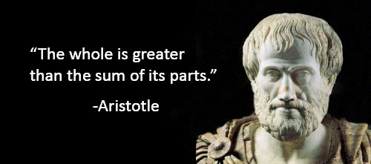
What to do, When to do What, and How to do it
How can the specific unique qualities of the VABBB best be harnessed, while avoiding ‘re-inventing the wheel’?
What are the low hanging fruit? What can we do right now? How should we prioritize?
Can other funded efforts be leveraged via collaboration?
  Whole genome sequencing, analysis, and annotation of data sets
  RNA-Seq, including drop-Seq, nuc-Seq, spatial transcriptomics, etc.
  Proteomics and mass spec, spatial mass spec
  Immuno-EM, Cryo-EM
  iPS generation, storage, analysis, and disbursement
  Longitudinal biofluid collection – blood, CSF, urine, PBMCs
SOPs to facilitate sharing samples and data across biorepositories and data collection efforts
  Harmonized collection methods for samples, data elements, nomenclature, QC methods
  What is important to strictly standardize and what can be flexible?
  How flexibility can strengthen the overall dataset
  Platform development and writing APIs
Costs associated with data storage, making (and keeping) data broadly available
  Raw WGS, other omics, and imaging data files are very large
  Multicentered vs. centralized storage, cloud storage
  Who “owns” the data?
Best practices for sharing biosamples and data with researchers
  How much review/oversight of requests for samples and data is needed?
  Avoiding duplication and fostering collaboration
  Standardized MTAs for academic and industry research
  Attribution/publication and intellectual property policies
Patient confidentiality, informed consent, and other regulatory considerations
  Importance of broad consent language for sharing – with regards to nature of research (e.g. “ALS” vs “Neurodegenerative” research), who can use the samples/data (academic and industry), and what it can be used for.
  Methods to de-identify the data - there are many different GUIDs currently in use
  Communicating unexpected genetic results back to families and patients, risks of RE-identifying with genetic data

